Slide 1
Improved NMS（review）
Author: QChen
Date: May 15 2019
汇报人：第PPT

Slide 2
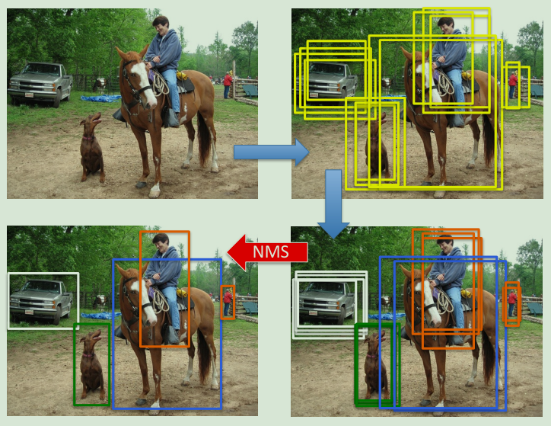
NMS
Foresight Review
1. First category independent region
proposals are generated.
2. These region proposals are
then assigned a score for each class label
using a classification network
3. Their positions are updated slightly
using a regression network.
4. Finally, non-maximum-suppression
is applied to obtain detections.

Slide 3
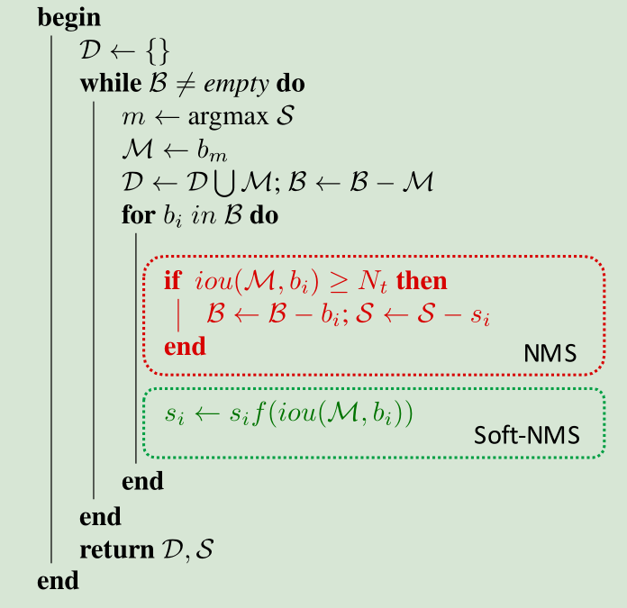
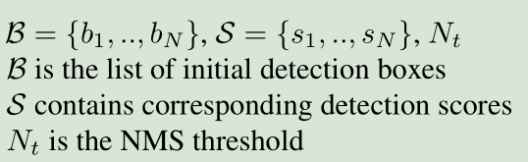
NMS

Slide 4
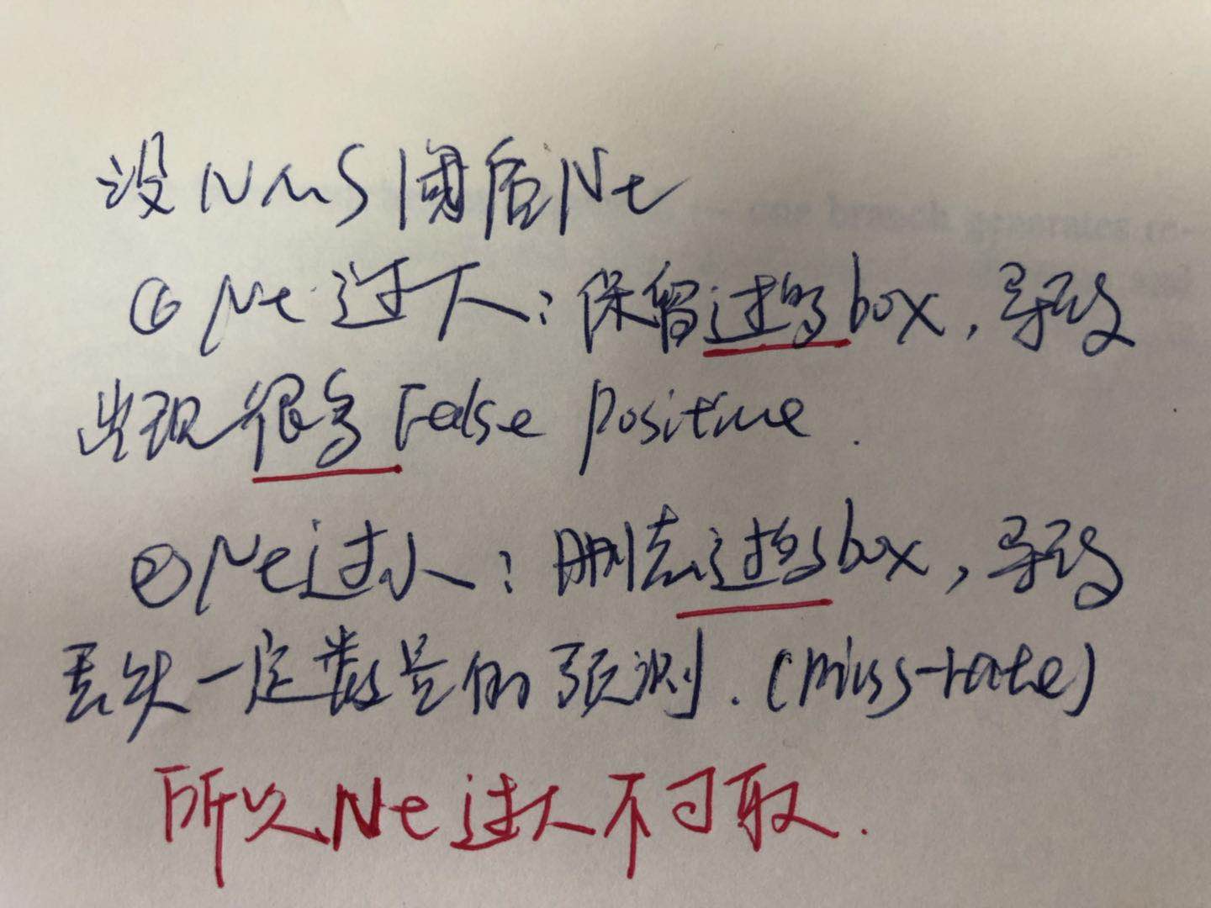

NMS

Slide 5
Pruning NMS
I

Slide 6
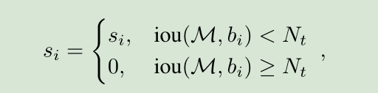
Pruning NMS
re-scoring
If bi contains an object not covered by M,
it won’t lead to a miss at a lower detection threshold.
if bi does not cover any other object (while M covers an object),
and even after decaying its score it ranks above true detections,
it would still generate a false positive.

Slide 7
Soft NMS

Slide 8
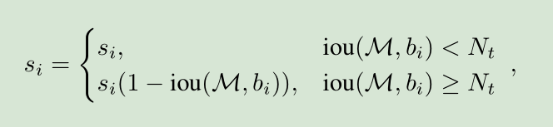
Soft NMS
It is also clear that scores for detection boxes
which have a higher overlap with M should be decayed more, as they have a higher likelihood of being false positives.
which are very close would be assigned a greater penalty

Slide 9

Soft NMS
It would be ideal if the penalty function was continuous,
otherwise it could lead to abrupt changes to the ranked list of detections.
A continuous penalty function should have no penalty when there is no overlap and very high penalty at a high overlap.
when the overlap is low, it should increase the penalty gradually,
as M should not affect the scores of boxes which have a very low overlap with it

Slide 10
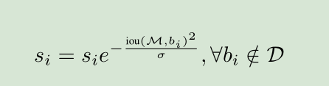

Soft NMS

Slide 11
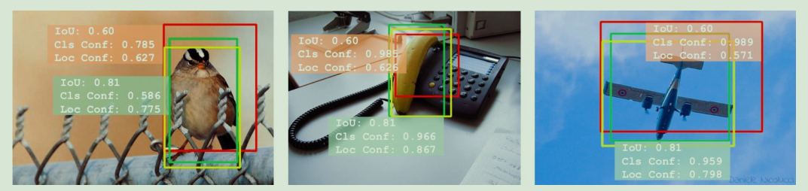
IOU Net
Using classification confidence as the ranking metric will cause accurately localized bounding boxes (in green) being incorrectly eliminated in the traditional NMS procedure.

Slide 12
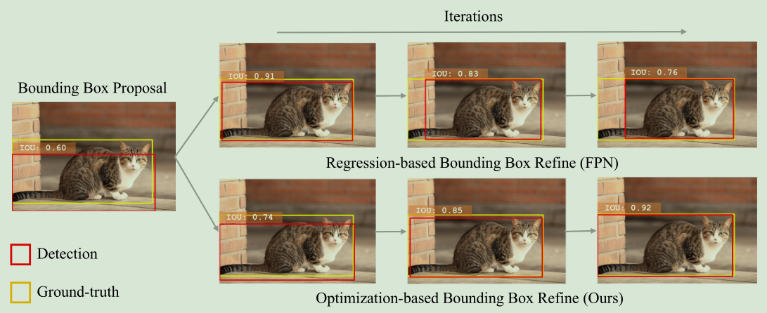
IOU Net
the non-monotonic localization in iterative bounding box regression

Slide 13
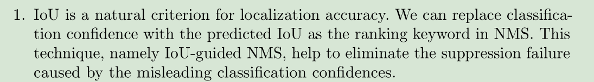
IOU Net

Slide 14
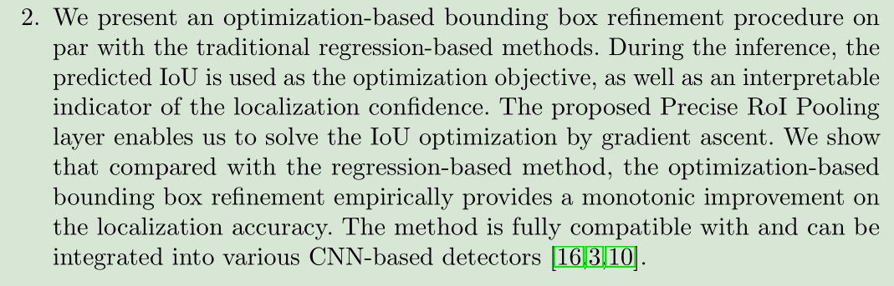
IOU Net

Slide 15
Bounding Box Regression with Uncertainty
for Accurate Object Detection

Slide 16
My Idea
1. 贪心？这个指标是什么？
2. 最小生成树？逆向思考？
3. GIOU? 考虑不重合部分以及间隔，但是没有将类别得分考虑进去，类别得分是否有用？

