Slide 1
SSD
Single Shot MultiBox Detector
Author: QChen
Date: Apr 18 2019
汇报人：第PPT

Slide 2
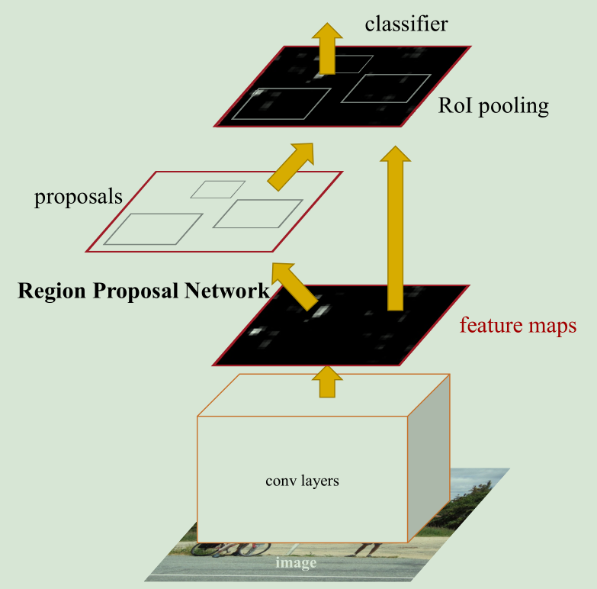
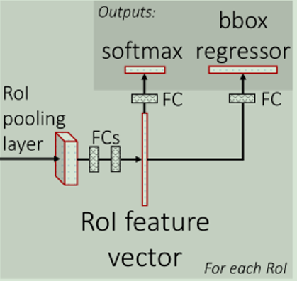
SSD
Foresight Review
Faster RCNN Architecture

Slide 3
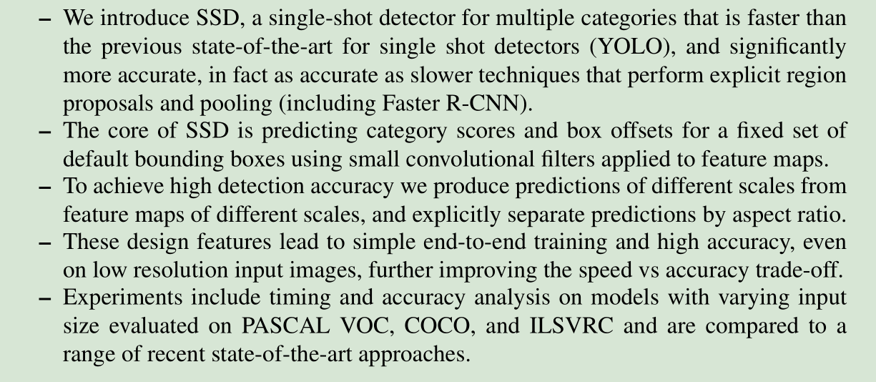
SSD
paper: SSD: Single Shot MultiBox Detector

Slide 4
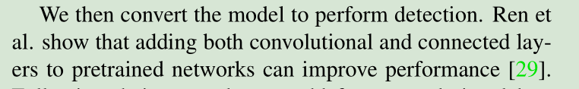
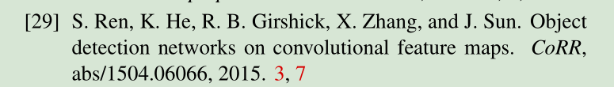
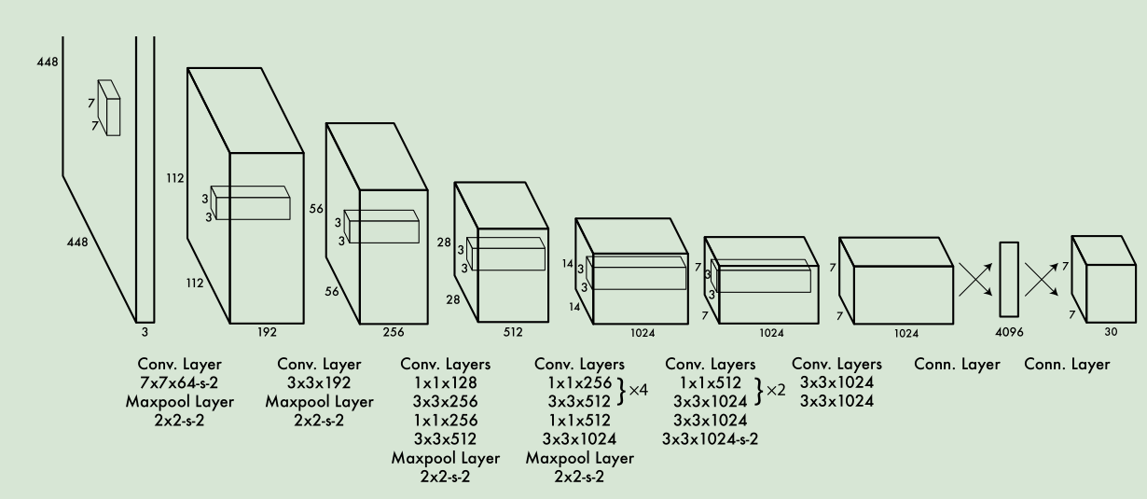
SSD
GoogleNet + 4Conv +2FC
YOLO

Slide 5
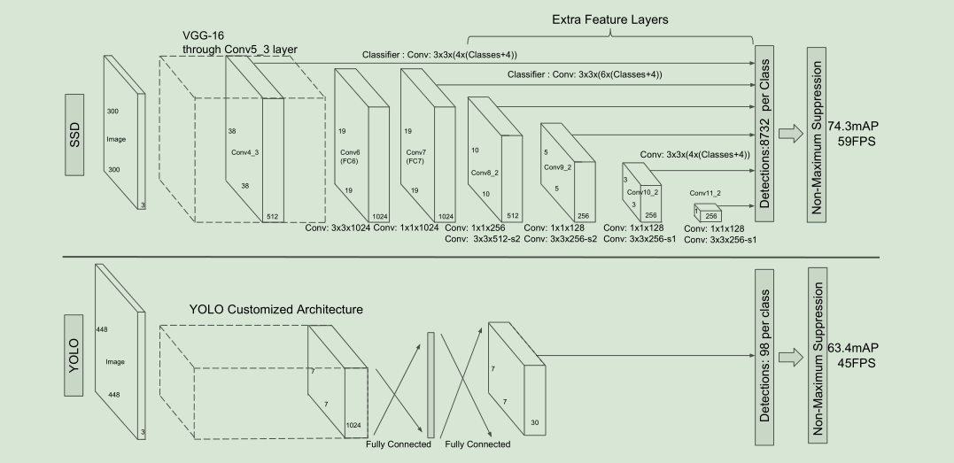
SSD
1. Model
Pyramidal Feature Hierarchy

Slide 6
SSD
Our improvements include using a small convolutional filter to predict object categories and offsets in bounding box locations
using separate predictors (filters) for different aspect ratio detections
applying these filters to multiple feature maps from the later stages of a network
in order to perform detection at multiple scales

Slide 7
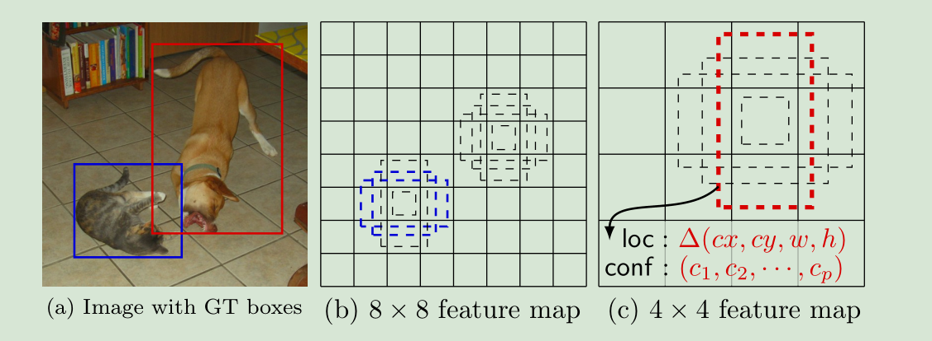
SSD
1. Model add auxiliary structure
discretize the space of possible output box shapes
显然前者适合检测小的目标，比如图片中的猫，
后者适合检测大的目标，比如图片中的狗。
Multi-scale feature maps for detection

Slide 8
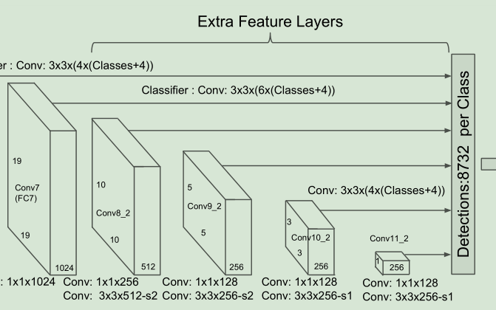
SSD
1. Model add auxiliary structure
Convolutional predictors for detection

Slide 9
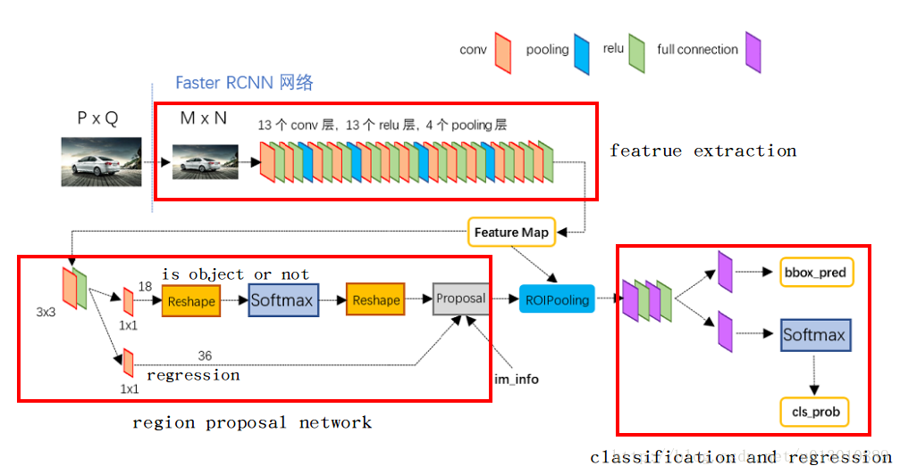
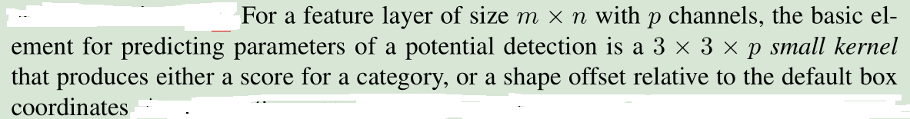
SSD
1. Model add auxiliary structure
Convolutional predictors for detection

Slide 10
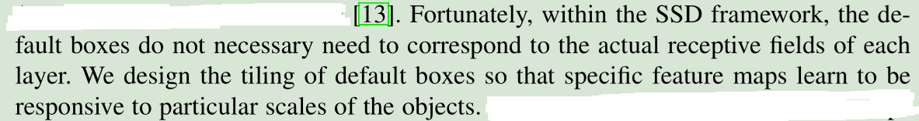
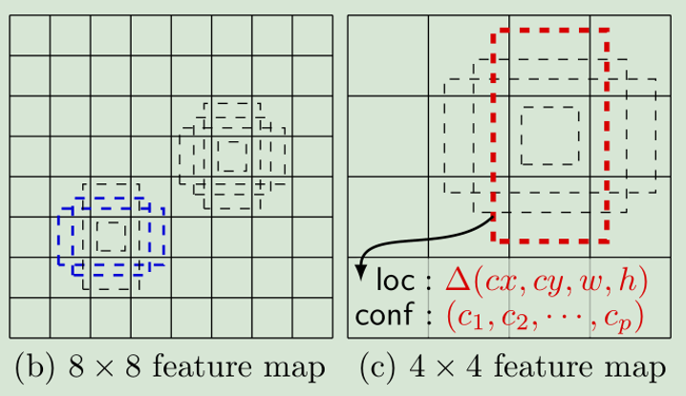
SSD
1. Model add auxiliary structure
Default boxes and aspect ratios
This results in a total of (c + 4)k filters that are applied around each location
in the feature map, yielding (c + 4)kmn outputs for a m × n feature map.
Bycombiningpredictionsforalldefaultboxeswithdifferentscalesandaspectratios from all locations of many feature maps, we have a diverse set of predictions, covering
various input object sizes and shapes.

Slide 11
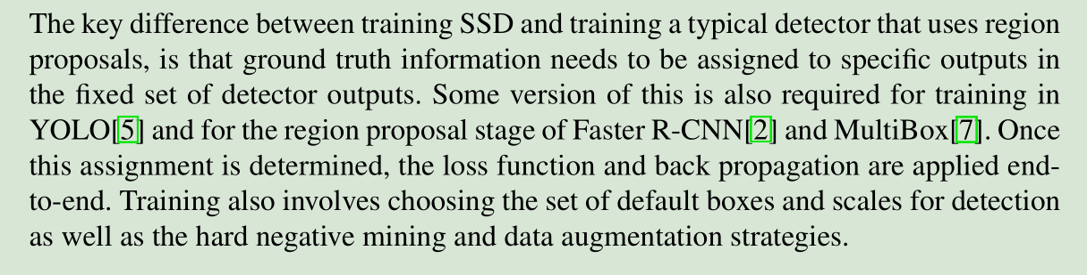
SSD
2. Training

Slide 12
SSD
2. Training
Matching strategy
For each ground truth box we are selecting from default boxes that vary over location, aspect ratio, and scale.
1. 先将每个groudtruth bbox和所有的anchors算IOU，最大的和groudtruth bbox进行配对，这一轮下来，每个groudtruth bbox就都会有一个anchor与之配对。
MultiBox
2. 接下来没有配对的anchors也会依次和所有groudtruth bbox算IOU，大于0.5的会与之配对。
这两轮下来，每个groudtruth bbox就会有多个anchors和它配上了

Slide 13
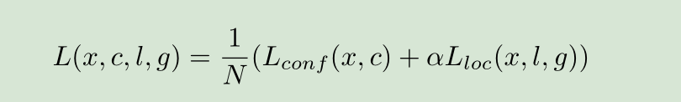

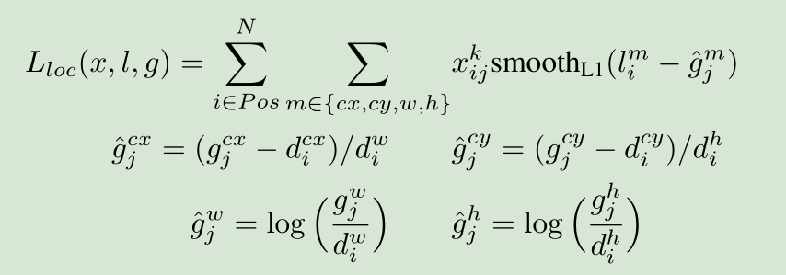

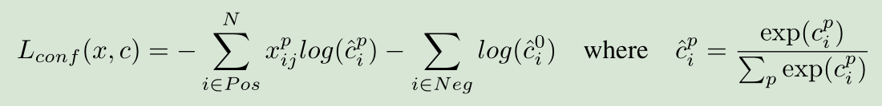
SSD
2. Training
Loss function
where N is the number of matched default boxes. If N = 0, wet set the loss to 0.

Slide 14

SSD
2. Training
Loss function
红色：Groud Truth
绿色：Default Box
红色框与绿色框的差就是我们的参照 cf
蓝色：预测框
我们希望预测（蓝色）框与红色框尽量靠近
怎么去靠近？以 cf 为标准

Slide 15
SSD
2. Training
Choosing scales and aspect ratios for default boxes
processing the image at different sizes
by utilizing feature maps from several different layers in a single network

Slide 16


SSD
2. Training
Choosing scales and aspect ratios for default boxes
ar ∈ {1,2,3,1/2, 1/3}.
ar = 1时，多加一个：

Slide 17
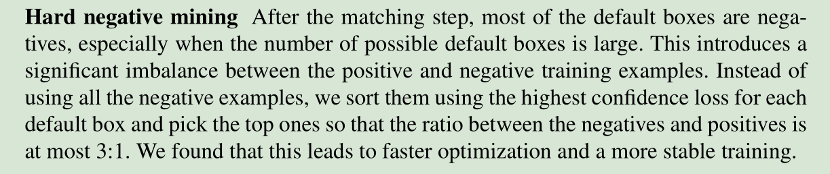
SSD
2. Training
Hard negative mining

Slide 18
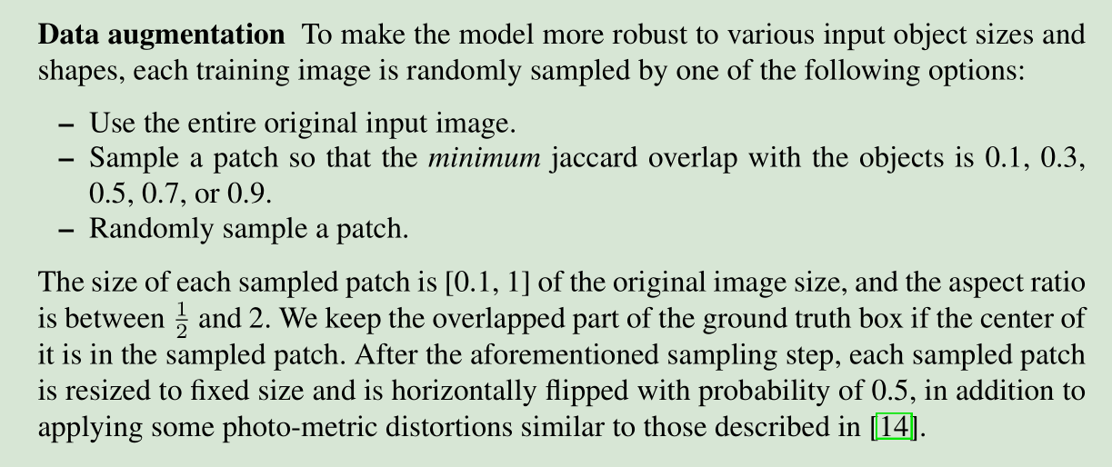
SSD
2. Training

Slide 19
SSD
Allowing different default box shapes in several feature maps let us efficiently discretize the space of possible output box shapes.
Fortunately, within the SSD framework, the default boxes do not necessary need to correspond to the actual receptive fields of each layer.
We design the tiling of default boxes so that specific feature maps learn to be responsive to particular scales of the objects.

Slide 20
SSD
FCOS

