Slide 1
EARLY BIOCHEMICAL TRAJECTORY PHENOTYPING
What direction a patient is moving
predicts more than where they are.
Unsupervised phenotyping of first-24-hour ICU biochemistry and its association with short-term mortality — MIMIC-IV v3.1
DongHwan Won
CST2213 Business Intelligence · Programming-2 Advanced Concepts · Final Project
ICU-Trajectory-Lab · July 2026
Notes:
0:00 · 20s
An intensive care unit is where a hospital puts the patients who could die today.
And the hardest job in that room isn't treating people — it's deciding who to look at first. One nurse watches several patients, and attention is the thing there's never enough of.
The line at the bottom of this slide is the whole project: what direction a patient is moving predicts more than where they are.

Slide 2
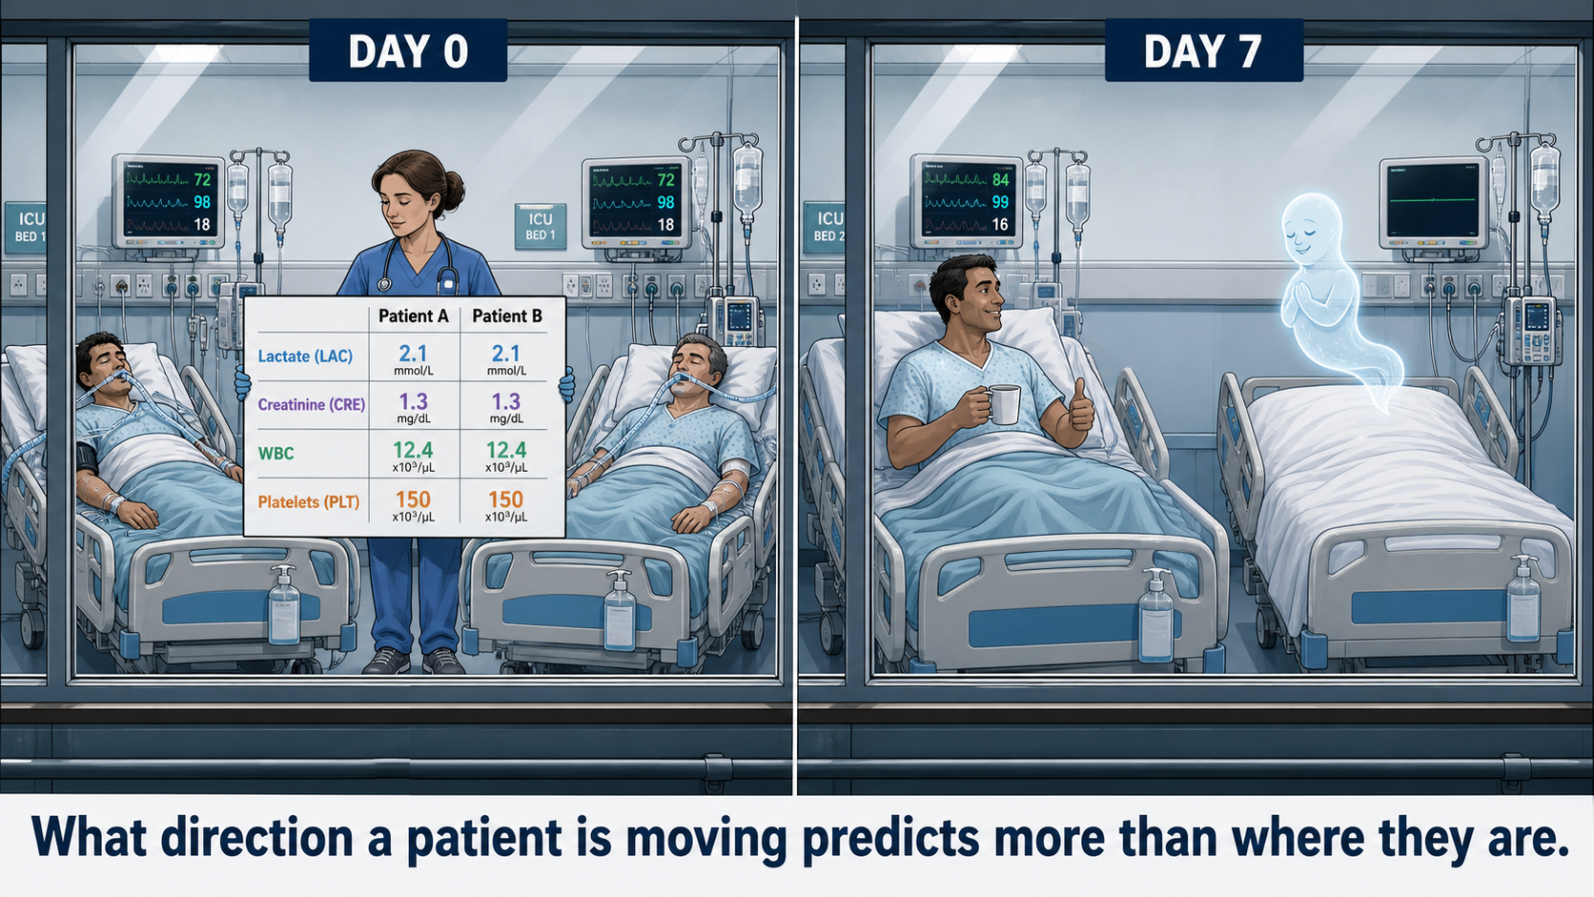
THE BLIND SPOT
Two Patients. Identical Numbers.
02
Notes:
0:20 · 45s — THE HOOK. Three seconds of silence after 'identical'.
-- This is the hook. Do not rush it. The silence is doing the work.
Look at the left panel. Day one. Two patients, two beds, one nurse holding both charts.
Four blood numbers each. Two point one, and two point one. One point three, one point three. Twelve point four, twelve point four. A hundred and fifty, a hundred and fifty.
Identical. Every single number.
(BEAT — stop talking. Let them read it. Three full seconds.)
Now the right panel. One week later.
One of them is sitting up drinking coffee, giving you a thumbs up.
The other one is a ghost.
(BEAT)
Same numbers on day one. One goes home, one doesn't. And that nurse did nothing wrong — there was nothing in those numbers to see.

Slide 3
ICU TRAJECTORY WATCH
Same Labs.
Opposite Endings.
Where the patient is heading, from the first 24 hours of labs.
74,829
4
24h
ICU stays screened
routine labs
to a direction
MIMIC-IV v3.1 · PostgreSQL · scikit-learn · Streamlit · Donghwan Won
Notes:
1:05 · 20s
So that's the question I took on. Same labs, opposite endings — can you tell them apart on day one?
Seventy-five thousand real ICU stays. Four blood tests every hospital already runs. And one day — twenty-four hours — to find a direction.

Slide 4
WHY LABS, NOT VITALS
The Body Lies With Vital Signs.
It cannot lie with its biochemistry.
📈
Vitals compensate. Heart rate and blood pressure are defended until they aren't — the monitor looks fine right up to the moment it doesn't.
🧪
Labs don't. Lactate, creatinine, WBC and platelets track perfusion, kidney, inflammation and coagulation. They move first.
🎯
A single value has no direction. One panel tells you where the patient is. Two panels tell you where they are going — that is the whole idea.
03
Notes:
1:25 · 30s
Why blood tests and not the monitor?
Because the beeping machines beside the bed are less honest than you'd think. The body protects those numbers, keeps them looking normal — right up until it runs out of room. Then they collapse all at once. That's late.
But here's the real reason: one measurement has no direction. A photograph tells you where someone is standing. It can't tell you which way they're walking.
Those two patients had the same photograph.
Oxygen starvation, kidney strain, how hard the immune system is fighting, and clotting.

Slide 5
THE BUILD
432 Million Rows, All Counted
A table that half-loaded looks exactly like real data.
19.5M
🐳 MIMIC-IV v3.1 in Docker
✅ Every row count validated
🧍 74,829 adult ICU stays
first-24-hour measurements extracted
Cross-checked against the 100-patient demo so no table could be silently truncated.
From 473 raw lab and vital labels, reduced to 8 trajectory variables: 4 markers × [initial value, normalized change].
04
Notes:
1:55 · 25s
To see direction I needed a lot of patients measured twice.
So I took a public database of real intensive care records and rebuilt the whole thing on my own machine. Seventy-five thousand stays — and the biggest single table has four hundred and thirty-two million rows.
Then I counted every table against the published totals, because a half-downloaded file looks exactly like a complete one.

Slide 6
THE CONTEST
I Let Four Metrics Vote. Two Tribes Won.
k = 2 on silhouette, Calinski–Harabasz, Davies–Bouldin and cluster size.
RBT · 76.3%
RIWT · 23.7%
Recovery-like Biochemical Trajectory
Renal-inflammatory Worsening Trajectory
Lactate clearing +25%
Creatinine stable
WBC −10.7%
Platelets −8.6%
Lactate not clearing
Creatinine +13.3%
WBC +50.0%
Platelets +18.4%
Silhouette 0.385 — overlapping, so this is risk stratification, not two species.
05
Notes:
2:20 · 40s — carries the clustering AND the mortality evidence.
-- This slide now carries the evidence too. Don't stop after the first half.
Then I did something deliberately dumb: I did not tell the computer what to look for. I handed it twenty-five thousand patients, each measured twice, and asked — are there natural groups in here?
It found two. Three quarters look like the left card: the oxygen number clearing. A quarter look like the right one: stuck, with the kidney and immune numbers climbing. Recovering, and worsening.
But a computer will always find groups — so I checked whether these ones meant anything. Within a week, nine in a hundred of the recovering group had died. In the worsening group, twelve in a hundred. And that gap held up after accounting for age, sex, unit, and how sick they already were.
"How do you know two is the right number of groups?" Four different measures of grouping quality all preferred two, independently.
"Is that gap real?" My first version of that check ran, finished, printed results — and had silently skipped the adjustment entirely. I caught it and redid it. "It didn't crash" is not "it was right."
[go to the browser — or show slide 7 for two seconds if you need the beat]

Slide 7
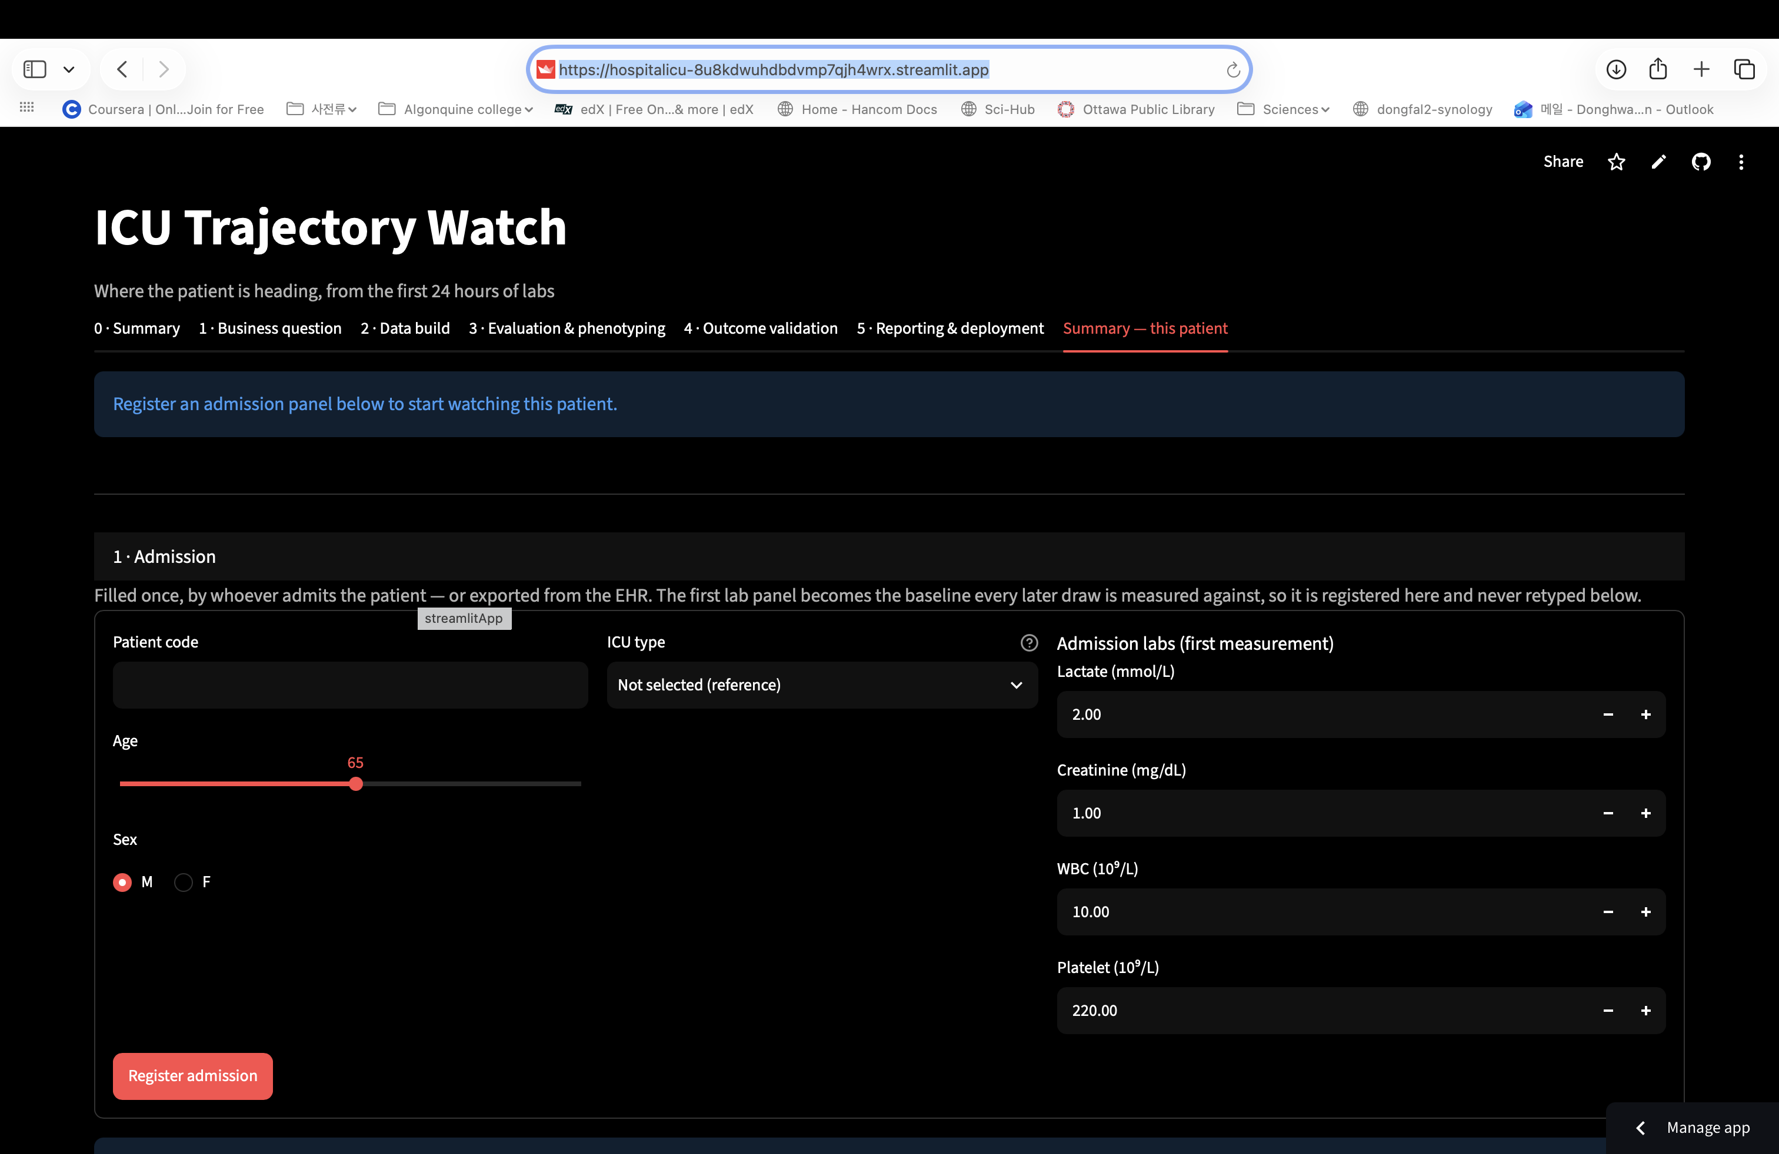

Slide 8
THE PAYOFF
Six Points, or Sixty.
Same phenotype. Same 14.5%. Completely different night.
−6.8
−60
Bed 7 at hour 6 — still labelled recovery-like, six points from flipping. Watch this one tonight.
The other patient at hour 6 — same label, same risk figure, sixty points of runway. This one can wait.
Four labs you already draw. No new equipment, no new cost — and instead of two identical charts and a coin flip, a direction and a reason to walk to bed seven first.
Still open: an independent severity score in the adjusted model, and external multi-centre validation.
08
Notes:
3:00 – 5:00 · optional bridge, then LIVE DEMO. Close on this slide.
DEMO INPUTS — BED-7 · 72 · M · MICU | admission 4.2 / 1.1 / 9.5 / 240 | hour 6 -> 3.9 / 1.2 / 11.0 / 235 | hour 12 -> 4.0 / 1.3 / 13.0 / 245
-- What they're looking at — 20 seconds
This is the tool. Two forms, and the split is the point.
The top one is filled in once, when the patient arrives. The nurse never touches it again.
The bottom one is all the bedside sees: a blood result comes back, you type four numbers, done.
-- Register the patient — 20 seconds
Type: BED-7 · age 72 · sex M · ICU type Medical Intensive Care Unit (MICU)
Admission labs: 4.2 · 1.1 · 9.5 · 240
Seventy-two-year-old man. His oxygen-starvation number is 4.2 — healthy is under two. He's sick. Register.
-- Six hours later — 40 seconds
Add draw: hour 6 · 3.9 · 1.2 · 11.0 · 235
Six hours in, new blood test. That first number came down a little — 4.2 to 3.9. The other two crept up. Honestly, nothing here would make you walk faster.
[open the Summary tab]
Recovering pattern. Chance of dying within a week: fourteen and a half percent.
Now this number — minus six point eight. Read it as how far he is from the line. Below zero is the recovering side, but the line is zero, and he's six points from it.
The other patient from the photograph? Same pattern, same fourteen and a half percent — his number reads minus sixty. Six steps from the edge, versus sixty. The percentage can't tell them apart. This can.
That's the whole thing: which bed do I walk to first.
-- Twelve hours — 30 seconds
[back to the entry form] Add draw: hour 12 · 4.0 · 1.3 · 13.0 · 245
Twelve hours. The first number stopped coming down. The immune number keeps climbing.
[Summary tab]
It flipped. Worsening pattern. Chance of dying within a week: fourteen and a half, up to twenty-six point six percent.
But look back at six hours. The label only changed at twelve. The warning was there at six.
-- Close — 10 seconds
[back to slide 7 if you can — the −6.8 and −60 are already on screen]
Four blood tests the hospital already runs. No new machine, no new cost. And instead of two identical charts and a coin flip, the nurse gets a direction — and a reason to walk to bed seven first.
Thank you.

