Slide 1
GoEvent Event Planner
Application Development 02 Project Proposal
Ashmitha Kanagiah
Ibrahim Awad
Andy-Tason Nguyen-Chao

Slide 2
Description
This Mobile Application that will allow for a company to post events of any types for users to attend
This is intended for people that want to participate to social events curated by the company without having to go through the process of searching online

Slide 3
Users
Admin
Create, edit and remove events (Concert, Party, etc.) that will be displayed for users to participate
Events can have fixed amounts of places
View who will attend and how many people will participate
User
Create a Profile
View all the events in the form of a calendar or list with the number of people attending it
Search for specific events
Filter by what type of events they want
Confirm their attendance to a event or remove them

Slide 4
Team Member Roles
Ashmitha (Team Leader):
Will manage the team, make sure the project is going smoothly according to the deadlines, communicate with the teacher, divide the length of the project to fit in the scheduling
Take part in the coding to build the application.
Andy:
Take part in the coding to build the application.
Design the UI for the application.
Ibrahim:
Take part in the coding to build the application.
Design the UI for the application.

Slide 5
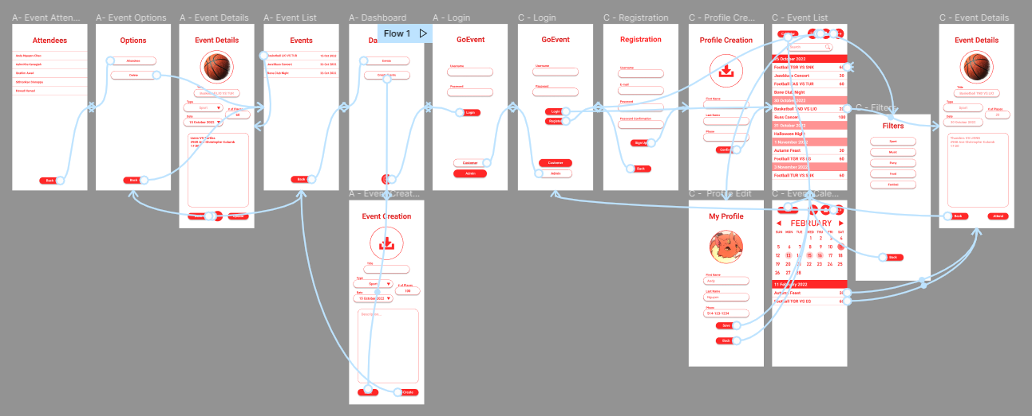
General Flow Overview
https://www.figma.com/file/g0b61hkbsCP8M9BsjUjNtO/AppDev02_Project?node-id=0%3A1
https://drive.google.com/file/d/1x26KOyQ2szcX8FsPYrEAZa8vfLd3OzWf/view?usp=sharing

Slide 6
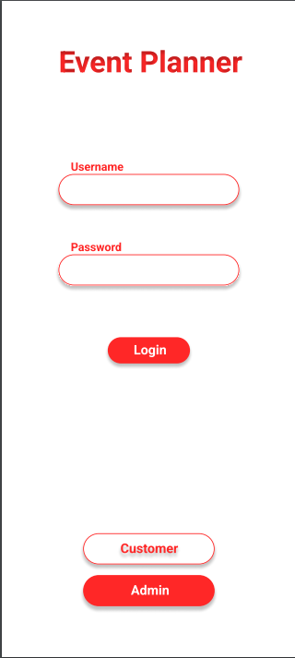
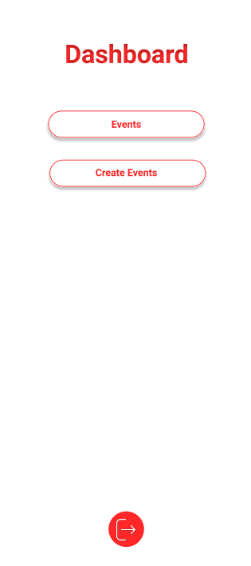
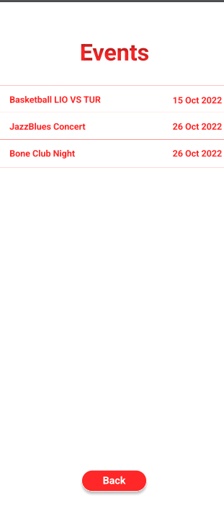
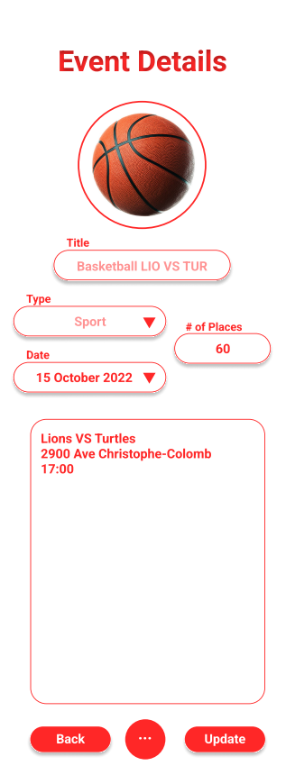
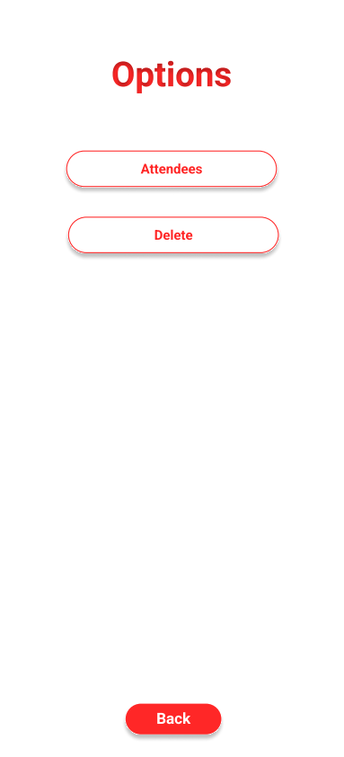
UI Interface Prototype (Admin)

Slide 7
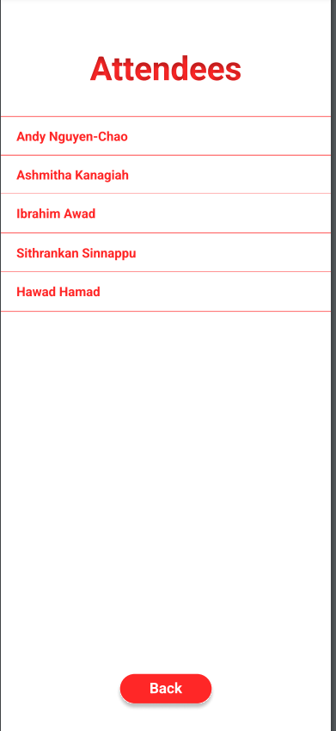
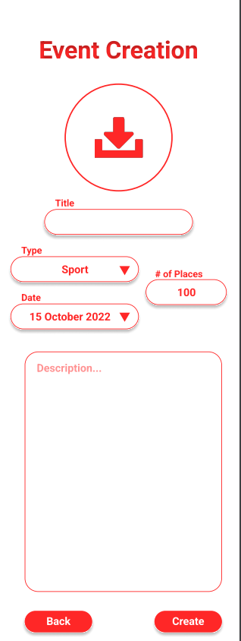
(Admin Continued)

Slide 8
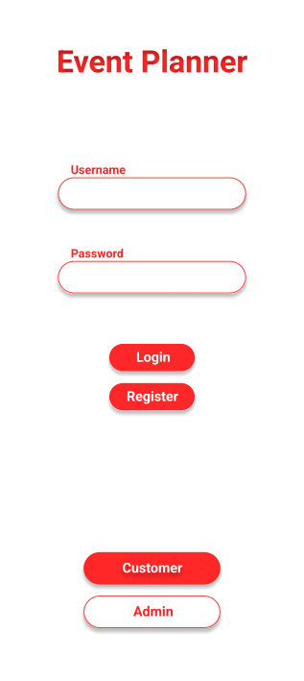
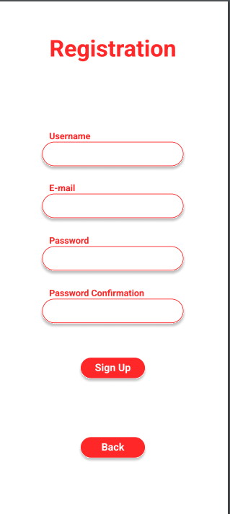
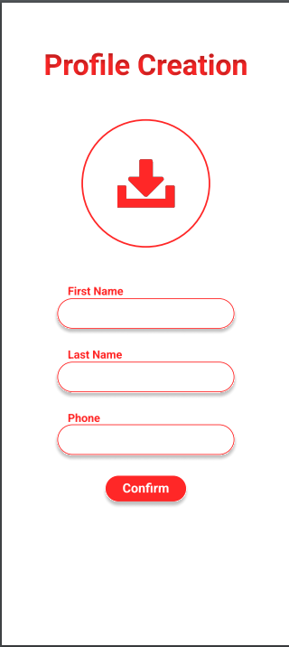
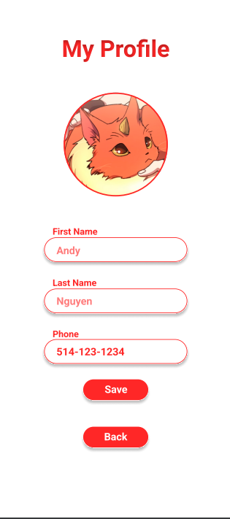
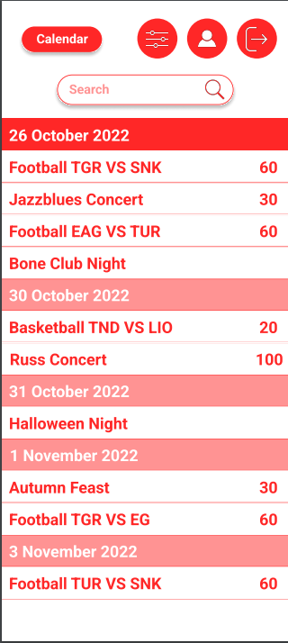
UI Interface Prototype (User)

Slide 9
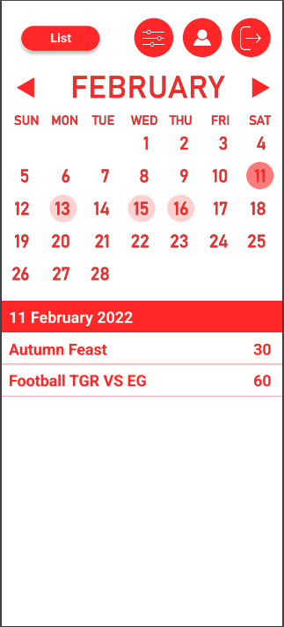
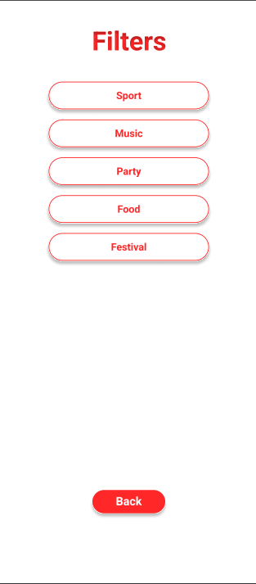
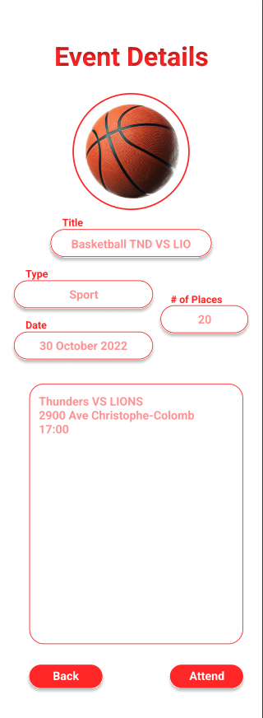
(Customer Continued)

Slide 10
Database Model
SQLite
PK | adminID
 | username
 | password
PK | userID
 | username
 | password
 | email
 | firstName
 | lastName
 | phone
 | image
PK | eventID
 | title
 | type
 | date
 | description
 | nbPlaces
FK | userID
 | image

