Slide 1
Team Code Masters
Linux assigment presentation
Friday September 8, 2023.

Slide 2
Team Member
Akinwale Idowu – Team Lead
Chukwuemeka Omeh – Deputy Team Lead
Adetayo Adebayo
Chimezie Ojukwu
Chikadibia Maduagwu
Olalekan Asaolu

Slide 3
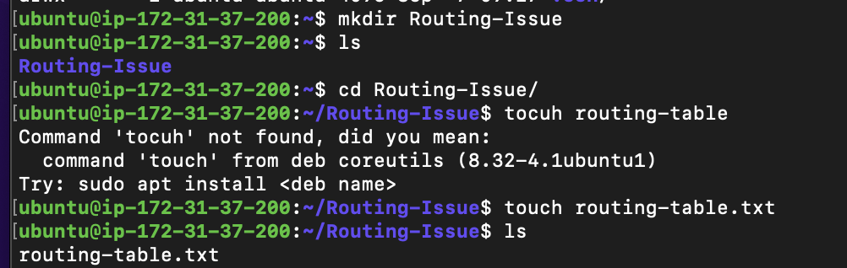
Assignment question number 1 Your Team is working with a Network Engineering Team on troubleshooting a routing issue on a Linux System. They have asked you to provide a copy of the system’s routing table to assist them in their diagnosis of the issue. Save a copy of the system’s routing table to a newly created folder named Routing-Issue on the root directory.
Solution:

Slide 4
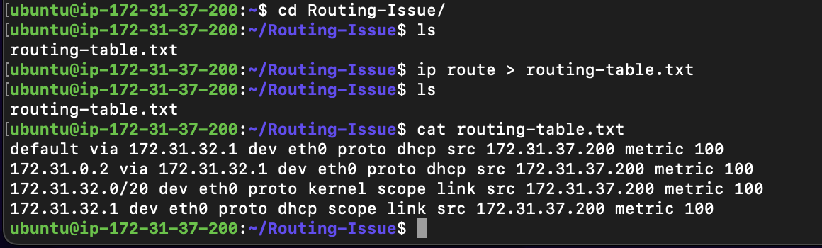

Slide 5
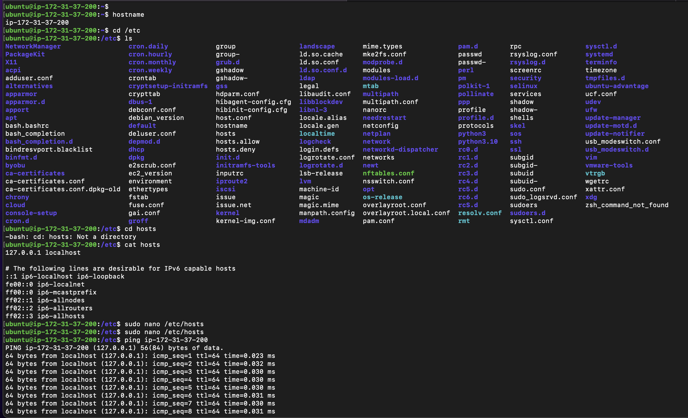
Assignment question number 2 Demonstrate your ability to configure network settings by performing the following tasks: a) Configure your Ubuntu Vm such that the hostname resolves to 127.0.0.1

Slide 6
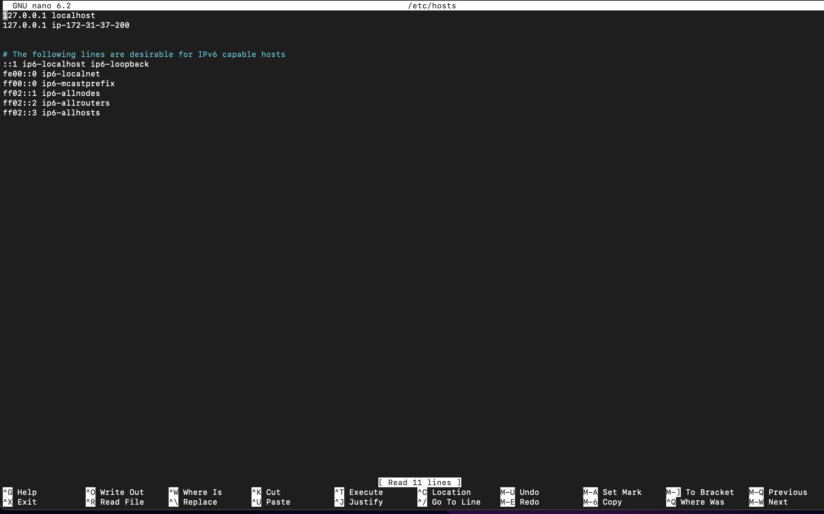

Slide 7
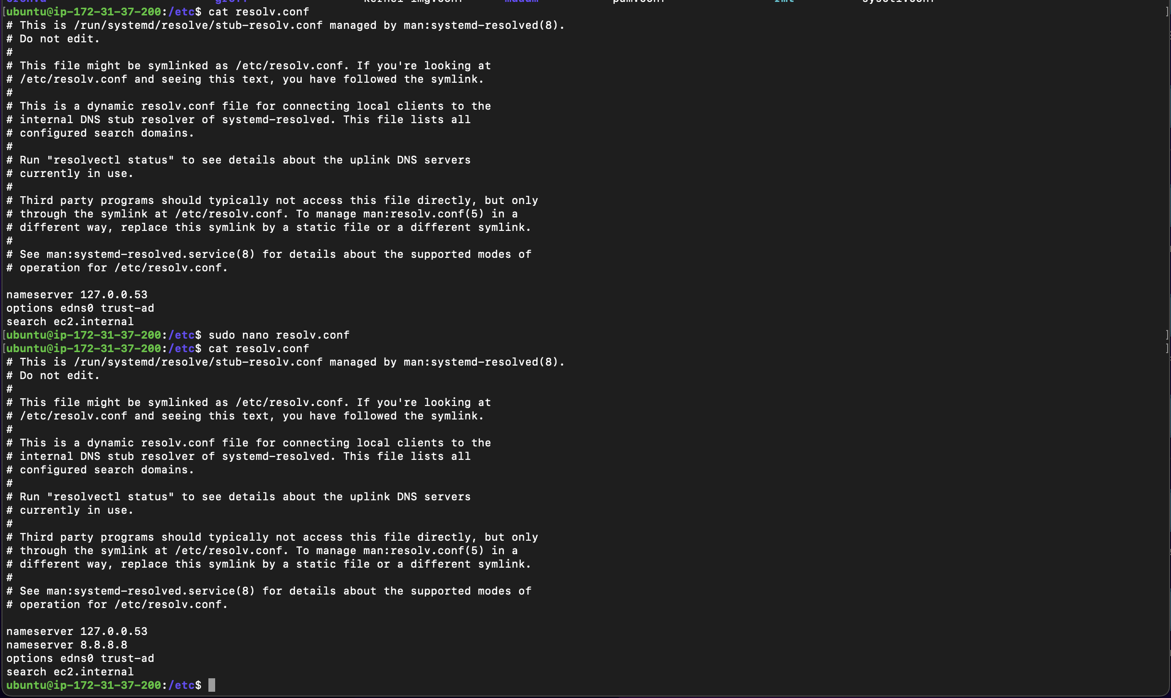
Assignment question number 2 b) Add an additional nameserver to the resolver configuration with address 8.8.8.8

Slide 8
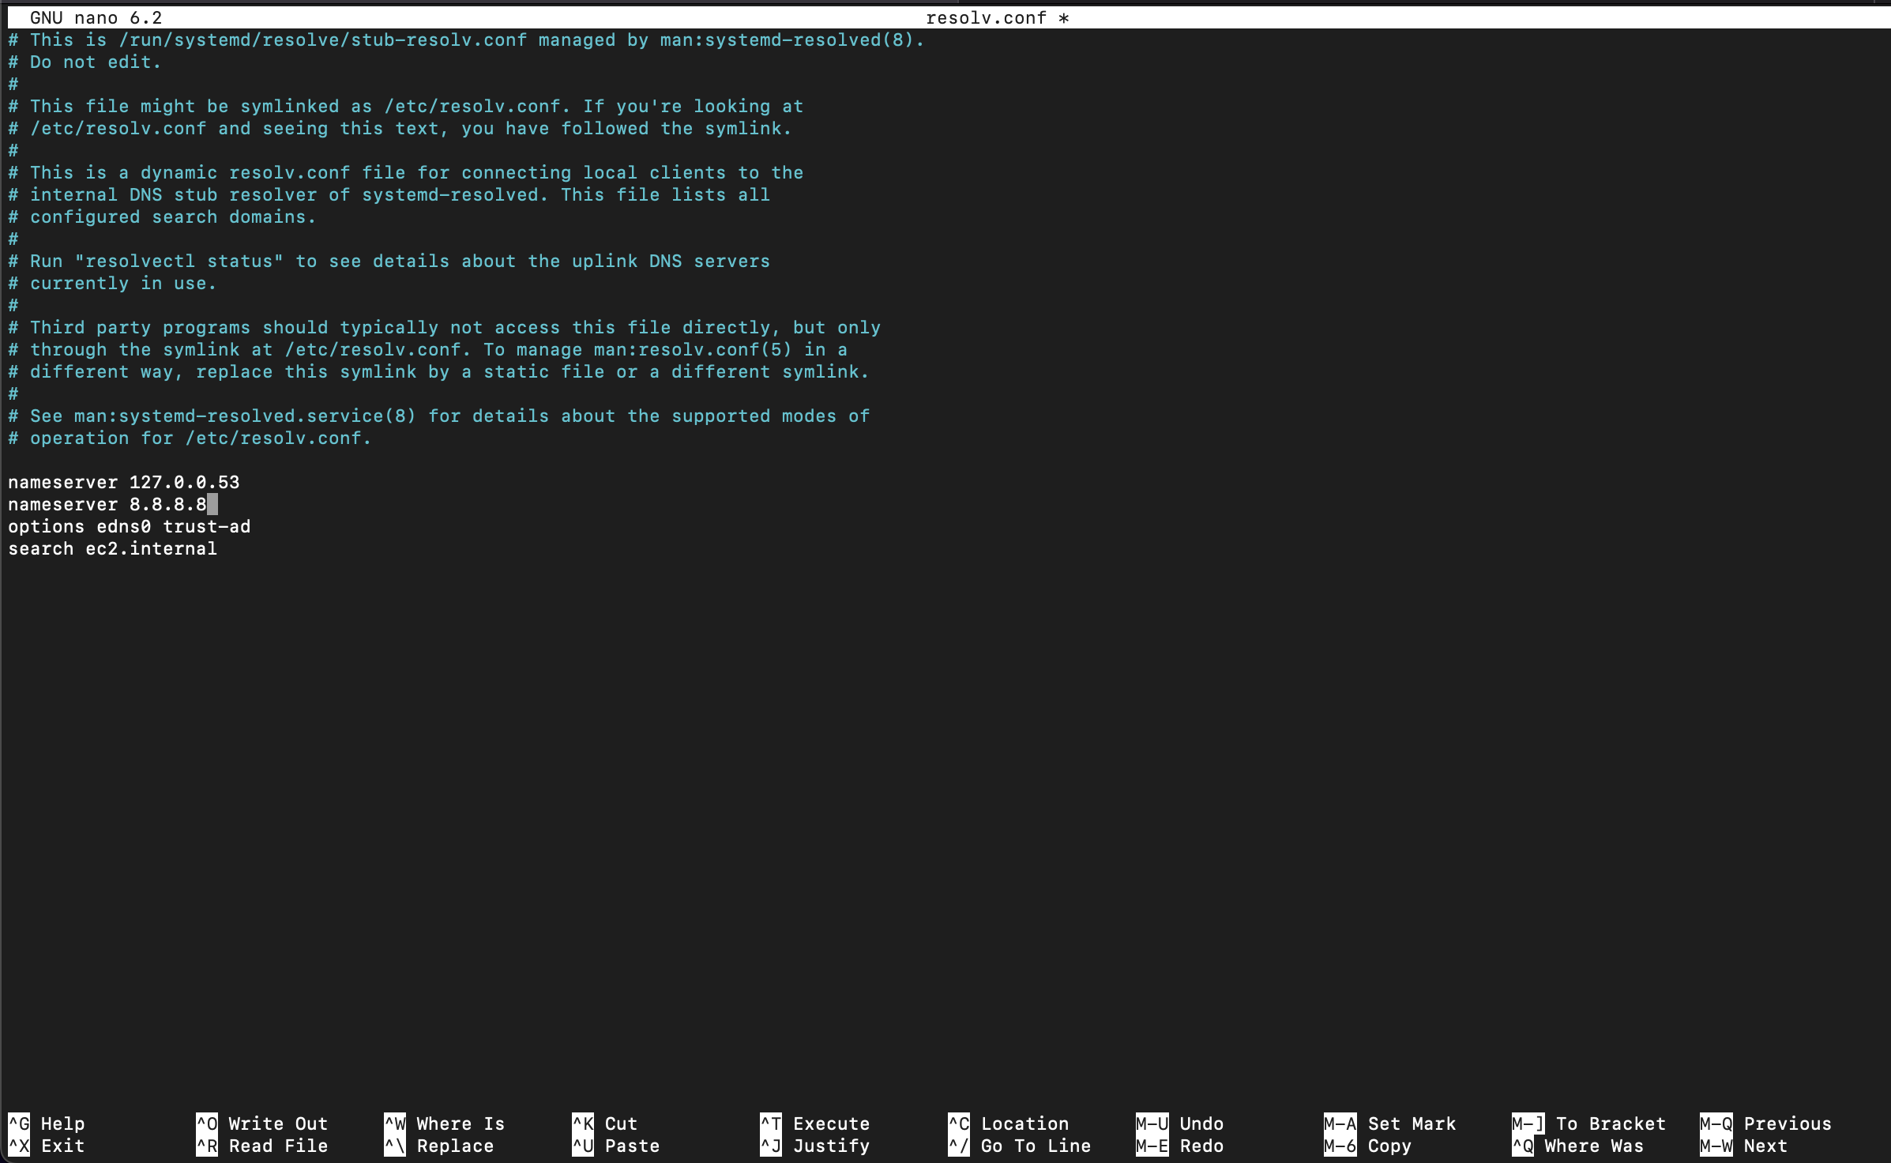
Assignment question number 2 b) Add an additional nameserver to the resolver configuration with address 8.8.8.8

Slide 9
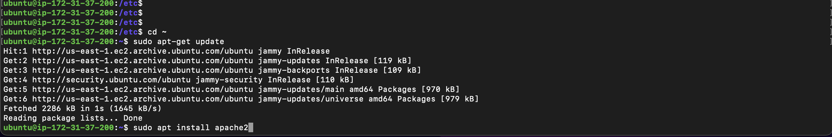
Assignment question number 3 You are In charge of running your Team's intranet server. A security policy change has necessitated that you change the server's listening port from the standard 80/tcp to 5080/tcp. The intranet server should be running a standard distribution installation of Apache HTTP Server. Make the change, ensure it takes effect, and that the change is persistent.

Slide 10
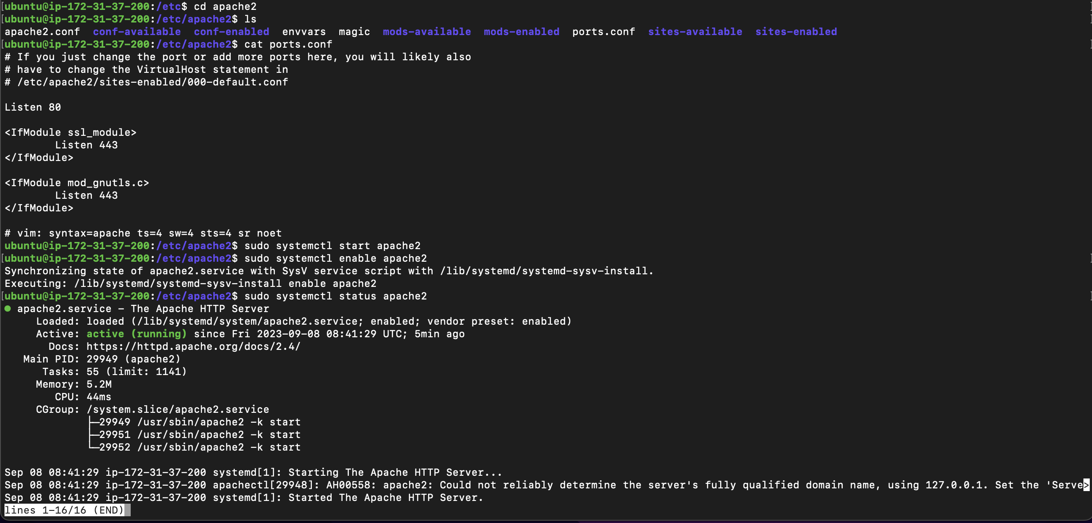

Slide 11
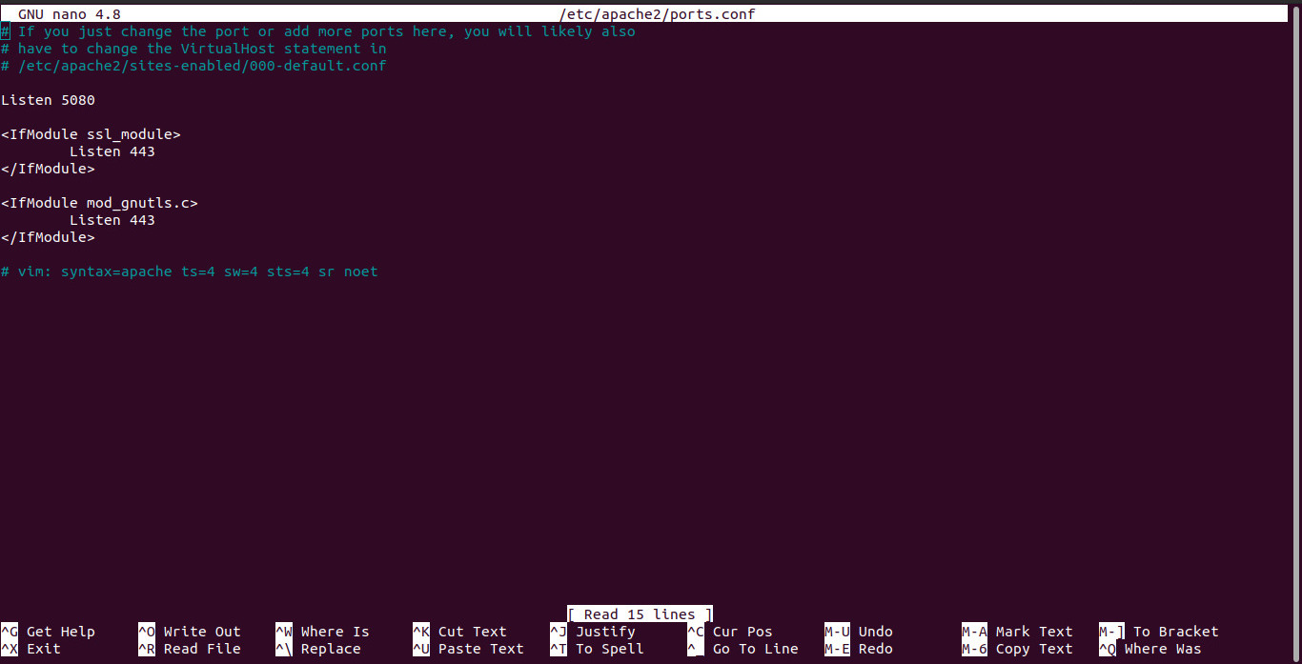
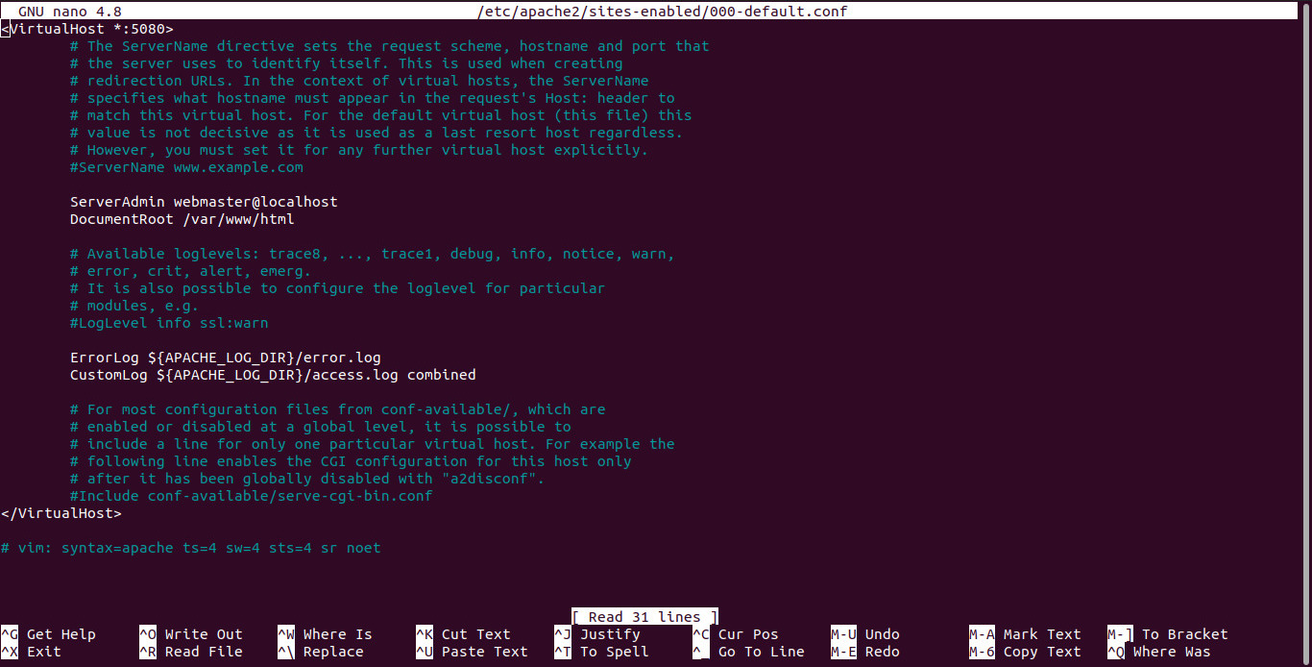

Slide 12
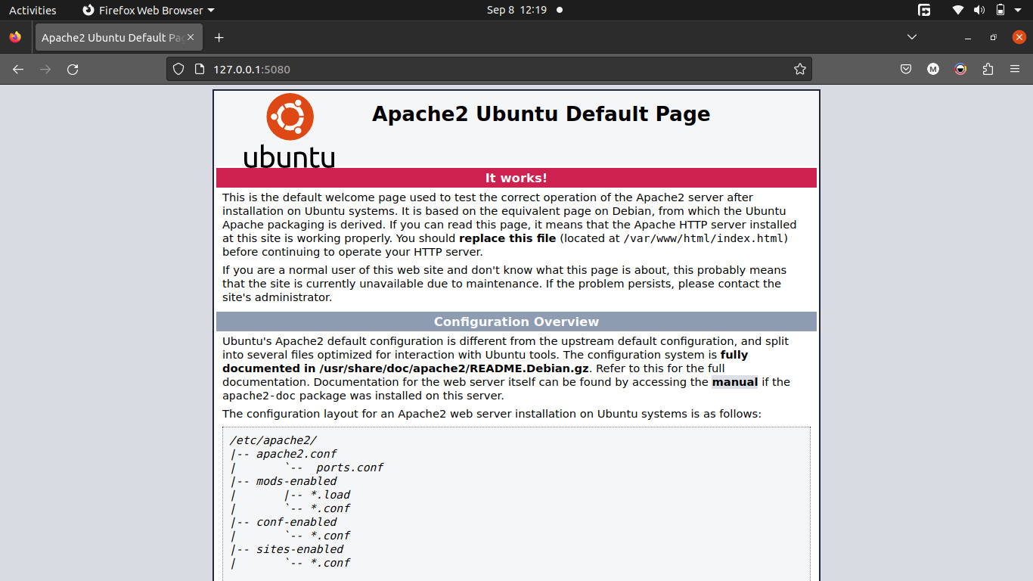

Slide 13
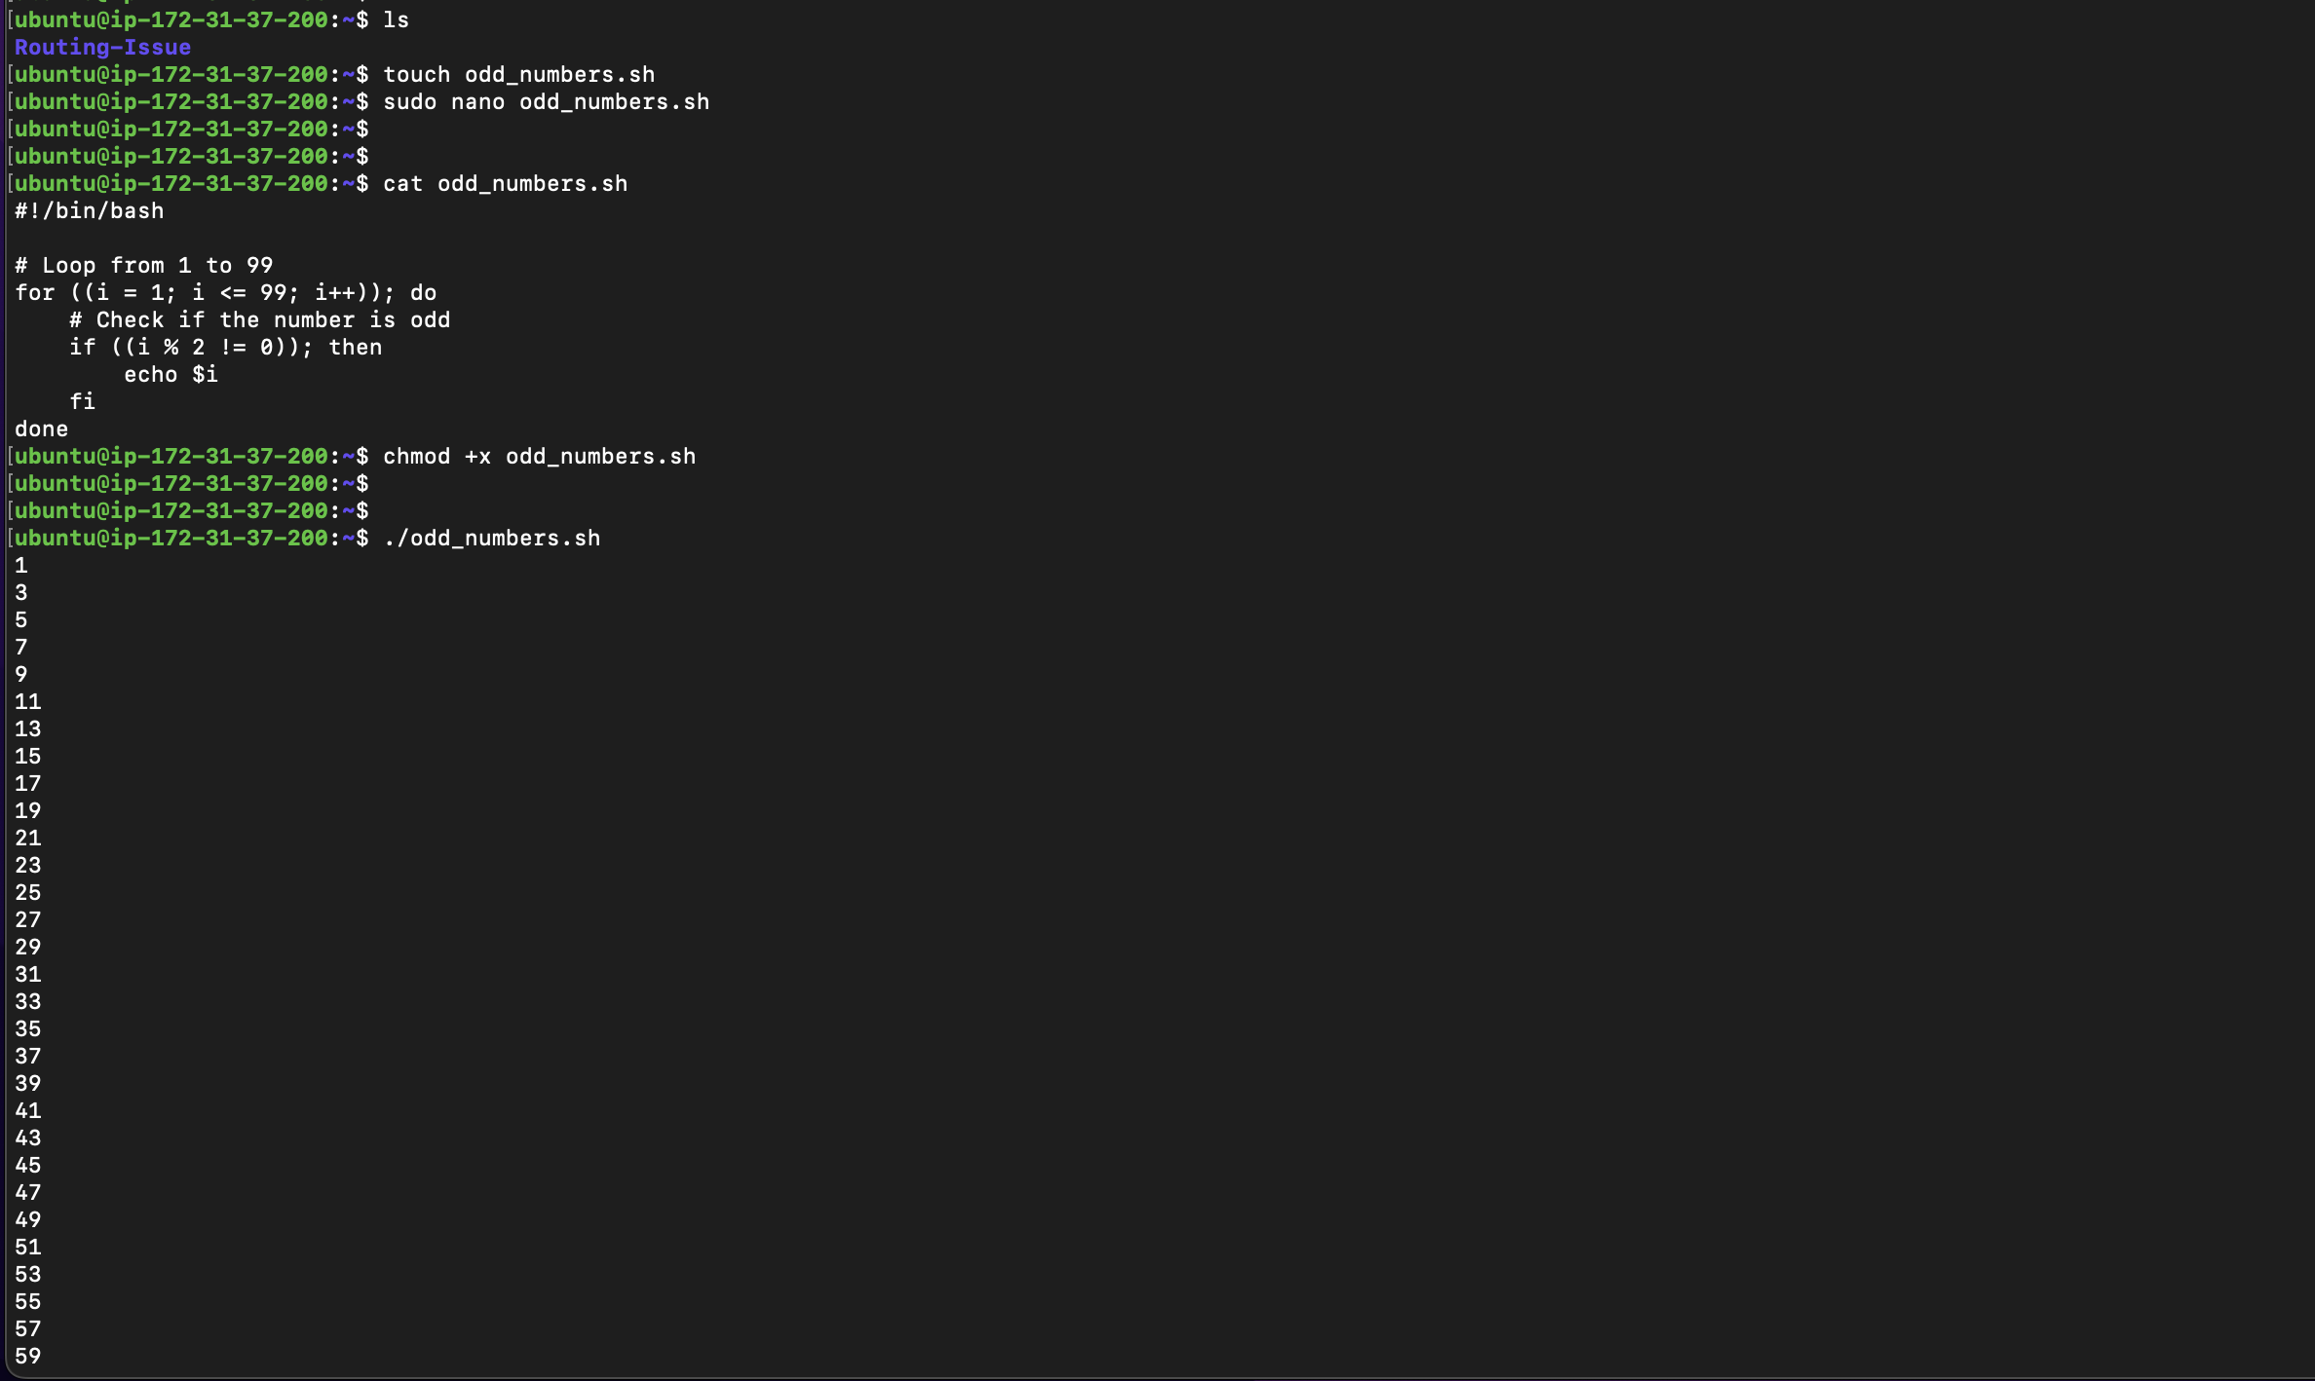
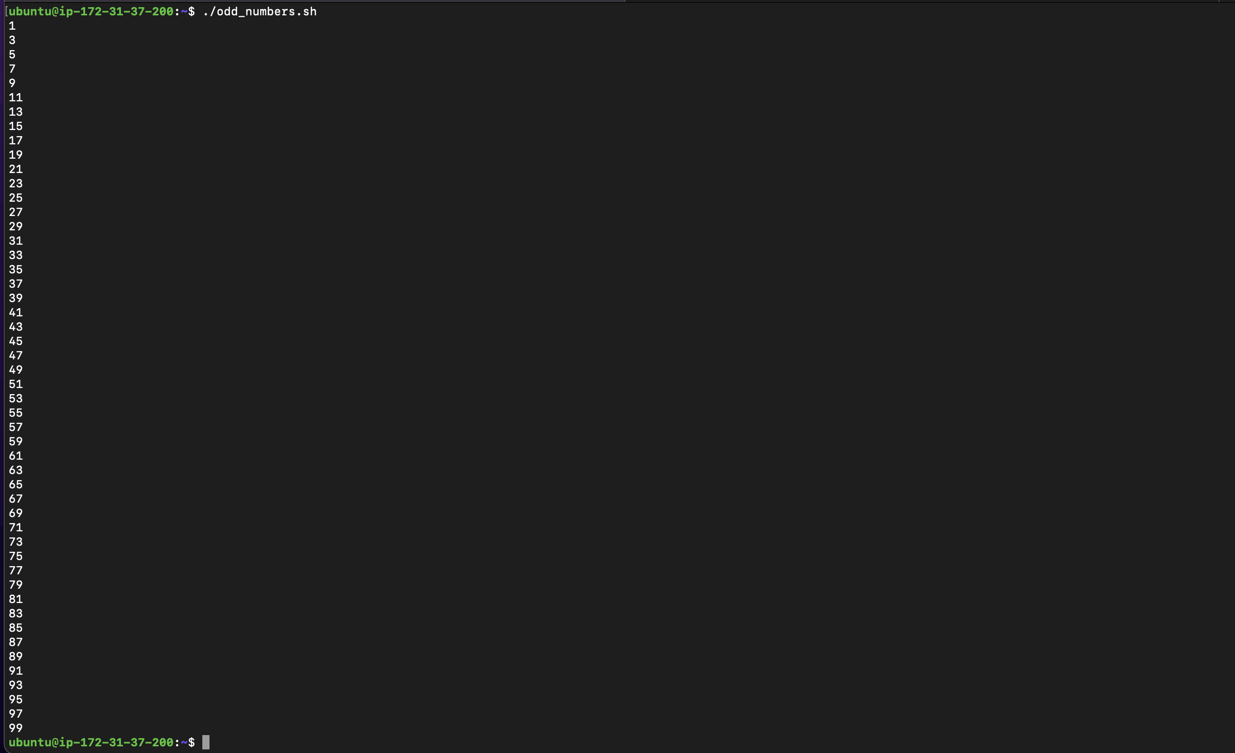
Assignment question number 4 Your task is to use for loops to display only odd natural numbers from 1 to 99.

Slide 14
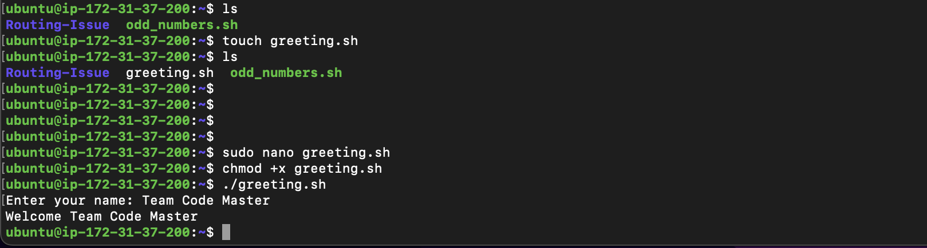
Assignment question number 5 Write a Bash script which accepts as input and displays the greeting "Welcome (name)"

Slide 15
Thank you

