Slide 1
XBUS-504
Data Analysis I: Statistics Day 2
David Waterman, Instructor
Georgetown University School of Continuing Studies

Slide 2
Planned Agenda
Day 1
Section 1: Descriptive Statistics
● Categorical & Quantitative Data
● Displaying Quantitative Data
● Describing Quantitative Data
● Location in a Distribution
● Density Curves
● Common Types of Distributions
Section 2: Relationships
● Scatterplots & Correlation
● Single Regression
● Experimental Design & Causation
● Sampling Techniques: Uniform, Stratified, and Poisson
Section 3: Probability
● Randomness & Probability
● Simulation & Stochastic Computing
● Probability Rules
● Joint Probability Distributions, Conditional Probability & Independence
Day 2
Section 3: Probability
● Bayesian Probability: prior and posterior distributions
Section 4: Inferential Statistics
● Sampling Distributions
● Confidence Intervals: Basics
○ Estimating a Population Proportion
○ Estimating a Population Mean
● Significance Tests: Basics
○ Tests about a Population Proportion
○ Tests about a Population Mean
● Type I and Type II errors
Section 5: Advanced Topics
● Chi-Square Tests
● ANOVA: Execution & Interpreting
● General Linear Models & Multivariate Regression
● Evaluating Regression Models

Slide 3
Review Homework
Cobra Effect: When an incentive produces the opposite result intended
“My cousin used to own a bakery store in Beijing. In order to reduce food waste, he allowed his employees to take unsold goods home at the end of the day. After a while, he found that his employees intended to bake more products so that they would have enough leftovers to split before closing.”
Survivorship Bias: Drawing conclusions from an incomplete set of data, because that data has ‘survived’ some selection criteria
“When looking at a group of freshmen, and analyzing what factors (academic records, outdoor curriculum, interpersonal skills, etc.) are important for a student to get into college, we have actually neglected the students who weren't admitted into colleges or dropped out from high school. The conclusion we draw from the described research might be math and sports are the most significant factor, but the family wealth, which prevents some students from even going to college or thinking about going to college might be overlooked.”

Slide 4
Bayesian Probability: prior and posterior distributions
There are two primary ways to view probability, and so far we have only looked at one.
The frequentist approach states that only events that are both random and repeatable, such as flipping of a coin or picking a card from a deck, have probabilities. These probabilities are equal to the long-term frequencies of such events occurring.
The Bayesian approach views probability as a more general concept; thereby allowing the assigning of probabilities to events which are not random or repeatable. A Bayesian approach can assign a probability based on prior knowledge.

Slide 5
Bayesian Probability: prior and posterior distributions
Frequentist Example: I can hear a phone beeping. I also have a mental model which helps me identify the area from which the sound is coming. Therefore, upon hearing the beep, I infer the area of my home I must search to locate the phone.
Bayesian Example: I can hear a phone beeping. Now, apart from a mental model which helps me identify the area from which the sound is coming from, I also know the locations where I have misplaced the phone in the past. So, I combine my inferences using the beeps and my prior information about the locations I have misplaced the phone in the past to identify an area I must search to locate the phone.

Slide 6
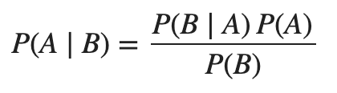
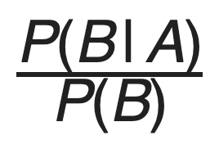
Bayes’ Rule (Bayes’ Law or Bayes’ Theorem)
For events A and B:
P (A), the prior, is the initial degree of belief in A.
P (A | B), the posterior is the degree of belief having accounted for B.
The quotient represents the support B provides for A.
The key to Bayesian statistics is that as we gain more information, we can update our prior distribution and calculate an update posterior. Bayesian Statistics is about learning new information.

Slide 7
Implementing Bayes’ Rule
Open notebook 3-3_Bayes_Theorem.ipynb

Slide 8
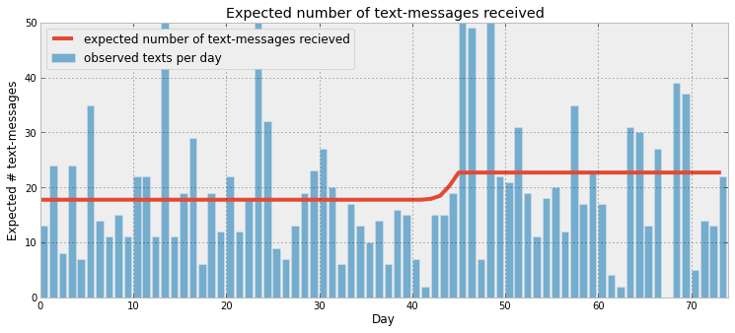
Guide to Bayesian Statistics
A great online pamphlet/book with Jupyter Notebooks examples that goes into much greater detail about Bayesian Statistics and implementation in Python that is beyond the scope of this course:
http://camdavidsonpilon.github.io/Probabilistic-Programming-and-Bayesian-Methods-for-Hackers/#contents

Slide 9
Section 4: Inferential Statistics

Slide 10
Sampling Distributions
A sampling distribution is the probability distribution of a given random-sample-based statistic. If an arbitrarily large number of samples, each involving multiple observations, were each used in order to compute one value of a statistic (such as, for example, the sample mean or sample variance), then the sampling distribution is the probability distribution of the values that the statistic takes on.
Notes:
For a finite population, the sampling distribution would contain the values of the statistics of interest for every single possible sample. For an infinite population that would be impossible, so we say an “arbitrarily large number of samples”.
Remember distribution definition: describes the possible values and how often the values occur

Slide 11
Sampling Distributions
Using sampling distributions, we can take a single sample and then calculate the expected sampling distribution of the statistic to make inferences about the population parameter. It is important to keep in mind the difference between the following 3 sets.

Slide 12
Sets Relevant to Sampling Distributions
Population: The set of all possible instances/items of interest. We will usually try to infer information about a single parameter of interest for the population (e.g. What is the mean income of ceiling painters in DC?)
Sample: A randomly chosen group meant to represent the population (a subset of the population), we will generally use a sample statistic to make inference about the related population parameter (e.g. The sample mean income of 20 randomly chosen DC ceiling painters is $45k, therefore the population mean income is probably close to $45k)
Sampling Distribution: The distribution meant to show all the possible sample statistics from the population of interest (e.g. We believe the sampling distribution of mean income of samples of 20 DC ceiling painters is the Normal distribution N($45,000, $3600) ).

Slide 13
Visualizing Sampling Distributions
Let’s assume the true population mean income of DC ceiling painters is Normally Distributed (the actual incomes are not important for this example). Use the following interactive applet to explore how samples and sampling distributions are created from the population.
http://onlinestatbook.com/stat_sim/sampling_dist/
Explore how changing sample sizes affects the sampling distribution by changing the drop-down box on the right that says “N=5”. Compare the different sizes available.
If you have time, also explore changing the shape of the population distribution from Normal to either skewed or your own custom distribution.

Slide 14
Sampling Distributions Key Points
Population = All the things (parameter = measurement of all the things)
Sample = Randomly chosen group of some of the things (statistic = measurement of the group)
Sampling Distribution = All the possible sample outcomes for the statistic
We construct sampling distributions based on assumptions from a sample since we won’t actually know the true population distribution (otherwise we wouldn’t need to perform inference)
Notes:
Parameters vs. statistics, e.g. xbar vs. mu
Compare center, shape, and spread of each

Slide 15
Point Estimates
A point estimate is a best guess for the value of a population parameter.
E.g.: We think the mean income of all ceiling painters in DC is $45,000.
A point estimate is rarely useful on it’s own.
(For continuous variables, how likely is a point estimate to be correct?)

Slide 16
Confidence Interval Basics
Because point estimates are rarely useful, it is more common to give a range for your estimate.
A Confidence Interval is an interval of plausible values for a parameter.
A confidence interval is a point estimate plus and minus a margin of error.

Slide 17
Confidence Interval Basics
The goal for the margin of error to be large enough to be correct most of the time, but not so large that it waters down the value provided by the estimate.
We choose a confidence level that determines how large our margin of error will be. (Most common CL = 95%)
The confidence level is a percentage that indicates how often the confidence interval will contain the true population parameter (if our necessary assumptions are true).
Significance Level α = 1 - Confidence Level
(We will define significance level when we discuss hypothesis tests)
Notes:
If our point estimate of ceiling painter income is $45,000, a margin of error of $100 is probably not large enough to be accurate, and a $40,000 margin of error is too large to make our estimate of any use.

Slide 18
Confidence Interval Basics
According to www.gallup.com, on August 13, 2010, the 95% confidence interval for the true proportion of Americans who approved of the job Barack Obama was doing as president was 0.44 +/- 0.03.
Explain the Confidence Interval: We are 95% confident that the interval from 0.41 to 0.47 captures the true proportion of Americans who approve of the job Barack Obama was doing as president at the time of the poll.
Explain the Confidence Level: In 95% of all possible samples of the same size, the resulting confidence interval would capture the true proportion of Americans who approve of the job Barack Obama was doing as president.

Slide 19
Visualizing Confidence Level
Confidence interval example for means:
http://digitalfirst.bfwpub.com/stats_applet/stats_applet_4_ci.html
Confidence interval example for proportions:
http://digitalfirst.bfwpub.com/stats_applet/stats_applet_20_ciprop.html

Slide 20
General Confidence Interval Formula
Point Estimate +/- Critical Value * Standard Deviation of the Sampling Distribution

Slide 21
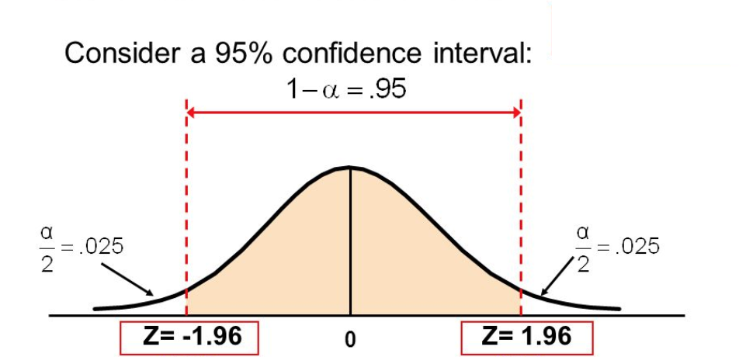
Critical Value: z*
http://digitalfirst.bfwpub.com/stats_applet/stats_applet_7_norm.html

Slide 22
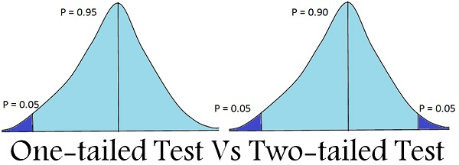
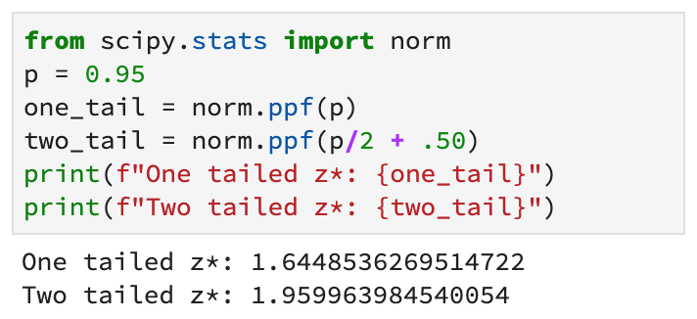
Critical Value: z*
If you wish to calculate a critical value, most functions give you results assuming a single tail. If you want a 2-tailed value, you have to modify the p before calling the function.

Slide 23
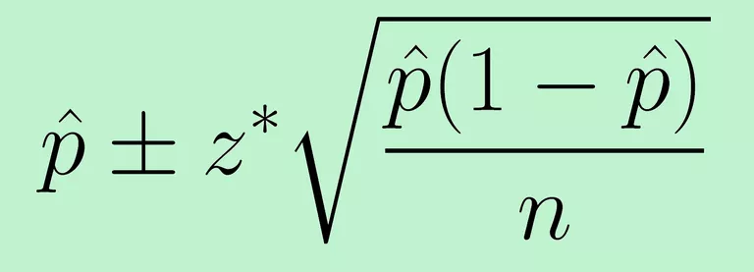
Proportion Confidence Interval Formula
Point Estimate +/- Critical Value * Standard Deviation of the Sampling Distribution

Slide 24
Confidence Interval Example
You and your friends are bored at work and want to estimate the proportion of pennies in circulation that are more than 10 years old. To do this, you gather all the pennies you have on hand. Overall, 57 of the 102 pennies you have are more than 10 years old. Construct and explain a 95% confidence interval for the proportion.
Parameter of interest:
Sample statistic:
Sample size:
p, the true proportion of pennies in circulation over 10 years old.
p̂, the proportion of pennies in the sample over 10 years old. p̂ = 57/102 = 0.559
n = 102

Slide 25
Confidence Interval Example
You and your friends are bored at work and want to estimate the proportion of pennies in circulation that are more than 10 years old. To do this, you gather all the pennies you have on hand. Overall, 57 of the 102 pennies you have are more than 10 years old. Construct and explain a 95% confidence interval for the proportion.

Slide 26
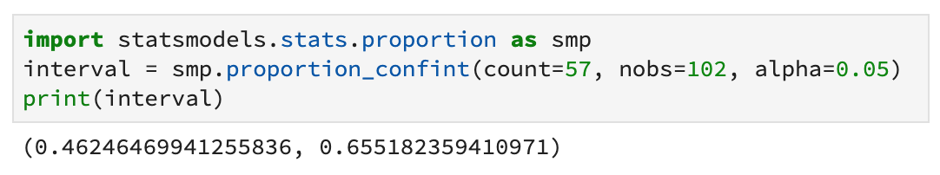
Confidence Interval Example
You and your friends are bored at work and want to estimate the proportion of pennies in circulation that are more than 10 years old. To do this, you gather all the pennies you have on hand. Overall, 57 of the 102 pennies you have are more than 10 years old. Construct and explain a 95% confidence interval for the proportion.
http://www.statsmodels.org/devel/generated/statsmodels.stats.proportion.proportion_confint.html

Slide 27
Circle Back: Unbiased Estimators
x̄ (x-bar) is an unbiased estimator of μ
p̂ (p-hat) is an unbiased estimator of p
s is not an unbiased estimator of σ (In which direction is s biased?)
We need to adjust our calculations if we are going to substitute in s for σ

Slide 28
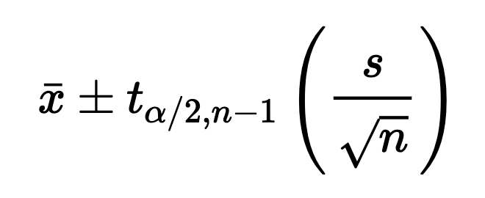
Mean Confidence Interval Formula
Point Estimate +/- Critical Value * Standard Deviation of the Sampling Distribution
The Critical Value t is defined by the significance level α, and the degrees of freedom n-1

Slide 29
Student’s t-distribution
The t distribution (aka Student’s t-distribution) is a probability distribution that is used to estimate population parameters when the sample size is very small and/or when the population standard deviation is unknown.
The name Student’s t comes from the fact that the first English language paper using the distribution was written in 1908 by William Sealy Gosset, an employee of the Guinness Brewery in Dublin. Gosset used the distribution to study small samples – for example, the chemical properties of barley where sample sizes might be as few as 3. Guinness preferred employees use pseudonyms for publication and Gosset published his paper as “Student”.

Slide 30
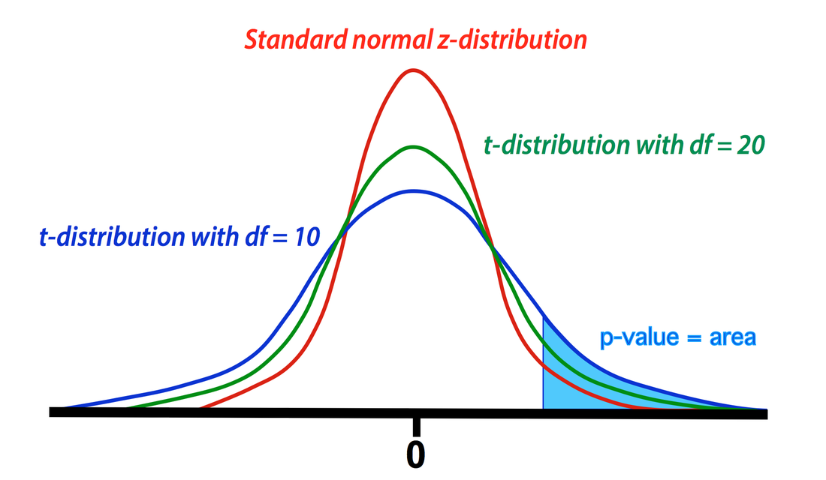
Student’s t- vs. Normal Distributions

Slide 31
Calculate Critical Value for Student’s t
Complete the 4-1_Critical_Values.ipynb notebook to find the following critical values:
95% Confidence Level, 9 degrees of freedom
95% Confidence Level, 19 degrees of freedom
95% Confidence Level, 99 degrees of freedom

Slide 32
Confidence Interval for Mean Example
You purchased a new car that records your gas mileage in mpg. Every time you fill up, you write down the recorded mileage. Given the following 20 records, determine a 90% confidence interval for the car.
15.8, 13.6, 15.6, 19.1, 22.4, 15.6, 22.5, 17.2, 19.4, 22.6, 19.4, 18.0, 14.6, 18.7, 21.0, 14.8, 22.6, 21.5, 14.3, 20.9
The manufacturer claimed this vehicle would get 22mpg. Do you have convincing evidence that this claim is incorrect?

Slide 33
Confidence Interval for mean Example
You purchased a new car that records your gas mileage in mpg. Every time you fill up, you write down the recorded mileage. Given the following 20 records, determine a 90% confidence interval for the car.
15.8, 13.6, 15.6, 19.1, 22.4, 15.6, 22.5, 17.2, 19.4, 22.6, 19.4, 18.0, 14.6, 18.7, 21.0, 14.8, 22.6, 21.5, 14.3, 20.9
Parameter of interest:
Sample statistic:
Sample size:
μ, the true mean gas mileage for this car
x̄, the mean gas mileage for the 20 fillups given
n = 20

Slide 34
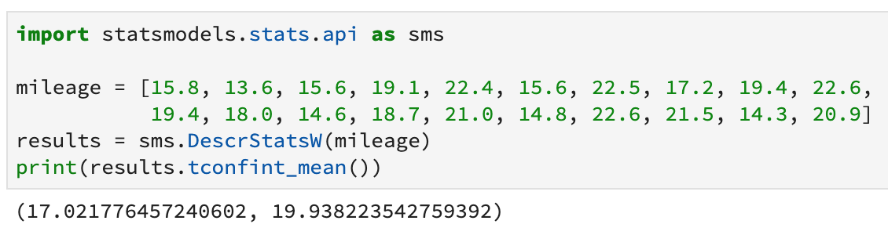
Confidence Interval for mean Example
You purchased a new car that records your gas mileage in mpg. Every time you fill up, you write down the recorded mileage. Given the following 20 records, determine a 95% confidence interval for the car.
The manufacturer claimed this vehicle would get 22mpg. Do you have convincing evidence that this claim is incorrect?

Slide 35
Inference for a Claim:
Hypothesis Tests

Slide 36
The Logic of Hypothesis Testing
A claim is made about the value of a population parameter.
When a statistic from a sample suggests that the claim isn’t true, we must decide which explanation is more plausible:
The claim is true and the statistic is different from the claimed value because of sampling variability.
The claim isn’t true.
If the value of the statistic is so different that it would rarely occur if the claim was true, we have good evidence that the claim isn’t true.

Slide 37
Null & Alternative Hypothesis
H₀: Null Hypothesis - Statement of no difference (Nothing is occurring, there is no change, etc.) Ex: The mean weight gain from a new drug is μ = 0 Ex: The proportion of people who prefer lime Skittles to green apple is p = 0.75.
H_{a}: Alternative Hypothesis - What we are trying to find evidence for/prove Ex: The mean weight gain from a new drug is μ > 0 Ex: The proportion of people who prefer lime Skittles to green apple is p ≠ 0.75.
Hypotheses are always written in regards to the parameter of interest.

Slide 38
Null & Alternative Hypothesis
One-sided vs. two-sided alternatives:
If we expect the change to be in a certain direction, we will write the alternative hypothesis as an inequality, e.g. “Since we think this drug improves pain management, we will say H_{a} > 0”.
If we are looking for any change in either direction, we will write the alternative as a not equals statement, e.g. “Does the new blood pressure drug affect pain management, either for better or worse? H_{a} ≠ 0”.

Slide 39
Null & Alternative Hypothesis
One-sided vs. two-sided alternatives visualized:
One Tailed Two Tailed

Slide 40
Steps for Hypothesis Testing
Assume the null hypothesis is true (there is no difference occurring).
Take a sample and calculate the statistic.
Create a sampling distribution based on the null hypothesis.
Determine how likely is it to get the sample statistic by random chance if the null hypothesis is true
Compare this probability (p-value) to the chosen significance level (α)
Conclude either:
If p-value > α, this result could happen often by random chance, so we don’t have evidence that the null is false. We will stick with the null hypothesis that nothing is happening.
If p-value < α, this result would rarely happen by chance if the null hypothesis was true, so we conclude that there is significant evidence that the null is false and our evidence suggests the alternative is true. We really try to avoid saying “The alternative hypothesis is (definitely) true).”

Slide 41
Hypothesis Test for p
A grocery chain decides to investigate whether customers prefer name-brand potato chips to generic potato chips. They randomly selected 50 customers and had each customer blindly try both types of chips, in random order. Overall, 32 of the 50 customers preferred the name-brand chips. The store performed a significance test using the hypotheses : H₀: p = 0.5 versus H_{a}: p > 0.5 Where p = the true proportion of customers who prefer name-brand chips. The resulting P-value was 0.020. What conclusion would you make at each of the following significance levels?
(a) = 0.05 (b) = 0.01

Slide 42
Significance Level α
When we were discussing confidence intervals we said that the confidence level was the complement of the significance level α. Confidence level was (essentially) how often the confidence interval contained the true parameter value.
Significance level, α, is: How often we would incorrectly reject the null hypothesis (as a result of random chance in our sample) if the null is true.
If we choose a significance level of α=0.01 and it turns out the null was true, then if we repeated the test many times with many different samples, then 1% of the time we would incorrectly reject the null in favor of the alternative.

Slide 43
Significance Level α
Since we won’t actually know if the null is true or not, another way to think about it is with a significance level of α=0.01, then there is (essentially) a 99% chance that our conclusion is correct and a 1% chance we are wrong.

Slide 44
Significance Level α
Historically, the most common significance level used in most scientific fields was α=0.05, but this has resulted in some researches using questionable methods like p-hacking to influence the results of their work. Most scientific fields are currently going through a period of transition as they try to identify ways to bring scientific rigor and robustness back to their disciplines.
Related readings:
“Science Isn’t Broken” https://fivethirtyeight.com/features/science-isnt-broken/
“First analysis of ‘pre-registered’ studies shows sharp rise in null findings” https://www.nature.com/articles/d41586-018-07118-1

Slide 45
Hypothesis Test for p
Notebook 4-2_P-Value.ipynb

Slide 46
Error: Type I and Type II
Type I error: Falsely rejecting a true null hypothesis
Type II error: Failing to reject a false null
Mnemonic for Type I & Type II:
Type I error: Single negative (Falsely rejecting a true)
Type II error: Double negative (Failing to reject a false)

Slide 47
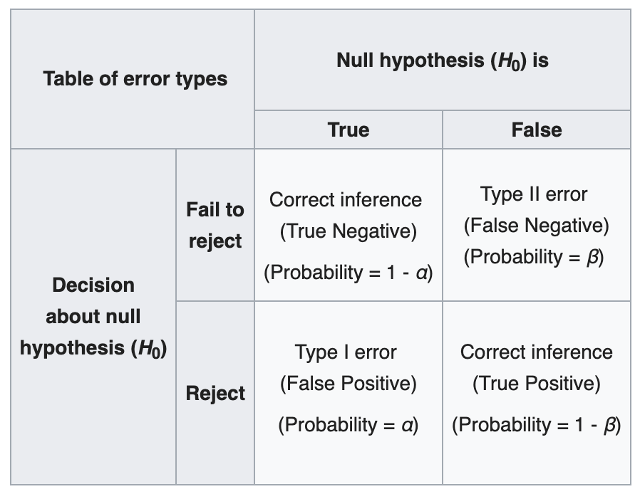
Error and Probabilities
α = Probability of Type I error α = Significance Level
β = Probability of Type II error
The probability of not committing a Type II error is called power (1 - β).
The power of a test is the probability a test rejects the null if the alternative is true.

Slide 48
Visualizing Power
https://rpsychologist.com/d3/NHST/Note that power is related to significance level α, sample size n, and the effect size (the distance between H₀ and H_{a}). You can calculate any one of these from the other 3.
As a result, for a given significance test that already has values for α and n, to calculate power you must choose an alternative value to measure the power at (e.g. “What is the power of this test if the true mean μ = 15.3?”)

Slide 49
5: Advanced Topics

Slide 50
Chi-Squared and ANOVA Significance Tests
We will look at 2 additional types of tests: Chi-Squared and ANOVA. The principles from our earlier tests remain the same:
Assume the null hypothesis is true.
Take a sample and calculate the statistic.
Create a sampling distribution based on the null hypothesis.
Calculate P (likelihood of the sample statistic if the null hypothesis is true)
Compare this probability (p-value) to the chosen significance level (α)
Conclude either:
If p-value > α, We don’t have evidence that the null is false
If p-value < α, There is significant evidence that the null is false and our evidence suggests the alternative is true

Slide 51
Chi-Squared
A chi-squared (χ²) test, or Pearson's chi-squared test, is used to determine whether there is a significant difference between the expected frequencies and the observed frequencies in one or more categories.
The null hypothesis is for a Chi-Square analysis is always the same:
Any difference between the observed and expected data is due to chance.

Slide 52
Chi-Squared Example
M&Ms candy come in 6 colors: Brown, Blue, Green, Orange, Red, Yellow. It seems reasonable to assume the colors are evenly distributed, ⅙ of each bag in each color. But for some reason, you always seem to get more of your most hated M&M: blue. Do you have convincing evidence that the distribution of M&M colors is not ⅙ each? Let α = .05.
H₀: All colors have p=⅙. H_{a}: There is some difference in probability between the colors.
You buy a bag with 73 M&Ms to use as your sample and count the distribution of colors.

Slide 53
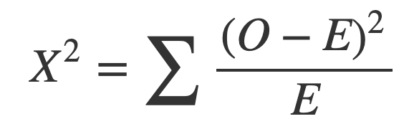
Chi-Squared Example
Expected Value = E(x) = ⅙ * 73 = 12.17
The formula for the test statistic is: O = Observed frequency E = Expected frequency
 | Blue | Brown | Green | Orange | Red | Yellow
Expected | 12.17 | 12.17 | 12.17 | 12.17 | 12.17 | 12.17
Observed | 19 | 11 | 15 | 9 | 10 | 9

Slide 54
Chi-Squared Example
𝛘² = Σ(O-E)²/E = 6.644
P_{df=5} (𝛘² > 6.644) = 0.087
 | Blue | Brown | Green | Orange | Red | Yellow
Expected | 12.17 | 12.17 | 12.17 | 12.17 | 12.17 | 12.17
Observed | 19 | 11 | 15 | 9 | 10 | 9
(O-E)²/E | 3.873 | 0.112 | 0.66 | 0.824 | 0.386 | 0.824

Slide 55
Chi-Squared Example
Do you have convincing evidence that the distribution of M&M colors is not ⅙ each? Let α = .05.
H₀: All colors have p=⅙. H_{a}: There is some difference in probability between the colors.
P_{df=5} (𝛘² > 6.644) = 0.087
Conclusion: Because the P-value 0.087 is greater than the significance level α = .05, we do not have convincing evidence that the distribution of colors is not ⅙ each.

Slide 56
Chi-Squared in Python
Notebook 5-1_Chi-Squared.ipynb

Slide 57
ANOVA: Analysis of Variance
There are two main types of ANOVA significance tests: one-way and two-way. Two-way tests can be with or without replication.
One-way ANOVA between groups: used when you want to test two groups to see if there’s a difference between them.
Two way ANOVA without replication: used when you have one group and you’re double-testing that same group. For example, you’re testing one set of individuals before and after they take a medication to see if it works or not.
Two way ANOVA with replication: Two groups, and the members of those groups are doing more than one thing. For example, two groups of patients from different hospitals trying two different therapies.

Slide 58
ANOVA: Analysis of Variance
The hypotheses for any ANOVA test are:
H₀: All population means are equal
H_{a}: There is a difference in population means

Slide 59
ANOVA: Analysis of Variance
A scientist wants to know if all children from schools A, B and C have equal mean IQ scores. Each school has 1,000 children. It takes too much time and money to test all 3,000 children. So a simple random sample of n = 10 children from each school is tested. The results are:
 | n | Mean IQ | Variance
School A | 10 | 99.2 | 111.1
School B | 10 | 112.6 | 205.6
School C | 10 | 93.3 | 160.5

Slide 60
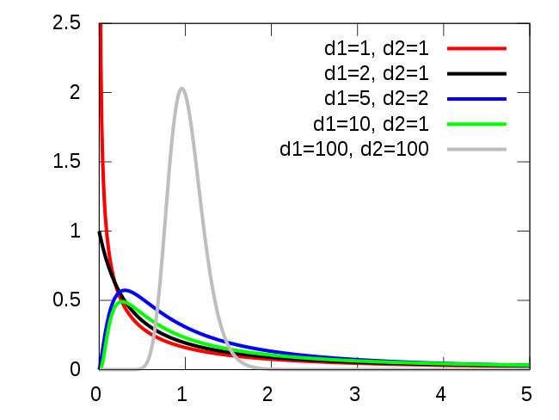
ANOVA: Analysis of Variance
In an ANOVA test we compute the variance among our 3 sample means. Everything else equal, a larger variance indicates that the sample means differ more. And the more different our sample means, the more likely that our population means differ as well.
The test statistic for ANOVA is F, which follows an F-distribution.
For our example, F(2, 27) = 6.15. P(F(2,27) > 6.15) = 0.006.

Slide 61
ANOVA: Analysis of Variance
A scientist wants to know if all children from schools A, B and C have equal mean IQ scores.
For our example, F(2, 27) = 6.15. P(F(2,27) > 6.15) = 0.006.
Conclusion: Because our P-Value 0.006 is so small (smaller than any standard α), we have convincing evidence that the children from schools A, B, and C have different mean IQ scores.

Slide 62
ANOVA in Python
Notebook 5-2_ANOVA.ipynb

Slide 63
Generalized Linear Models (GLMs)
In OLS regression, it is assumed that errors of the points are Normally distributed about the regression line. If that assumption does not hold true, the OLS model is not appropriate.
Generalized Linear Models (GLM) are a flexible generalization of ordinary linear regression that allows for response variables that have error distribution models other than a normal distribution.

Slide 64
Why Use GLMs
We can use GLMs when the probabilistic framework of a linear model can't handle the different types of data we have. For example, OLS works well for continuous data, but may be inadequate for use with discrete or binary data.
In GLMs we can specify the use of different link functions that are more appropriate for our data.

Slide 65
Exploring GLMs
Notebook 5-3_GLMs.ipynb

Slide 66
Multivariate vs. Multivariable Regression
Multivariate regression is a technique that estimates a single regression model with more than one dependent variable (outcomes). Multivariable regression is when there is more than one independent variable (inputs). Multivariate multivariable regression has multiple independent and multiple dependent variables (multiple inputs & outcomes).
Regression analysis is used to predict the value of one or more responses from a set of predictors.
It can also be used to estimate the linear association between the predictors and responses.
Predictors can be continuous or categorical or a mixture of both.

Slide 67
Interpreting Regression Output
In this course we spent most of our time on regression discussing simple Ordinary Least Squares regression models, but what we have covered can still be applied to more complex regression models.

Slide 68
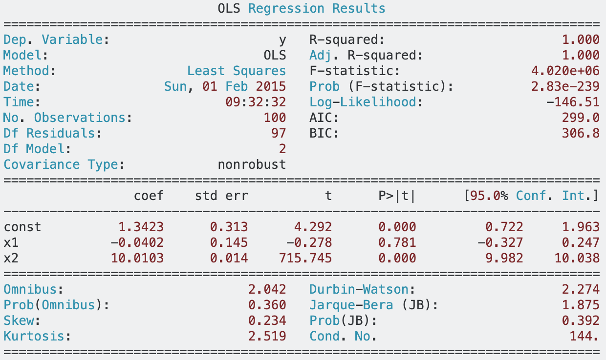
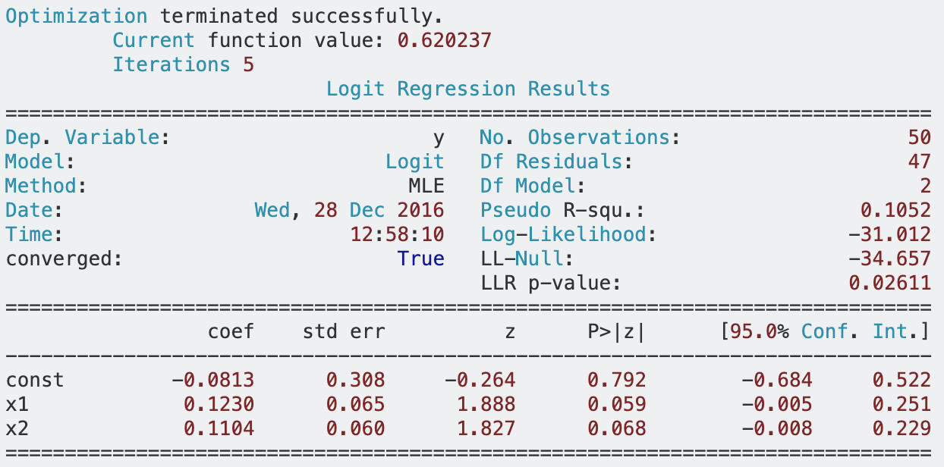
Interpreting Regression Output
OLS Regression Logistic Regression

Slide 69
Final Questions

Slide 70
Course Survey
Log in to the secure Non-Credit Student Portal at: http://scs.georgetown.edu/myscs/
Under Announcements in the middle of the page, click on Course Evaluations | Center for Continuing and Professional Education and then click on Complete Your Course Evaluation
Follow the prompts within the survey by selecting the course from the drop down menu and complete the evaluation.
I get to see these surveys. I would like feedback on the course. Especially since this is my first time teaching in this format, it would be very valuable to me to know what you felt the strengths and weaknesses have been.

Slide 71
Thank You
This has been a really enjoyable experience for me, I’ve always liked teaching but this has been my first time with a full class of adults and it’s been an absolute pleasure. You have been a very engaged, insightful, and intelligent cohort and I appreciate the opportunity to have been your instructor. I look forward to seeing your capstone presentations in June!

