Slide 1
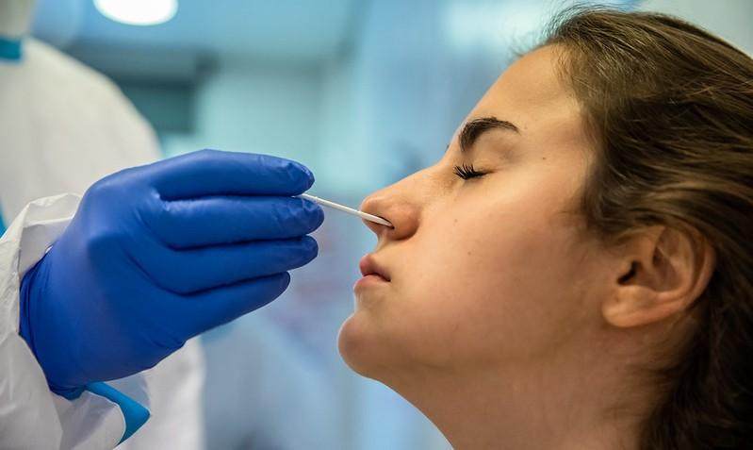
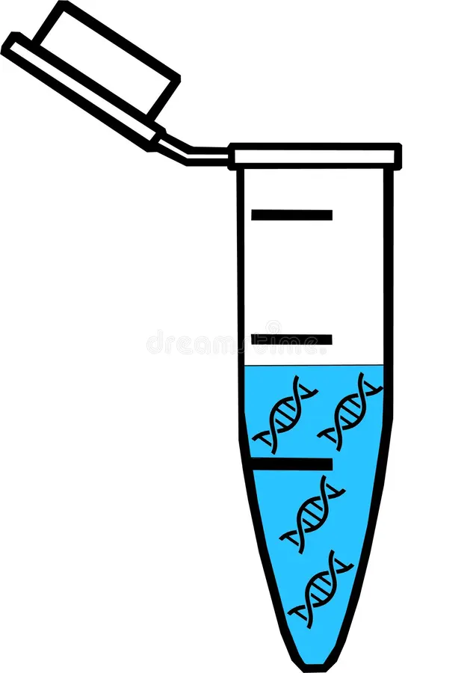

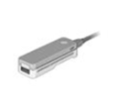
Patient Sample
Samples are PCR tested and
placed in a PCR tube
Sample is run through
Illumina
Sample is run through
Oxford nanopore
The sequencing produces a digital copy of the DNA sequence

Slide 2
Tokenize
Vectorize

Slide 3
Alpha
Alpha
Beta
Beta
Delta
Delta
Epsilon
Epsilon
Gamma
Gamma
Mu
Mu
Omicron
Omicron

Slide 4


One Substitution Mutation
(Hamming distance of 1)
3 Substitution Mutations
(Hamming distance of 3)

