Slide 1
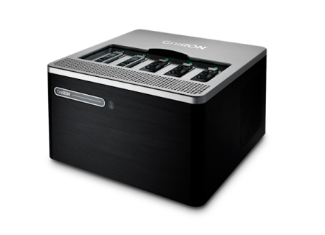
B
A
Filtering of Reads to ROI
Samtools
Alignment to Reference
Minimap2
PCR
WGS
C
D
Alleles separation based on length
Samtools and Awk
NO
Variant Calling Clair3
YES
F
E
Read
Correction/Assembly Canu
Phasing
Whatshap
G
H
Corrected Reads/Assembly
Postprocessing
In-house
VNTR Motifs Assembly
TRViz
J
Visual Representation of VNTR
In-house
I
QC and Detection of LoF Variants
In-house

