Slide 1
Eclipse Helper Installation
Jason Carter

Slide 2
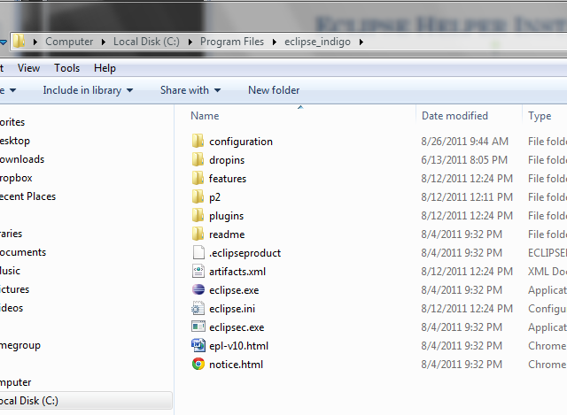
Eclipse Helper Installation
From the course website download the file named Eclipse Helper
Go to the folder you opened earlier called “eclipse”

Slide 3
Eclipse Helper Installation
Open the plugins folder

Slide 4
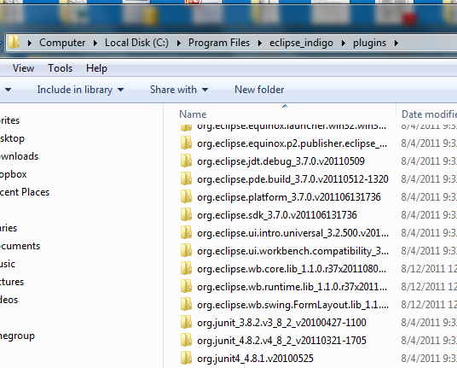
Eclipse Helper Installation
Plugin Folder should look like this

Slide 5
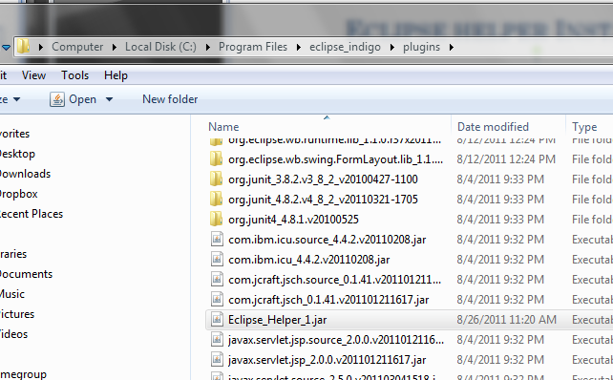
Eclipse helper Installation
Drag the file named Eclipse_Helper_1.jar into the plugin folder

Slide 6
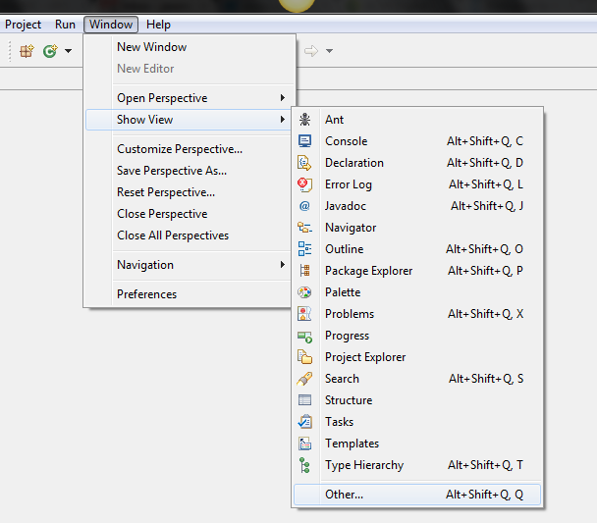
Eclipse helper – One Time Setup
To set up Eclipse Helper, restart Eclipse and Click on the “Window” Menu
Go to Show View
Click Other

Slide 7
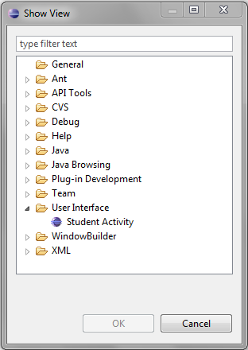
Eclipse helper – One Time Setup
A “Show View” window should pop up
Open the User Interface Folder
Double Click Student Activity

Slide 8
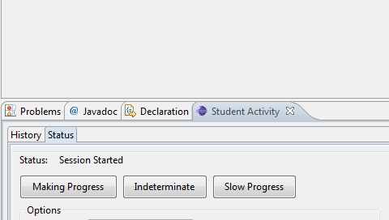
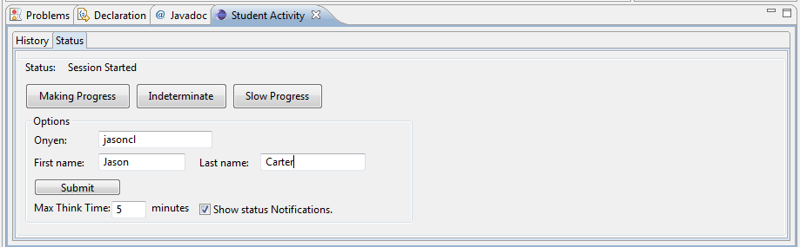
Eclipse Helper – One Time Setup
The Student Activity View should appear at the bottom of Eclipse
Click here and drag the window up until you see this view

Slide 9
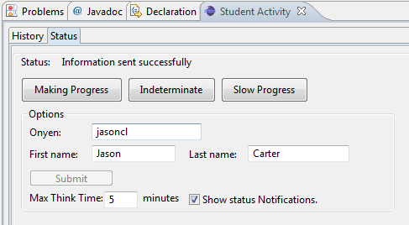
Eclipse Helper
Enter your:
onyen
First name
Last name
Press Submit
Should see a message that says “Information sent successfully"

