Slide 1
Neural Network Colliding with Material Model
He, Xuhong
Ao, Yuyi
Wu, Yuxing
Notes:
Good evening, all the distinguished professors. Now I’m going to start our demonstration about our project.

Slide 2
Project Overview
Predict the parameters of the materials
DATASET
TRAINING
Freq
Freq, Phase
TDTR Model
ML Model (NN)
NOISE
Phase
Coef1
Coef2
TDTR Physical Model:
Freq
$$Phase=TDTR_func(freq,phase,coef1,coef2,…)$$
Metal
Phase
Substrate
Notes:
Firstly, I’m going to introduce our project. The project focuses on predicting the parameters of a certain material, which is based on a physical experiment called TDTR model. A laser with a certain frequency is hit on a synthetic material and we will get the output phase. This process can be simulated as a function with many input parameters.
With frequencies and phases as dataset, we put them into the neural network and start training, finally we can get some of their coefficients.

Slide 3
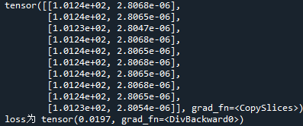
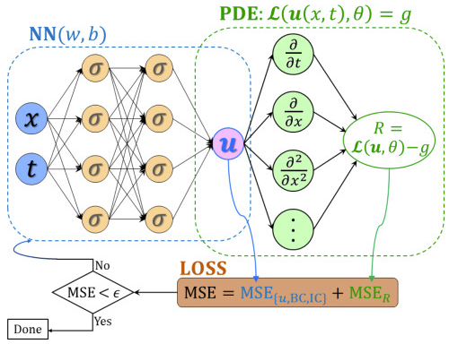
Project Outcome
Actual values: 1.00e02, 2.80e-06
1. Model Constructing
Physical Model -> Numpy ->Pytorch
2. Parameter Fitting
2 parameters
3. Practical Problem
Noise
Math problems (PDE)
Notes:
Here are some outcomes of our project.
First, we have transformed the original numpy code to Pytorch code. Therefore, we can use Pytorch to apply to this physical model. Therefore, we can make the physical experiment come true on our computers.
Second, we have finished the parameter fitting job, we can predict 2 parameters with accuracy. We have tried a series of adjustments like normalization, deepen the neural network. Finally, like what we can see in the right picture, the output of the network is very close to the actual values.
Third, we have thought some practical problems. Like noise, we try to simulate the noise and predict the parameters again. In order to do this, we use noises as new outputs of our neural network and predict them, too. Besides, we also found that this method can be used to get the solutions of some Partial Differential Equation.

Slide 4
Project Limitations
Noise
Undetermined
Generalization
More Materials (Multi-Dimensional)
Notes:
We also found that there are some limitations of our project.
In the first place, because the noise is undetermined, we cannot predict the parameters very well when the noise is big enough.
Besides, the generalization of predicting still needs to improve. Since we can just focus on one kind of material and use it data to train the network. If there are more materials that required measuring, the problem will be raised up to multi-dimension, which will require more work.

Slide 5
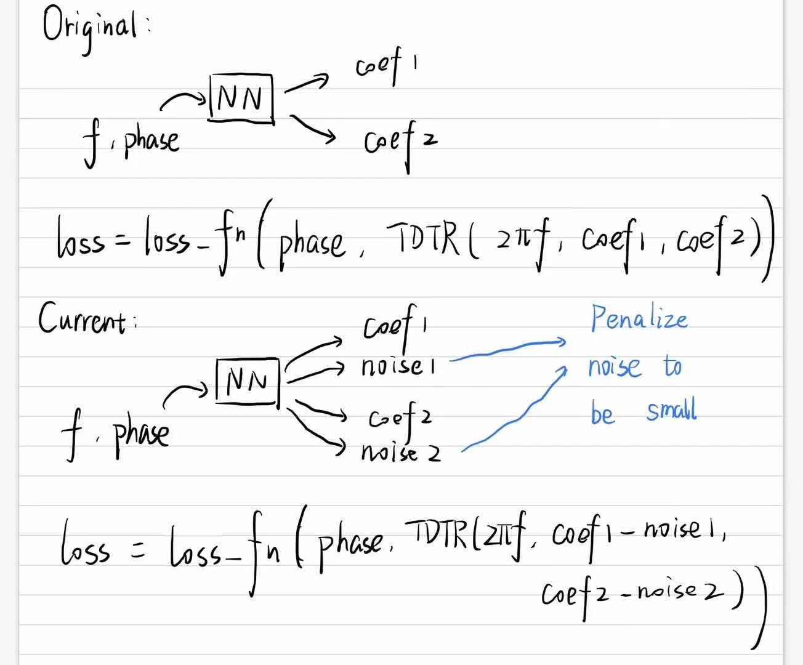
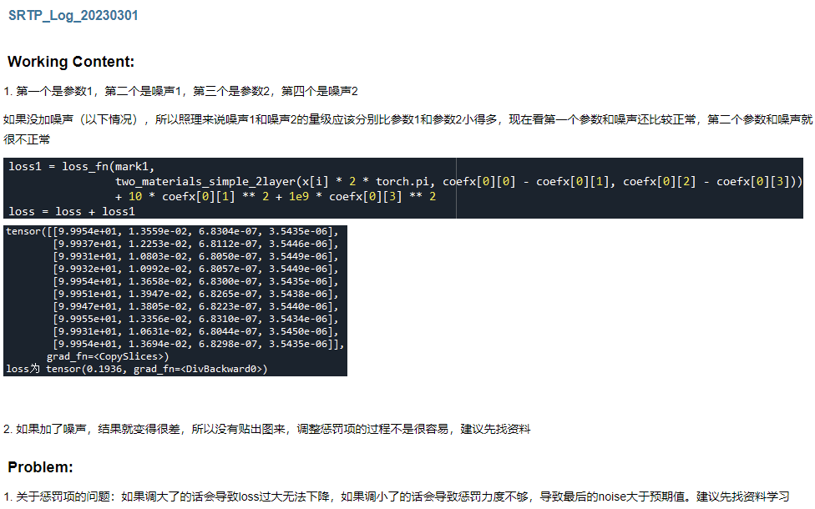
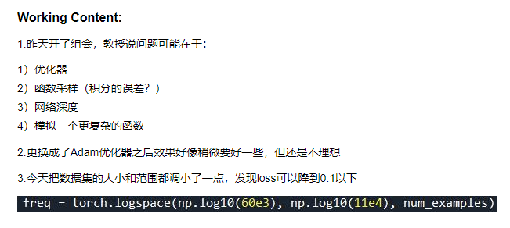
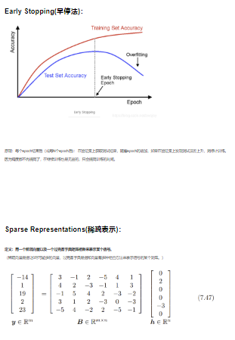
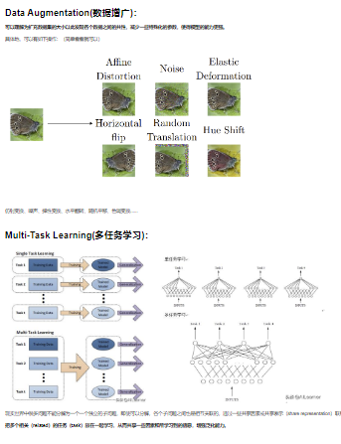
Project Gains
Weekly/Daily Record
Seminar
Self-study Group
Notes:
We have acquired a lot of skills during this meaningful project.
We record our process weekly or daily on the blog and write down some thoughts.
We attended some seminars given by seniors or professors and understood some cutting-edge knowledge.
We also joined the self-study group and communicate with other students to learn from each other, which helped us have a better understanding of machine learning.
Therefore, we have gained a lot in this project.

Slide 6
Thanks
Notes:
These are all ideas of our project demonstration, thanks for listening.

