Slide 1
4.15 SRTP
Xuhong He, Yuyi Ao, Yuxing Wu

Slide 2
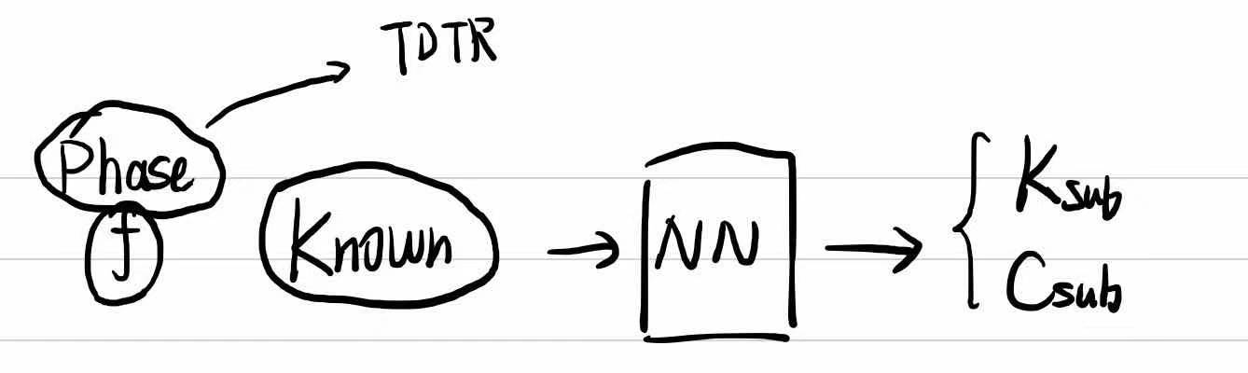
Current Progress
Purpose:
Experiment: The laser (frequency is controllable) is struck on the double-layer material and the phase value is received.
1. Fit: Meaning: Predict Properties (K, C, h)
Metal
Substrate

Slide 3
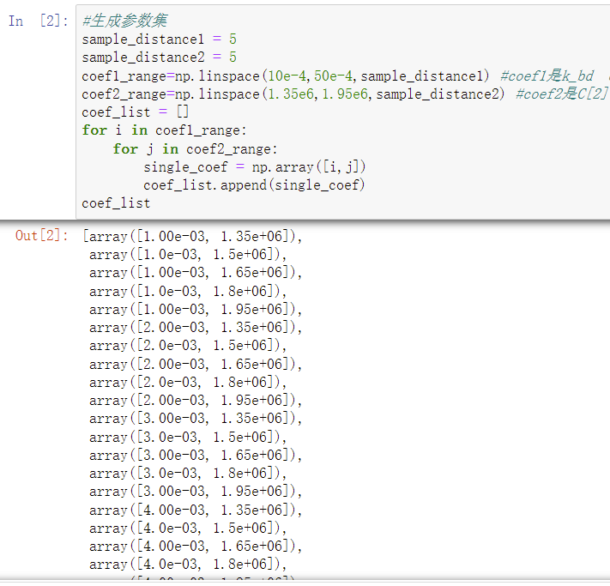
2. Noise
Idea: Find what combinations of parameters are most affected by noise
(1)Generate Parameters sets (select 2 parameters randomly)
f is also a set.

Slide 4
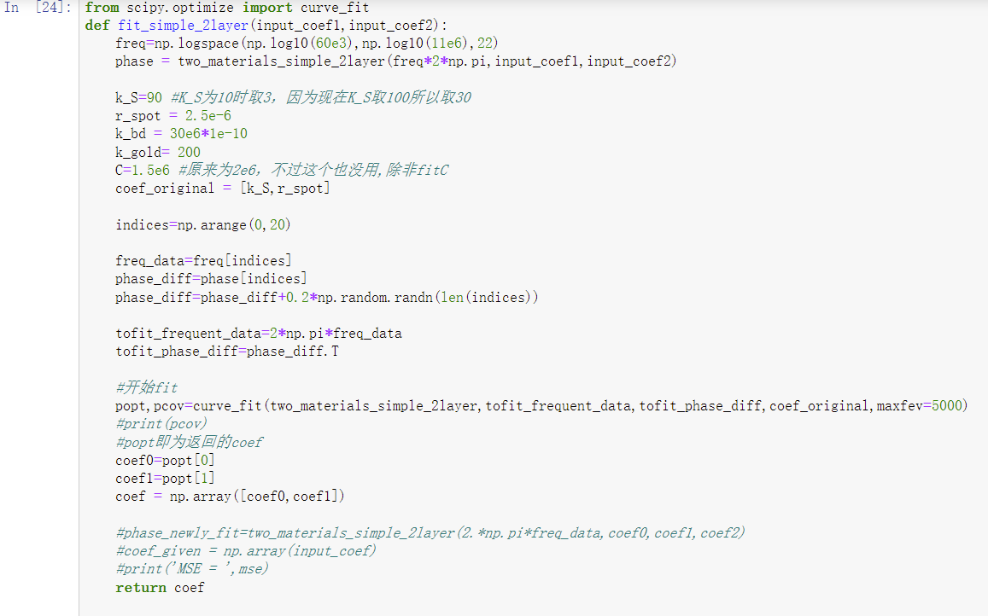


(2) Function for fitting
Determine 2 parameters randomly and get phase value.
(Already known, but to test whether the fitting outcome is good.)
Function: curve_fit()

Slide 5
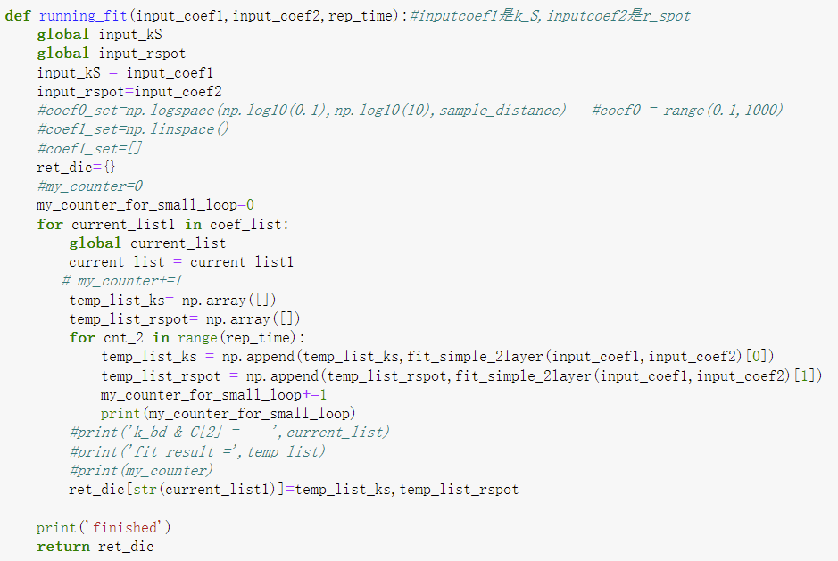
(3) Loop the Function:
Try every group of combination and test which combinations’ fitting are bad.

Slide 6
Summary & Plan for next week
Problem: Noise: fitting methods & parameters.
Start with fitting:
Try other methods and test whether it would be affected largely by the noise

Slide 7
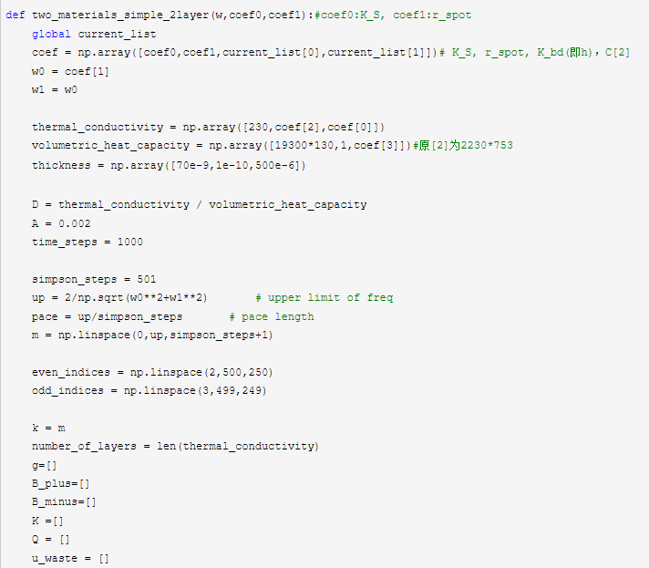
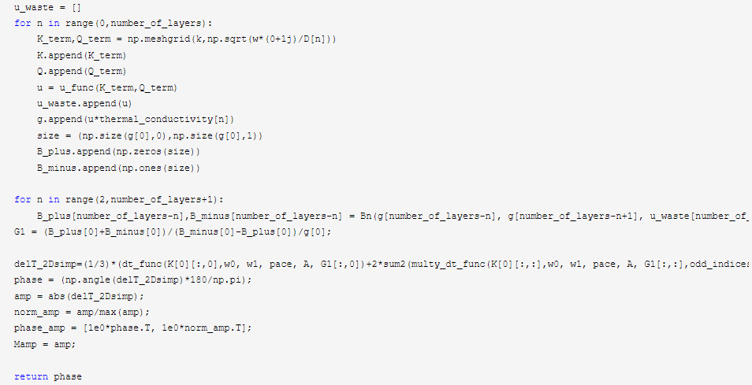

Slide 8
2 Determined Property Parameters
TDTR MODEL
FUNCTION
Phases
A Range of Frequencies
DATASET

Slide 9
…
…
…
2 INPUT NEURONS
(Dataset)
2 OUTPUT NEURONS (Predicted Parameters)
4 LAYERS OF 200 NEURONS

