Slide 1
4.22 SRTP
Xuhong He, Yuyi Ao, Yuxing Wu

Slide 2
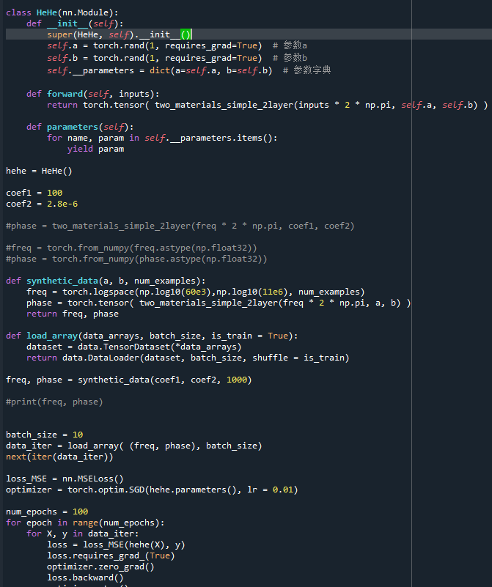
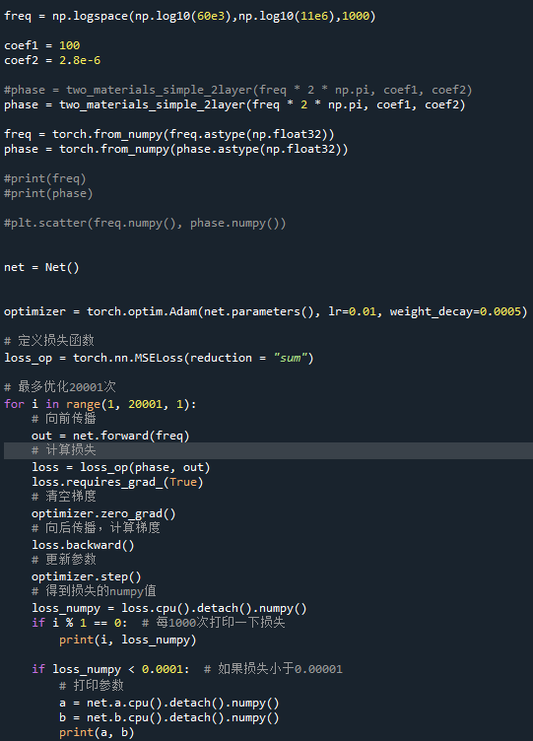
Current Progress
Try to use neural network to fit.
Problems:
Type
Speed
Match parameters

Slide 3
Plan for next week
1. Revise the code to combine model and neural network.
2. Essay: “Polynomial Fitting Algorithm Based on Neural Network”

