Slide 1
5.6 SRTP
Xuhong He, Yuyi Ao, Yuxing Wu

Slide 2
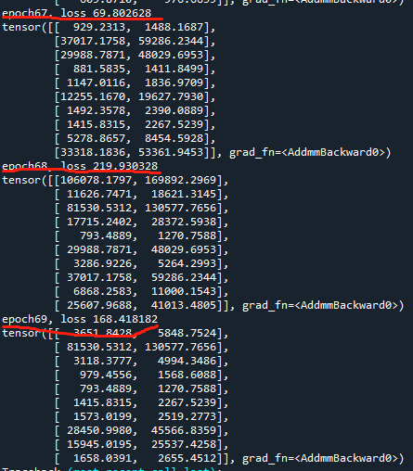
Current Progress
Frame of the NN
Problem:
The value of 2 neurons get closer
Loss didn’t change much
Speed

Slide 3
Plan for next week
Debug
Paper: “Polynomial Fitting Algorithm Based on Neural Network”

