Slide 1
6.10 SRTP
Xuhong He, Yuyi Ao, Yuxing Wu

Slide 2
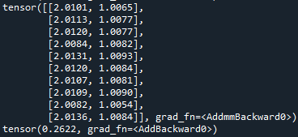
Current Progress
1. Test the network code with simple function.
2. Ask senior for the mathematical equation of the model.
3. Adjust the model to fit BP. (In progress)

Slide 3
Plan for next week
1. Adjust the model to fit BP.
2.

