Slide 1
Air Quality Index Analysis in Data Mining
CS699 Spring 2018
D. Hoogasian & Jung

Slide 2

1. Data mining goals
Our original dataset had difficult to understand measures of air quality
Our goal was to create an easy to understand class attribute to show if an area’s air quality is poor enough for people to make a note of
Goal was only to “flag” areas, more detailed research is needed if this is a serious concern
Would be good piece of information to include on real estate websites or on area statistics websites like city-data.com

Slide 3
2. Description of dataset
Annual summary of Air Quality Index (AQI) values for 2016, which are recordings of the levels of various hazardous airborne molecules (particulates)
1053 tuples – one for each county in America
Made available by EPA through their AQS Data Mart database
Datasets going back to 1990

Slide 4

2. Description of dataset
First 3 attributes (A-C) are state, county and year, respectively
4th attribute (D) is the number of days the AQI was recorded
5th through 10th attribute (E-J) represent the number of days falling under the specified classification representing the overall level of air quality

Slide 5

2. Description of dataset
11th through 13th attribute (K-M) are statistics on the overall AQI measurement
14th through 17th attribute (N-Q) are the number of days where levels of the particulate exceeded some threshold
18th and 19th attribute (R & S) similarly each represent a group of like sized particulates

Slide 6
3. Tools and algorithms used - 4 attribute selection algorithms
Correlation attribute evaluator – uses correlation coefficient between the numeric attribute and class attribute to assign weights for all attributes
Information gain attribute evaluator – uses logarithmic functions to quantify the information needed to classify a given tuple, according to which attributes are being considered
Gain ratio attribute evaluator - takes information gain of an attribute and weighs it against the number of values for that attribute
ReliefF attribute evaluator - samples tuples and looks at the k-nearest instances to quantify the worth of an attribute
Lastly we used a set selected by ourselves, based on which attributes had the overall highest relative weights

Slide 7
3. Tools and algorithms used - 6 classification algorithms
Naïve Bayes - use Bayes Theorem and probabilistic prediction
Random forest tree ensemble - uses a variety of decision tree algorithms to create more accurate classifications
J48 tree - based on the C4.5 tree algorithm
OneR rule – makes decisions based off whichever attribute has the lowest error rate
IBK - uses a k-nearest neighbor type algorithm
Logistic function – polynomial logistic regression model

Slide 8
4. Data mining procedure
∙ We downloaded the data from EPA https://aqs.epa.gov/aqsweb/airdata/download_files.html.
∙ Data preprocessing
For making the class attribute we follow this steps.
Give 1 points if a value is more than average for each attributes.
Make row sums and define bad air quality proportion.
Set 25% of row sum attribute as a bad air quality
Create class attribute and this step’s also used for testing 2017 data sets.

Slide 9
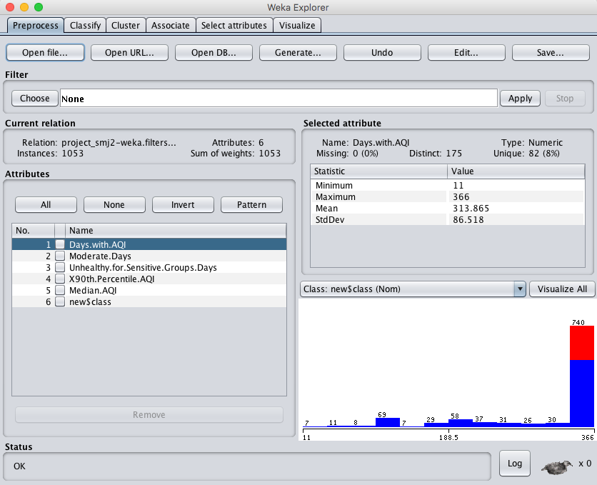
4. Data mining procedure
After preprocessing we saved the data as csv file and read it into Weka
Then ran 4 attribute selection algorithms, saved files with these selections, then ran 6 different classifiers on each set

Slide 10
∙ Attribute selection
Attribute Evaluator | Search Method | Selected attributes | Total number
CorrelationAttributeEval | Ranker | 0.6371 3 Moderate.Days 0.5108 9 X90th.Percentile.AQI 0.434 10 Median.AQI 0.4071 4 Unhealthy.for.Sensitive.Groups.Days 0.3291 1 Days.with.AQI | 5
GainRationAttributeEval | Ranker | 0.1955 3 Moderate.Days 0.1944 6 Very.Unhealthy.Days 0.1882 9 X90th.Percentile.AQI 0.1878 5 Unhealthy.Days | 4
InfoGainAttributeEval | Ranker | 0.3746 3 Moderate.Days 0.306 9 X90th.Percentile.AQI 0.2879 4 Unhealthy.for.Sensitive.Groups.Days 0.2642 8 Max.AQI | 4
ReliefFAttributeEval | Ranker | 0.129451 1 Days.with.AQI 0.120633 2 Good.Days 0.092016 15 Days.PM2.5 0.085883 13 Days.Ozone 0.067579 3 Moderate.Days | 5
Personally Selected Attributes | N/A | 1 Days.with.AQI 2 Good.Days 3 Moderate.Days 4 Unhealthy.for.Sensitive.Groups.Days 13 Days.Ozone | 5

Slide 11
5. Data mining result & evaluation

Slide 12
CorrelationAttributeEval
Selected Attributes; 1 Days.with.AQI, 3 Moderate.Days, 4 Unhealthy.for.Sensitive.Groups.Days, 9 X90th.Percentile.AQI, 10 Median.AQI,
Classifier | Accuracy | TP rate | FP rate | AUC(ROC) | Time taken to build model
Naïve Bayes | 87.84 | 0.908 | 0.217 | 0.944 | 0.02 seconds
RandomForest | 91.83 | 0.953 | 0.193 | 0.965 | 0.5 seconds
J48 | 92.59 | 0.965 | 0.201 | 0.928 | 0.08 seconds
OneR | 83.67 | 0.907 | 0.390 | 0.759 | 0.01 seconds
IBK | 88.60 | 0.924 | 0.237 | 0.847 | 0 seconds
Logistic | 90.31 | 0.958 | 0.273 | 0.957 | 0.07 seconds

Slide 13
GainRatioAttributeEval
Selected Attributes; 3 Moderate.Days, 5 Unhealthy.Days, 6 Very.Unhealthy.Days, 9 X90th.Percentile.AQI
Classifier | Accuracy | TP rate | FP rate | AUC(ROC) | Time taken to build model
Naïve Bayes | 83.10 | 0.965 | 0.602 | 0.909 | 0 seconds
RandomForest | 84.81 | 0.910 | 0.353 | 0.922 | 0.31 seconds
J48 | 86.32 | 0.874 | 0.173 | 0.907 | 0.01 seconds
OneR | 83.67 | 0.907 | 0.390 | 0.759 | 0 seconds
IBK | 84.24 | 0.917 | 0.398 | 0.809 | 0 seconds
Logistic | 84.52 | 0.935 | 0.446 | 0.925 | 0.02 seconds

Slide 14
InfoGainAttributeEval
Selected Attributes; 3 Moderate.Days, 4 Unhealthy.for.Sensitive.Groups.Days, 8 Max.AQI, 9 X90th.Percentile.AQI
Classifier | Accuracy | TP rate | FP rate | AUC(ROC) | Time taken to build model
Naïve Bayes | 83.57 | 0.964 | 0.578 | 0.916 | 0 seconds
RandomForest | 89.74 | 0.927 | 0.197 | 0.950 | .028 seconds
J48 | 91.64 | 0.933 | 0.137 | 0.914 | 0.01 seconds
OneR | 83.67 | 0.907 | 0.390 | 0.759 | 0 seconds
IBK | 87.27 | 0.922 | 0.285 | 0.817 | 0 seconds
Logistic | 86.23 | 0.939 | 0.386 | 0.940 | 0.02 seconds

Slide 15
ReliefFAttributeEval
Selected Attributes; 1 Days.with.AQI, 2 Good.Days, 3 Moderate.Days, 13 Days.Ozone, 15 Days.PM2.5
Classifier | Accuracy | TP rate | FP rate | AUC(ROC) | Time taken to build model
Naïve Bayes | 79.58 | 0.750 | 0.056 | 0.927 | 0 seconds
RandomForest | 89.74 | 0.935 | 0.225 | 0.953 | 0.17 seconds
J48 | 89.55 | 0.932 | 0.221 | 0.901 | 0.01 seconds
OneR | 83.67 | 0.907 | 0.390 | 0.759 | 0 seconds
IBK | 86.32 | 0.913 | 0.297 | 0.821 | 0 seconds
Logistic | 89.93 | 0.958 | 0.289 | 0.957 | 0.02 seconds

Slide 16
Personally Selected Attributes
Selected Attributes; 1 Days.with.AQI, 2 Good.Days, 3 Moderate.Days, 4 Unhealthy.for.Sensitive.Groups.Days, 13 Days.Ozone
Classifier | Accuracy | TP rate | FP rate | AUC(ROC) | Time taken to build model
Naïve Bayes | 88.13 | 0.892 | 0.153 | 0.944 | 0 seconds
RandomForest | 91.55 | 0.945 | 0.181 | 0.965 | 0.17 seconds
J48 | 92.88 | 0.961 | 0.177 | 0.928 | 0.01 seconds
OneR | 83.67 | 0.907 | 0.390 | 0.759 | 0 seconds
IBK | 85.57 | 0.907 | 0.309 | 0.813 | 0 seconds
Logistic | 89.46 | 0.958 | 0.309 | 0.960 | 0.02 seconds

Slide 17
5. Data mining result and evaluation
Best algorithm
Chose Random Forest and J48 as the top two algorithms with personal selection sets.
Random Forest with personal selection sets and correlation attribute evaluator shows the best AUC.
J48 with personal selection sets shows the best accuracy.

Slide 18
6. Application
We applied these two models (J48 and Random Forest) built from the 2016 dataset on the 2017 dataset. The two models performed more than 90% accuracy. J48 performed better than Random Forest in both ways.
We ran R to predict 2017 result using 2016 model.

Slide 19
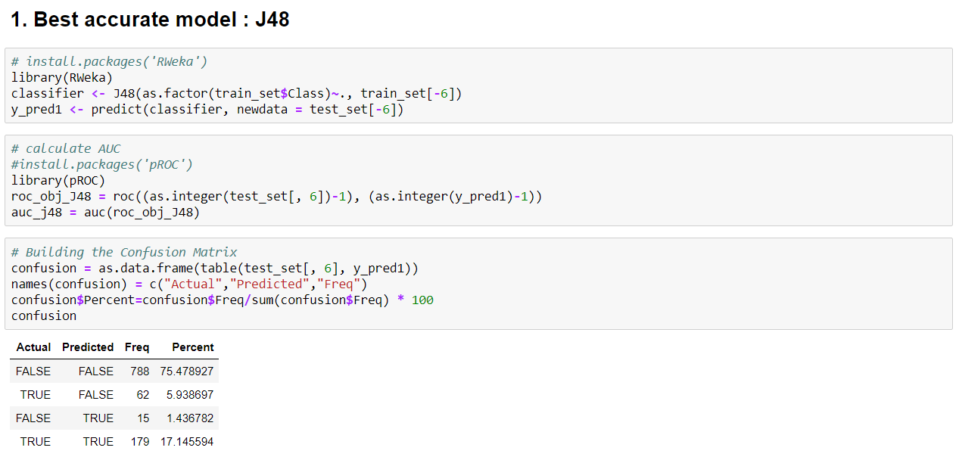

Slide 20
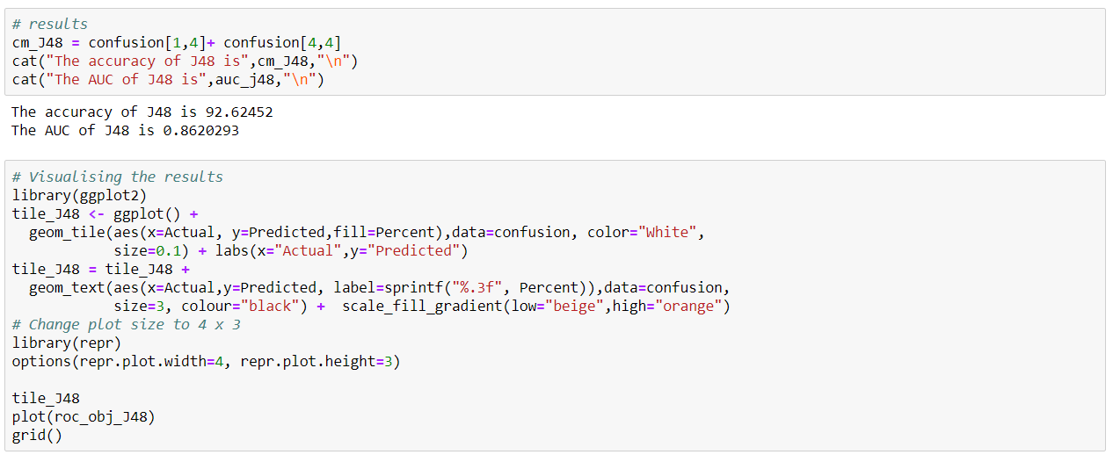

Slide 21
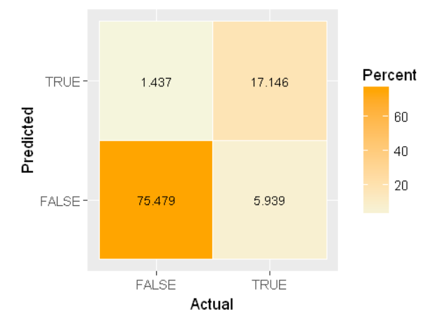
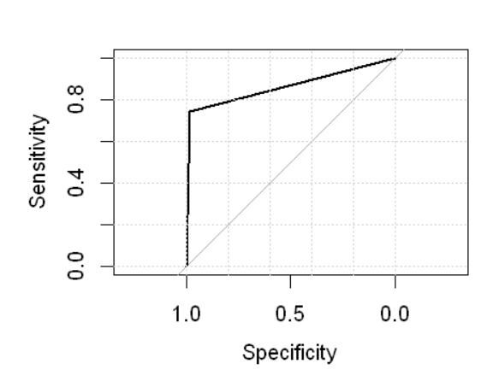

Slide 22
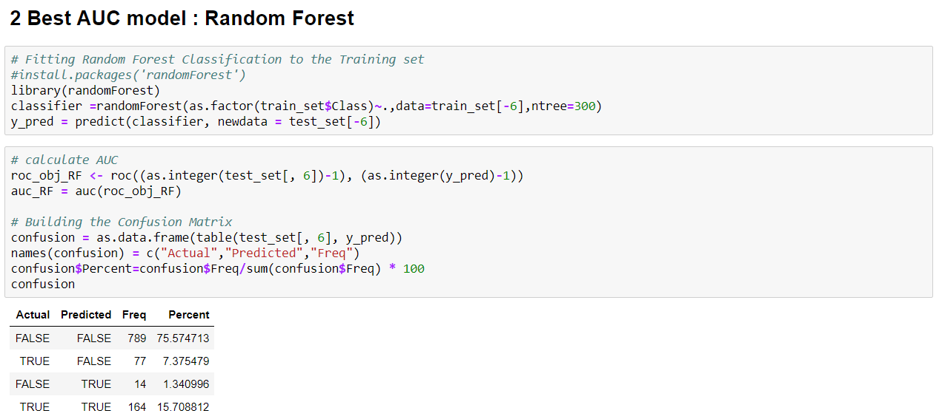

Slide 23
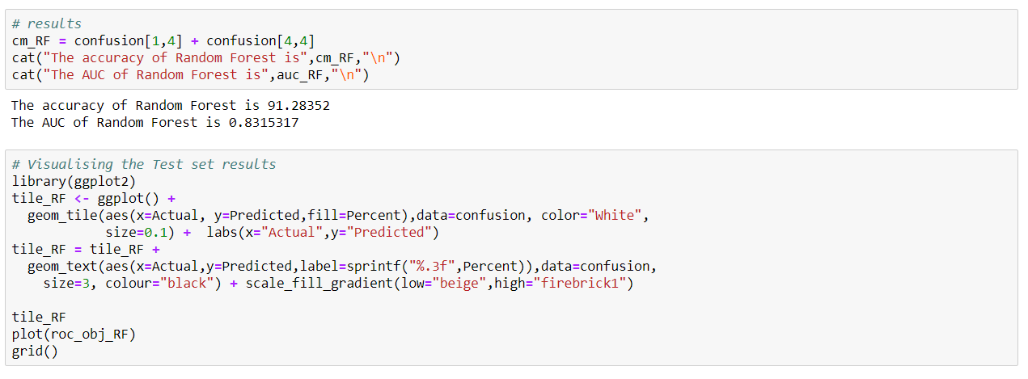

Slide 24
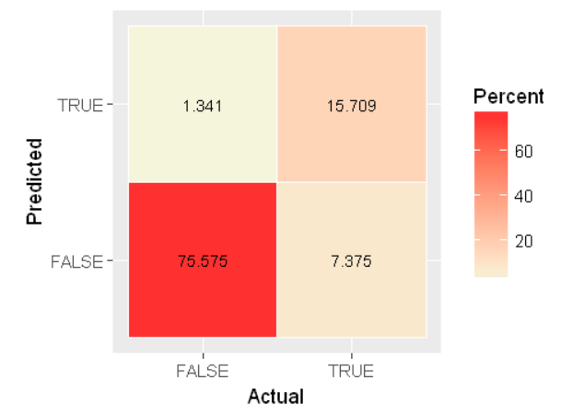
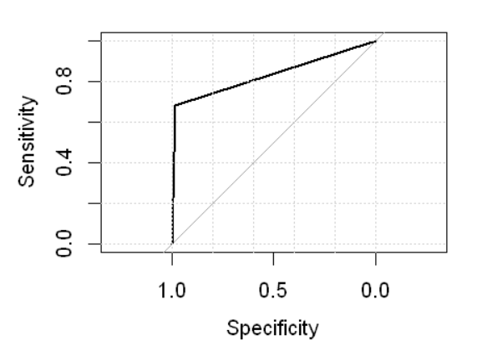

Slide 25
7. Discussion and conclusion
∙ We can successfully create a useful set of data classifications. With our dataset, further research would be needed to make a fully informed decision where to not live if air quality is a concern. Our results simply flag areas of concern.
∙ From this project we learned how to complete the whole procedure of taking a dataset, creating class attributes, selecting efficient sets of attributes, running data mining classification algorithms, comparing quantified classification performance measures and choosing a top classifier to use on new datasets.
∙ We went a step farther and actually applied it to a dataset from a different year. We found the pattern using data mining and proved our model is accurate. We can predict any place in any year using our model.

