Slide 1


Prime Partners Engineering
Dylan Tam, Ryan Chng,
Dorian Houssou, Erik Geibler
Historical Engineer of Choice Performance
April 15, 2024
Notes:
https://www.vaughn.edu/wp-content/uploads/2021/01/Mechanical-Engineering-Jobs_Feature.jpg
Hello, today we will be discussing the system analysis phase report of Prime Partners Engineering, a small business electrical engineering contracting company based in DC. Before we officially begin, let me introduce the team

Slide 2
Mission
To improve the efficiency of PPE’s current system of assessing and assigning an Engineer of Choice to construct work on projects. We aim to provide our clients with the best service possible by assigning them engineers who fit each project to ensure quality results. This system will allow our company to push innovative and sustainable solutions to complex engineering endeavors while maintaining satisfaction between clients and staff.
Notes:
erik

Slide 3
Mission Objectives:
What is the number of jobs each Engineer is assigned to?
What is the proportion of jobs that are completed vs canceled for each Engineer?
For job types, which Engineer has the highest completion/success rate?
What is the average number of jobs an Engineer is assigned to?
For each manager, how many projects took no more than six months to complete?
Which manager has the highest overall completion/success rate?
What is the most common project type worked on?
Notes:
erik

Slide 4
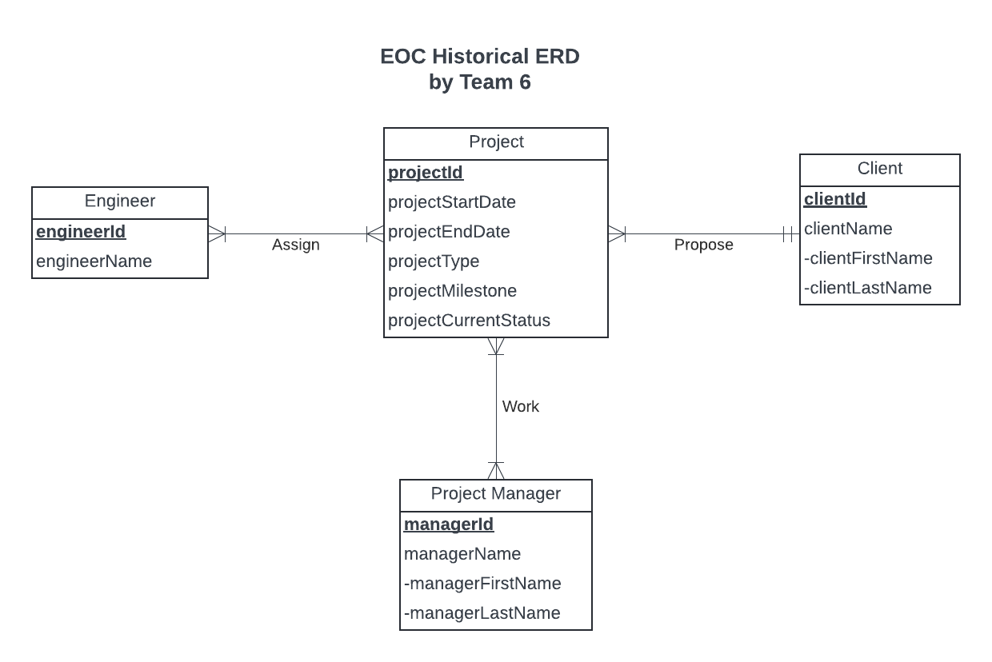
Conceptual Database Design
Notes:
Dorian
Many engineer can be assigned on many projects (changed to many to many)
One Client can propose many projects
One Project manager can work on project and many project can have many project manager

Slide 5
Logical Database Design
ProjectManager (managerId, managerFirstName, managerLastName)
Client (clientId, clientFirstName, clientLastName)
Project (projectId, projectStartDate, projectEndDate, projectType, projectMilestone, projectCurrentStatus, clientId)
Work(managerId, projectId)
Engineer (engineerId, engineerFirstName, engineerLastName)
Assign(engineerId, projectId)
Notes:
Ryan - entities to relation, as well as assign and work, split composite attributes

Slide 6
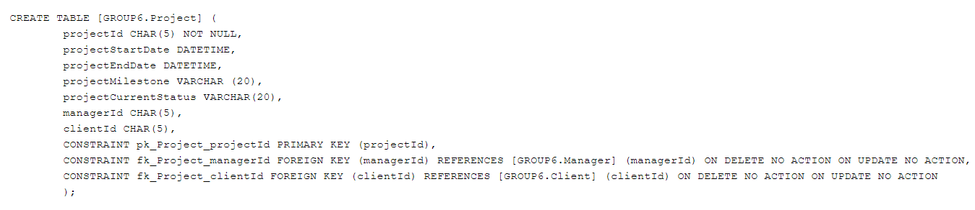
Physical Database Design
Notes:
Dylan
This is the create table for our Project entity. ProjectId is the primary key, with other attributes like project start date, end date which have datetime data type, and project milestone and project current status which have varchar data type. We have the constraint functions to specify the primary and foreign keys, as well as ensuring that on delete and on update, there is no action as we want to maintain the historical integrity of the database.

Slide 7

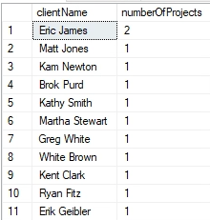
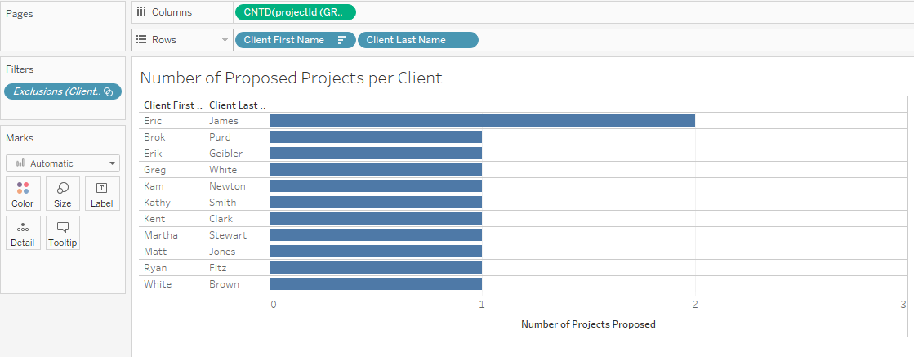
Application 1
Which clients had the most projects proposed?
Notes:
erik

Slide 8

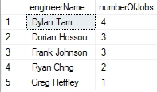
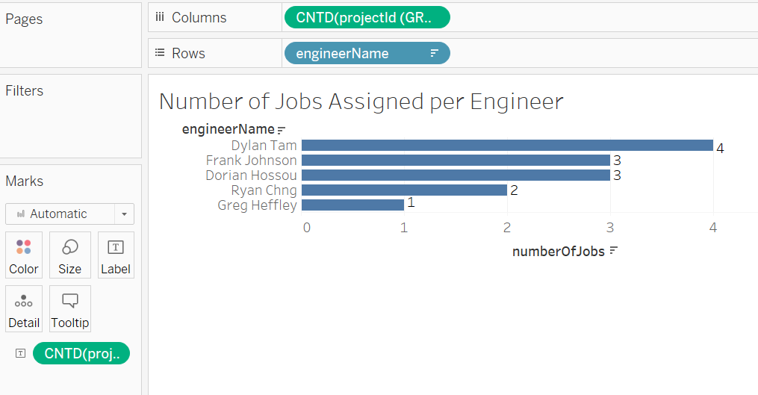
Application 2
What is the number of unique jobs an Engineer is assigned to?
Notes:
Dylan - Here we are looking for the number of unique jobs that an Engineer (EOC) is assigned to. With our select statement, we decided to retrieve the engineer’s name, ensuring that engineering ID from the engineering table and engineering ID from the assign table are equal, and the Project IDs from the assign table are equal to the project IDs in the project table. As we learned earlier last week, if we did not group by, we would have gotten the error, saying that engineer name cannot be grouped due to not being an aggregate function. Here is the SQL output and the Tableau table.

Slide 9
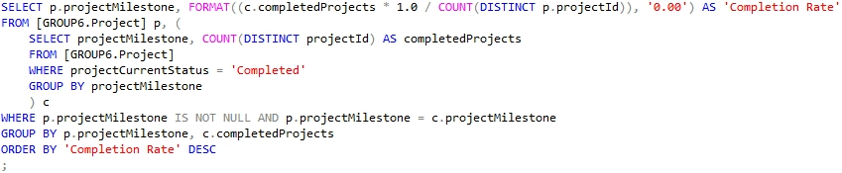
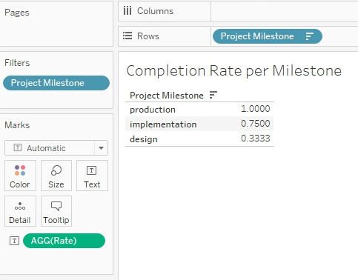

Application 3
For job milestones, which had the highest completion/success rate?
Notes:
Ryan - subquery

Slide 10
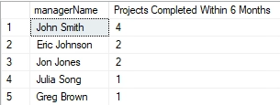
Application 4
For each manager, how many projects took no more than six months to complete?
Notes:
Dylan and Dorian
This query combines the first and last names of the managers to create a full name and makes then manger name
Does a distinct count of projects to remove duplicates
manager's ID matches the manager's ID in the Work table’
DATEDIFF function to filter only those projects where the difference between the project's start and end dates is six months or less.
The GROUP BY clause groups the results by each unique manager,Finally, the results are sorted in descending order based on the number of projects completed within six months.

Slide 11

Application 5
What is the average project duration per job type?
Notes:
Dylan and Dorian
This query combines the first and last names of the managers to create a full name and makes then manger name
Does a distinct count of projects to remove duplicates
manager's ID matches the manager's ID in the Work table’
DATEDIFF function to filter only those projects where the difference between the project's start and end dates is six months or less.
The GROUP BY clause groups the results by each unique manager,Finally, the results are sorted in descending order based on the number of projects completed within six months.

Slide 12
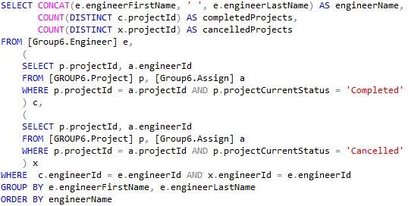
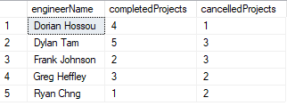
Application 6
What is the proportion of jobs that are completed vs canceled for each Engineer?
Notes:
Dylan and Dorian
This query combines the first and last names of the managers to create a full name and makes then manger name
Does a distinct count of projects to remove duplicates
manager's ID matches the manager's ID in the Work table’
DATEDIFF function to filter only those projects where the difference between the project's start and end dates is six months or less.
The GROUP BY clause groups the results by each unique manager,Finally, the results are sorted in descending order based on the number of projects completed within six months.

