Slide 1
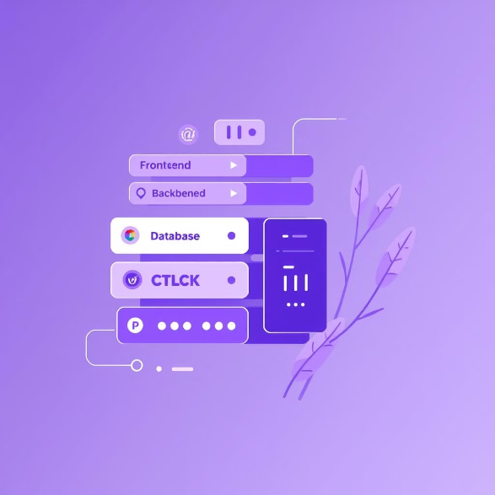
Tech Stack
Frontend: HTML, CSS, JavaScript - for a dynamic user interface.
Backend: Node.js, Express.js - handles server-side logic.
Database: MongoDB Atlas - a scalable cloud database.
Authentication: JWT - ensures secure user authentication.
Tools & Libraries: Firebase, Nodemon, bcrypt.js, CORS - supporting development and security.

