Slide 1
Introduction to workflows
Akshay Krishna Ammothum Kandy
IR, Sorbonne University
Notes:
Hello, In this session we introduce workfows and their general concepts and application.

Slide 2
Outline
Understand workflow fundamentals
Survey established workflow management systems
Hands-on AiiDA workflow on google colab.

Slide 3
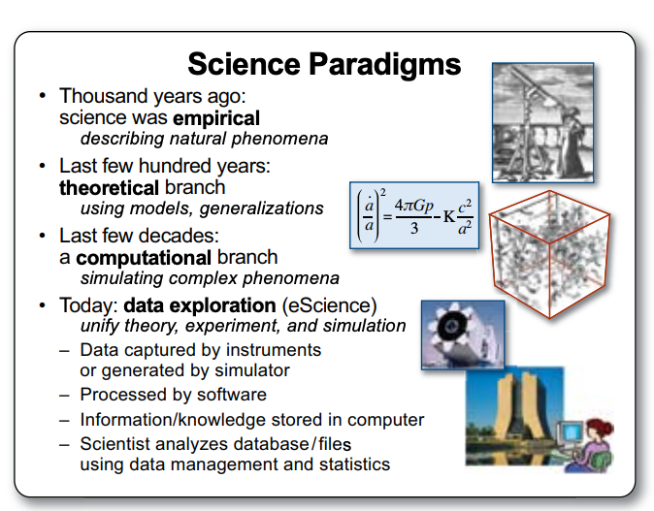
Introduction
Fourth paradigm is using the computational power to generate, curate, analyze, archive massive amounts of scientific data
Notes:
Science has evolved from observation, to theory, to computational simulation, and now to data-intensive research. Modern research combines all of these paradigms and generates increasingly complex computational processes and large amounts of data. This complexity is one of the main reasons we need scientific workflow management systems.

Slide 4
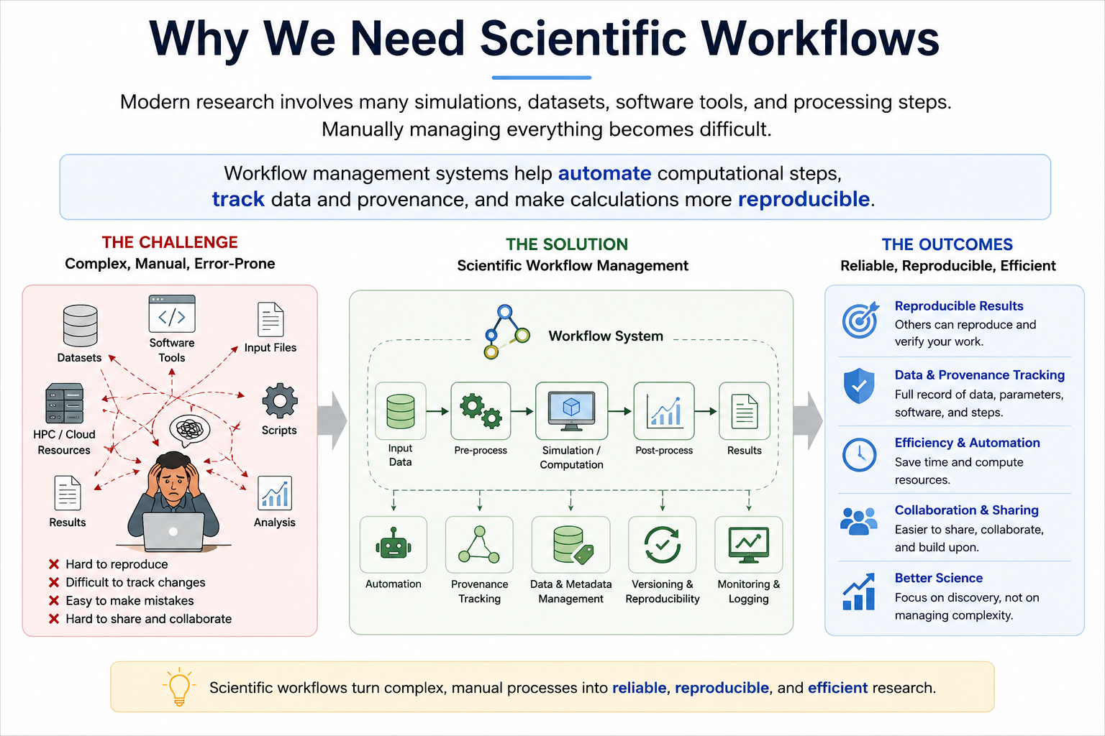
Introduction
Modern scientific research involves
many simulations,
datasets,
software tools
processing steps
Manually managing everything becomes difficult.
Notes:
Science has evolved from observation, to theory, to computational simulation, and now to data-intensive research. Modern research combines all of these paradigms and generates increasingly complex computational processes and large amounts of data. This complexity is one of the main reasons we need scientific workflow management systems.

Slide 5
Introduction
Notes:
Science has evolved from observation, to theory, to computational simulation, and now to data-intensive research. Modern research combines all of these paradigms and generates increasingly complex computational processes and large amounts of data. This complexity is one of the main reasons we need scientific workflow management systems.

Slide 6
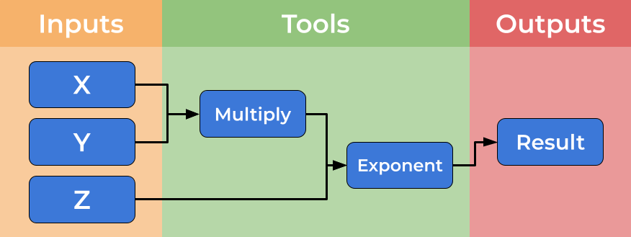
What is a workflow?
Computational workflows explicitly create a divide between a user’s dataflow and the computational details which underpin the chain of tools, placing these elements in separate files

Slide 7
What is a workflow?
Control flow: Dictate the sequence in which steps are executed ( Analogous to traffic lights & intersections)
Data flow: what moves between steps (eg: files, data) ( Analogous to cars )

Slide 8
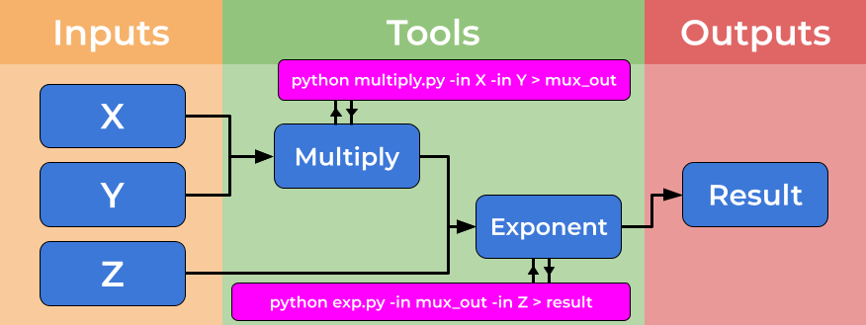
What is a workflow?
Abstraction: components can be thought of as black boxes

Slide 9
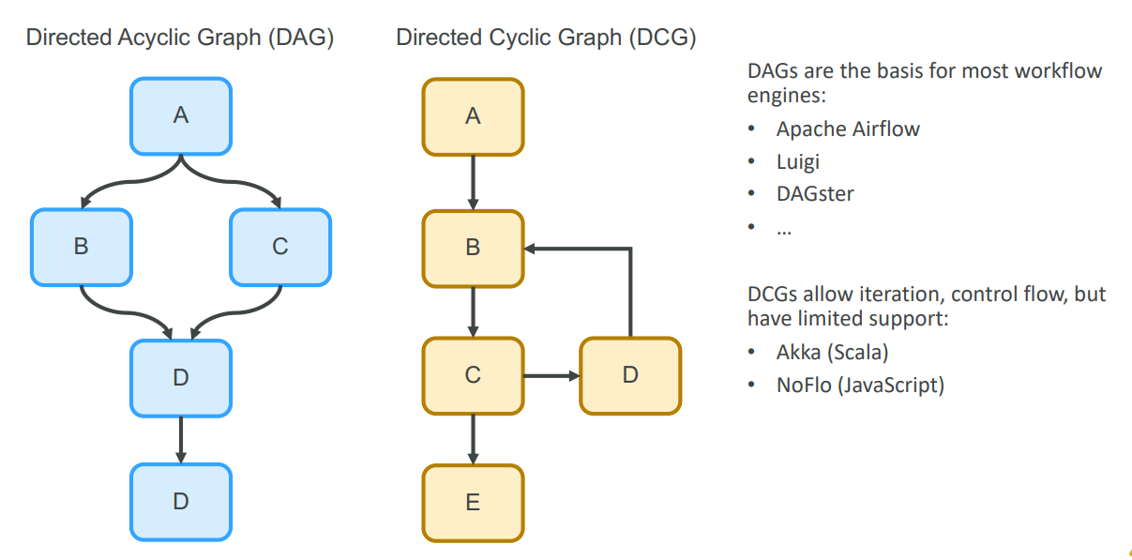
Complex workflows

Slide 10
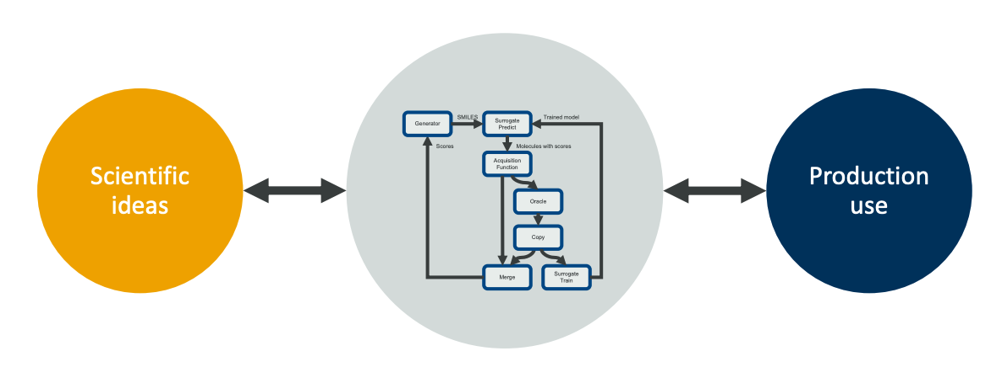
What are workflow managers?
Workflow managers are a tool for abstraction!
you write “what” to run; the system handles “how/where/when”
https://ai-dd.eu/sites/default/files/slides/Thomas_Loehr-maize-talk.pdf

Slide 11
What are workflow managers?
relax → phonons → DOS over ~200 structures, with automatic plane-wave cutoff convergence
https://ai-dd.eu/sites/default/files/slides/Thomas_Loehr-maize-talk.pdf

Slide 12
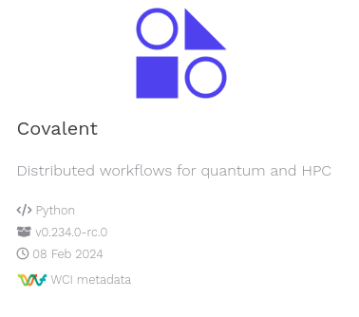
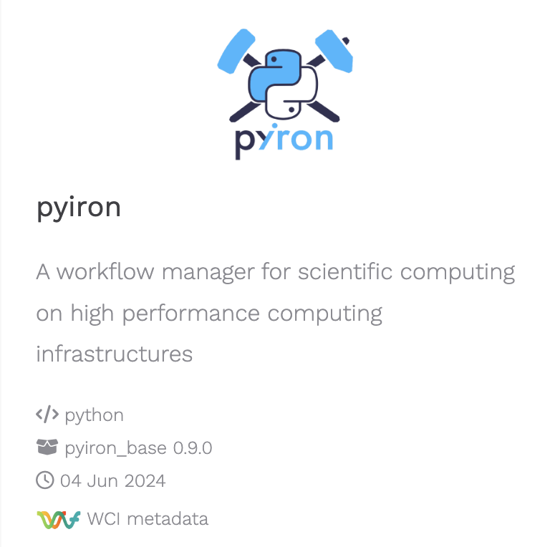
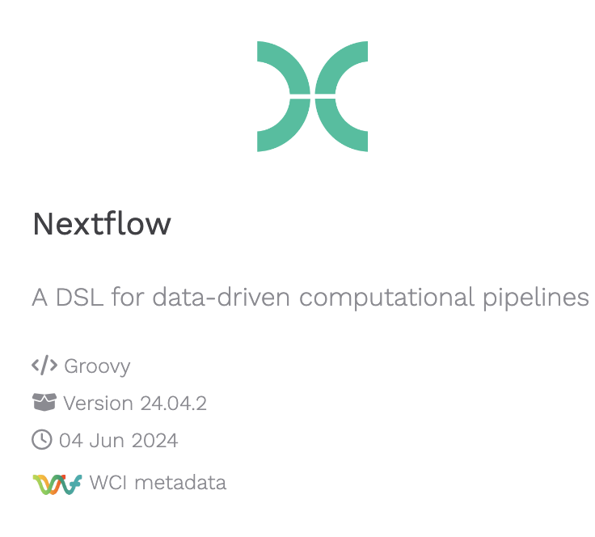
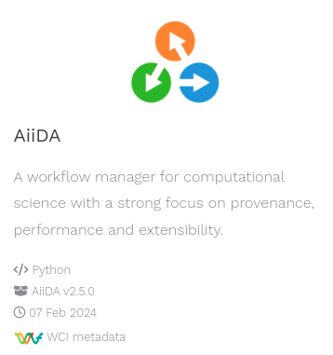
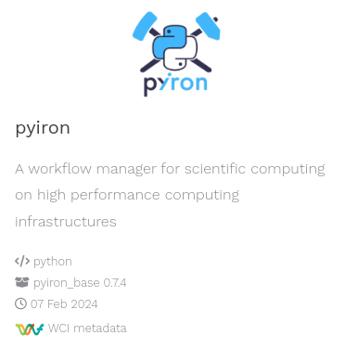
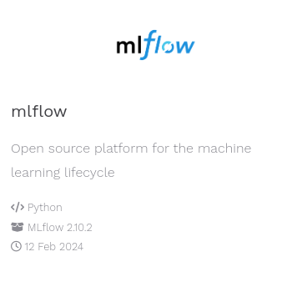
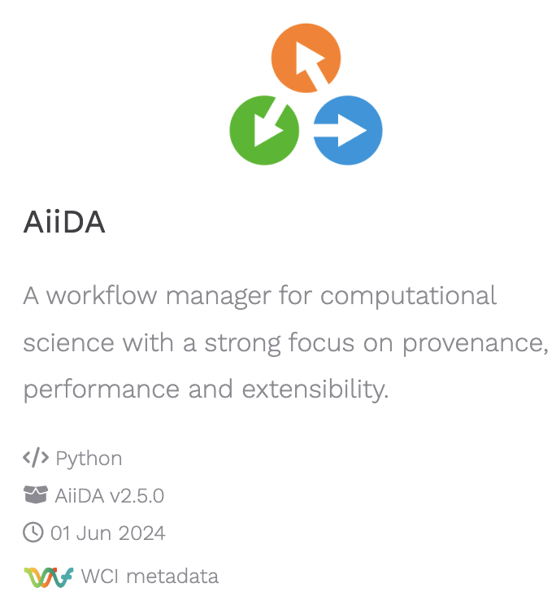
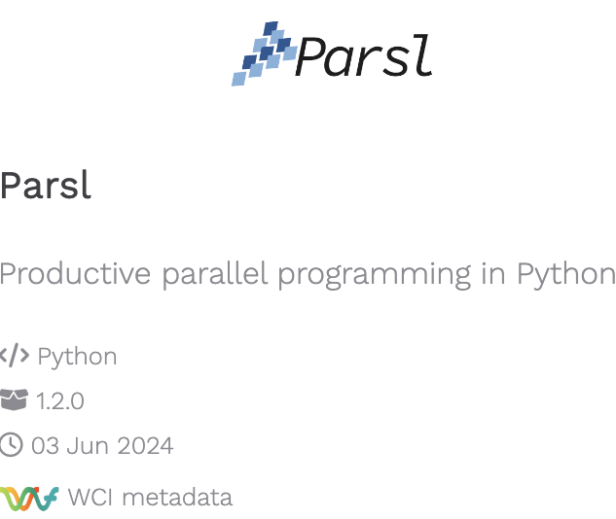
Commonly used workflow managers
100+ workflow managers available…

Slide 13
Why not use python or bash scripts?
• Reproducibility – not just for others
• Configuration – no searching through shell history for used parameters
• Modularization – easily exchange components to make experiments easier
• Automation – easier to integrate into routine systems
• Abstraction – components can be thought of as black boxes
• Performance – some workflows allow parallelization
https://ai-dd.eu/sites/default/files/slides/Thomas_Loehr-maize-talk.pdf

Slide 14
Introduction to AiiDA: automated interactive infrastructure and database for computational science
Part 2

Slide 15
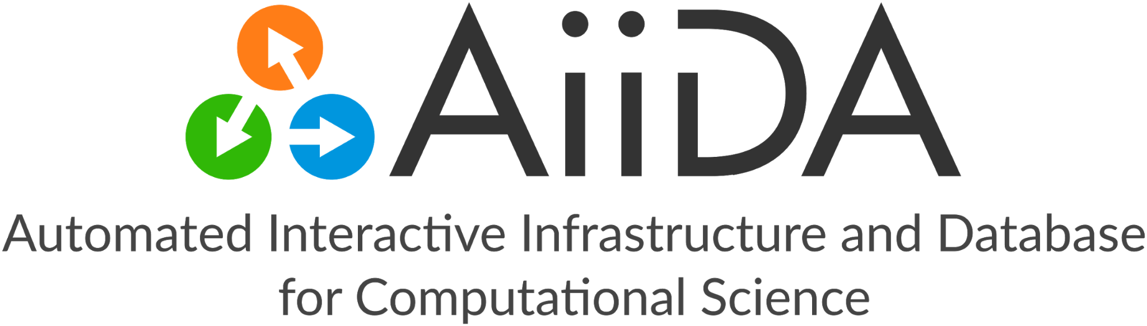
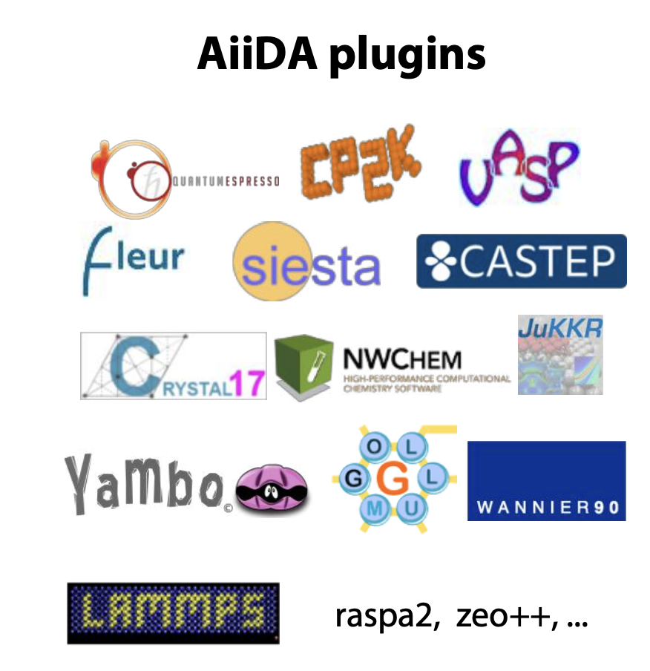
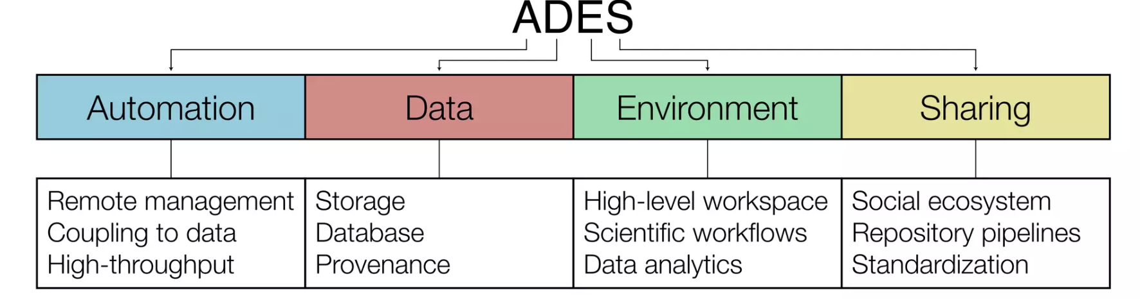
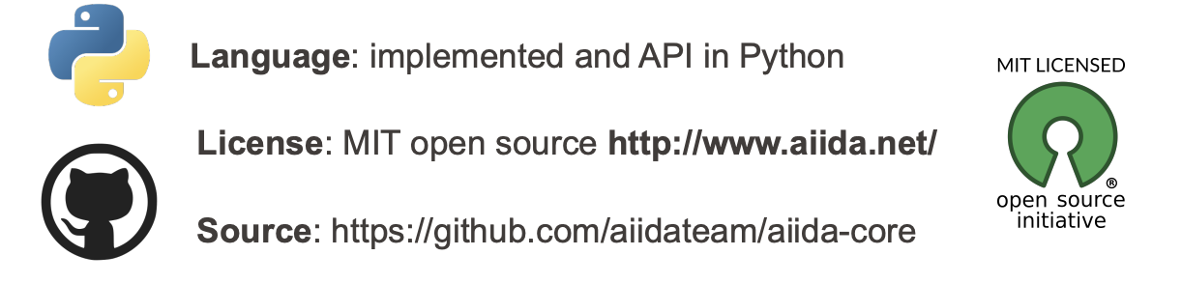

Slide 16
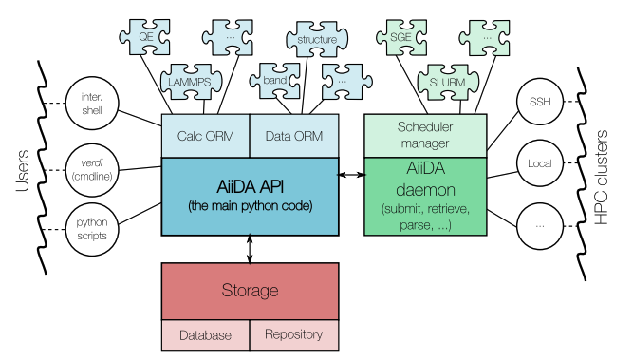
AiiDA schema
Object–Relational Mapping: a layer that maps classes/objects in code to tables/rows in a relational database.
Plugin interface: supports any computational code and data type via extensible plugins.
Daemon (background engine): automates job submission, monitoring, file retrieval, and parsing.
Schedulers: talks to SLURM/PBS/… through scheduler plugins; abstracts queue details.
Transports: connects to resources locally or via SSH (and other channels).
Remote interaction: submits jobs, checks states, and fetches results from clusters automatically.

Slide 17
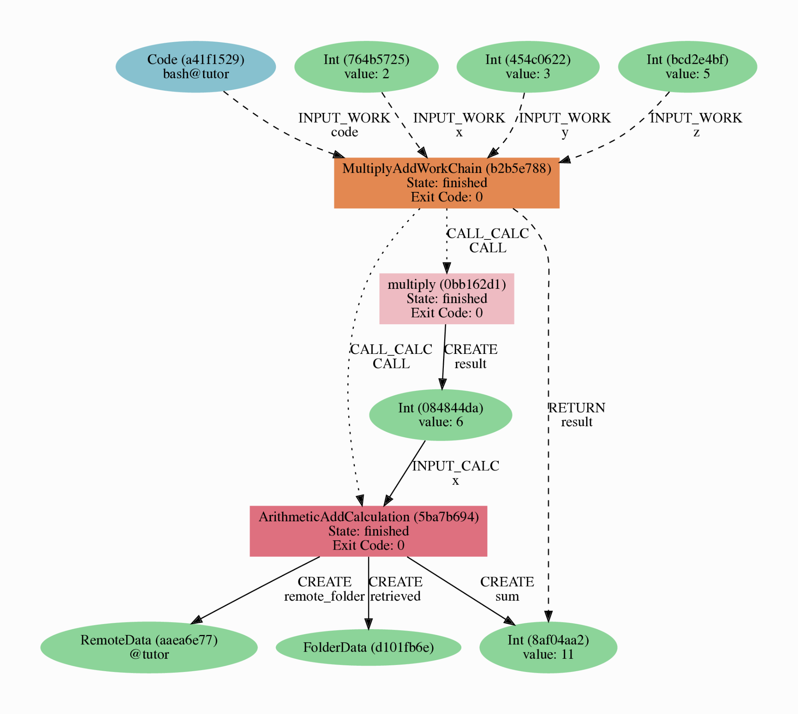
Provenance
AiiDA stores results, inputs, and every execution step of your calculations.
All this information is captured as a Directed Acyclic Graph (DAG).
Provenance lets you fully retrace how any data was produced → reproducibility.
Provenance graph

Slide 18


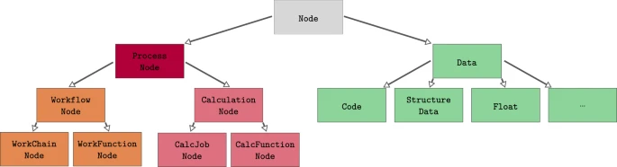
Basic concepts
Data Types
Python classes hosting data, allow storing in the database and provenance.
Simple wrappers of python types.

Slide 19
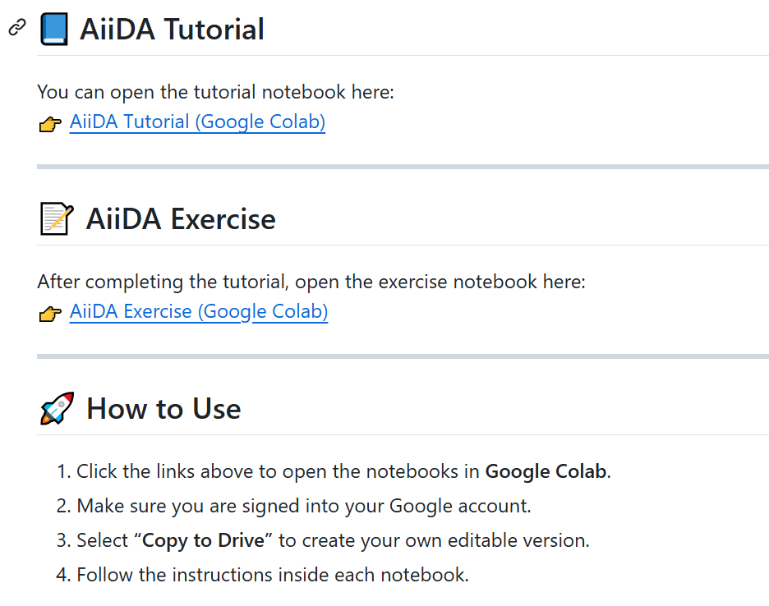
Hands on

Slide 20
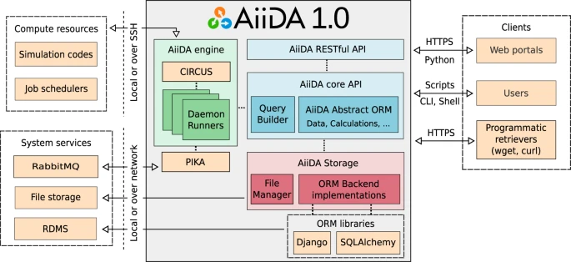
AiiDA schema

Slide 21
Merci de votre attention
pepr-diadem.fr

