Slide 1
Does the network know what film history knows?
Parallel graph analytics of the Hong Kong release network
CS5488 Data-Intensive Computing · Group project · November 2026
170 M rows scanned · 388,168 co-star edges · three parallel tiers on 20 cores
Notes:
SPEAKER 1 (60 s). Open with the question, not the method. 'Film historians say Hong Kong cinema was built on a small set of recurring collaborators. We asked whether an algorithm given nothing but cast lists arrives at the same answer — and what it costs to compute that at the scale of the whole IMDb.' Then the one-line roadmap: data, three parallel tiers, three findings.

Slide 2
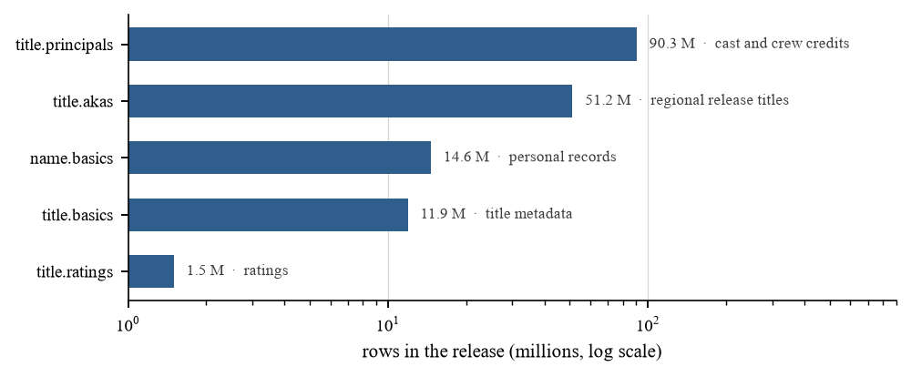
1 · THE DATASET
The data has no country field — so we had to choose
• IMDb public dumps: 1.78 GB compressed, 9.2 GB of text, 169.6 M rows
• Five files: titles, release aliases, cast/crew credits, people, ratings
• No production-country column exists in this release
  – Three candidate filters, three different answers:
  – region = HK → 25,997 titles (admits every import)
  – region = HK + Chinese alias → 15,715 (selects the imports)
  – region = HK + Chinese original title → 0 (IMDb romanises)
Decision: keep the release market, state it plainly, and let community detection separate the cinemas. That turned a data defect into the main result.
Notes:
SPEAKER 1 (60 s). Own the weakness before the examiner finds it. 'The obvious filter is region equals HK. It returns 26,000 titles — and Brad Pitt is in the largest community, because every Hollywood film released in Hong Kong also has a Hong Kong alias. Requiring a Chinese alias makes it worse: that selects the imports. So we stopped pretending we had a production list and analysed the release network instead.'

Slide 3
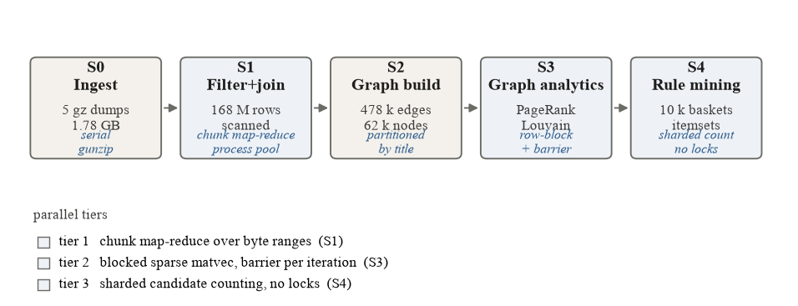
2 · ENGINEERING
Three workloads, three parallel strategies
• Tier 1 · byte-range map-reduce, process pool
  – Parse-bound → the GIL rules out threads
• Tier 2 · blocked sparse matvec
  – Rows partition; one barrier per iteration
• Tier 3 · sharded counting
  – No locks during the scan; merge once
gzip is not seekable, so decompression is serial by construction (33.8 s, 4% of the serial cost). We report it separately instead of hiding it inside a stage.
Notes:
SPEAKER 2 (60 s). The claim to land: 'parallelise it' is not one decision. Three workloads of the same size, same machine, three different ceilings. Point at the pipeline, then at the three tiers. Mention the gunzip openly — it is the Amdahl argument made concrete.

Slide 4
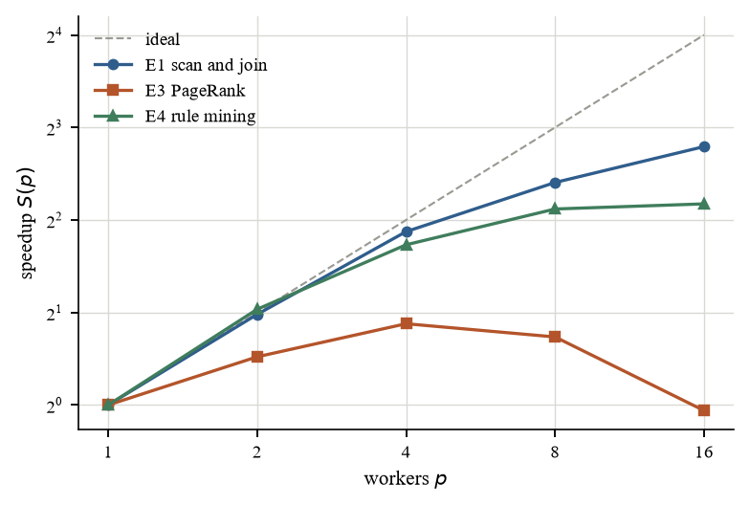
3 · RESULTS
Same machine, three ceilings
• Scan 6.9× at 16 workers
  – serial merge is the tail
• Rule counting 4.5× at 16 workers
  – candidate generation saturates at ~1×
• PageRank 1.0× — and 2.1× at 16× the graph
  – bandwidth-bound, not overhead-bound
First version created a pool per stage: 2.6× peak, then slower at 16 workers. One pool, one reference file per worker: 6.8×.
Notes:
SPEAKER 2 (60 s). Give the three numbers in order and explain each in one sentence. E1 slows because the parent merges the partial results serially. E4's candidate generation is irregular, so the slowest shard decides the finish. PageRank does not improve when the graph grows sixteen-fold, which means the limit is memory bandwidth, not synchronisation — a different failure mode, and a more interesting one.

Slide 5
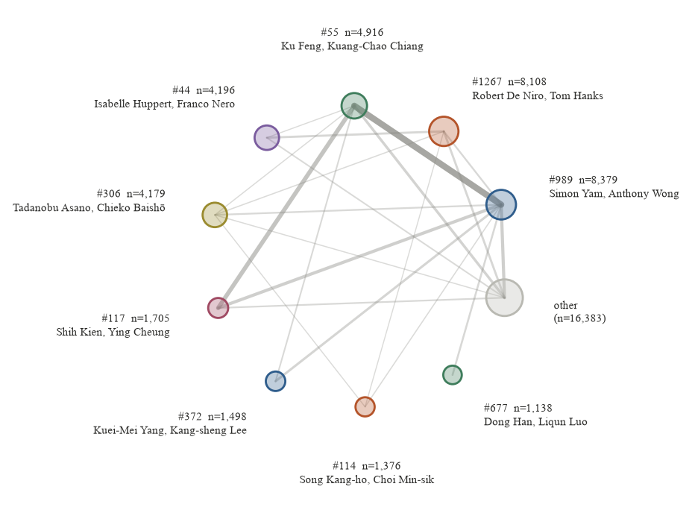
4 · FINDING 1
The blocs are real, and nobody labelled them
• Louvain: Q = 0.75, 1,285 communities
  – Cross-seed stability NMI = 0.89
• Nine blocs cover 68% of 51,878 people
  – Hollywood · Cantonese · mainland · Shaw-era · European · Japanese
• Label propagation collapses: Q = 0.09, 87% in one label
  – Cheap, and useless on this graph
Notes:
SPEAKER 3 (60 s). The headline: no country label was given to the algorithm, and it still separated the cinemas. Then the negative control — label propagation is five times cheaper and returns one giant blob at modularity 0.08. That is why we report both: the cheap method fails in a way that is invisible unless you measure modularity.

Slide 6
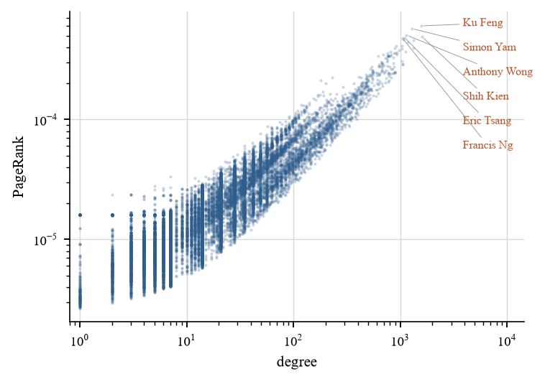
5 · FINDING 2
Inside the local bloc, rank ≠ volume
• PageRank and degree correlate at ρ = 0.53 — related, not the same
• Top rank: Ku Feng, Simon Yam, Anthony Wong, Shih Kien, Eric Tsang, Francis Ng
• These are the people the industry's own histories name
  – Several higher-degree performers do not appear
  – They accumulated credits, not central collaborators
• Decade profile: the local bloc peaks before 1990, the mainland bloc after 2000
Notes:
SPEAKER 3 (60 s). Make the analytical point, not the fan point: PageRank rewards repeated collaboration with hubs, so the ranking surfaces the industry's structural centre rather than its busiest performers. If asked 'isn't this just the famous names' — that is the result: the algorithm independently recovers the names film historians list.

Slide 7
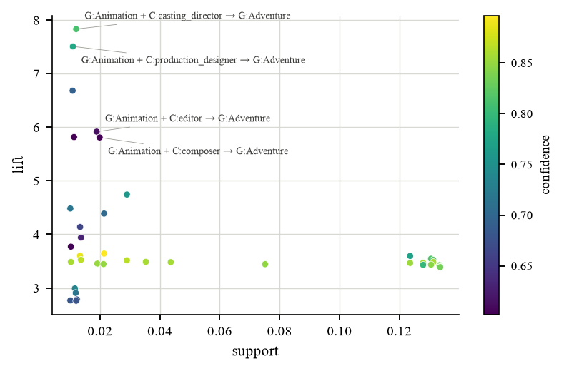
6 · FINDING 3
Rules validate the pipeline before they explain it
• 652 rules at support ≥ 1%, confidence ≥ 0.6, lift > 1.2
• Strongest are structural: animation → adventure, lift 7.8
• Crew-role pairs above 2% support are the studio signature
  – Technical roles travel together in assembly-line production
  – Weakest after 2000 — the comparison is future work
• Career clustering (k = 8, silhouette 0.66) agrees with the graph ranking
Notes:
SPEAKER 4 (55 s). Be honest that the top rules are unsurprising — that is the point: a pipeline that returns anything else would be broken. The interesting rules are the crew-role pairs in the middle of the distribution.

Slide 8
7 · CLOSE
What we would do next, and what we would not
• Replace Apriori with FP-Growth
  – moves the ceiling from the irregular phase to counting
• Get a country label from a dump, not a SPARQL endpoint
  – removes the largest threat to validity
• Dynamic community detection instead of fixed-label flux
• What we would not do again
  – run PageRank in parallel at 10⁵ edges
  – spawn a pool per stage
  – trust a release-region filter as a production filter
•
• Reproducible: every number from one command
  – python src/bench.py --exp all
Notes:
SPEAKER 4 (55 s). Close on judgement rather than a summary: the three things we would change, and the three we would not repeat. End on the reproducibility line — if an examiner asks how a number was produced, the answer is a command, not a recollection.

