Slide 1

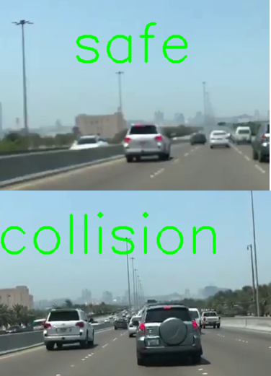
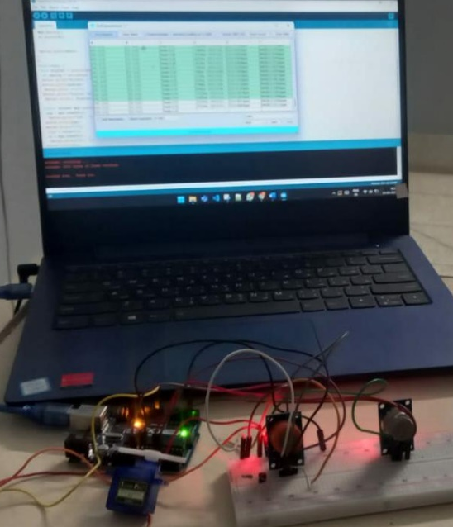
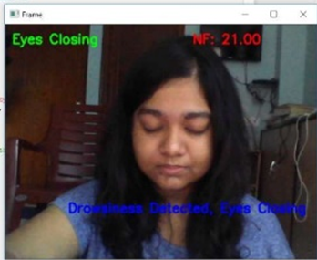
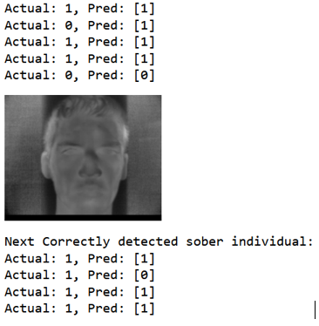
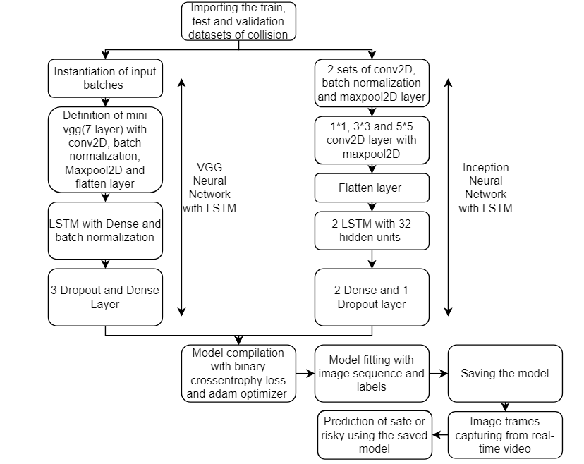
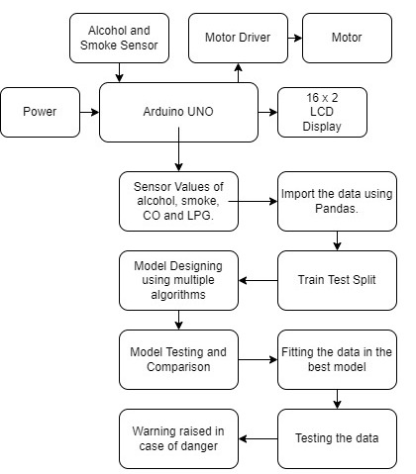
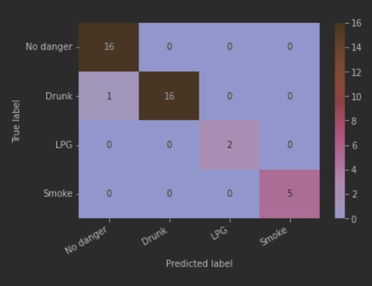
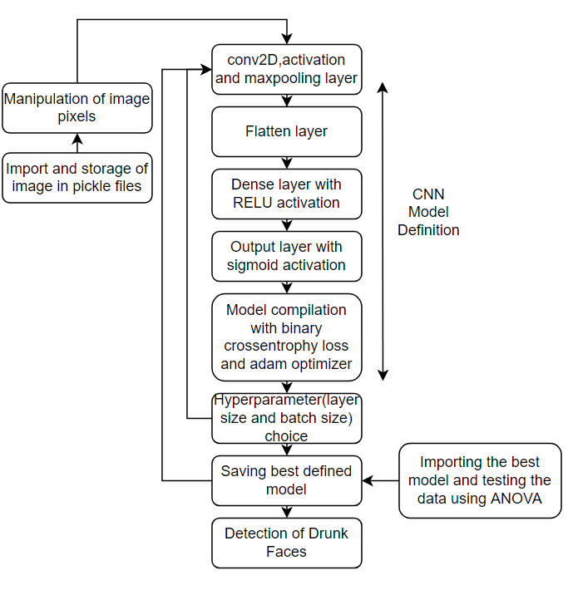
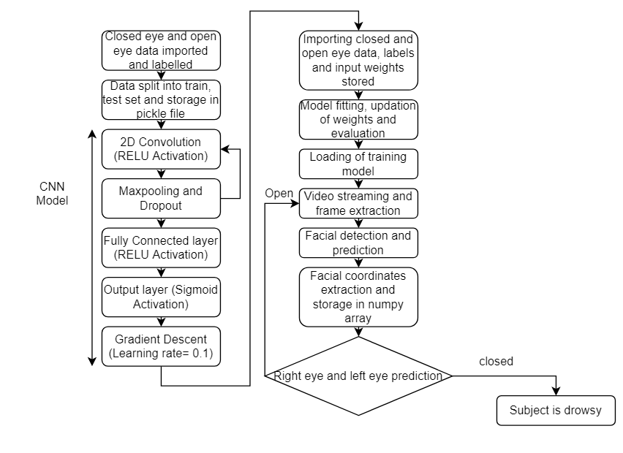
DEVELOPMENT OF AN INTEGRATED DRIVER ACCIDENT PREVENTION SYSTEM
Kathakoli Sengupta, Abhyuday Tripathi and Nandini Awtani| Prof. V. Naveen Kumar | SENSE
Motivation/ Introduction
Results
Recent reports show that there has been around 12256 road accidents due to drunk driving in India in the year 2019. Given, the surge of road vehicles in every city in the current scenario and its necessity in people’s daily lives it has become inevitable to come up with a solution to accident problems. Several research took place related to this but none of them could address all causes of accidents including collision with other vehicles, fire outbreaks and driver’s lack of concentration due to either drunk or drowsy state. The project is implemented using sensors, microcontroller and camera for real-time data collection and CNN and ML algorithms for its classification and decision making. A comparison of detection accuracy of the algorithms used are made for each type of detection system and best is chosen for real-time usage. The system is cost-effective since it uses very less software, robust and accurate enough for real-time usage.
SCOPE of the Project
The prototype designed by us is very easily procurable, less space consuming and cost effective. Hence, it is can implemented in large scale for in real-time. This is an easily integrable solution and hence can be used by any layman without knowledge of internal working of the system. Moreover, Its accuracy for every detection system makes it suitable enough for usage in outdoor situations. Hence, this solution can find considerable applications in risk management, road safety and hazard management domains.
Figure 2
Figure 1
Methodology
Figure 4
Figure 3
Fig 1: Real-time collision detection
Fig 2: Hazardous and Alcoholic Gas Detection Setup
Fig 3: Drunk Face Detection
Fig 4 : Drowsy Face Detection
Fig 5: Car’s Gas Concentration Analysis
Fig 1 : Collision Detection
Fig 2 : Hazardous and Alcohol Detection
Conclusion/ Summary
The prototype implemented shows around 85% accuracy in real-time scenario for all the detection systems. Hence, it can be safely concluded that it can efficiently detect fire, collision, sleepy or drunk driver conditions. The final prediction models are decided after implementing various algorithms and choosing the best based on accuracy factor. The extensive hardware value recorded with instances of smoke and alcohol makes the analysis accurate and sensitive. In future, GPU based analysis can be implemented for faster operation of the algorithm and industry level highly sensitive sensors and camera can be used for data recording.
Fig 3 : Drunk Face Detection
Contact Details
senguptadia25@gmail.com nandiniawtani11@gmail.com abhyudaytripathi15@gmail.com
Fig 4 : Drowsy Face Detection
The project is implementing a car accident prevention system dealing with any risks related to collision with other vehicles, fire outbreaks and driver being drunk or falling asleep. The collision detection system algorithm shown in Fig 1 takes real-time images of car’s vicinity and predicts possibility of accident with an inception or VGG based model which was trained by accident datasets. Further, MQ2 and MQ3 sensors are introduced inside the car to detect gas concentrations and machine learning algorithms like SVM, random forest and MLP are used to predict presence of any hazardous gases indicating fire-outbreak or alcoholic gases indicating drunk person inside car as shown in Fig 2. To detect more accurately, a drunk face detection system is also designed for the driver where real-time image is extracted from driver’s face video. These images are used as input and a sequential CNN model trained with intoxicated face dataset is used for prediction as shown in Fig 3. Since, driver falling asleep can also be another possible cause of accident, a similar system using driver’s face as input and another sequential CNN model, this time trained with eye open and closed dataset is used for prediction as shown in Fig 4. All these systems together forms a strong and accurate accident detection system.
Acknowledgments/ References
https://www.who.int/news-room/fact-sheets/detail/road-traffic-injuries
Qiang Luo, Xiaodong Zang, Jie Yuan, Xinqiang Chen, Junheng Yang, and Shubo Wu, “Research of Vehicle Rear-End Collision Model Considering Multiple Factors”, published:10 Apr 2020, vol 2020.
Chew Cheik Goh, Latifah Munirah Kamarudin , Ammar Zakaria, Hiromitsu Nishizaki, Nuraminah Ramli, Xiaoyang Mao, Syed Muhammad Mamduh Syed Zakaria , Ericson Kanagaraj, Abdul Syafiq Abdull Sukor and Md. Fauzan Elham, “Real-Time In-Vehicle Air Quality Monitoring System Using Machine Learning Prediction Algorithm”, published: 21 July 2021
Kavish Atul Sanghvi, “Drunk Driving Detection, Computer Science and Information Technology”, 6(2): 24-30, 2018
Ira C. Valenzuela, Lean Karlo S. Tolentino, Ronnie O. Serfa Juan, “Utilization of e-Nose Sensory Modality as Add-On Feature for Advanced Driver Assistance System”, International Journal of Advanced Trends in Computer Science and Engineering, vol 8, No.4 , July-August 2019

