Slide 1
Clustering
What is Clustering?
• Clustering aims to partition the data into distinct groups so that the observations within each group are homogenous and quite similar to each other. We understand with a simple example.
• A bank wants to give credit card offers to its customers. Currently, they look at the details of each customer and based on this information, decide which offer should be given to which customer.
• The bank can potentially have millions of customers. And making decision individually for each and every customer would be a strenuous task.
• So what can the bank do? One option is to segment its customers into different groups. For instance, the bank can group the customers based on their income, occupation, age group etc.
So there are many algorithm for clustering, in this presentation we learn about KMeans.

Slide 2
Real World Use Cases Of Clustering
Customer Segmentation for all products to see whether user will renew the contract or not?
–Median usage of days
–Median of session numbers
–Median of session length
–Fluctuation of product use
–Patterns of session frequency and length
–Usage recency before earlier renewals
Document Cluster
–key-words
–authors
–context- date- time- author
Store segmentation for a brand
–zip code
–age group
–product price
–competitor

Slide 3
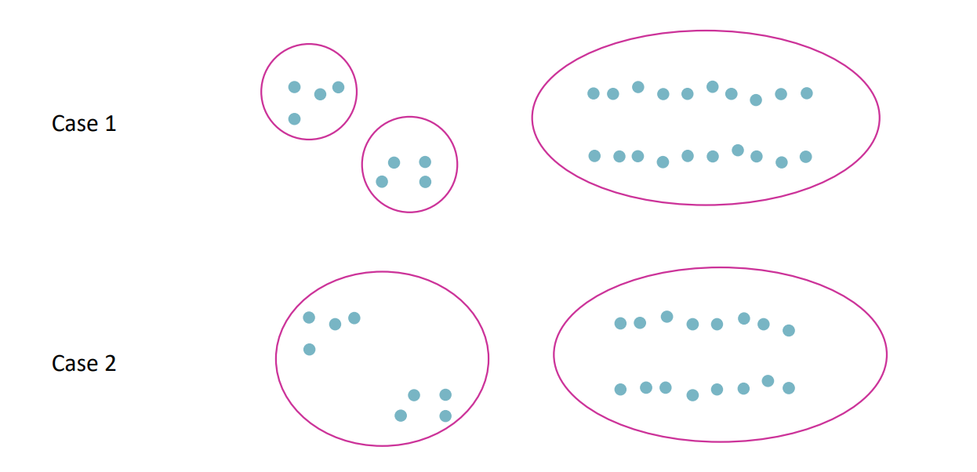
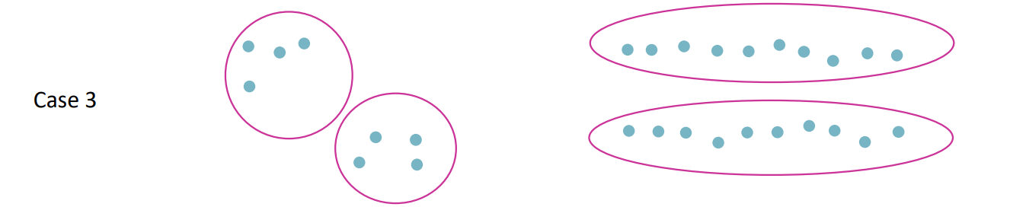
Custering
Basic idea: Group together similar instances
Example: 2D point patterns

Slide 4

What is the meaning of “similar” data points
One option: small Euclidean distance (squared)
Clustering results are crucially dependent on the measure of similarity (or distance) between “points” to be clustered and the domain knowledge of the data points being considered.

Slide 5
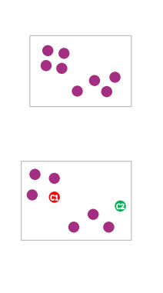
Introduction to K-Means Clustering
The points within a cluster should be similar to each other. So, our aim here is to minimize the distance between the points within a cluster. Let’s now take an example to understand how K-Means actually works: We have these 8 points and we want to apply K-Means to create
clusters for these points. Here’s how we can do it.
Step 1: Choose the number of clusters k
The first step in K-Means is to pick the number of clusters, k.
Step 2: Select k random points from the data as centroids
Next, we randomly select the centroid for each cluster. Let’s say we
want to have 2 clusters, so k is equal to 2 here. We then
randomly select the centroid:

Slide 6
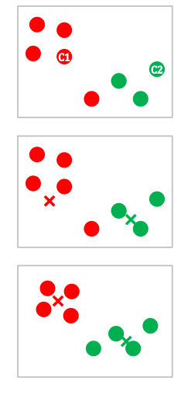
Step 3: Assign all the points to the closest cluster centroid Once we have initialized the centroids, we assign each point to the closest cluster centroid:
Step 4: Recompute the centroids of newly formed clusters Now, once
we have assigned all of the points to either cluster, the next step is to
compute the centroids of newly formed clusters:
Step 5: Repeat steps 3 and 4 We then repeat steps 3 and 4
The step of computing the centroid and assigning all the points to the cluster based on their distance from the centroid is a single iteration.

Slide 7
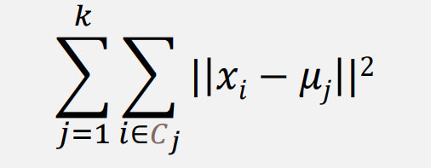
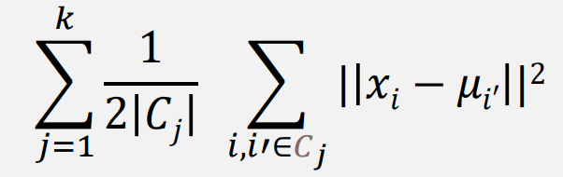
K-Means Clustering
Input: A set of points 𝑥1 , … , 𝑥𝑛 𝜖 ℝ𝑑 ; an integer k denoting the number of clusters Output: A partition of the points into clusters C1 ,…, Ck along with a center 𝜇𝑗 for each cluster, so as to minimize
The K-Means cost function can equivalently be rewritten as

Slide 8
Example- Tshirt based on S, M, L
Height Weight
166 68.30679
178 55.79946
169 67.02459
173 78.27659
177 58.50331
182 110.37332
186 102.73013
168 83.79284
121 44.04066
126 45.36331

Slide 9
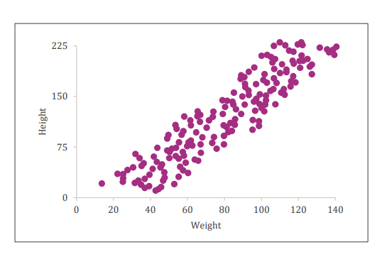
• We are given a dataset of Height and Weight of 170 people
• We would like to group the people such that we can assign T-shirts to the group of people
• We have 3 sizes of T-shirt available with us S,M,L
x

Slide 10
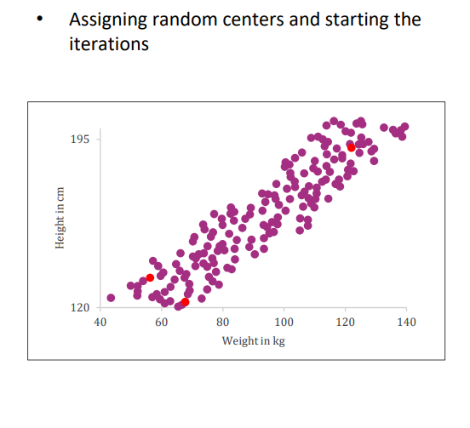
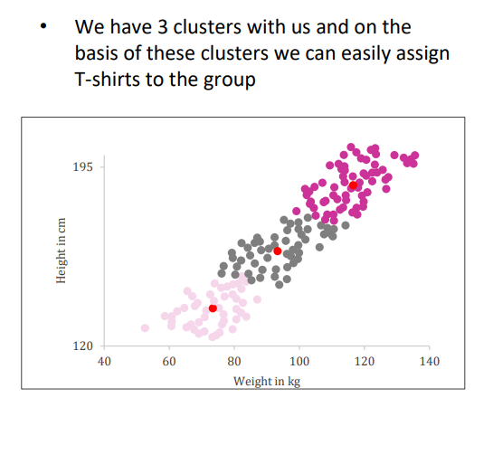

Slide 11
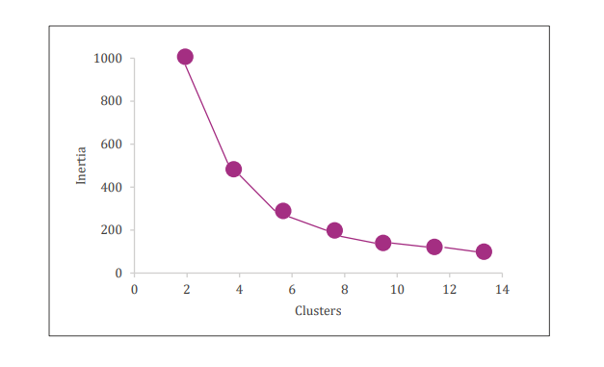
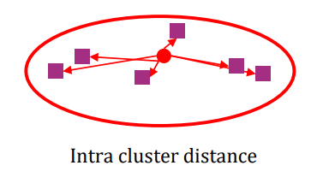
Stopping Criterion for K-Means Clustering
Centroids of newly formed clusters do not change within a specified tolerance of 2 consecutive iterations
How to determine the right number of clusters in Kmeans
Elbow method
• Inertia metric: calculates the sum of distances of all the points within a cluster from the centroid of that cluster.
• We calculate this for all the clusters and the final inertia value is the sum of all these distances. This distance within the clusters is known as intracluster distance. So, inertia gives us the sum of intracluster distances:

Slide 12
Disadvantages of K-Means
–Sensitive to Outliers.
–Sensitive to the choice of the initial seeds (centroids).
–May not always be able to cluster properly.
Code for better understanding
https://github.com/codebasics/py/blob/master/ML/13_kmeans/13_kmeans_tutorial.ipynb

Slide 13
Decision trees
Decision Tree is a Supervised learning technique that can be used for both classification and Regression problems, but mostly it is preferred for solving Classification problems. It is a tree-structured classifier, where internal nodes represent the features of a dataset, branches represent the decision rules and each leaf node represents the outcome.
In a Decision tree, there are two nodes, which are the Decision Node and Leaf Node. Decision nodes are used to make any decision and have multiple branches, whereas Leaf nodes are the output of those decisions and do not contain any further branches.
The decisions or the test are performed on the basis of features of the given dataset.
It is a graphical representation for getting all the possible solutions to a problem/decision based on given conditions.
It is called a decision tree because, similar to a tree, it starts with the root node, which expands on further branches and constructs a tree-like structure.
In order to build a tree, we use the CART algorithm, which stands for Classification and Regression Tree algorithm.
A decision tree simply asks a question, and based on the answer (Yes/No), it further split the tree into subtrees.

Slide 14
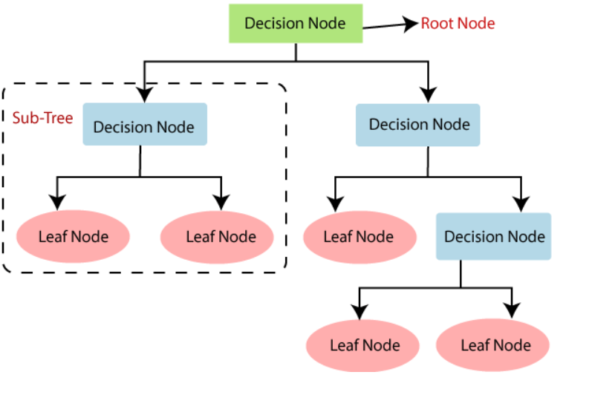

Slide 15
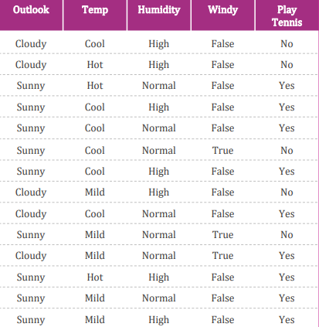
Decision tree Example

Slide 16

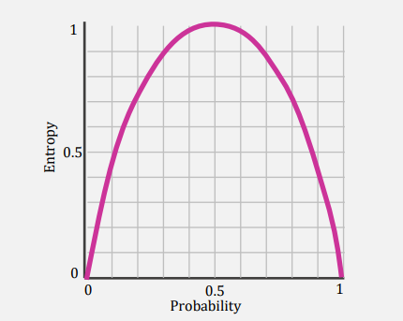
For determining the pure or impure split
Pure and impure splits can be compared by two ways-
Entropy
Given a categorical feature S, containing ‘c’ different classes, the entropy of S relative to this classification:
Where p(i) is the probability of a random sample
belonging to class i
It takes up a value close to 0 if all p(i) ’s are close to 0 or 1
If its a pure spilt then value will be 0 or 1
If its a impure split then value will be between 0 to 1

Slide 17
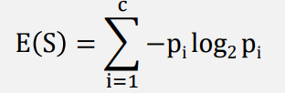
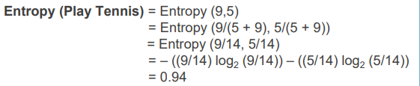
Entropy Calculation
Want to play tennis?
Yes No
9 5

Slide 18

2. Gini Index
• Like Entropy, it also takes up a value close to 0 if all p(i) ’s are close to 0 or1, that is the collection being dominated by a single class.
• Gini Index is referred to as a measure for Node Purity.
• It is computationally less expensive and quicker to calculate as compared to Entropy because it is simple algebraic equations without any logarithmic functions.
• It is generally used when handling a very large feature space with limited computation power and time constraints.

Slide 19
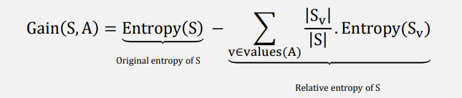
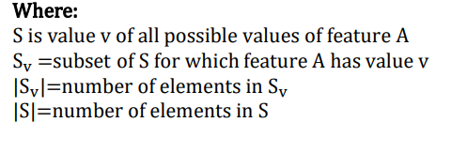
Information Gain
• Decides which feature goes into a decision node.
• To minimize the decision tree depth, the feature with the most entropy reduction is the best choice. Higher the value that feature will get selected.

Slide 20
Advantages of decision trees
• Can handle huge datasets
• Can handle mixed predictors— categorical and continuous
• Small trees are easy to interpret
Disadvantages of decision trees
• Very large trees are hard to interpret
• Prediction performance is often poor as it is prone to overfitting

Slide 21
Pruning
Post Pruning
This technique is used after construction of decision tree.
This technique is used when decision tree will have very large depth and will show overfitting of model.
This technique is used when we have infinitely grown decision tree.
Pre pruning
This technique is used before construction of decision tree.
Pre-Pruning can be done using Hyperparameter tuning.
Overcome the overfitting issue.
we generally use GridSearchCV for Hyperparameter tuning

Slide 22
Ensemble
• Single “weak learners” have the problem of their individual bias or variance.
• So multiple “weak learners” are combined to form one strong model which has a lower bias and variance than all it’s individual building blocks.
• If all the “weak learners” are same type of model, then it’s called Homogeneous Ensemble(eg: Random Forest) and if the “weak learners” are different then it’s called Heterogeneous Ensemble.
There are two types of Ensemble techniques
Bagging
Boosting

Slide 23
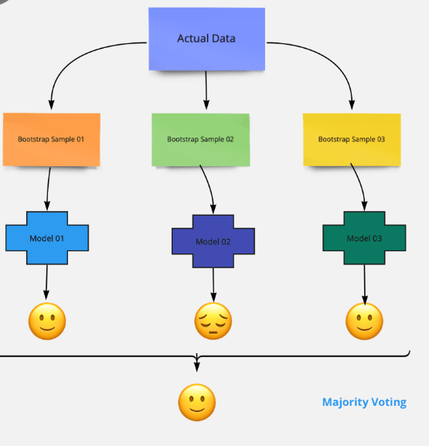
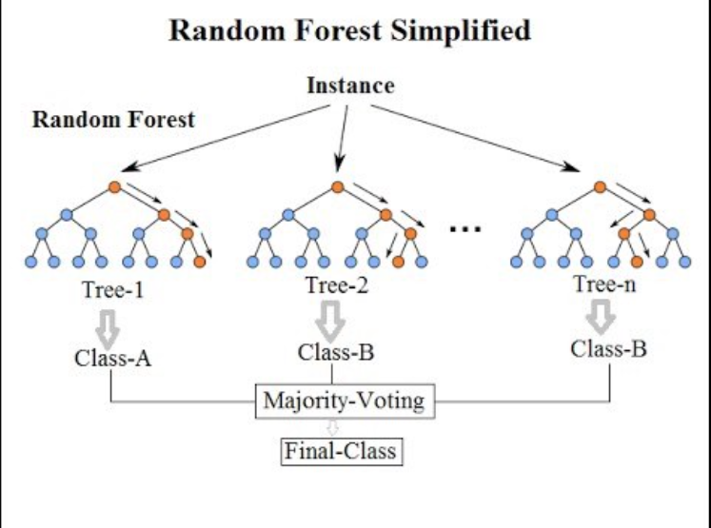
Bagging-
Bagging meta-estimator is an ensembling algorithm that can be used for both classification (BaggingClassifier) and regression (BaggingRegressor) problems
Random forest is one the bagging algorithm

Slide 24
Boosting- Boosting is a sequential process, where each subsequent model attempts to correct the errors of the previous model.
AdaBoost
GBM
XGboost
Light GBM
CatBoost

Slide 25
SVM-Support Vector Machine
SVM is a powerful supervised algorithm that works best on smaller datasets but on complex ones. Support Vector Machine, abbreviated as SVM can be used for both regression and classification tasks, but generally, they work best in classification problems.
What is a Support Vector Machine?
It is a supervised machine learning problem where we try to find a hyperplane that best separates the two classes. Note: Don’t get confused between SVM and logistic regression. Both the algorithms try to find the best hyperplane, but the main difference is logistic regression is a probabilistic approach whereas support vector machine is based on statistical approaches.
NOTE- Logistic regression and SVM without any kernel have similar performance but depending on your features, one may be more efficient than the other
https://colab.research.google.com/drive/1yiL0p5xFFIeekKeHBh1K-IJgrffZvVKX?usp=sharing

Slide 26
Types of Support Vector Machine
Linear SVM
When the data is perfectly linearly separable only then we can use Linear SVM. Perfectly linearly separable means that the data points can be classified into 2 classes by using a single straight line(if 2D).
Non-Linear SVM
When the data is not linearly separable then we can use Non-Linear SVM, which means when the data points cannot be separated into 2 classes by using a straight line (if 2D) then we use some advanced techniques like kernel tricks to classify them. In most real-world applications we do not find linearly separable datapoints hence we use kernel trick to solve them.

Slide 27
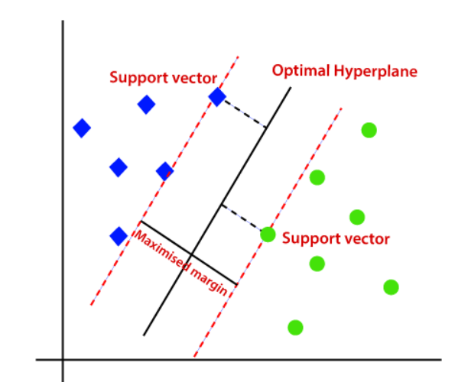
Working of SVM
Let’s understand the working of SVM using an example. Suppose we have a dataset that has two classes (green and blue). We want to classify that the new data point as either blue or green. To classify these points, we can have many decision boundaries, but the question is which is the best and how do we find it?Since we are plotting the data points in a 2-dimensional graph we call this decision boundary a straight line but if we have more dimensions, we call this decision boundary a “hyperplane”

Slide 28
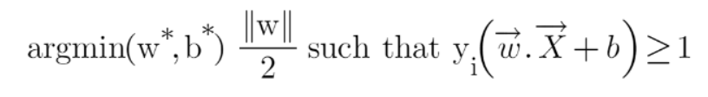
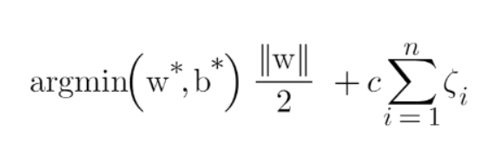
Optimization function
This is the optimization function but there is a catch here that we don’t find this type of perfectly linearly separable data in the industry, there is hardly any case we get this type of data and hence we fail to use this condition we proved here.
This type of problem which we just studied is called Hard Margin SVM.
Soft Margin SVM
In real-life applications we don’t find any dataset which is linearly separable, what we’ll find is either an almost linearly separable dataset or a non-linearly separable dataset. In this scenario, we can’t use the trick we proved above because it says that it will function only when the dataset is perfectly linearly separable.

Slide 29
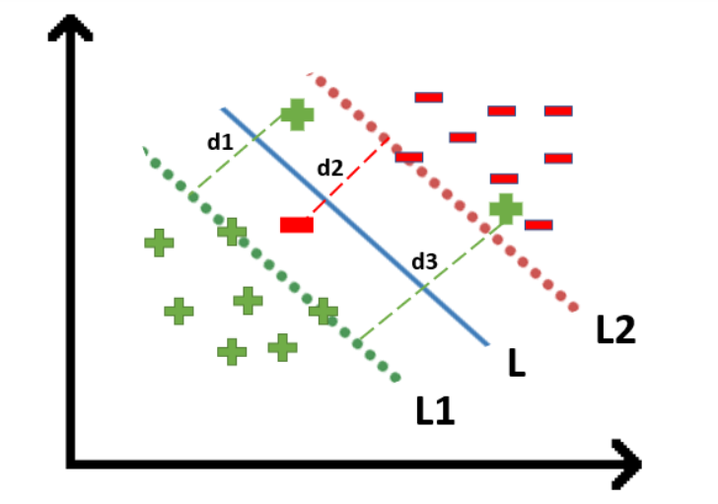
For all the correctly classified points our zeta will be equal to 0 and for all the incorrectly classified points the zeta is simply the distance of that particular point from its correct hyperplane that means if we see the wrongly classified green points the value of zeta will be the distance of these points from L1 hyperplane and for wrongly classified redpoint zeta will be the distance of that point from L2 hyperplane.
So now we can say that our that are SVM Error = Margin Error + Classification Error. The higher the margin, the lower would-be margin error, and vice versa

Slide 30
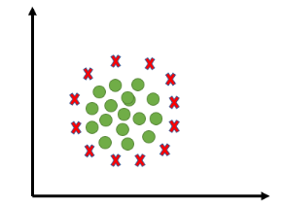
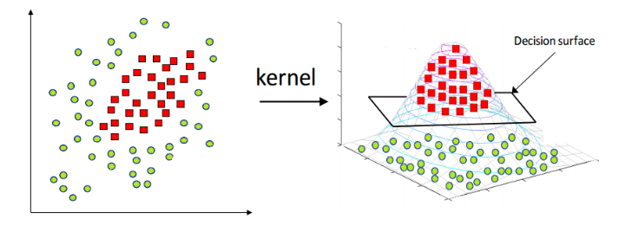
Kernels in Support Vector Machine
The most interesting feature of SVM is that it can even work with a non-linear dataset and for this, we use “Kernel Trick” which makes it easier to classifies the points. Suppose we have a dataset like this:
Here we see we cannot draw a single line or say hyperplane which can classify the points correctly. So what we do is try converting this lower dimension space to a higher dimension space using some quadratic functions which will allow us to find a decision boundary that clearly divides the data points. These functions which help us do this are called Kernels and which kernel to use is purely determined by hyperparameter tuning.

