Slide 1
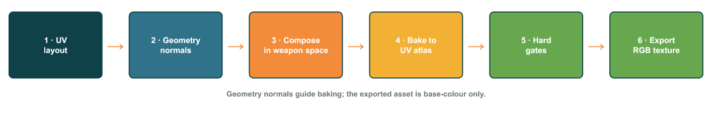
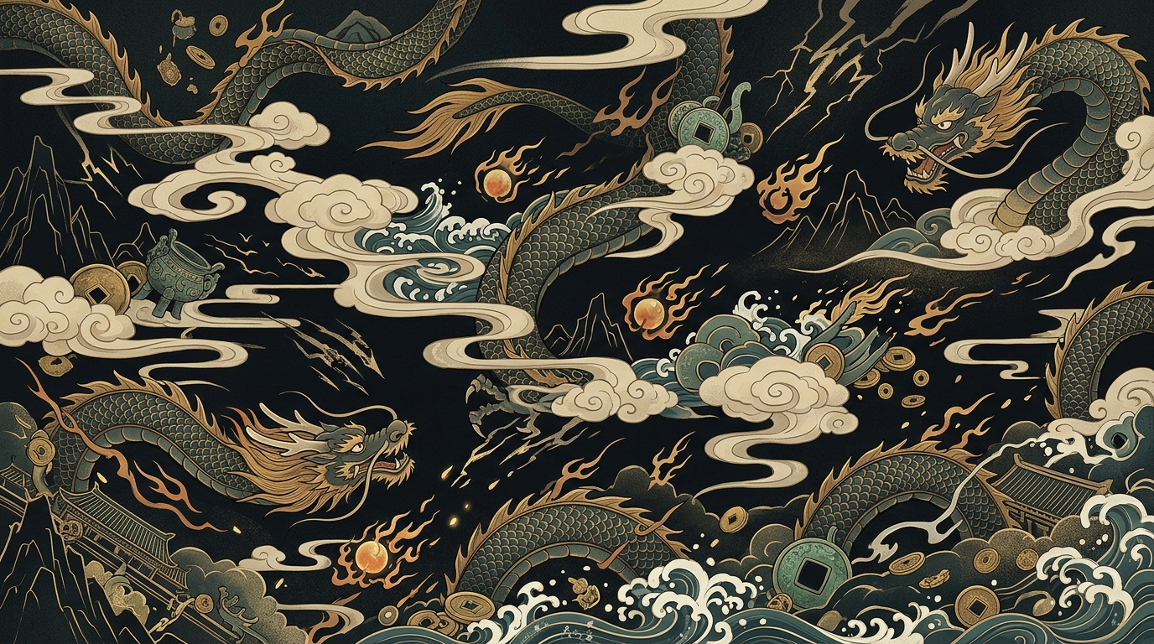
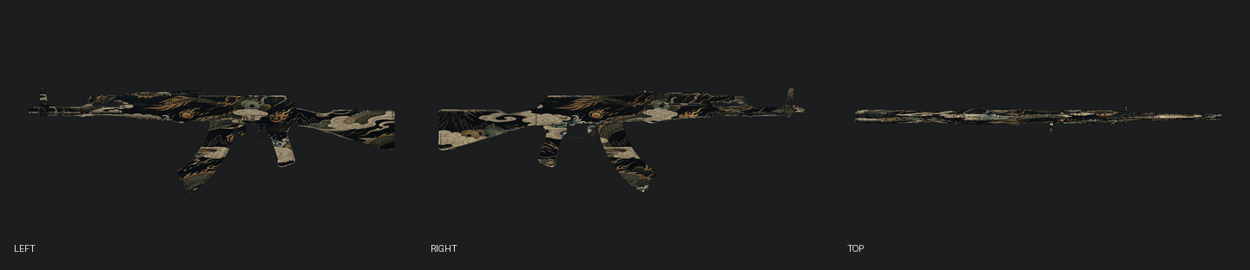
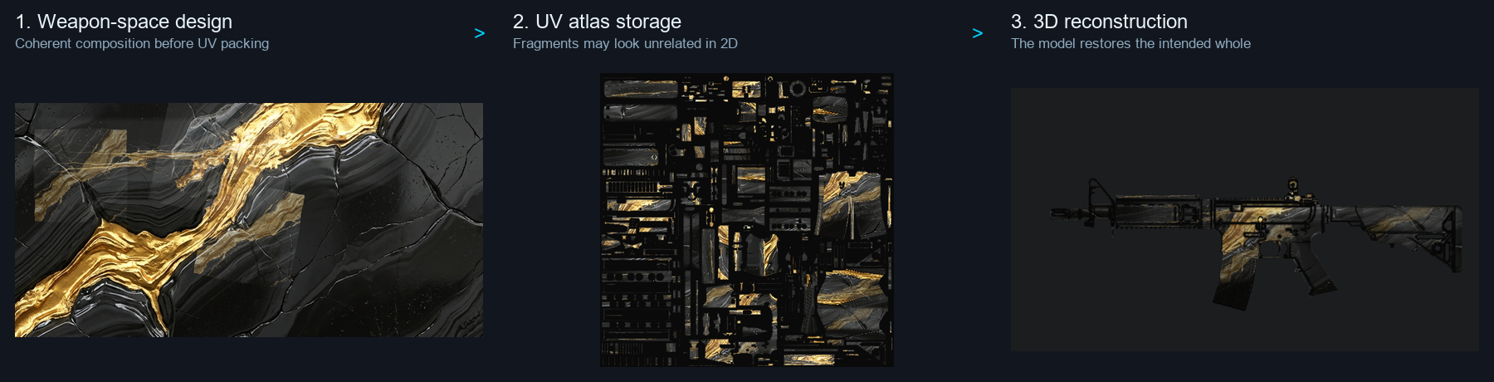
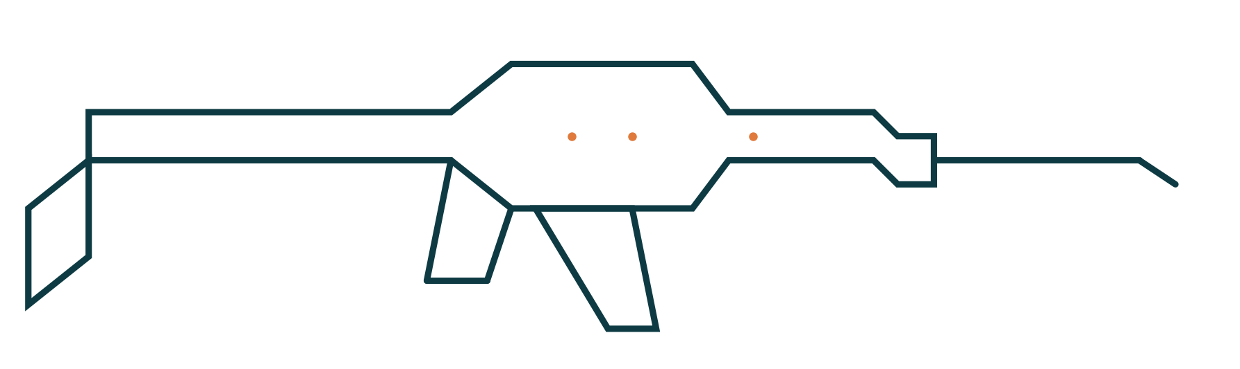
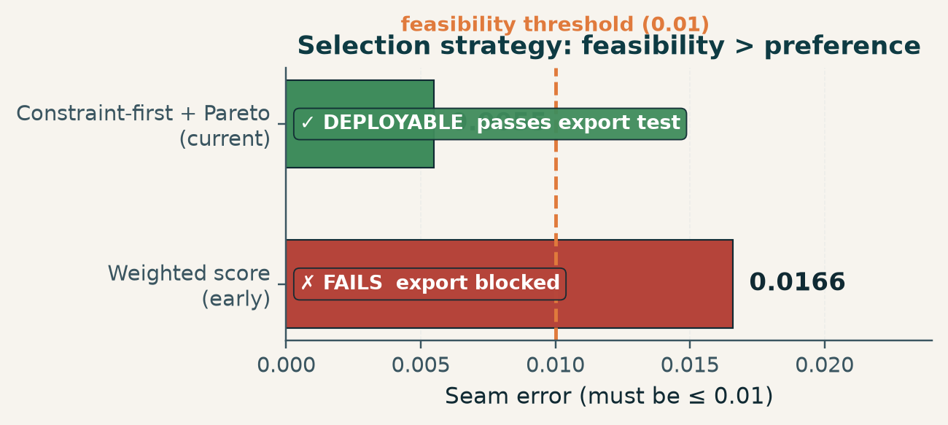
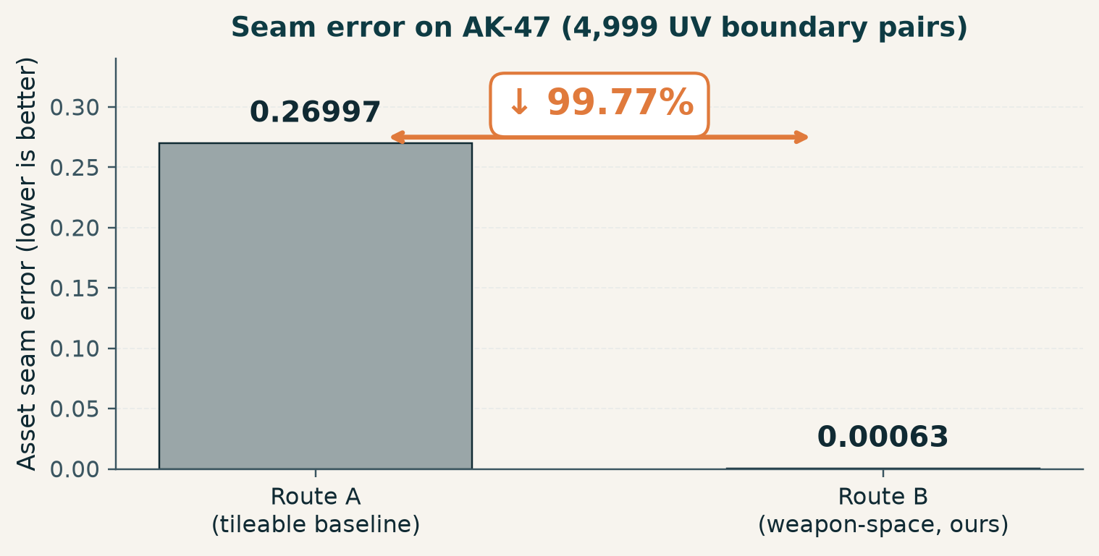
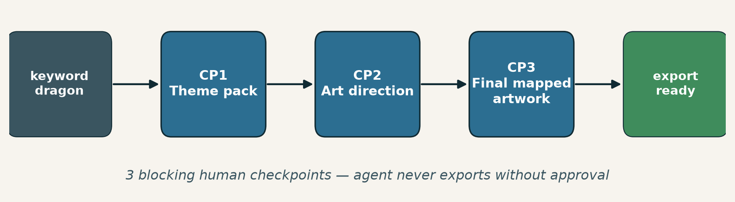
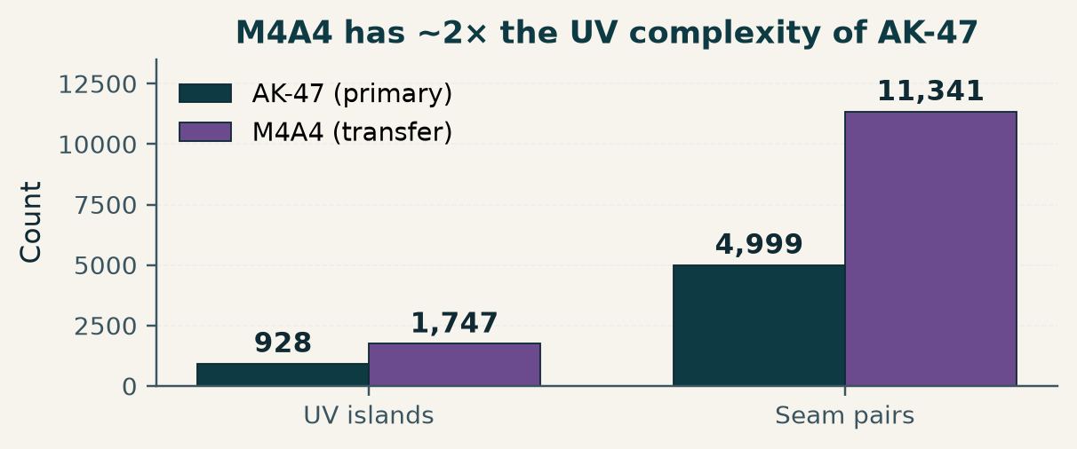
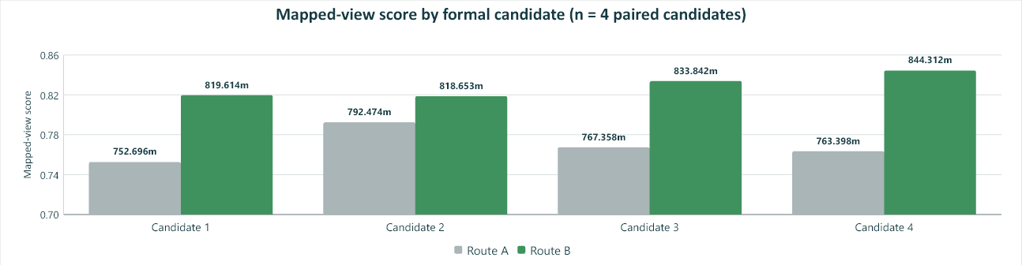
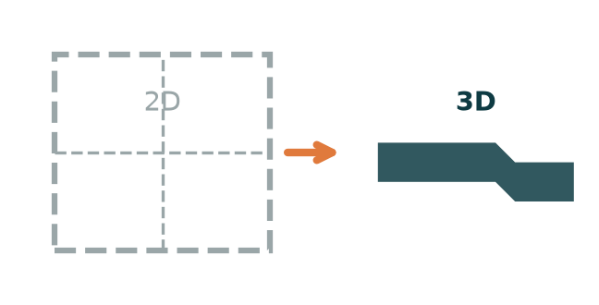
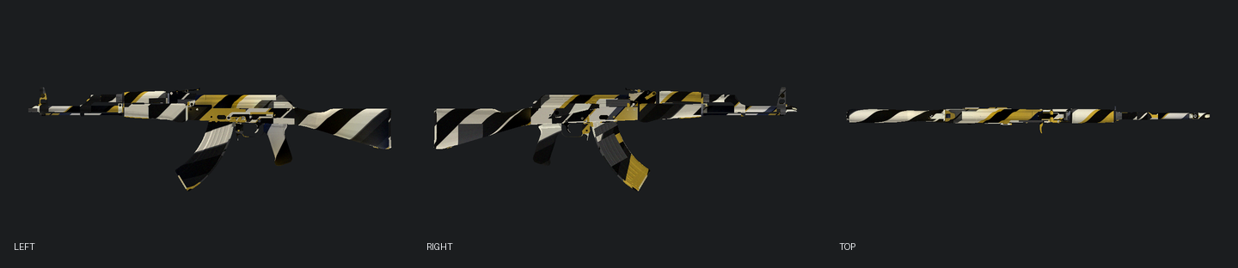

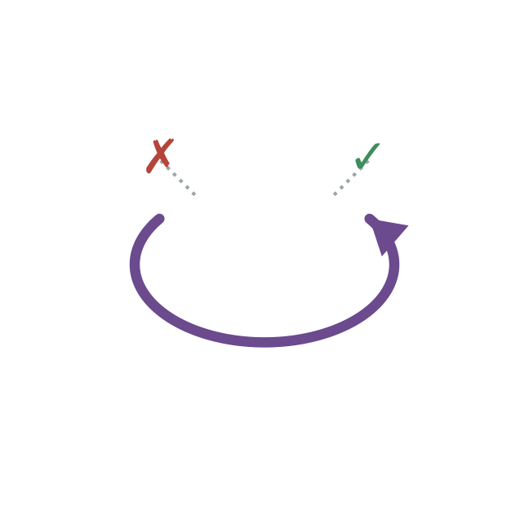
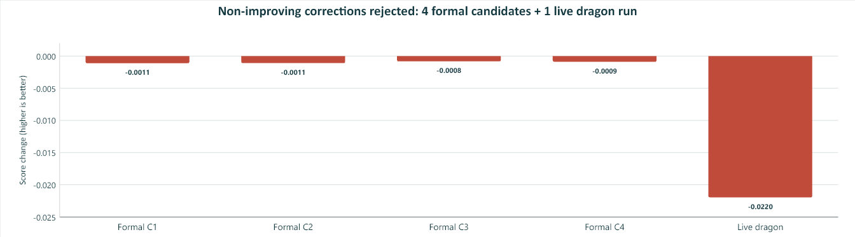
SkinSmith: A Constraint-Aware Generative Agent for Game Weapon Skin Design
Turn a single keyword (e.g. “dragon”) into a mapped, seam-compliant CS2 weapon texture — with three blocking human checkpoints.
1 · Background & Problem Why image generation alone is insufficient for mapped textures
6 · Route B: Weapon-Space Composition Compose in 3D, then bake to UV atlas
11 · Key Results on AK-47 Route B vs Route A — head to head
▸ Modern text-to-image models (SD-Turbo, Gemini-Image, …) can produce stunning rectangular art — but a game skin is not a rectangle.
▸ UV fragmentation: a 3D surface is unfolded, scaled, and repacked into an atlas, shredding any continuous pattern.
▸ View inconsistency: art that looks great on the left side may collapse from the top.
▸ Export constraints: hard rules on resolution, drawable area, seams, and palette.
▸ Pretty source image ≠ deployable weapon texture.
▸ Route A (tileable baseline): compose a crop-tolerant 2D pattern, then map it through the asset UV.
▸ Route B (this work): compose continuously in weapon space, then use geometry-normal guidance to bake back to the UV atlas.
Substantially reduces true mapped seam error while preserving multi-view content.
ASSET SEAM ERROR
MULTI-VIEW SCORE
▼ 99.77%
▲ +0.060
0.00063 vs 0.26997 (Route B vs Route A)
0.829 vs 0.769 4 / 4 candidates improve
Source art · dragon master artwork generated after CP2 and evaluated at CP3
12 · Real Run: dragon → Treasured Relic The end-to-end run that produced the final export
▸ Selected: artwork_04 (1 of 4)
▸ Seam error: 0.00078 (< 0.01)
▸ Multi-view: 0.8166 (left / right / top)
▸ Export: 2048 × 2048 RGB PNG/TGA
2 · Aims What this project is — and is not
13 · Selection Strategy: Feasibility > Preference Constraint-first + Pareto selects a feasible export candidate
▸ Build a constraint-aware generative Agent: theme keyword → mapped CS2 texture candidate.
▸ Apply hard feasibility rules (seam budget and fixed multi-view checks) before export.
▸ Test adapter-level transfer on M4A4 without claiming equivalent acceptance.
▸ Academic prototype — not affiliated with Valve; not published to Steam Workshop.
7 · True Seam Error on AK-47 Geometric discontinuity of 4,999 3D-adjacent UV boundary pairs
3 · Three Blocking Human Checkpoints The agent never exports without approval
14 · Adapter Transfer: AK-47 → M4A4 Agent contract is reusable · asset params must be re-calibrated
REUSABLE (purple)
MUST RE-CALIBRATE (amber)
8 · Hard Constraints the Agent Enforces Feasibility is not preference — it is a gate
• Agent state machine • Checkpoint contract • Generation back-end • Eval & logging
• OBJ / UV binding • Seam map • Camera poses • Mask, edge width, thresholds
CP1 · Theme pack Confirm the visual world: concept, palette, motifs, mood, forbidden content.
Seam budget
Palette lock
CP2 · Artistic direction Pick 1 of 3–4 text-prompted style directions. Model recommends, user decides.
≤ 0.01 / edge
user-locked set
No repeat
Multi-view OK
CP3 · Final mapped artwork See source + 3 mapped views (left / right / top) before approving any export.
anti-periodic UV
3 / 3 fixed views
9 · Paired Multi-View Result · 4 / 4 Route B improves mapped-view score for all four formal candidates
4 · Three Principles What we learned — and what we recommend
15 · Visual Gallery · Route B Outputs LEFT / RIGHT / TOP software renders of two mapped candidates
1
Bind the source image to the mapping view. Never approve art on a flat canvas — the human must see how it sits on the gun.
2
Feasibility ≠ preference. Treat export readiness as a hard gate, not as another weighted feature in the score.
3
Corrections have a budget and a rollback rule. Small “reasonable” edits can erase detail. Roll back unless the score genuinely improves.
10 · Selection & Self-Correction Feasibility > preference · Route C safely rejected
Treasured Relic (artwork_04)
Hazard Sigil (alt. style)
Weighted score (early)
Constraint-first + Pareto (current)
16 · Conclusion What we deliver
5 · What We Deliver Concrete outputs and how to reproduce
seam = 0.0166
seam = 0.0055
▸ Deliver: mapped, seam-compliant CS2 texture candidates with three human checkpoints.
▸ Validate: 100 automated tests; code on GitHub; AK-47 primary, M4A4 adapter transfer.
▸ Safety result: four formal corrections and the live dragon correction were rejected as non-improving.
▸ Pipeline: Streamlit + CLI for the CP1 → CP2 → CP3 → export workflow.
▸ Models: SD-Turbo (local), Gemini-3.1 Flash Image (API), and Flash-Lite planning.
▸ Evidence: machine-readable JSON/CSV logs and 100 automated tests.
▸ Output: 2048 × 2048 RGB PNG/TGA textures baked to the AK-47 UV atlas.
✗ FAILS export test — small visual gain hid an export-gate failure.
✓ EXPORTABLE — passes texture export gates.
17 · Limitations & Future Work Honest about what this prototype does not yet do
▸ Weapons: AK-47 complete; M4A4 is adapter-level transfer evidence only.
▸ Materials: base-colour only; no normal, roughness, metallic, height, or full PBR output.
▸ Deployment: Streamlit is the demo client; no automated Steam Workshop publication.
▸ Demo: python -m streamlit run streamlit_app.py
Code & Evidence
SkinSmith · Constraint-Aware Generative Agent for Game Weapon Skin Design
Route B
github.com/DID-FIELD/SDSC6002-SkinSmith
City University of Hong Kong · SDSC6002 Research Project
YUAN Ye 60089337 · CHEN Yuhong 59877861
Ben Tangjie 59341974 · Wang Zhengye 59928724
WANG Lihui 59252928 · Supervisor: Prof. Yu Yang
100 automated tests · machine-readable logs · versioned exports

