Slide 1
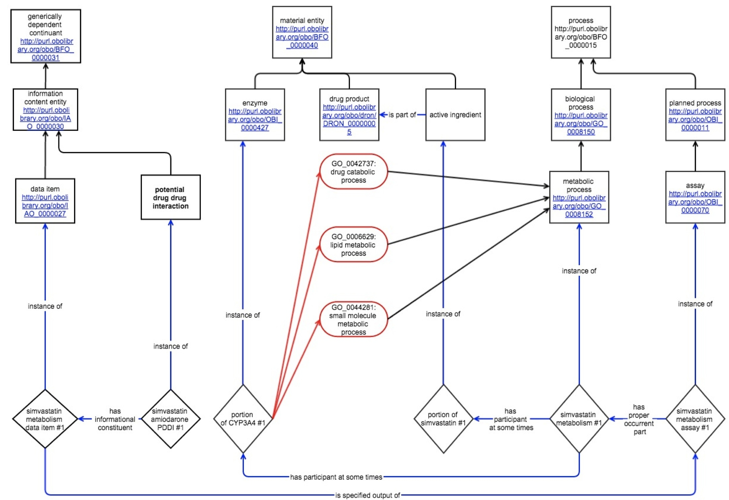
Using Semantic Web technology to link potential drug-drug interaction information to biological and biomedical data Mathias Brochhausen¹, William R. Hogan², Philip E. Empey³, Daniel C. Malone⁴, Richard D. Boyce³ ¹University of Arkansas for Medical Sciences, Little Rock, AR; ²University of Florida, Gainesville, FL; ³University of Pittsburgh, Pittsburgh, PA; ⁴University of Arizona,Tucson, AZ
Introduction
Does the medication, in the intended form of administration, inhibit or induce the action of one or more proteins responsible for the membrane-transport of any drug, d, and does d have a Narrow Therapeutic Index (NTI)?
If a PDDI is possible based on physiological and biological mechanisms, is there evidence of PDDIs occurring for other drugs by similar mechanisms? In other words, is there evidence that drugs which undergo similar metabolic or physiologic processes (e.g. metabolized to the same degree by the same enzyme which is being modulated) were involved in PDDIs?
For examples of target PDDIs, we annotate all drug ingredients and their families with ChEBI [7] URIs and the proteins with its PRO URI. While these annotations have been done manually at first; the development of scripts to automate this process is underway. In addition, each PDDI alert gets assigned a URI.
Table 1: Examples of target PDDIs for competency question 1 (second row) and competency question 2 (third row) and their transformation based on our methodology.
Potential drug-drug interactions (PDDIs) are a significant cause of preventable drug related harm [1]. Current information resources designed for clinicians are incomplete and lack agreement [2]. To address these limitations, we propose a new PDDI knowledge representation paradigm. The new foundational representation focuses on the actual material entities and processes referenced by PDDI evidence and claims. It is designed to enable integration of clinically-oriented PDDI information with basic biological information about chemical and pharmacological mechanisms. The goal of the representation is to help information systems to better meet the information needs of persons who synthesize PDDI information into knowledge resources.
The new ontology is called the Drug-drug Interaction and Drug-drug Evidence Ontology (DIDEO) and is implemented in Web Ontology Language (OWL2) [http://www.w3.org/TR/owl2-primer]. The basic ontological commitments and main features of DIDEO have been described in Brochhausen et al. [3]. This poster shows how DIDEO enables linking drug-drug interaction information to biological and biomedical data annotated with widely used biomedical ontologies, such as the Protein Ontology (PRO) [4] in a way that is highly relevant to the use cases underlying our project.
 | Object | Precipitant | Mechanism | Protein
Target Competency Question 1 | Simvastatin | Amiodarone | Inhibition of metabolism of simvastatin/ lovastatin by CYP3A4 | CYP3A4
Target Competency Question 2 | Rosuvastatin | Gemfibrozil | Inhibition of hepatic transport of rosuvastatin by OATP2B1 | OATP2B1
Transformation Row 1 | http://purl.obolibrary.org/obo/CHEBI_9150 | http://purl.obolibrary.org/obo/CHEBI_2663 | http://purl.obolibrary.org/obo/GO_0009892 | http://purl.obolibrary.org/obo/PRO_000006130
Transformation Row 2 | http://purl.obolibrary.org/obo/CHEBI_38545 | http://purl.obolibrary.org/obo/CHEBI_5296 | http://purl.obolibrary.org/obo/GO_0009892 | http://purl.obolibrary.org/obo/PRO_000015227
Results
Table 2: Example of target PDDIs for competency 3 and its transformation based on our methodology.
Tables 1 and 2 display drug information, drug interaction and mechanism information and the protein involved in examples for target PDDIs for the competency questions. The tables also show the result of transforming the information using pre-existing identifiers from PRO and ChEBI.
The ChEBI annotation of the drug ingredients links the PDDI alert to the Drug Ontology [8]. Since DIDEO shares the DRON developers' aim of scientific accuracy and logical consistency [9] it re-uses the representation of drugs from DRON. In addition ChEBI identifiers are cross-referenced with relevant databases such UniProt KB, Reactome, BRENDA.
Figure 1 shows how using PRO identifiers allows linking to information found in the PIR's iProClass database [http://pir.georgetown.edu/pirwww/dbinfo/iproclass.shtml].
 | Object | Precipitant | Evidence | Shared chemical structure | Protein
Target Competency Question 3 | Alprazolam | Isoniazid | Diazepam – Isoniazid Interaction | Benzodiazepine | CYP3A4
Transformation Row 1 | http://purl.obolibrary.org/obo/CHEBI_2611 | http://purl.obolibrary.org/obo/CHEBI_6030 | http://purl.obolibrary.org/obo/DIDEO_001023 | http://purl.obolibrary.org/obo/CHEBI_22720 | http://purl.obolibrary.org/obo/PRO_000006130
References
Magro L, Moretti U, Leone R. Epidemiology and characteristics of adverse drug reactions caused by drug-drug interactions. Expert Opin. Drug Saf. 11, 83–94 (2012).
Hines LE, Murphy JE, Grizzle AJ, Malone DC. Critical issues associated with drug-drug interactions: highlights of a multistakeholder conference. Am. J. Health-Syst. Pharm. AJHP Off. J. Am. Soc. Health-Syst. Pharm. 68, 941–946 (2011).
Brochhausen M, Schneider J, Malone D, Empey PE, Hogan WR, Boyce RD. Towards a foundational representation of potential drug-drug interaction knowledge. In: Joint Proceedings of Workshops co-located with the International Conference on Biomedical Ontologies 2014 (ICBO 2014), Houston, TX, USA, October 6-9, 2014. CEUR-WS.org, online http://ceur-ws.org/Vol-1309/paper2.pdf.
Natale DA, Arighi CN, Barker WC , Blake JA, Bult CJ, Caudy M, et al. The Protein Ontology: A Structured Representation of Protein Forms and Complexes, Nucleic Acids Research 2011, 39 (Database Issue), D539-545.
Boyce RD. Draft Competency Questions for a Drug Interaction Knowledge Base Derived from Discussions with Clinical Experts, http://purl.net/net/drug-interaction-knowledgebase/competency-questions. Last accessed: 10/01/2014.
The Gene Ontology Consortium. Gene ontology: tool for the unification of biology. Nat Genet. May 2000;25(1):25-9.
Degtyarenko K, de Matos P, Ennis M, Hastings J, Zbinden M, McNaught A, et al. ChEBI: a database and ontology for chemical entities of biological interest. Nucleic Acids Res. 2008, 36, D344–D350.
Hanna J, Joseph E, Brochhausen M, Hogan WR. Building a drug ontology based on RxNorm and other sources. J Biomed Semantics. 2013 Dec 18;4(1):44. doi: 10.1186/2041-1480-4-44.
Hogan WR, Hanna J, Joseph E, Brochhausen M. Towards a Consistent and Scientifically Accurate Drug Ontology. http://www2.unb.ca/csas/data/ws/icbo2013/papers/research/icbo2013submission_40.pdf. Last accessed: 07/05/2015.
Methods
The identification of use cases and the definition of queries that the ontology is meant to support is a crucial activity in ontology development. The formulations of such queries in natural language are called “competency questions”. Competency questions are a key method for validating the result of an ontology development process. We elicited competency questions from clinical experts [5] with significant experience managing PDDI resources. The competency questions related to the underlying drug-drug interaction mechanisms are:
Does the medication, in the intended form of administration, inhibit or induce the action of one or more metabolic pathways (enzymes or glucuronidation) that metabolize any drug, d and does d have a Narrow Therapeutic Index (NTI)?
Conclusion
The results show that a wealth of PDDI data is linkable and retrievable through cross-referencing based on identifiers from pre-existing ontologies. However, we are aware of the fact that aggregating data from different resources can lead to the kind of scientifically problematic affirmation that DIDEO is trying to circumvent.
Acknowledgement:
This project is supported by a grant from the National Library of Medicine: “Addressing gaps in clinically useful evidence on drug-drug interactions” (R01LM011838-01).
Figure 1: Mechanism-related DIDEO representation for the Simvastatin-Amiodarone PDDI, including example candidate relations and related GO classes (in red) found in iProClass. The PDDI is inferred based on a simvastatin metabolism assay and evidence of amiodarone’s effect on the same metabolic pathway (not shown).

