Slide 1
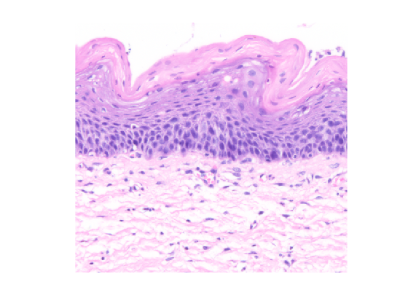
Superficial cells
X = 266; Y = 52
Basal cells
X = 337; Y = 266
Stroma
X = 416; Y = 319

Slide 2
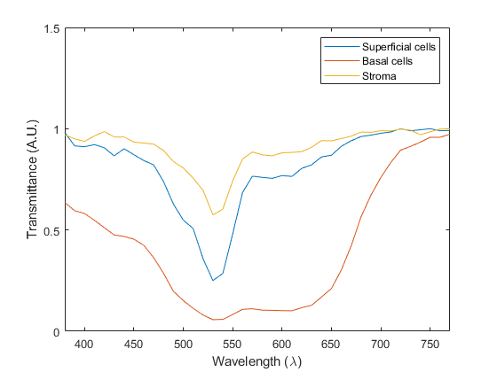
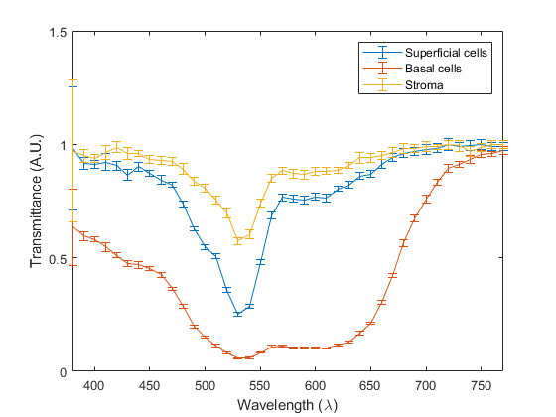
(a)
(b)
Figure 2: (a) Spectral mean values of the transmittance for three pixel positions and (b) corresponding error bar plots with a 95% confidence interval (coverage factor k = 2).

Slide 3
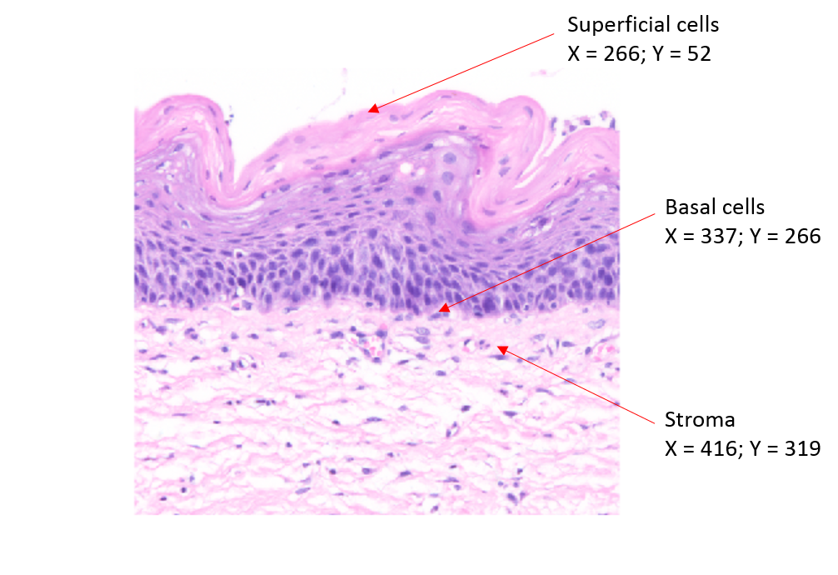
Figure 1: sRGB image of the Uterine Cervix example tissue slide.

Slide 4
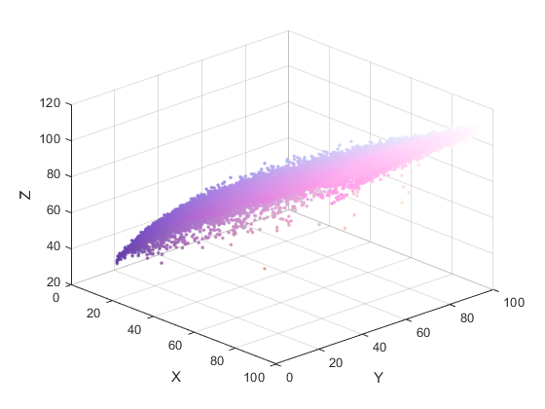
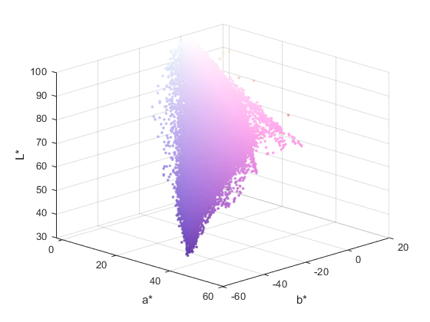
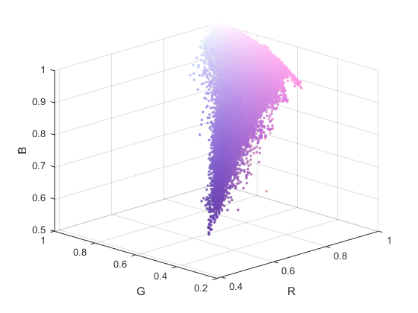
(a)
(b)
(c)
Figure 3: (a) CIEXYZ coordinates, (b) CIEL*a*b* coordinates and (c) sRGB coordinates of the Uterine Cervix example image.

