Slide 1
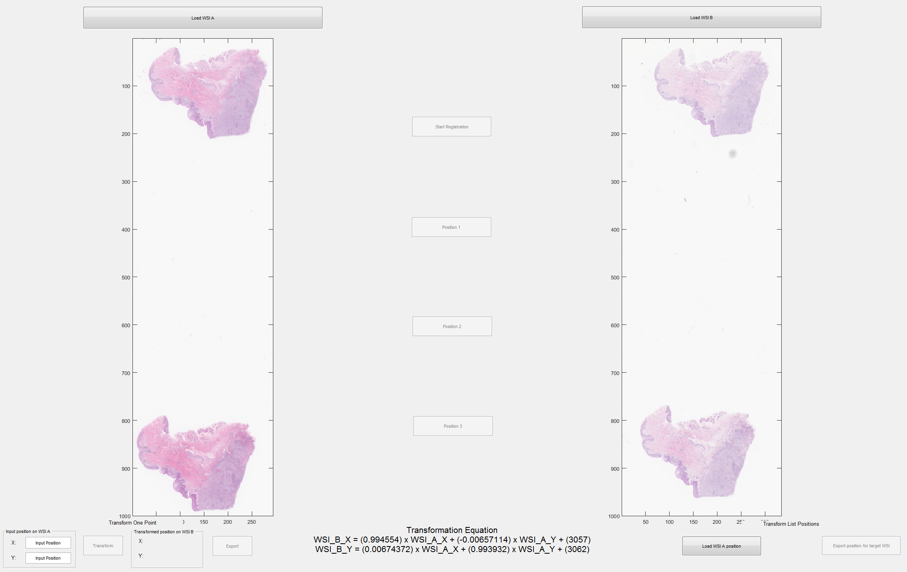
3 points Registration
Live transfer one position
Transfer A List of Positions
Transformation Equation

