Slide 1
Programming in DIAM:
Project Report
Rohan Pathare
June 18, 2013

Slide 2
Topics
Subversion (SVN)
  Version control software
iMRMC
  Reader Study Analysis and Sizing Software
iRoeMetz
  Reader Study Simulation Package

Slide 3
SVN
Subversion, a version control system
  Successor to CVS
Backup
Collaboration
Maintains record of changes
Space grows as a function of changes made

Slide 4
SVN: Usage
Maintain a “repository” on /raidb
  Consists of database of versioned files, revision information, user accounts with fine-grained access
Repository is NOT a filesystem that is directly accessible
“Checkout” repository contents to local machine
Make changes and “commit” them back

Slide 5
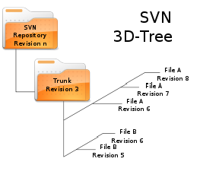
SVN: Usage
Merge conflicting changes
View previous versions of files
  Compare changes between
  versions
Command-line and GUI clients
for all platforms
  TortoiseSVN
  RabbitVCS

Slide 6
SVN: Demo
Create file, commit (machine 1)
Checkout folder, file (machine 2)
Make changes, commit (machine 2)
Update/pull down changes (machine 1)
View log, diff of changes
Notes:
Connect to gray ethernet jack, login to warewulf, projector: input 2 RGB

Slide 7
SVN: Contents
Directory structure
  /administrata
  /eeDAP
  /imrmc
  /lib

Slide 8
SVN: Contents
Subdirectories can act as individual repositories
Simple to create directories for new projects/branches
  No risk of accidental changes to existing projects

Slide 9
iMRMC
Analyze and size MRMC reader studies
Process reader study data from various sources

Slide 10
iMRMC: MRMC Concepts
ROC reader studies¹
  Reader rates an image with likelihood of one of two mutually exclusive alternatives
  Studies have multiple readers, cases, modalities
ROC curves
  Drawn as function of sensitivity, specificity, threshold
Variance analysis
  Determine components of variance
    Readers, normal cases, diseased cases, and interactions
Sizing studies

Slide 11
iMRMC: Original Functionality
Forms of input
  Database
  Raw study data
  Components of variance
Variance analysis of fully crossed data
  With two modalities
Size new trials

Slide 12
iMRMC: Features
New raw data input format
  Non-fully crossed design
  More than two modalities
Graphical depictions of input
Analyze two modalities at a time
  BDG, BCK for non-fully crossed
Alternate calculations of DoF and power
Size trial with arbitrary designs
  Split plot
  Paired readers/cases
Notes:
Split this into two slides

Slide 13
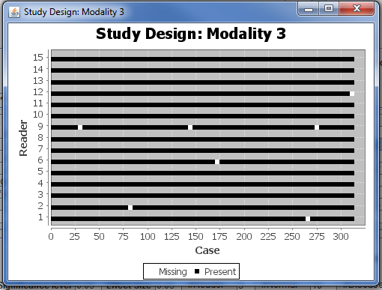
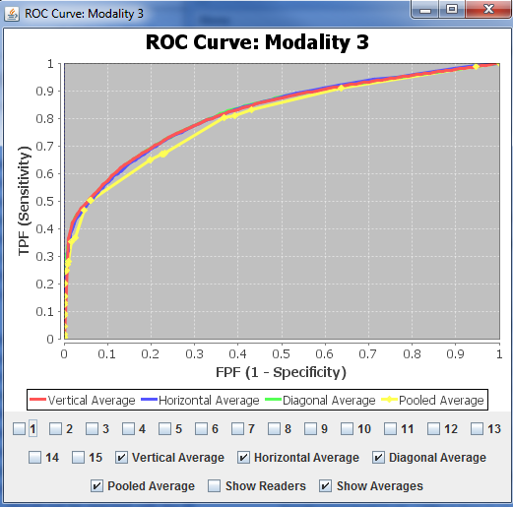
iMRMC: Input file
Study design
  Compare all readers, cases,
  modalities
  Note missing data points
ROC curves
  Individual readers
  Different types of average
  curves
Notes:
Merge this slide into concepts/new features

Slide 14
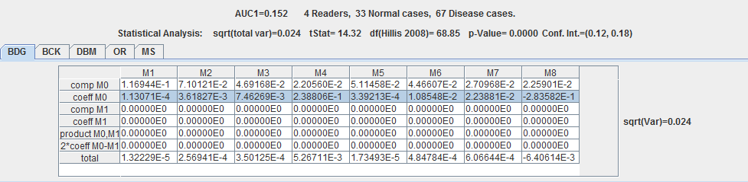
iMRMC: Implementation
Use U-statistics or maximum likelihood estimates of variance components (BDG)²
Components can be transformed
  Other decompositions
    BCK³
    DBM⁴
    MS⁴
    OR⁵
Notes:
Merge this slide into concepts/new features

Slide 15
iMRMC: Implementation
Coefficients account for study design
Fully crossed
  Function of readers, normal cases, disease cases
Arbitrary Design
  Compares both modalities against readers, normal, disease cases if data is present
Notes:
Merge this slide into concepts/new features

Slide 16
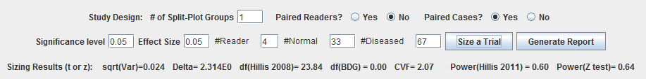
iMRMC: Implementation
Sizing new trial
  Arbitrary designs
    Split plot
    Paired readers/cases
  Sig level, effect size, experiment size
  Effects on study power
Notes:
Merge this slide into concepts/new features

Slide 17
iMRMC: Demo
Demo different types of inputs
For raw data, show fully crossed and non-fully crossed + study design and ROC curves
Variance analysis, explain statistics
  AUC
  DoF (number of variable values that factor into AUC)
  P-value (probability that value of AUC1-AUC2 is just due to noise)
  Power (probability we reject hypothesis that AUC1-AUC2 = 0 given that AUC1-AUC2 != 0)
  Confidence Interval (where we expect AUC to be)
Size new trial, show split-plot design, case/reader pairings and their effect on power

Slide 18
iMRMC: Future Suggestions
Automatic, permanent database entry
  User supplied
Generalized AUC → concordance
  Binary truth → multi-level truth
Generalize for multi-reference scores
  expert panel

Slide 19
iRoeMetz
Simulate MRMC experiments
  Output ready for iMRMC
Simulation parameters (decision scores)
→ Numerical integration
→ MRMC parameters (AUCs)

Slide 20
iRoeMetz: Concepts
Generalized Roe & Metz model
Original model: six variances
  (Readers, cases, readers-cases)
  Modality * (readers, cases, readers-cases)
Generalized model: eighteen variances
  Same as above
  Truth dependent
  Modality dependent

Slide 21
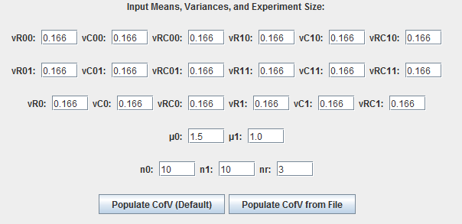
iRoeMetz: Features
Input means, variances, experiment size
  Ability to load values from file

Slide 22
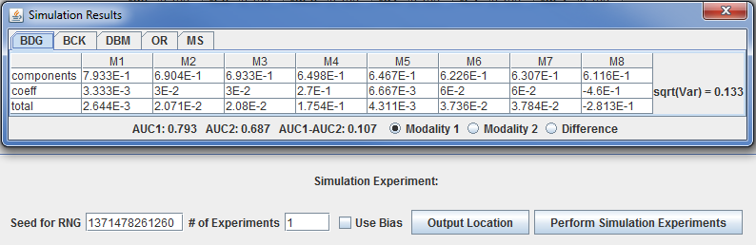
iRoeMetz: Features
Simulate Experiments
  Multiple, randomized experiments
  Estimate components of variance with iMRMC
  Save simulations to file
  Averaged results of simulation

Slide 23
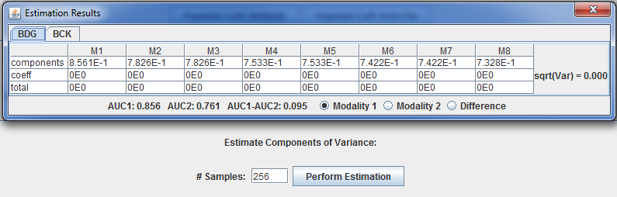
iRoeMetz: Features
Calculate Components of Variance
  Via Numerical Integration

Slide 24
iRoeMetz: Demo
Input means, variances, size, populate automatically, and load from file
Perform multiple simulation experiments, show output
Compare simulation averages to calculation

Slide 25
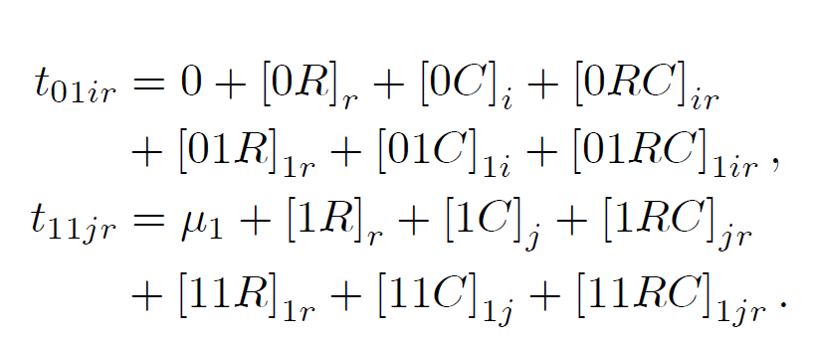
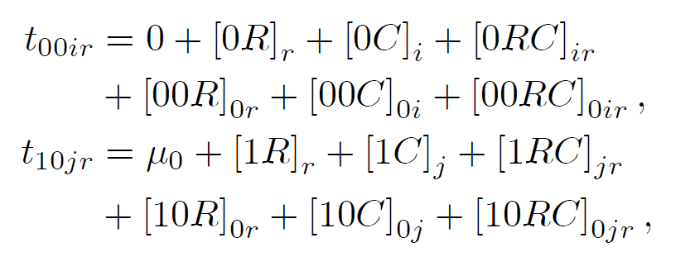
iRoeMetz: Implementation
Generalized Roe & Metz equation
Normally-distributed simulations
  Random number generators
  Mersenne Twister, seed

Slide 26
iRoeMetz: Functionality with iMRMC
Simulated experiment data is formatted as input to iMRMC or other MRMC analysis software
Notes:
Quick demo of iRoeMetz output into iMRMC input, comparison of variance analysis

Slide 27
iRoeMetz: Future Suggestions
What might be implemented next?

Slide 28
Platforms
iMRMC, iRoeMetz both created in Java
Compatible with all platform with Java 6/7
  Windows, OS X, Linux

Slide 29
Distribution
Tools intended to be used by researchers
iMRMC, iRoeMetz hosted on Google Code
Code can be freely shared, modified and improved by open-source community
Gives interface to interactive wiki
https://imrmc.googlecode.com

Slide 30
References
1. Metz, C.E., “Basic principles of ROC analysis.”, Semin Nucl Med. 1978 Oct;8(4):283-98
2. Gallas, B. D. (2006), 'One-Shot Estimate of MRMC Variance: AUC', Acad Radiol 13(3), 353-362.
3. Clarkson, E.; Kupinski, M. A. & Barrett, H. H. (2006), 'A Probabilistic Model for the MRMC Method. Part 1.Theoretical Development', Acad Radiol 13(11), 1410-1421.
4. Dorfman, D. D.; Berbaum, K. S. & Metz, C. E. (1992), 'Receiver Operating Characteristic Rating Analysis: Generalization to the Population of Readers and Patients with the Jackknife Method', Invest Radiol 27(9), 723-731.
5. Obuchowski, N. A. (1995), 'Multireader, Multimodality Receiver Operating Characteristic Curve Studies: Hypothesis Testing and Sample Size Estimation Using an Analysis of Variance Approach with Dependent Observations', Acad Radiol 2(Suppl 1), S22-S29.
6. Gallas, B. D. & Brown, D. G. (2008), 'Reader Studies for Validation of CAD Systems', Neural Networks 21(2-3), 387-397.

