Slide 1
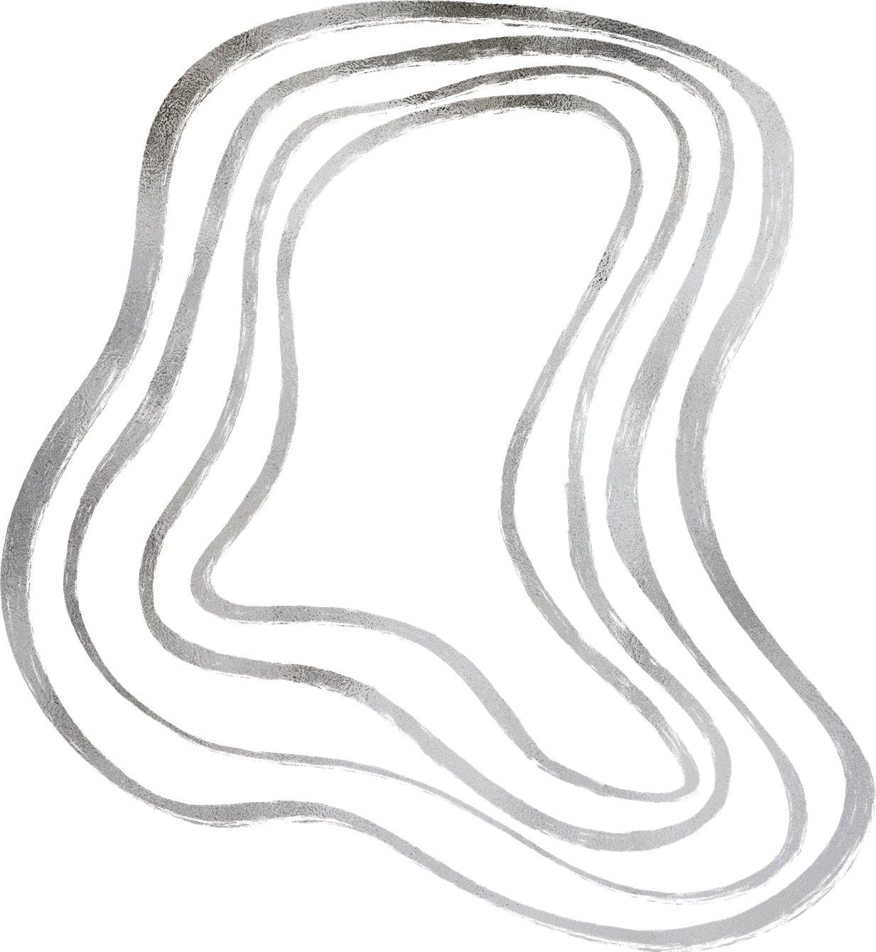

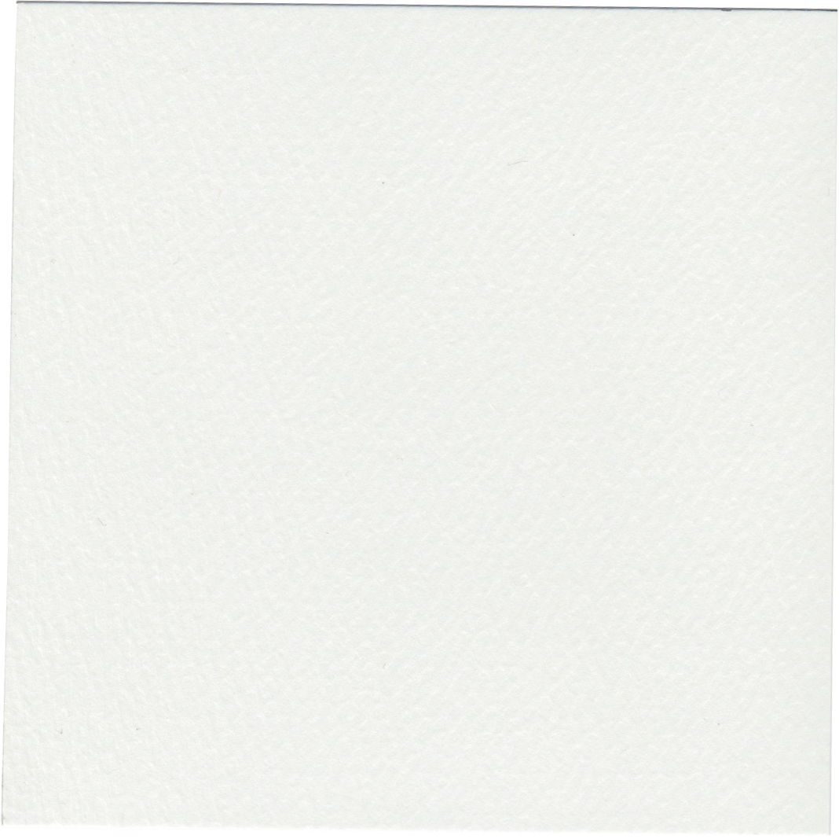

study platform

Slide 2

study platform

Slide 3
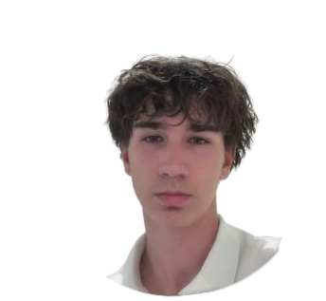
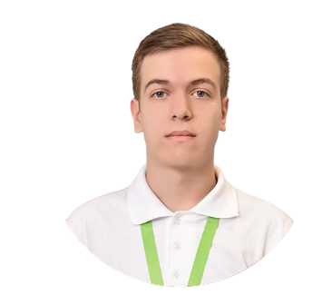
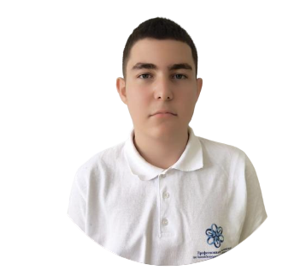
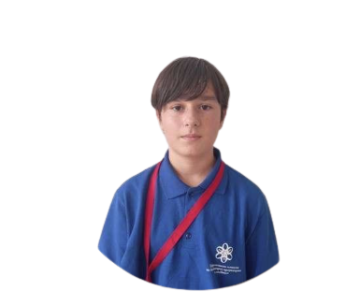
OUR TEAM
alexander dyanov
denislav
dimov
-FRONTEND developer
-SCRUM TRAINER
georgi
georgiev
dimitar
rusev
-backend developer
-backend developer

Slide 4
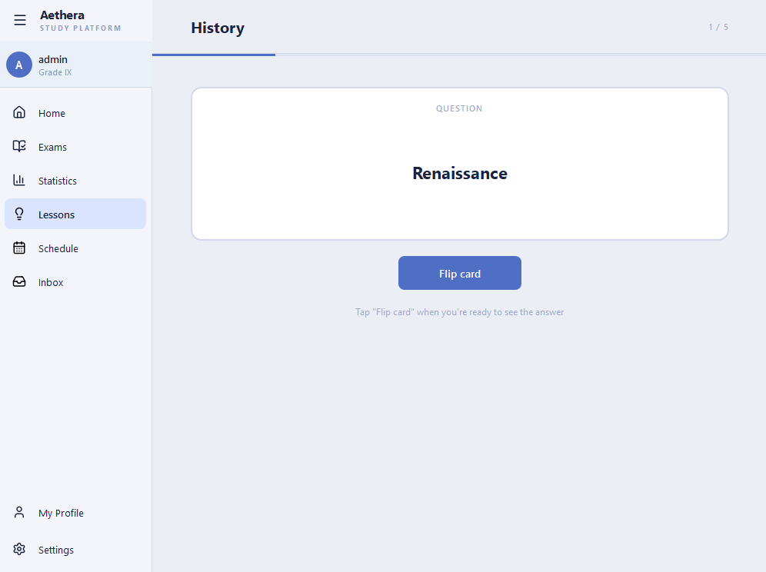
OUR MISSION
Aethera was built to give students a fast and focused way to prepare for exams. We wanted learning to feel rewarding, not exhausting - so we built a fully graphical desktop application using Qt. Our platform lets you test your knowledge, track your progress, and study with flashcards.

Slide 5
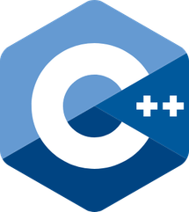






Tech stack

Slide 6
let’s start the demo

