Slide 1

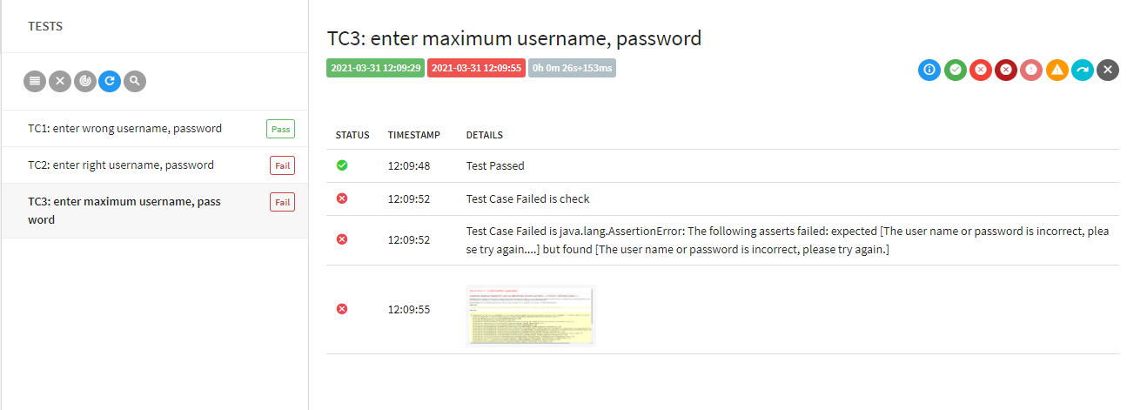
BUILD AN APPLICATION THAT SUPPORTS AUTOMATION TESTING
BUI THI HONG NHUNG 17110201
VO THI KIEU DIEM 17110109
PHAM THI THANH HANG 17110132
Advisor: NGUYEN DUC KHOAN, PhD.

Slide 2
Content of the project
01
02
Use Selenium IDE to perform automated testing on a specific website and build test cases.
Build an application that supports automation testing

Slide 3
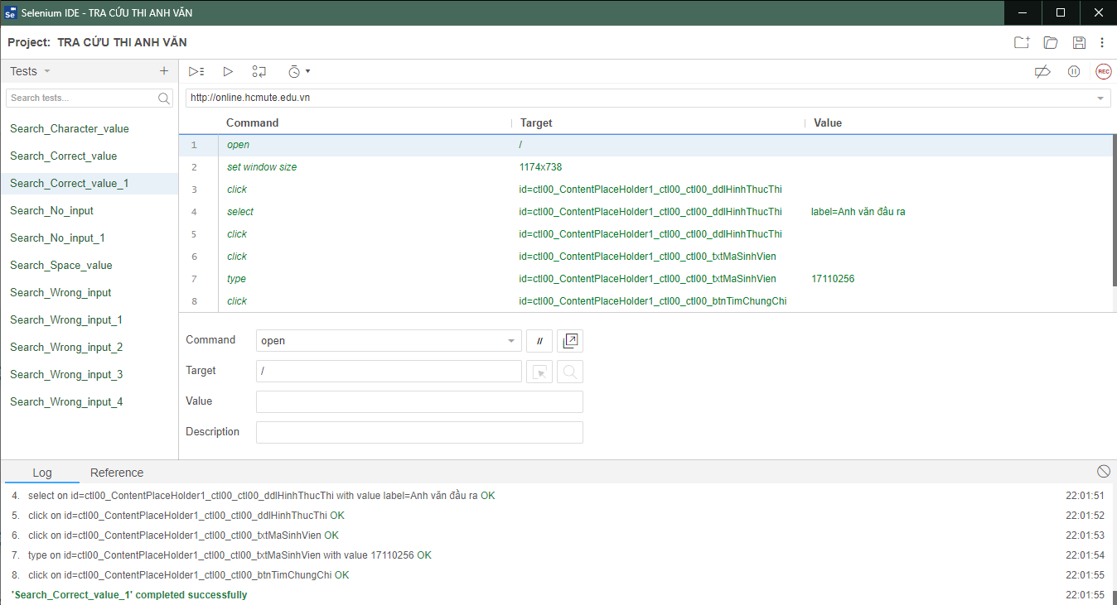





Selenium IDE

Slide 4
Content of the project
01
02
Use Selenium IDE to perform automated testing on a specific website and build test cases.
Build an application that supports automation testing

Slide 5
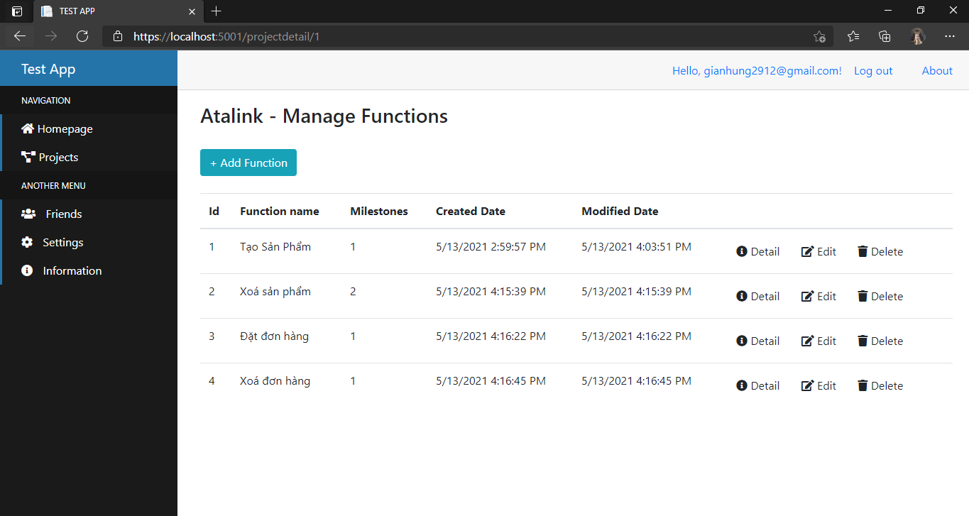
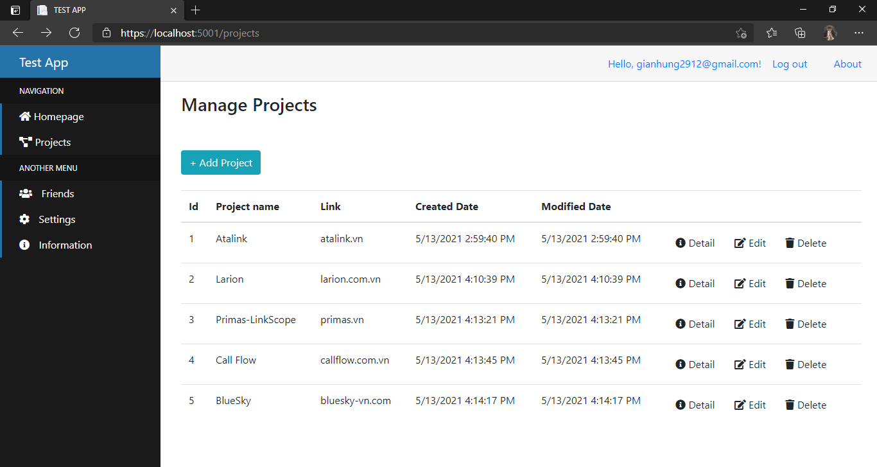
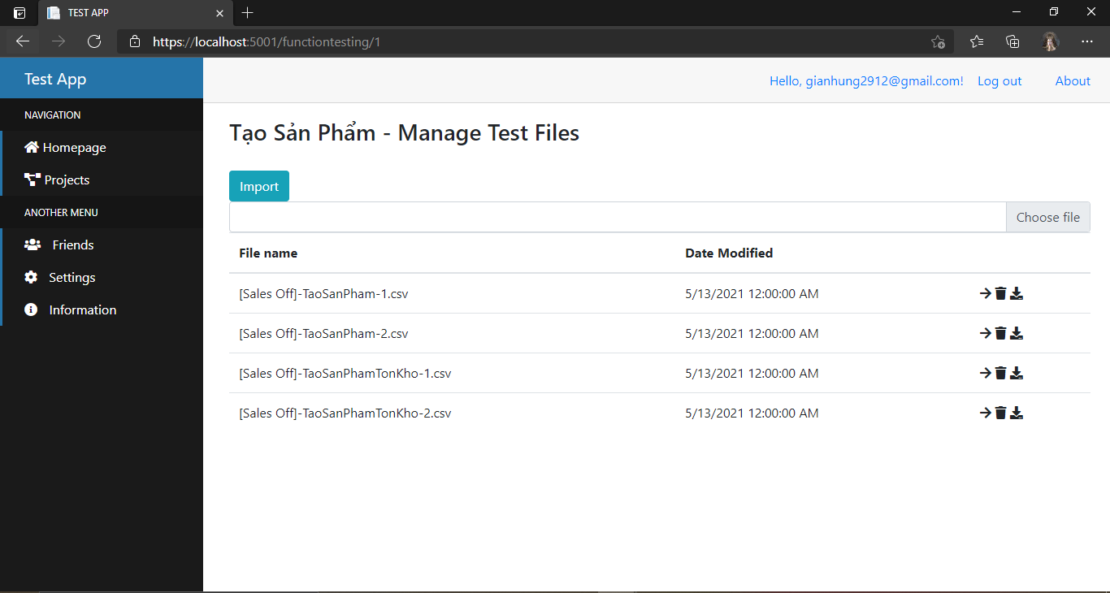
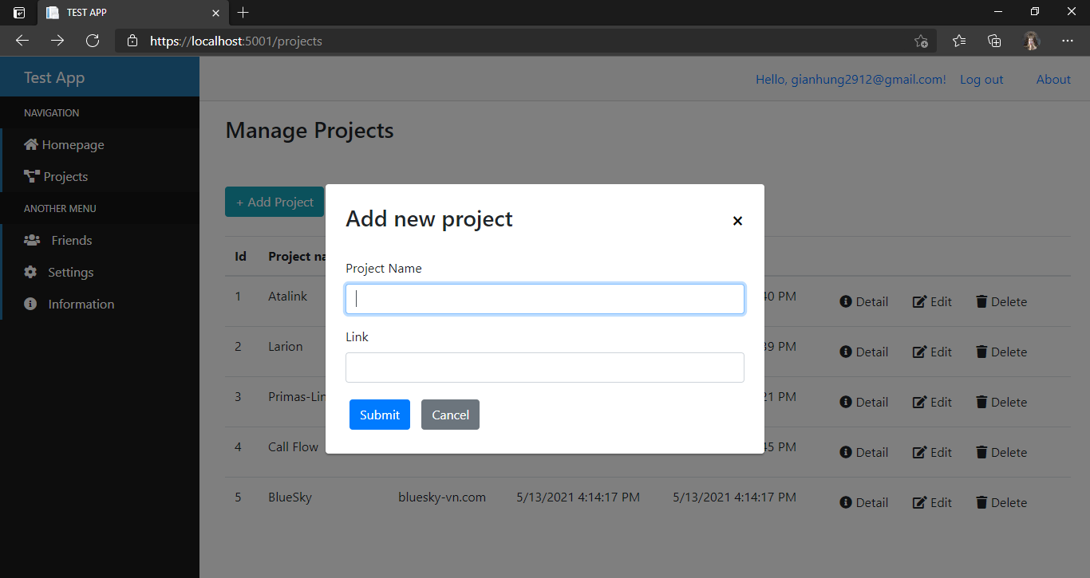
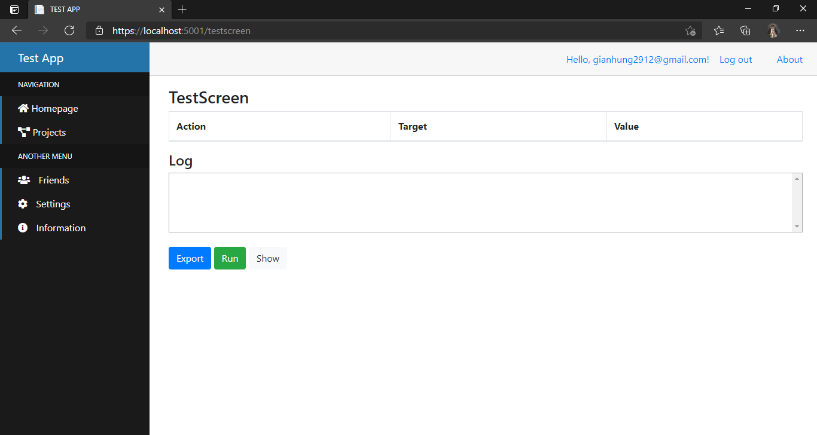
User Interfaces Design
.

Slide 6
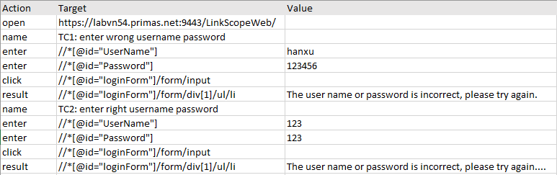
File Input Design
.

Slide 7
Report Screen
.

Slide 8
Thank you for listening!
.

