Slide 1

Crop Recommendation Using Ensemble of Machine Learning Model
Presented By: -
Name | Reg.No.
Kinshuk Goyal | BL.EN.U4CSE20075
Likesh K | BL.EN.U4CSE20086
Puneeth Kumar Oyyavuru | BL.EN.U4CSE20133

Slide 2

INTRODUCTION
India relies heavily on agriculture as its primary source of income.
Conventional agricultural practices are facing challenges in terms of efficiency, cost-effectiveness, and resource utilization.
Precision agriculture is an emerging technology that focuses on site-specific farming and crop recommendation.
Machine learning algorithms are being used to develop efficient and cost-effective solutions for farmers.
Researchers in agribusiness are experimenting on a larger scale and making more accurate real-time forecasts.

Slide 3
OBJECTIVES
Design a recommendation system for accurate crop selection based on the various soil, rainfall, and surface temperature parameters.
To improve crop productivity by providing predictions of high accuracy and efficiency through the ensembling technique.
To analyze the efficiency and speedup gained using Parallelizing the Model training using MPI
To reduce the wrong choice on a crop by application of principles of precision agriculture.

Slide 4
Ensemble Method
Ensembling is a technique that combines multiple machine-learning models to create a predictive model.
Ensembling provides a classifier that performs better than each individual classifier.
In Ensemble learning, multiple models are trained independently and each model predicts the class independently.
A voting method is used to predict the final class.

Slide 5
MPI
MPI provides a standardized communication interface and programming model.
It allows processes running on different nodes to exchange messages, synchronize their operations, and collaborate on complex tasks.
MPI is widely used in various domains, including scientific computing, HPC, and distributed computing, to achieve high performance and scalability.

Slide 6
Parallelizing using MPI
Parallel Model Training: MPI enables parallel training of ensemble models, reducing training time. Each child process is training a individual model .
Data Distribution: MPI allows for data partitioning and distribution, enabling each process to work on its portion of the data.
Information Sharing: when training variables by splitting and using broadcast, it typically involves distributing data across multiple computing resources and synchronizing updates to shared variables.

Slide 7
Parallelizing using MPI
Scalability: The amount of computational power needed to process and share information can grow as data sizes do as well. Therefore, parallelizing tasks can improve a system's ability to scale.
Model Combination and Consensus: MPI facilitates consensus-building by combining multiple models to make more accurate crop recommendations. we are using voting classifier in the parent process for predicting the final class.

Slide 8
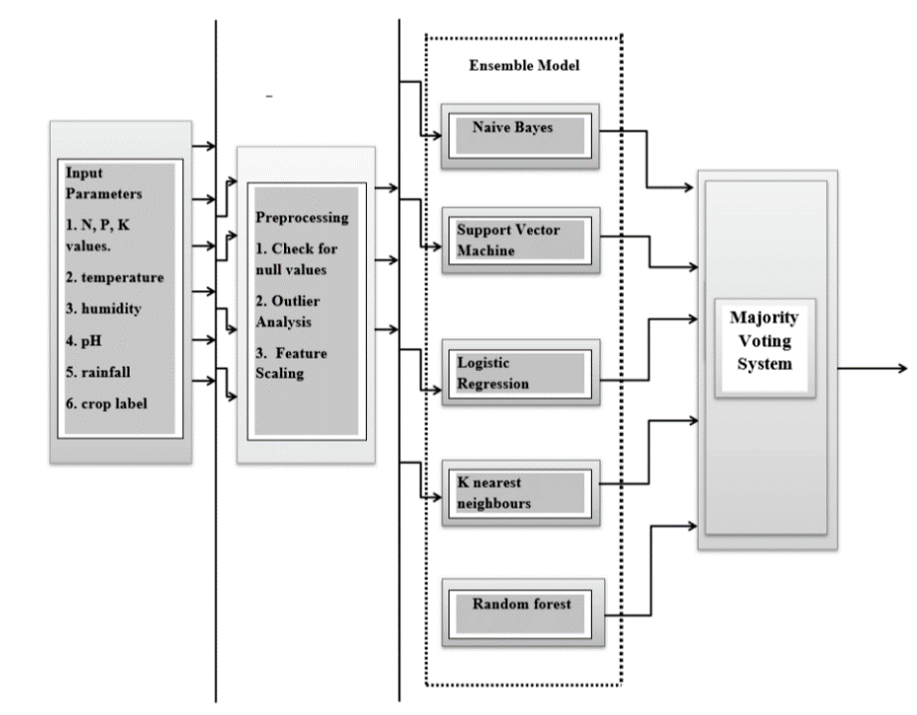
Architecture Diagram

Slide 9
Result
Accuracy: 0.9924242424242424
Sequntial time: 48.67186450958252
Parallel time: 35.67362380027771
Speedup: 1.3643655823158516
Number of processors: 6
Efficiency: 0.2273942637193086

Slide 10
Refrences
[1] Crop_Recommendation_System_Using_Ensembling_Technique- 2022 International Conference on Breakthrough in Heuristics And Reciprocation of Advanced Technologies
[2]Improving Crop Productivity Through A Crop Recommendation System Using Ensembling Technique - 3rd IEEE International Conference on Computational Systems and Information Technology for Sustainable Solutions 2018

