Slide 1

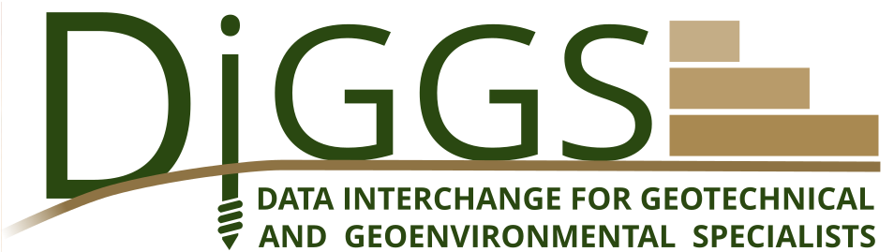
Standardizing Rigid Inclusion Soil Improvement Data with DIGGS
Dr. Mohamed Ezzat

Slide 2
Pre-Installation Phase

Slide 3
Stage 1: Site Investigation Planning
Pre-Installation
Plan a ground investigation program that is good enough to (a) confirm ground conditions, (b) quantify variability, and (c) support RI/CMC design (settlement and bearing) and constructability.
Report at end of stage (key parameters):
Investigation plan: number/location of boreholes and CPTs, target depths, sampling plan
Proposed lab test matrix (classification + strength + compressibility)
Groundwater measurement plan (standpipes/piezometers, monitoring period)
Utility clearance / access constraints
Health & safety plan for drilling and site access
Investigation schedule + responsible parties
DIGGS - Feature
Need new objects:
RigidInclusionProgram (main Program object
ExplorationDesign – phase design object
TargetSF
TargetInstallation
TargetSample
TargetTests
Questions:
Utility/access - per hole location or general for plan?
Health & safety – string, file, or detailed object?
Responsible parties covered by inherited Roles property at Program and/or Design levels

Slide 4
Stage 2: Field Site Investigation Execution
Pre-Installation
Perform borings, CPT/CPTu (often very valuable for CMC), trial pits if needed, groundwater measurements, and obtain good quality samples.
Report at end of stage (key parameters):
Borehole logs: stratigraphy, sample depths, recovery, RQD (if rock), SPT N-values (if used)
CPT/CPTu logs: qc, fs, u2, inferred soil behavior type
Groundwater levels (date/time stamped) and installation details for piezometers
In-situ test results (vane shear, pressuremeter/dilatometer if done)
Any anomalies: fill pockets, obstructions, boulders, artesian conditions, contamination indicators
Coordinates and elevations of all investigation points
DIGGS - Feature
All existing:
Borehole
Sounding
Well
Monitor
SamplingActivity
Sample
Test
StaticConePenetrationTest
VaneShearTest
PressuremeterTest (check)
FlatPlateDilatometerTest (check)
LithologySystem

Slide 5
Stage 3: Laboratory Testing and Soil Characterization
Pre-Installation
Lab tests define engineering parameters: strength, compressibility, index properties, unit weights, permeability.
Report at end of stage (key parameters):
Index: moisture content, Atterberg limits, grain size distribution, unit weight
Strength: UU/CIU/CD triaxial, direct shear (as applicable), undrained shear strength Su correlations
Compressibility: oedometer/consolidation parameters (Cc, Cr, mv, Cv)
Chemical aggressivity (if durability/cement compatibility is relevant): sulfates, chlorides, pH
Summary statistics and variability by layer (mean, range, COV)
DIGGS - Feature
All existing:
Test
WaterContenTest
AtterbergLimitsTest
ParticleSizeTest
LabDensityTest
TriaxialTest
DirectShearTest
ConsolidationTest
ChemicalTest
GeoUnitSystem/Observations - for layer definitions and characteristic property values – presently range only – will have to add for other statistics

Slide 6
Stage 5: Feasibility and Selection of CMC/RI as the Ground Improvement Solution
Pre-Installation
Confirm that CMC/RI is the right solution versus alternatives (piles, stone columns, preloading, DSM, etc.).
Report at end of stage (key parameters):
Target performance criteria: allowable total settlement, differential settlement, bearing/stability targets
Concept options and screening rationale (cost/schedule/risk)
Constructability assessment (access, spoil, groundwater, obstructions)
Preliminary RI/CMC concept: approximate spacing, diameter, depth range, load transfer platform (LTP) concept
Key risks + mitigation (e.g., soft layers thickness uncertainty → additional investigation)
DIGGS - Feature
New objects required -
Need to flesh this out – there's a mix of stuff here, possible objects
RIPerformanceSpecifications (ProgramSpecification)
RIFeasibilty (ProgramDesign) - RI assessment vs others, would include risks/mitigations, soil conditions, etc.
RIConcepts (ProgramDesign) - general design properties – multiple ideas here, or is this essentially final concept/design?

Slide 7
Stage 6: Define Design Basis and Acceptance Criteria
Pre-Installation
Set the “Acceptance Criteria” before detailed design and construction: what counts as compliant installation and compliant performance.
Report at end of stage (key parameters):
Structural loads and load combinations to be supported (service and ultimate)
Settlement criteria and monitoring locations
Minimum column toe level / required bearing layer definition
Minimum LTP thickness and material requirements (if known)
Installation acceptance metrics (examples):
minimum depth / toe tolerance
minimum grout volume ratio or expected theoretical vs actual take
limits on withdrawal rate / pressure range
verticality tolerance
Verification test types and preliminary frequencies (to be finalized with contractor)
DIGGS - Feature
New objects required – needs discussion to flesh out
RIDesignSpec - (ProgramSpecification)
Questions:
I think the list to left can be properties of this one primary object with subobjects: Loads, Settlements, ColumnSpecs, LTPSpecs, InstallationSpecs? Do these topics interrelate at all (requiring several top level objects)
What are preliminary frequencies and verification test types? - is one a spec and the other design?

Slide 8
Stage 7: Detailed CMC/RI System Design (Owner/Engineer Design or Design-Assist)
Pre-Installation
Design the CMC layout and LTP so the system meets settlement, bearing, and stability requirements.
Report at end of stage (key parameters):
Column geometry: diameter, target depth, toe criteria, head cut-off level
Layout: grid type (square/triangular), spacing, treatment footprint, edge detailing
Area replacement ratio (or equivalent) and design stress concentration assumptions
LTP design: thickness, gradation, compaction targets, reinforcement (geogrid) if required
Global stability checks (especially embankments)
Predicted performance: settlement estimate, differential settlement, factors of safety
Drawings + specs: coordinate-based plan, details, tolerances
DIGGS - Feature
New Objects in RigidInclusionProgram dependent on level of detail:
Column geom – per column or general spec?
Layout – can be defined by column locations if individually specified or are designs always regular and can be defined by some type of grid where properties such as footprint, edge detailing, area replacement ratio can be properties of a proposed column?
Predicted performance – overall or for individual elements?
LTPDesign (Program Design)
Global stability checks – not sure how to handle this – need more detail
Drawings can be passed as AssociatedFiles

Slide 9
Stage 8: Contractor Procurement and Method Statement Approval
Pre-Installation
Select the specialty contractor and lock down the construction methodology and QA/QC plan.
Report at end of stage (key parameters):
Contractor qualifications and relevant RI/CMC experience
Equipment/method: displacement vs partial displacement; grout/concrete system; monitoring system
Proposed grout/mortar mix design and supply plan
Inspection & Test Plan (ITP): hold points, records, nonconformance process
Trial section plan and verification testing plan
Proposed production rate and sequencing plan
DIGGS - Feature
Not sure how this fits into current structure.
Seems like possible addendum to the Contract section of the Project object. Perhaps most of these items would be spelled out as part of the Contract between Contractor and Client – if so, we can consider modifying existing Contract object, or
Maybe best handled by AssociatedFile or do we need machine readable metadata on this?

Slide 10
B. Installation Phase

Slide 11
Stage 9: Pre-Construction Site Preparation and Controls
Installation
Prepare the site so the rig can work safely and consistently, and so columns go in the correct locations.
Report at end of stage (key parameters):
Working platform design and certification (bearing capacity, thickness, proof rolling)
Site grading, drainage, dewatering readiness (if needed)
Survey control: benchmarks, grid layout, coordinate system
Utilities clearance confirmation
Environmental controls (washout, spoil handling, grout spill plan)
Approved shop drawings and “Issued for Construction” package
DIGGS - Feature
<name attribute=“attribute value”>value</name>

Slide 12
Stage 10: Trial Section / Test Columns (Optional)
Installation
Install a small number of test columns to confirm constructability and to calibrate acceptance criteria.
Report at end of stage (key parameters):
Test column logs: depth, torque, rotation, penetration/withdrawal rate, grout pressure/volume
Observed issues: obstructions, grout losses, refusal, groundwater effects
Adjusted method parameters and updated acceptance criteria (if needed)
Initial verification results (e.g., early-age strength tests if applicable)
DIGGS - Feature
This was out of order in Pre-Installation Phase but moved here to installation phase.

Slide 13
Stage 11: Production CMC Installation (Main Construction)
Installation
Install the full production set of columns per design and method statement. This is where disciplined data capture is critical.
Report at end of stage (key parameters):
Per column (as-built record):
Unique column ID, coordinates (X/Y), ground level, cut-off level
Start/end time, rig ID/operator
Target depth vs achieved depth; toe stratum confirmation (how verified)
Installation method (tool type, displacement level)
Monitoring While Installing (typical):
penetration rate and withdrawal rate
torque (and/or crowd force)
rotation speed
grout/concrete pressure
grout/concrete volume (and volume vs theoretical)
pauses/stoppages and reasons
Deviations and nonconformances (e.g., short column, obstruction, abnormal grout take)
Corrective actions (re-drill, secondary column, local redesign)
DIGGS - Feature
<name attribute=“attribute value”>value</name>

Slide 14
Stage 11: Production CMC Installation (Main Construction)
Installation
Install the full production set of columns per design and method statement. This is where disciplined data capture is critical.
Report at end of stage (key parameters):
Production summary statistics (weekly/end-of-stage):
Total columns installed vs planned
% meeting each acceptance criterion
List of exceptions + resolutions
Material consumption totals and trends
DIGGS - Feature
<name attribute=“attribute value”>value</name>

Slide 15
Stage 12: Column Head Treatment (Caps) and Platform Interface Works
Installation
Caps or Trim/cut columns to level, protect heads if needed, and prepare for LTP placement.
Report at end of stage (key parameters):
Final head elevation distribution (as-built)
Head condition and any repairs
Confirmation of spacing tolerance / positional tolerance (survey)
Any damaged columns and remediation steps
Integrity tests (if any)
DIGGS - Feature
<name attribute=“attribute value”>value</name>

Slide 16
Stage 13: Load Transfer Platform (LTP) Construction
Installation
Place and compact the granular LTP; install geogrid if designed.
Report at end of stage (key parameters):
LTP thickness (design vs as-built) and level survey results
Material certification:
Gradation
fines content
moisture content range
source and quality tickets
Compaction results:
target relative compaction (%MDD) or density index
in-place density tests (locations and results)
Geogrid/geotextile details (if used): type, strength, overlap, placement photos
Proof rolling/plate load test results if specified
DIGGS - Feature
<name attribute=“attribute value”>value</name>

Slide 17
C. Post-Installation

Slide 18
Stage 14: Verification Testing Program
Post-Installation
Prove the system meets requirements. Typically combines “column quality” verification and “system performance” verification.
Report at end of stage (key parameters):
Test matrix executed vs planned (type, number, locations)
Column verification results (depending on spec/contractor method), such as:
coring results (diameter/continuity, material quality)
compressive strength test results (if samples/cubes are used)
integrity observations (method-dependent)
Load testing (if specified):
column load tests or zone load tests
plate load tests on LTP (if required)
load–settlement curves, interpreted stiffness, acceptance statement
Nonconformances + corrective works + retest outcomes
DIGGS - Feature
<name attribute=“attribute value”>value</name>

Slide 19
Stage 15: Performance Monitoring and Final Acceptance
Post-Installation
Confirm the system performs as expected under construction loads and/or early service loads (especially for embankments).
Report at end of stage (key parameters):
Settlement monitoring results (time vs settlement) at agreed points
Differential settlement checks (adjacent points)
Pore pressure readings (if piezometers used) and trends
Any trigger/action levels exceeded and actions taken
Final acceptance statement linked to criteria in Stage 6
DIGGS - Feature
<name attribute=“attribute value”>value</name>

Slide 20
Stage 16: Closeout and Handover
Post-Installation
Deliver a clean as-built package so the owner can reuse the data and so future teams can learn from the project.
Report at end of stage (key parameters):
Complete as-built dataset: every column + LTP + test results + monitoring records
Summary of compliance: pass/fail counts, exceptions and resolution
Final drawings (as-built layout), certifications, and signed QC/QA package
Lessons learned and recommended improvements for future projects
DIGGS - Feature
<name attribute=“attribute value”>value</name>

Slide 21
Summary of the Parameters for DIGGS

Slide 22
[REQ] = minimum fields that should exist for a usable RI/CMC dataset
[REC] = strongly recommended for QA/QC, analytics, and interoperability
[OPT] = optional (project‑specific or nice to have)

Slide 23
Pre-Installation
A. Project and dataset metadata
[REQ] ProjectID (unique string; persistent) [REQ] ProjectName [REQ] Owner / Client [REQ] SiteName / LocationName [REQ] CoordinateReferenceSystem (EPSG code or WKT) [REQ] VerticalDatum [REQ] UnitsPolicy (explicit; SI/US customary; preferably SI internally) [REQ] DatasetVersion / RevisionID [REQ] AuthoringOrganization [REQ] DataCreationDateTime (ISO 8601) [REC] SpecificationVersion / ContractPackageID [REC] DesignEngineer / GeotechnicalEngineerOfRecord [REC] ContractorName (if known at this stage)

Slide 24
Pre-Installation
B. Ground model linkage (site investigation and design parameters)
(We don’t need to repeat full logs if they already exist in DIGGS SI data, but you must link the RI design to them.)
[REQ] ReferenceToInvestigationData (IDs/links to boreholes/CPTs/lab tests used)
[REQ] DesignGroundwaterLevel (elevation; plus basis: seasonal high/mean)
[REQ] GoverningSoilLayers (IDs or names; thickness ranges)
[REC] DesignParameterProfiles (per layer or depth-dependent):
Su(z) or strength parameters (Su, φ’, c’)
Compressibility (mv, Cc/Cr, Cv)
Stiffness (E or equivalent)
[OPT] GeohazardFlags (soft pockets, organic, liquefaction susceptibility, obstructions risk)

Slide 25
Pre-Installation
C. RI/CMC design intent (what was designed)
C1. Treatment area / zones (recommended as a “TreatmentArea” feature)
[REQ] TreatmentAreaID
[REQ] TreatmentAreaBoundaryGeometry (polygon)
[REQ] GroundImprovementPurpose (enumeration; settlement control / bearing / stability / etc.)
[REC] ZoneType (building slab / embankment / tank / platform)
[REC] TargetPerformanceCriteria
MaxTotalSettlement (mm)
MaxDifferentialSettlement / AngularDistortion (mm or ratio)
FactorOfSafetyTargets (bearing/stability)

Slide 26
Pre-Installation
C2. CMC layout and geometry (design values)
[REQ] DesignInclusionType (RigidInclusion / CMC)
[REQ] PatternType (square / triangular / custom)
[REQ] DesignSpacingS (m)
[REQ] DesignDiameterD (m)
[REQ] DesignDepth / ToeElevation (m or elevation)
[REQ] CutoffElevation (planned column head level)
[REQ] EndBearingLayerDefinition (text + layer ID)
[REC] EdgeTreatmentDetails (half‑spacing, perimeter rows, transitions)
[REC] AreaReplacementRatio (dimensionless)
[REC] DesignStressConcentrationAssumption (dimensionless, if used)
[OPT] DesignMethodReference (unit‑cell / numerical / project method memo)

Slide 27
Pre-Installation
C3. Load Transfer Platform (LTP) design intent
[REQ] LTP_ID
[REQ] LTP_ThicknessDesign (m)
[REQ] LTP_MaterialType (granular fill / engineered fill)
[REQ] LTP_GradationLimits (spec band or reference)
[REQ] LTP_CompactionRequirement (e.g., %MDD or relative density)
[REC] LTP_ReinforcementFlag (yes/no)
[REC] GeosyntheticType (geogrid/geotextile)
[REC] GeosyntheticStrengthProperties (as specified)
[OPT] LTP_StiffnessTarget (Ev2 / modulus target)

Slide 28
Pre-Installation
D. Construction plan and acceptance criteria (the “rules”)
[REQ] InstallationMethodPlanned (full displacement / partial displacement / predrill + tremie / etc.)
[REQ] Grout/ConcreteMixDesignID (reference)
[REQ] TargetProductionTolerances
PositionTolerance (mm)
VerticalityTolerance (% or mm/m)
DepthTolerance (m)
[REQ] AcceptanceCriteriaSetID (reference)
[REC] TrialSectionRequired (yes/no; and limits)
[REC] PlannedVerificationTests
type + frequency + locations logic
[OPT] EnvironmentalConstraints (spoils handling, washout plan, etc.)

Slide 29
Installation
A. Rig / equipment / monitoring system metadata
[REQ] RigID [REQ] MonitoringSystemName/Version (if digital logging used) [REQ] OperatorID (or crew ID) [REC] ToolType (auger type, diameter, bit) [REC] CalibrationRecords (flow meter, pressure sensor calibration date) [OPT] WeatherConditions (if relevant for grout)
B. Material batching and delivery (linked to columns)
[REQ] MaterialBatchID [REQ] MaterialType (grout / mortar / concrete) [REQ] BatchDateTime [REQ] BinderType (cement type) [REQ] WaterCementRatio (or mix proportions) [REC] Admixtures (type + dosage) [REC] FreshProperties (slump/flow, density, temperature) [OPT] SupplierTicketID
This is the core of RI/CMC value. In DIGGS terms, treat each CMC as a Feature with geometry, plus an InstallationActivity with time series or summarized metrics.

Slide 30
Installation
C. Per‑column “header” (minimum as‑built identity + geometry)
[REQ] InclusionID (unique, persistent) [REQ] TreatmentAreaID (link) [REQ] PlannedX, PlannedY [REQ] AsBuiltX, AsBuiltY (survey or rig GNSS) [REQ] GroundSurfaceElevationAtInstall [REQ] StartDateTime / EndDateTime [REQ] PlannedDepth vs AchievedDepth [REQ] CutoffElevationAchieved [REQ] InstallationMethodActual (enumeration) [REQ] Status (installed / replaced / rejected / reworked)
This is the core of RI/CMC value. In DIGGS terms, treat each CMC as a Feature with geometry, plus an InstallationActivity with time series or summarized metrics.

Slide 31
Installation
D. Per‑column installation records (summaries)
These can be recorded either as time series (preferred) or as summary values (minimum).
Minimum summary metrics
[REQ] TotalInjectedVolume (m³) [REQ] VolumePerMeter (m³/m) (or equivalent) [REQ] MaxInjectionPressure (kPa or bar) [REQ] AverageInjectionPressure [REQ] WithdrawalRateAverage (m/min) [REC] PenetrationRateAverage (m/min) [REC] MaxTorque / AverageTorque (kN·m) [REC] RotationSpeedAverage (rpm) [REC] MaterialBatchIDUsed (link)

Slide 32
Installation
Termination / refusal information
[REQ] TerminationType (design depth reached / refusal / obstruction / other)
[REQ] TerminationDepth / Elevation
[REC] TerminationReasonDetail (free text + code list)
[REC] ObstructionEncounteredFlag (yes/no; depth)
Nonconformance + corrective action
[REQ] NonconformanceFlag (yes/no)
[REQ] NonconformanceType (short column / low take / high take / deviation / etc.)
[REQ] CorrectiveAction (re-drill / additional column / redesign / accept as-is)
[REC] EngineerDispositionID (approval/refusal record)

Slide 33
Installation
E. Installation time‑series (strongly recommended)
If the rig logs continuously, store time series keyed by timestamp and depth.
[REC] Depth(t) or Depth vs Time
[REC] PenetrationRate(t)
[REC] WithdrawalRate(t)
[REC] Torque(t)
[REC] RotationSpeed(t)
[REC] CrowdForce/Downforce(t) (if available)
[REC] PumpPressure(t)
[REC] FlowRate(t)
[REC] CumulativeVolume(t)
[OPT] GroutTemperature(t)
[OPT] Vibration/Noise metrics (if recorded)

Slide 34
Post-Installation
A. As‑built RI/CMC inventory summary
[REQ] TotalInstalledCount
[REQ] InstalledByZoneCount
[REQ] ExceptionsList (IDs)
[REC] StatisticalSummaries (depth/volume/pressure distributions)
[REC] AsBuiltSpacingCheckResults (min/mean/max spacing; outliers)
B. Column head treatment and survey
[REQ] FinalHeadElevation (per column or per cluster)
[REQ] PositionSurveyResult (per column)
[REC] HeadCondition (good / damaged / repaired)
[OPT] HeadProtectionDetails (cap, lean concrete, etc.)

Slide 35
Post-Installation
C. LTP construction (as‑built + QC)
[REQ] LTP_AsBuiltThicknessMap (spot checks with coordinates)
[REQ] MaterialSourceID
[REQ] GradationTestResults (IDs; location/date)
[REQ] CompactionTestResults (density/moisture; location/date)
[REC] GeosyntheticAsBuilt (type, roll IDs, overlaps, photos reference)
[OPT] PlateLoad / ModulusTestResults (Ev2 or equivalent)

Slide 36
Post-Installation
D. Verification testing (columns and/or system)
You may not do all of these on every project, but the schema should support them.
Column verification
[REQ] VerificationTestID [REQ] TestType (coring / UCS / integrity / excavation exposure / etc.) [REQ] AssociatedInclusionID(s) [REQ] TestDateTime [REQ] ResultSummary + PassFail [REC] CoreDetails (if coring): core length, recovery %, observed defects measured diameter UCS results (MPa) + specimen metadata [OPT] IntegrityMethodDetails (if used; method‑specific fields)

Slide 37
Post-Installation
D. Verification testing (columns and/or system)
Load testing (if required)
[REQ] LoadTestID
[REQ] TestType (single inclusion / group / zone / plate)
[REQ] LoadSteps (kN) + hold times
[REQ] SettlementMeasurements (mm vs time/load)
[REQ] AcceptanceCriteriaReference
[REC] InterpretedStiffness/Capacity (project-defined)

Slide 38
Post-Installation
E. Performance monitoring time‑series (if instrumentation exists)
[REQ] InstrumentID (settlement plate, extensometer, piezometer, inclinometer)
[REQ] InstrumentType
[REQ] Location (X,Y,Z)
[REQ] ReadingDateTime
[REQ] ReadingValue + Units
[REC] TriggerLevels (alert/action thresholds)
[REC] EventsLog (construction stage, embankment lift height, loading milestones)
[OPT] AutomatedDataFeedMetadata (if IoT)

Slide 39
Post-Installation
F. Remediation / rework records
[REQ] RemediationActionID
[REQ] Trigger (why remediation was required)
[REQ] ActionType (additional column / replacement / local redesign / etc.)
[REQ] LinkedInclusionIDs
[REQ] VerificationAfterRemediation (test ID + pass/fail)

Slide 40
Post-Installation
G. Final acceptance package fields
[REQ] AcceptanceDate
[REQ] AcceptanceAuthority (name/role)
[REQ] ComplianceStatement (met all criteria / exceptions accepted)
[REQ] FinalAsBuiltDatasetReference (file set ID / repository tag)

Slide 41
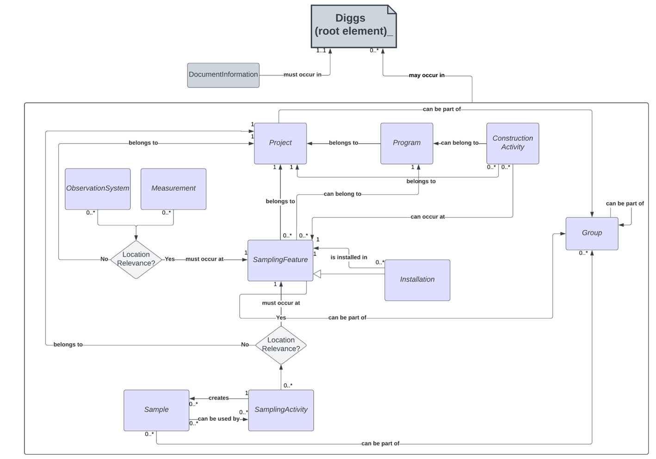

Slide 42
Thank You
Mohamed Ezzat

