Slide 1
Project Presentation
Name – D.Y. Senanayake
Reg no. - 1019
Link - DIKA-S/Dimantha_HelloWorldLabs: jwjwjwajkwajkaw (github.com)
Invitation Link - https://github.com/DIKA-S/Dimantha_HelloWorldLabs/invitations

Slide 2
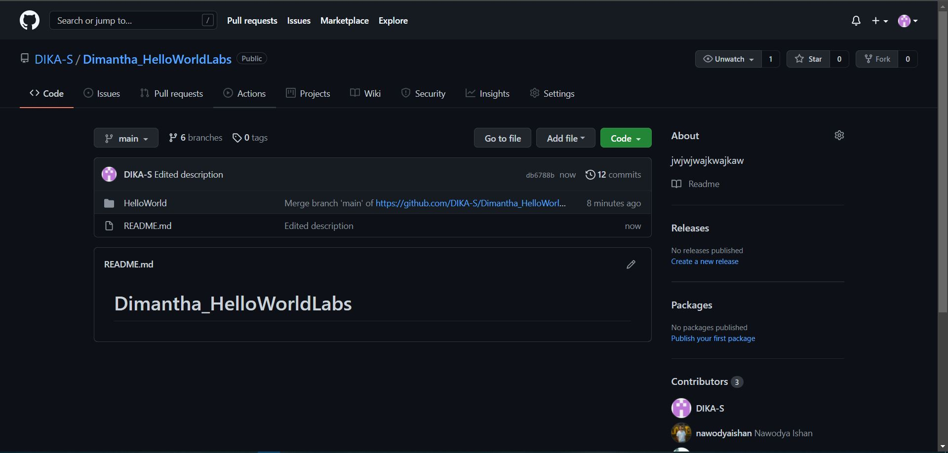

Slide 3
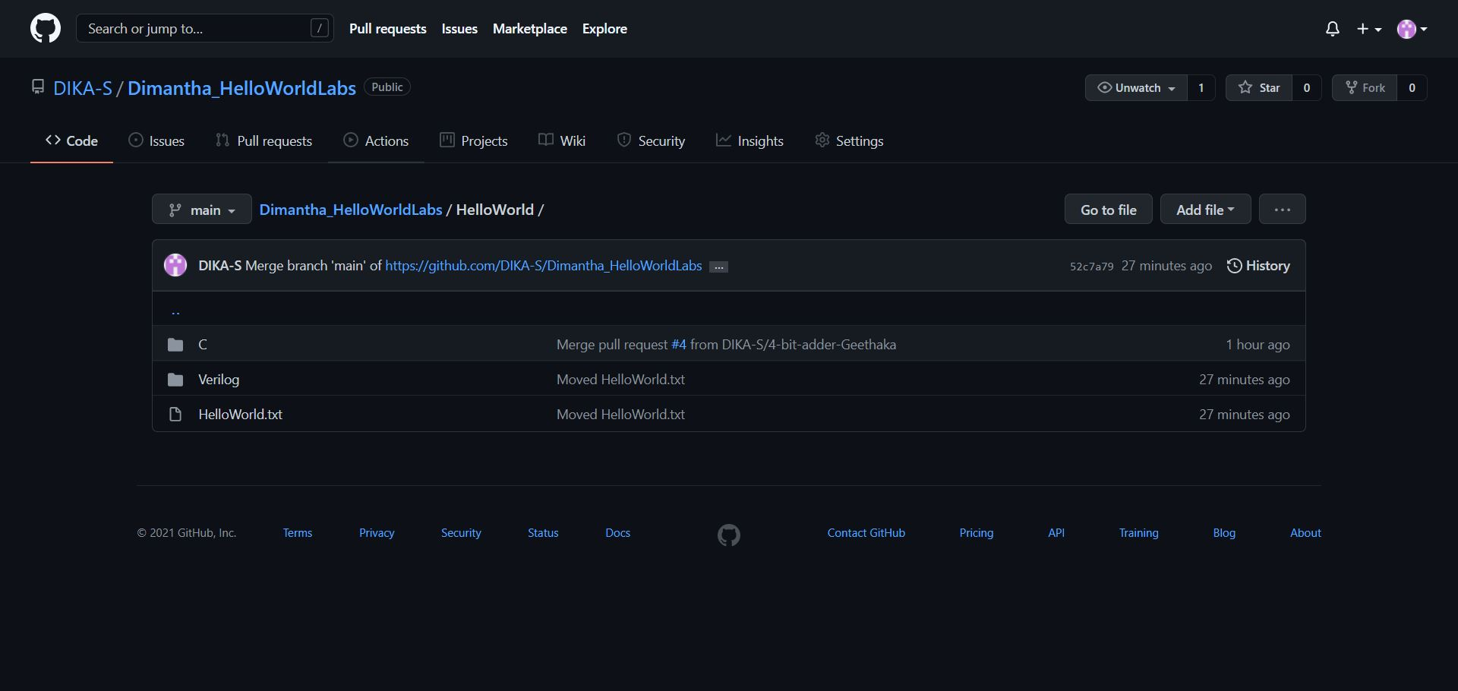

Slide 4
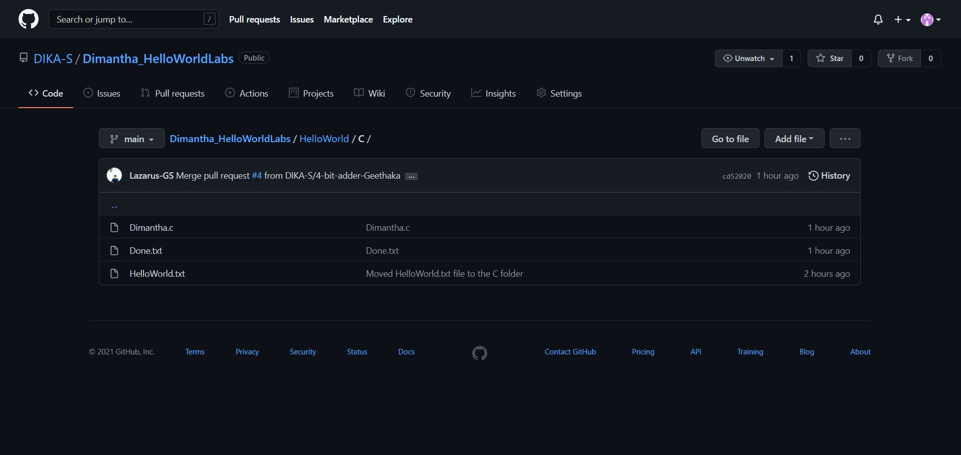

Slide 5
