Slide 1
PROJECT ON ANALYTICS
Presented by:
Diksha Harad
Under the guidance of:
Priti Yadav

Slide 2
Project-1 Part-1

Slide 3
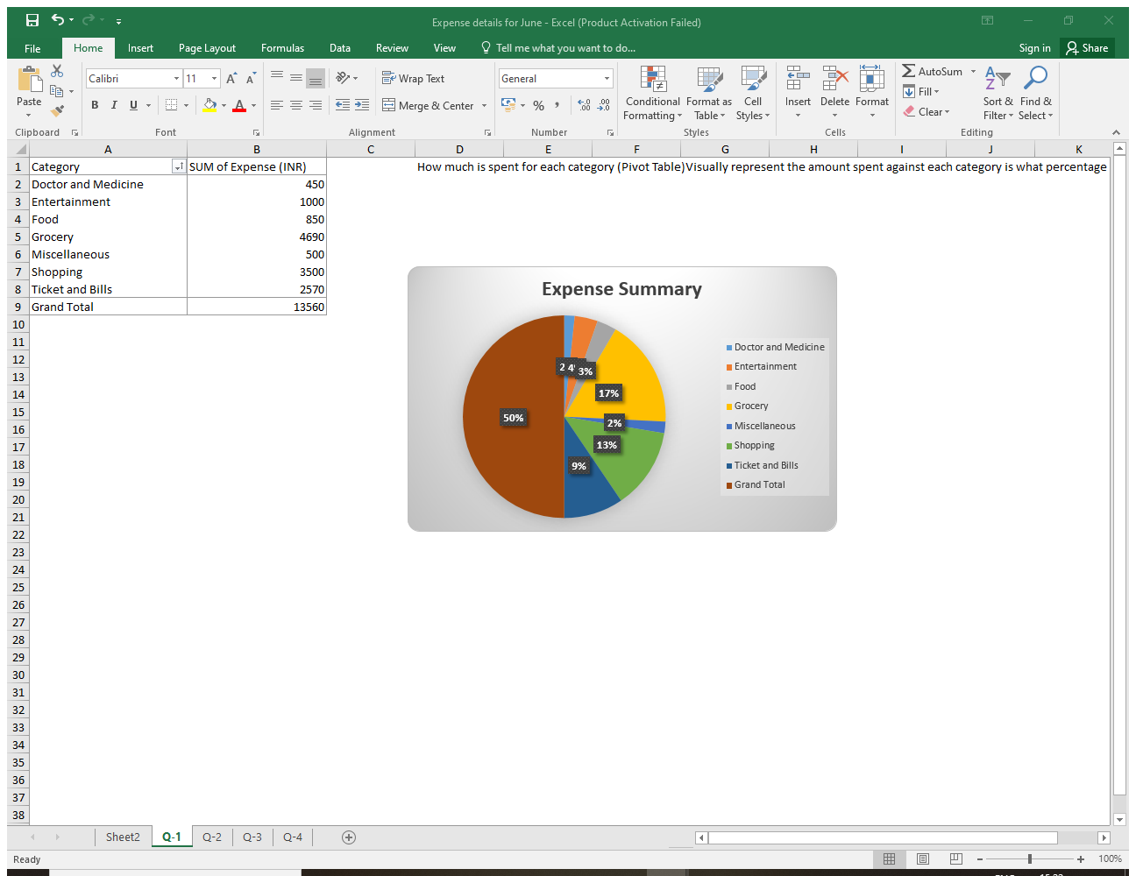
How much is spent for each category (Pivot Table)
Visually represent the amount spent against each category is what percentage of the total expense amount (Pivot Chart)

Slide 4
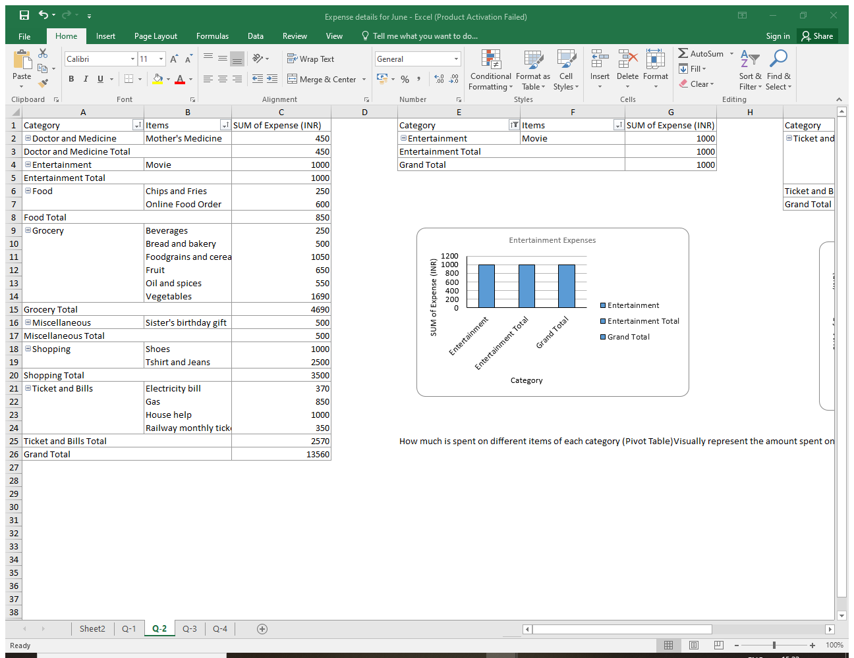
How much is spent on different items of each category (Pivot Table)
Visually represent the amount spent on different items of Entertainment and Tickets and bills category (Pivot Chart)

Slide 5
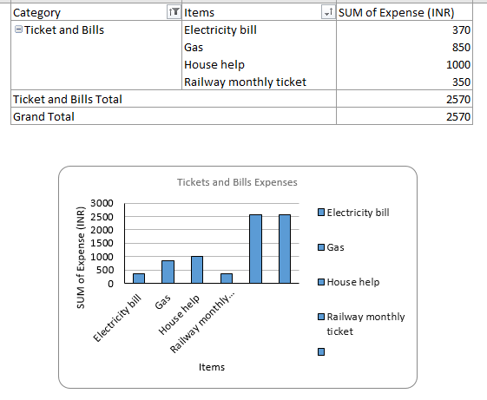

Slide 6
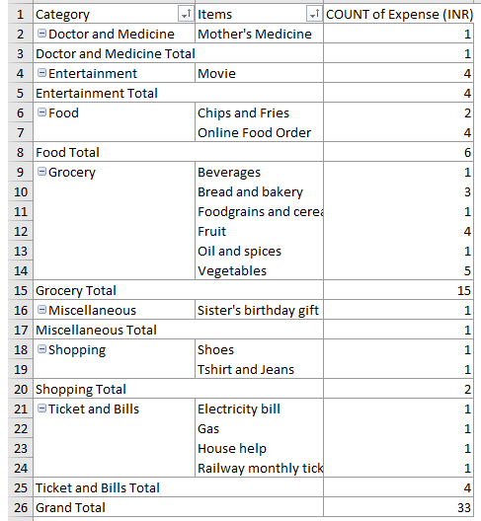
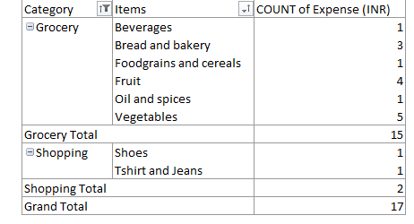
How many times money has been spent against different items of each category (Pivot Table)
Filter the data to display the data for Grocery items and Shopping items

Slide 7
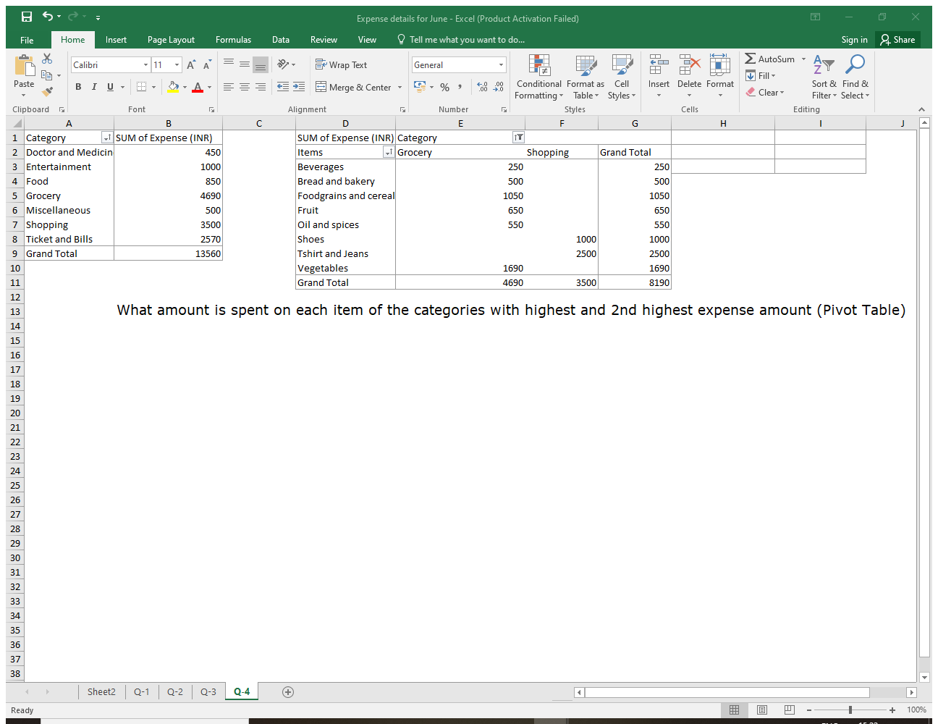
What amount is spent on each item of the categories with highest and 2nd highest expense amount (Pivot Table)
Visually represent the data with data bars (Conditional formatting)

Slide 8
Project-1 Part-2

Slide 9
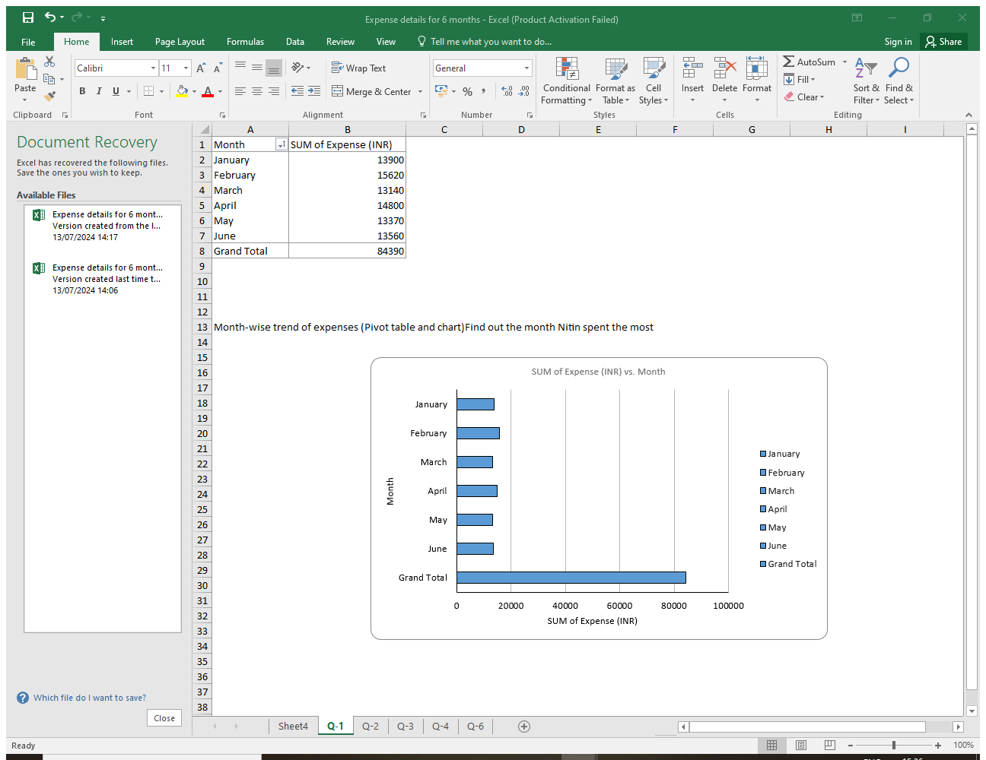
Month-wise trend of expenses (Pivot table and chart)
Find out the month Nitin spent the most

Slide 10
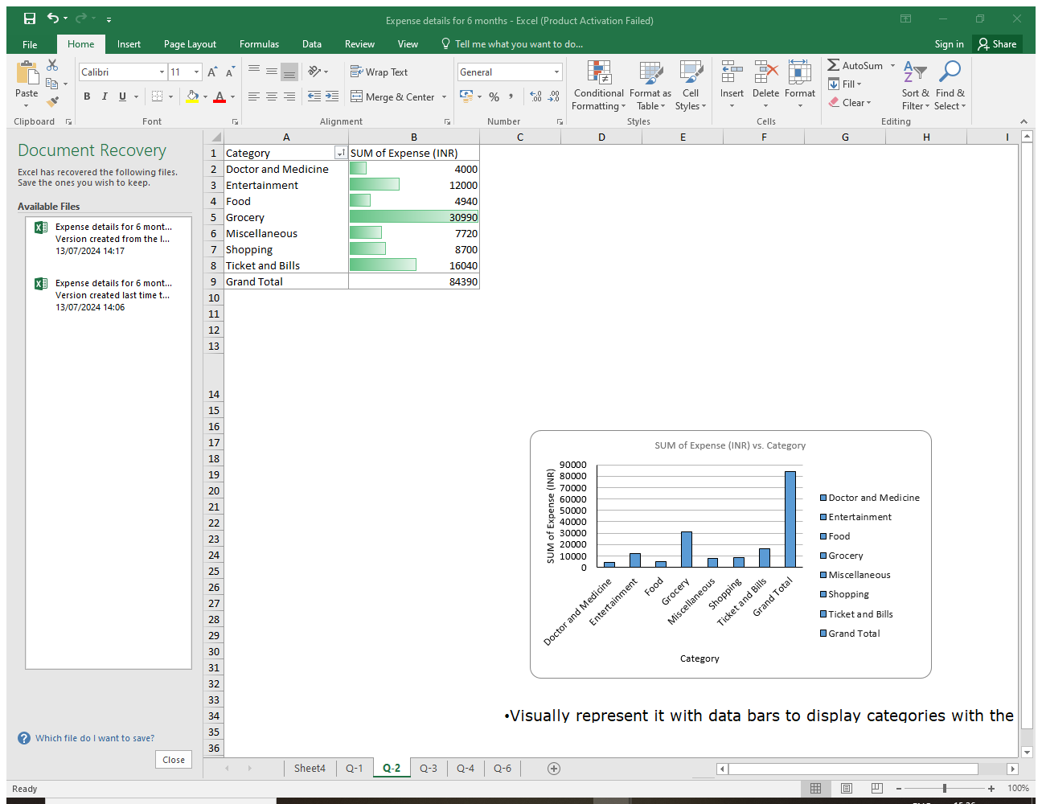
Category wise expenses (Pivot table)
Visually represent it with data bars to display categories with the highest and lowest expense amount

Slide 11
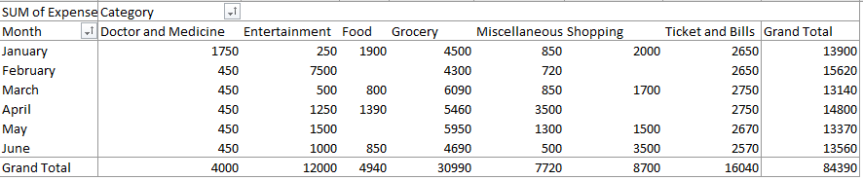
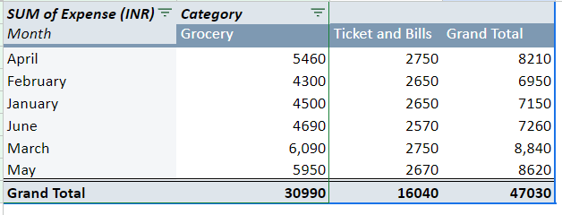
Month-wise expense of each category (Pivot table)
Find out 2 categories with higher expenses for each of the 6 months

Slide 12
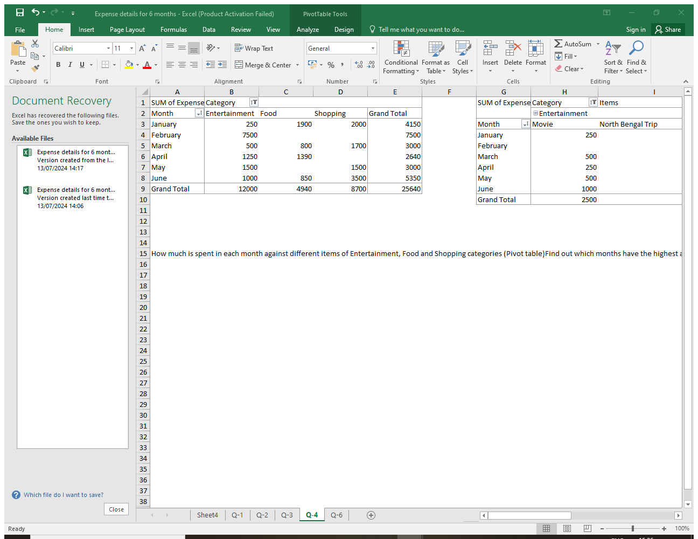
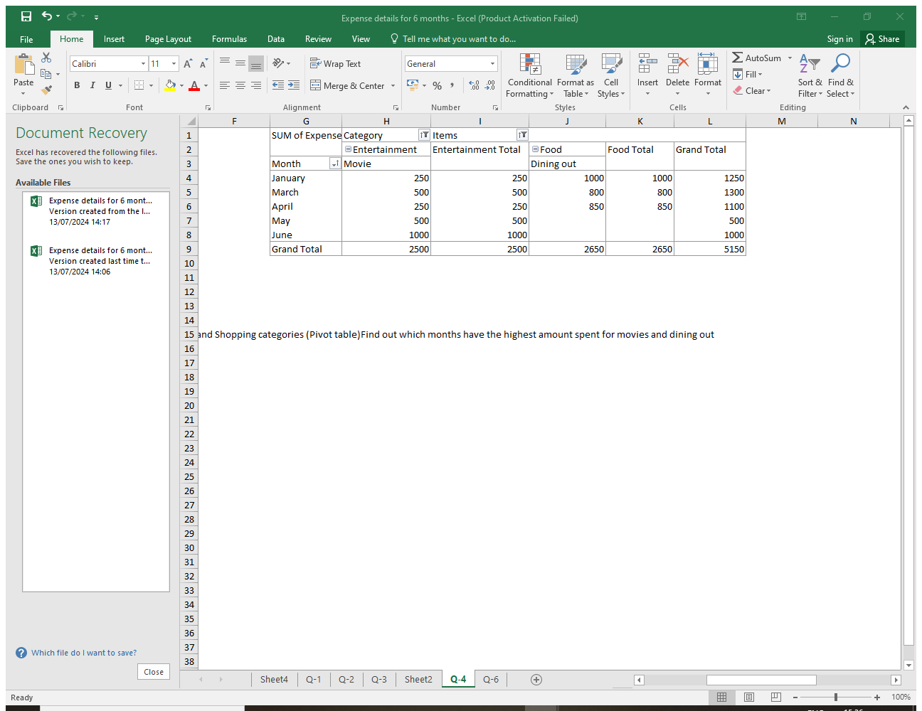
How much is spent in each month against different items of Entertainment, Food and Shopping categories (Pivot table)
Find out which months have the highest amount spent for movies and dining out

Slide 13
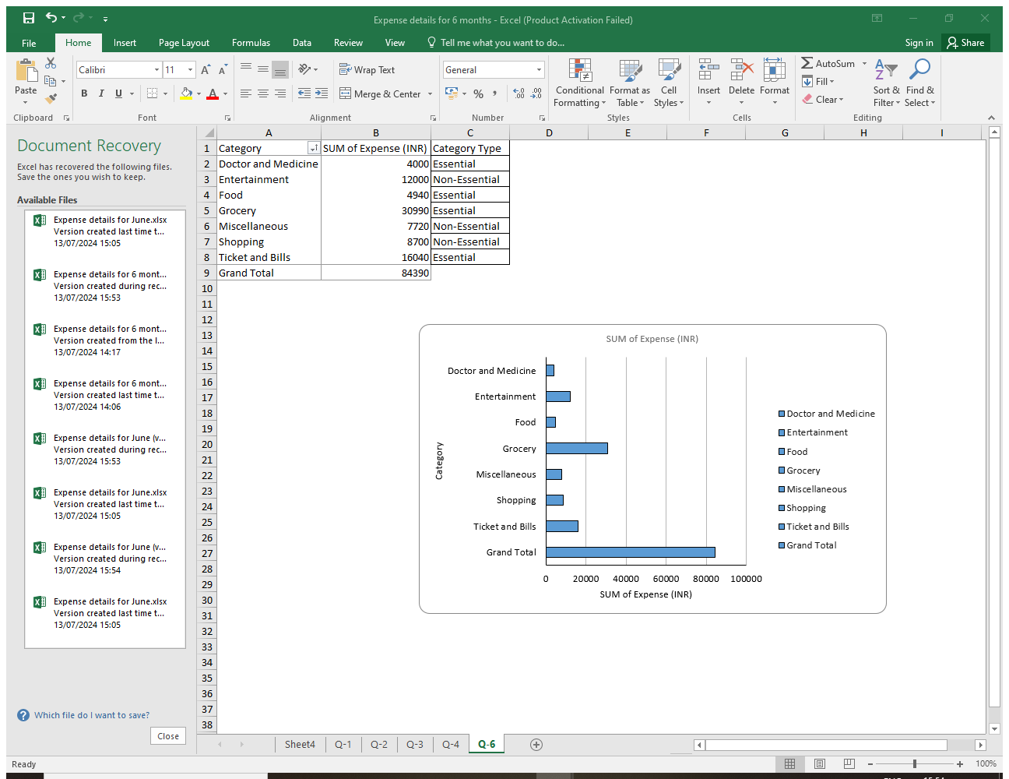
Decide on the essential and less essential items and analyse the expenses
Recommend how can Nitin increase his savings

Slide 14
Recommend how can Nitin increase his savings
Track and Analyze Spending Patterns: - Review spending trends to identify areas of high expenditure and assess necessity. Regularly update and analyze monthly expenses to ensure adherence to budget goals.
Set Clear Savings Goals: - Establish specific, measurable, achievable, relevant, and time-bound (SMART) savings goals. Break them into monthly targets to track progress and stay motivated.
Create a Realistic Budget: - Allocate funds for essential expenses first (e.g., Doctor and Medicine, Food, Grocery, Ticket and Bills). Set limits for non-essential categories (e.g., Entertainment, Shopping, Miscellaneous) to prevent overspending.
Use a Shopping List: - Always shop with a list to avoid impulse purchases. Stick to the list to prevent unnecessary spending on non-essential

Slide 15
Thank You

