Slide 1
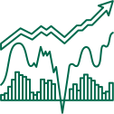

Presented by DIKSHA NADKARNI
Employee Performance Prediction Using Machine Learning
Final Model Selection and Analysis

Slide 2



Project Overview
Objective:
Build a model to predict performance of employees, based on the visualisation and analysis of past data of employee performance
Compare multiple ML models to select the best one.

Slide 3


Methodology
Task 1 - Exploring the Dataset:
Task 2 - Cleaning the dataset:
Task 3 - EDA Analysis:
Task 4 - Data Scaling:
Task 5 - ML model with XGBoost, CatBoost, LightBGM:
Task 6 - Best Scaling Function and Best model for your dataset.

Slide 4
Methodology used in the analysis
Task 1- Exploring the Dataset:
Dataset Highlights:
Features: department, education, KPIs, awards won, training scores, etc.
Target: previous_year_rating (1-5)
Task 2 - Data Preprocessing
Steps taken:
Handled missing values → Mode(categorical) & Median(numerical)
One-Hot Encoding for categorical variables
Dropped ID column
Train-Test Split (80%-20%)

Slide 5
Task 3- Exploring EDA
Steps taken:
Univariant Analysis Plots (Count,Box,Bar,Pie,KDE)
Bivariate Analysis Plots(Box, Bar,Strip,Scatter)
Multivariate Analysis Plots(HeatPlot, Stacked Bar,Scatter,Pair)
Task 4 - Data Scaling
Steps taken:
Features in different units (e.g., age, training scores) can bias models.
Algorithms like Logistic Regression, XGBoost benefit from normalized input.
Scalers like Standard Scaler,Robust,MinMax,MaxAbs are been used.

Slide 6
Task 5- Models
Models Compared:
Logistic Regression
XGBoost
CatBoost
LightGBM
Metrics evaluated: Accuracy, Precision, Recall, AUC, Confusion Matrix.
Task 6 - Best Scaling Function and Best model for your dataset.
Steps taken:
Best Scaler function evaluated
Best Model Evaluated and the reasons for accepting that model.

Slide 7

Model Performance
Model | Accuracy | Precision | F1 | AUC | Recall
Logistic Regression | 0.1363 | 0.090 | 0.0553 | 0.6547 | 0.1245
XGBoost | 0.4506 | 0.326 | 0.2698 | 0.6822 | 0.2953
CatBoost | 0.4485 | 0.297 | 0.2704 | 0.6836 | 0.2941
LightGBM | 0.4534 | 0.3094 | 0.2536 | 0.6865 | 0.2900

Slide 8

Final Model Selection
Selected Model: XGBoost
Selected Scaler: Standard
Reasons:
Highest accuracy (45.34%)
Highest AUC(0.6865)
Handles categorical & missing values efficiently
-Robust to overfitting

Slide 9
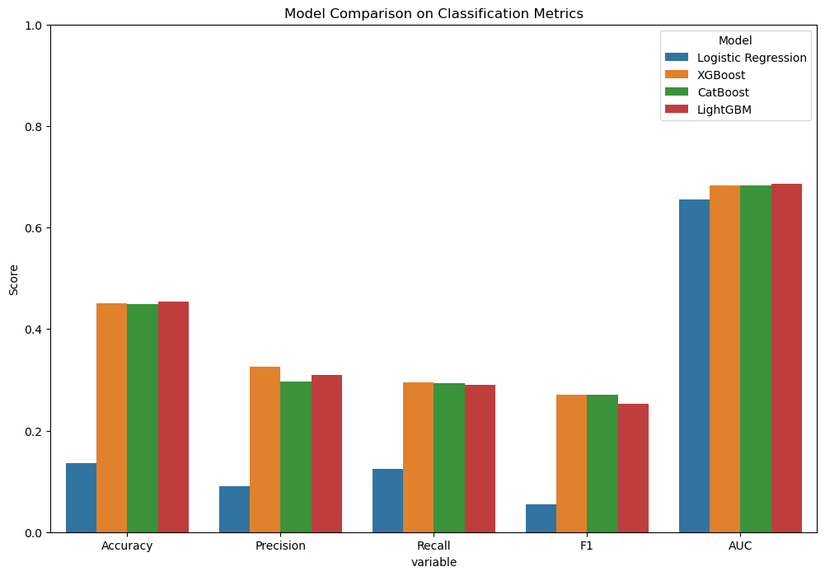

Comparison of all ML

Slide 10

Conclusion
The data set was preprocessed to the requirement.
Various EDA plots were studied.
Different ML models for the target variable was explored and analysed using different scaling methods.
An acceptable and robust design was selected

Slide 11
Resources Page

Slide 12
Thank you
so much!

