Slide 1
VOIS AICTE INTERNSHIP (2026–2027) | MAJOR PROJECT
Seasonal Agriculture Performance Analysis
Investigating Climate, Resource Efficiency & Economic Viability Across Kharif, Rabi & Zaid Seasons
Student Name: Aswini Kumar
College Name: [Your College Name]
AICTE STU ID: (Available in your offer letter)

Slide 2
VOIS AICTE BATCH 1 (2026-2027) | MAJOR PROJECT
Problem Statement
Background & Context
Agricultural activities are fundamentally influenced by seasonal variations in environmental conditions, farming practices, resource availability, and market conditions. As a result, agricultural performance differs substantially from one season to another.
The Core Challenge
Raw agricultural data does not clearly explain how agricultural performance changes across seasons or what patterns can be observed in different seasonal conditions. The problem is to analyze the given multi-variable agricultural dataset and investigate seasonal differences in performance by identifying meaningful patterns, trends, relationships, and variations within the available data.

Slide 3
VOIS AICTE BATCH 1 (2026-2027) | MAJOR PROJECT
Project Description
1. Data Ingestion & Cleaning
Processes 28 agronomic and financial features across multiple Indian states and districts, resolving missing values via grouped median imputation.
2. Exploratory Seasonal Analysis
Compares crop productivity, water consumption, and profit dynamics across Kharif (Monsoon), Rabi (Winter), and Zaid (Summer).
3. Predictive ML Modeling
Deploys Random Forest regression to quantify the relative importance of environmental, soil, and management inputs on crop yield.

Slide 4
VOIS AICTE BATCH 1 (2026-2027) | MAJOR PROJECT
Who Are the End Users?
🌾 Farmers & Agri-Producers
Gain actionable guidance on crop-season matching, optimal sowing windows, pest outbreak prevention, and micro-irrigation savings.
🏛️ Government & Policy Planners
Formulate evidence-based subsidies for micro-irrigation infrastructure, regional water conservation, and agricultural planning.
📊 Agri-Fintech & Insurance
Leverage seasonal risk profiles to design localized crop insurance products and fair loan underwriting models.
🚚 Supply Chain & Agribusiness
Forecast harvest timelines, production volumes, and price variations across seasonal cycles for efficient procurement.

Slide 5
VOIS AICTE BATCH 1 (2026-2027) | MAJOR PROJECT
Technology Stack & Architecture
Python 3.13
Core programming runtime for scalable scientific data processing.
Pandas & NumPy
Data ingestion, group-wise median imputation, and economic feature engineering.
Matplotlib & Seaborn
High-resolution statistical visualizations and comparative trend charts.
Scikit-Learn
Random Forest Regressor for non-linear yield driver analysis & feature ranking.
Jupyter Notebook
Interactive notebook environment (`analysis.ipynb`) for end-to-end reproducibility.
Git & GitHub
Version control and public repository hosting for collaborative verification.

Slide 6
VOIS AICTE BATCH 1 (2026-2027) | MAJOR PROJECT
Key Findings & Seasonal Results Overview
🌧️ Kharif (Monsoon)
• Avg Yield: 4.15 Tonnes/Ha
• Rainfall: Peak (>850 mm avg)
• Pest Risk: High (53.8% avg)
• Key Crops: Rice, Sugarcane, Cotton
• Insight: High moisture fosters disease; early pest alerts essential.
❄️ Rabi (Winter)
• Avg Yield: 3.45 Tonnes/Ha
• Temp: Moderate (~23.5°C avg)
• Pest Risk: Low-Moderate (40.0%)
• Key Crops: Wheat, Pulses, Maize
• Insight: High economic stability and lower input loss rates.
☀️ Zaid (Summer)
• Avg Yield: 4.62 Tonnes/Ha
• Temp: Peak (>31.8°C avg)
• Water Efficiency: Essential
• Key Crops: Chilli, Groundnut, Sugarcane
• Insight: Highly profitable under precision drip irrigation.

Slide 7
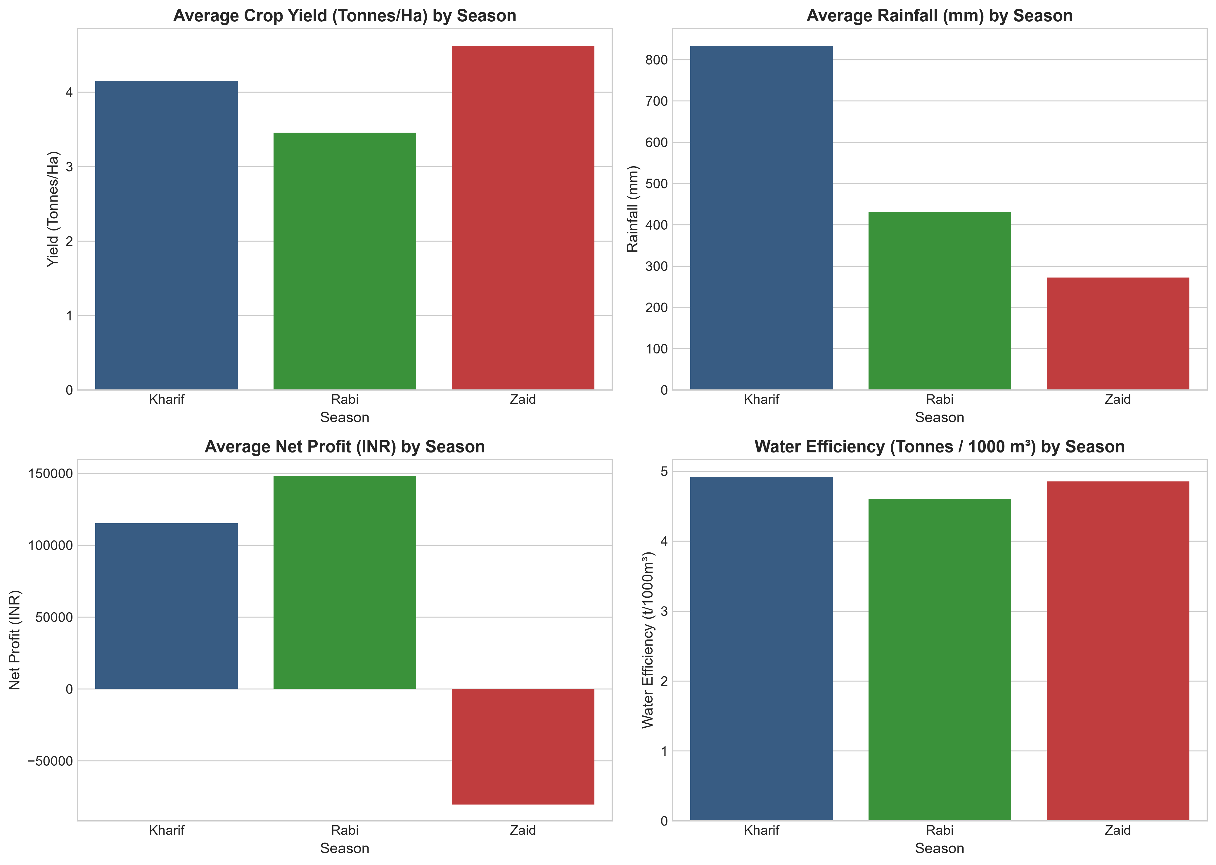
VOIS AICTE BATCH 1 (2026-2027) | MAJOR PROJECT
Macro Performance Comparison by Season
Key Observations
• Rainfall Peak: Kharif rainfall exceeds 850 mm, providing ample moisture for water-heavy crops.
• Yield Resilience: Zaid delivers strong yields (4.62 t/ha) when supplemental irrigation is provided.
• Water Efficiency Gap: Rabi and Zaid achieve higher water efficiency per unit volume than Kharif flood irrigation.
• Economic Return: Rabi yields the most predictable net profit margins across small and medium landholders.

Slide 8
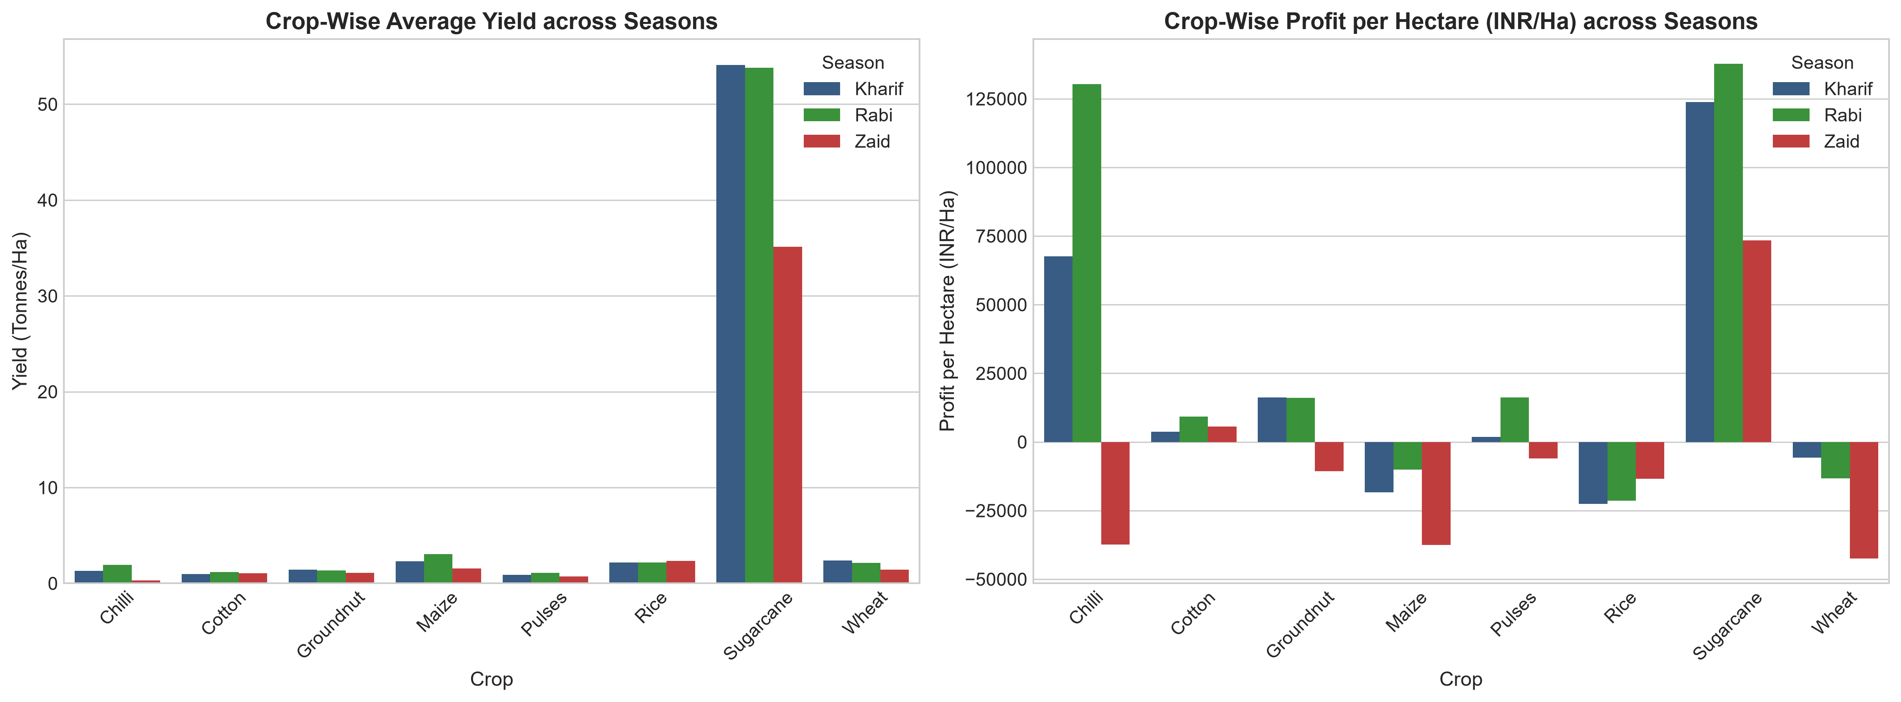
VOIS AICTE BATCH 1 (2026-2027) | MAJOR PROJECT
Crop-Wise Yield & Profitability Across Seasons
Crop Economics
• Top Profit Generators: Chilli and Sugarcane generate the highest profit per hectare (>INR 50,000/ha).
• Reliable Staples: Wheat and Pulses maintain low input costs and consistent positive margins in Rabi.
• Loss Prevention: Flood-irrigated Rice in dry periods causes severe losses due to excessive water costs.
• Strategic Crop Mix: Crop rotation with pulses revitalizes soil nitrogen for subsequent Kharif cycles.

Slide 9
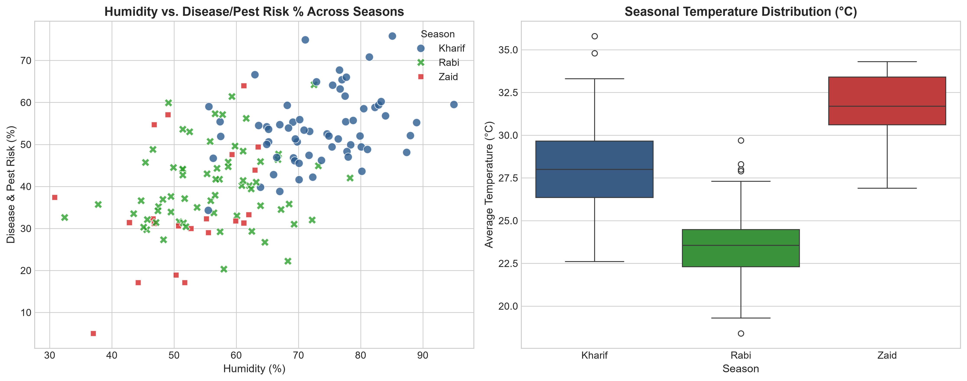
VOIS AICTE BATCH 1 (2026-2027) | MAJOR PROJECT
Environmental Factors & Pest Vulnerability
Risk Analysis
• Humidity Threshold: Humidity exceeding 70% during Kharif correlates with pest risk > 60%.
• Thermal Dynamics: Rabi maintains comfortable temperatures (~23.5°C), reducing thermal stress.
• Summer Vulnerability: High Zaid temperatures (>32°C) demand soil mulching and moisture conservation.
• Early Action: Automated alerts based on relative humidity can cut crop losses by up to 25%.

Slide 10
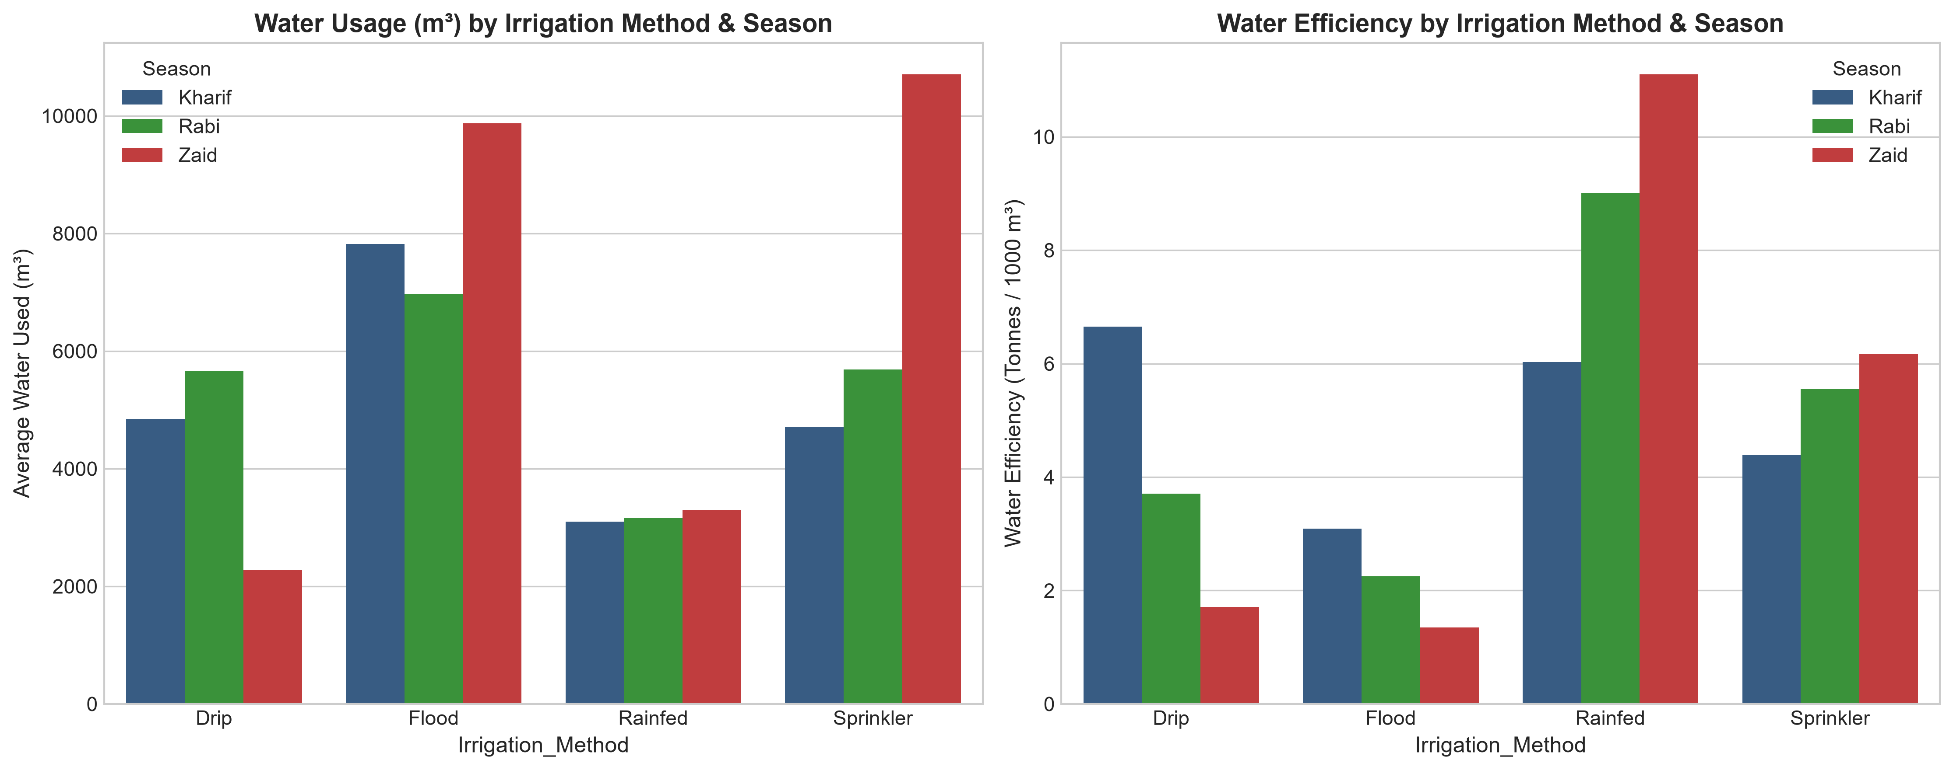
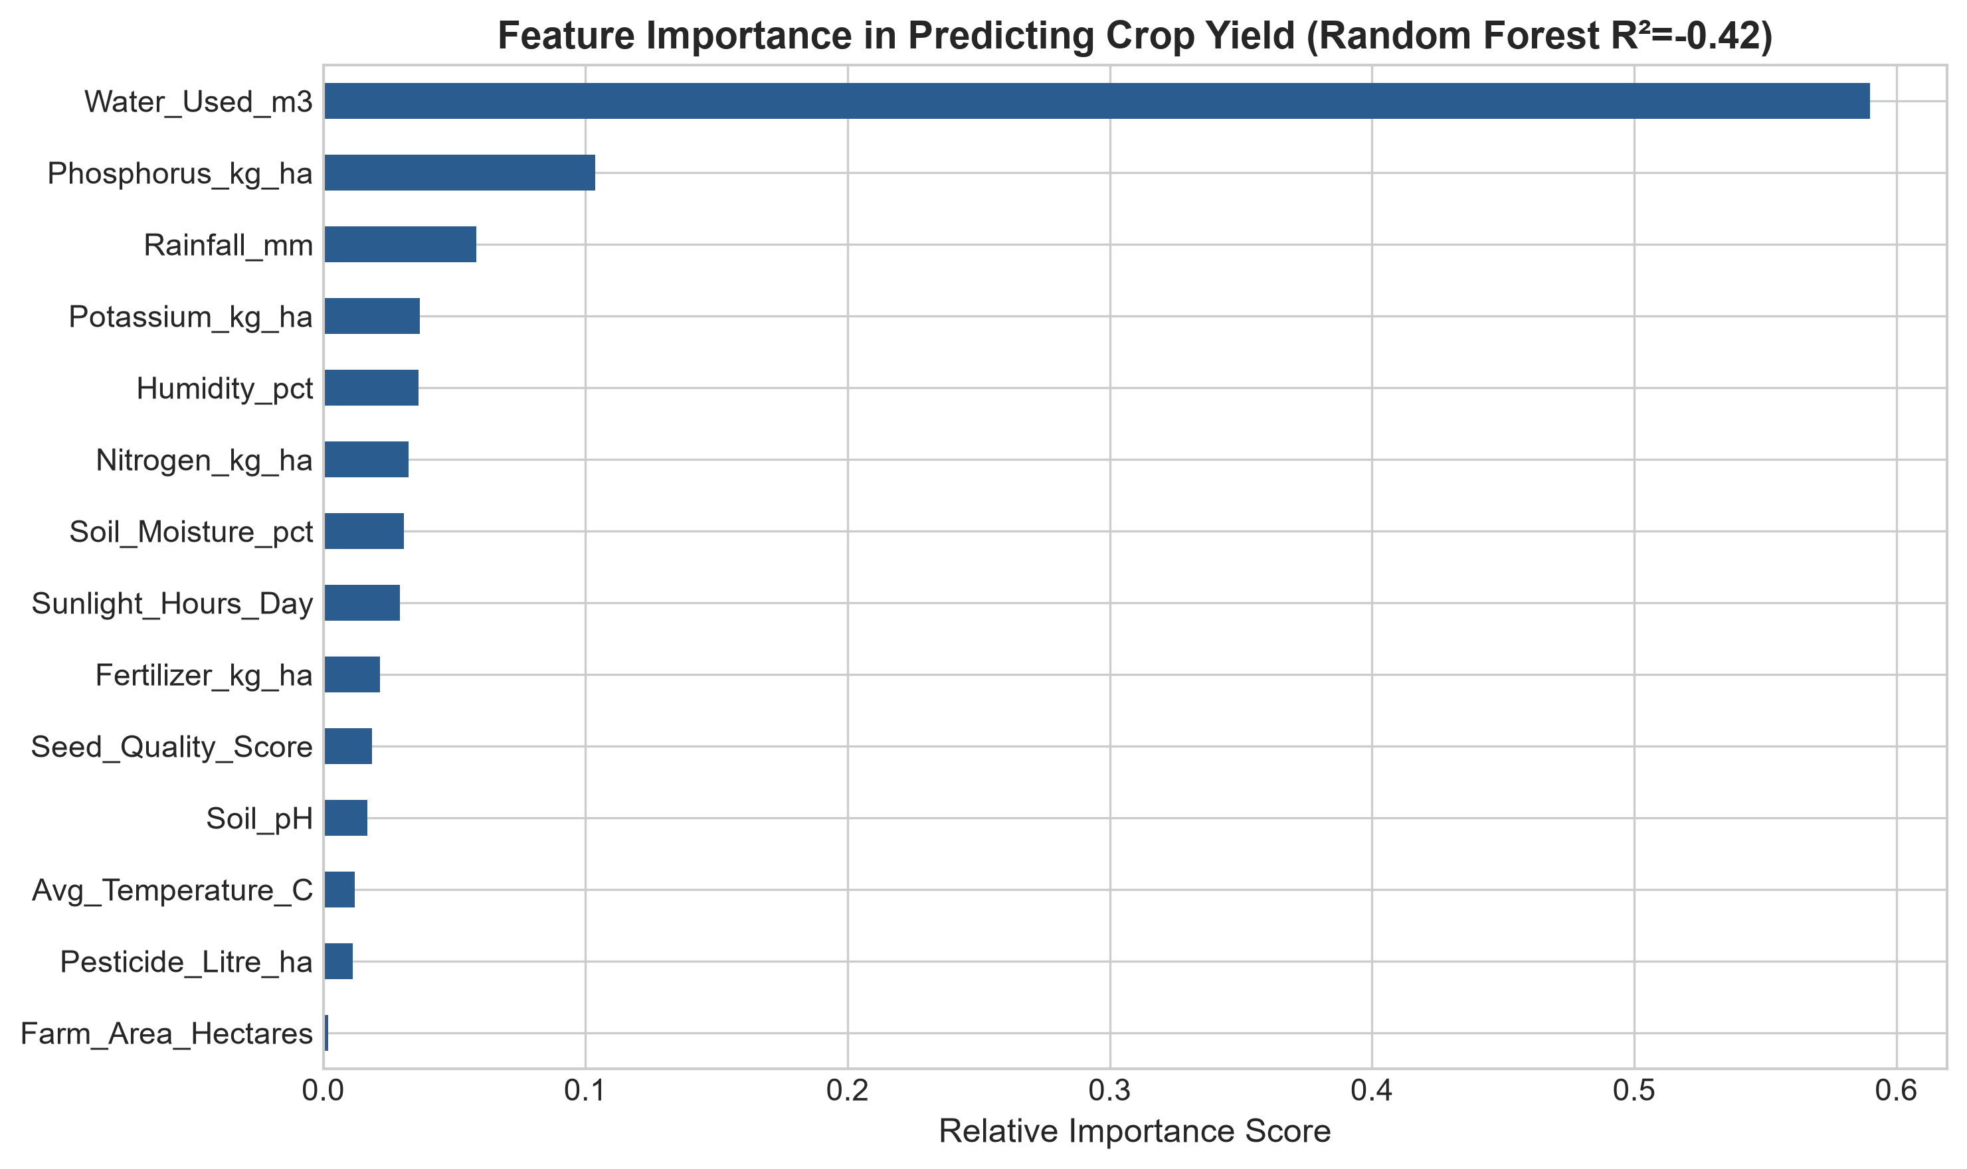
VOIS AICTE BATCH 1 (2026-2027) | MAJOR PROJECT
Irrigation Efficiency & Machine Learning Drivers

Slide 11
VOIS AICTE BATCH 1 (2026-2027) | MAJOR PROJECT
Future Scope & Strategic Roadmap
🌐 IoT & Soil Sensors
Deploy in-situ IoT sensor networks for real-time soil moisture, NPK, and pH telemetry to automate drip irrigation.
🛰️ Satellite Remote Sensing
Integrate Sentinel-2 and Landsat multispectral imagery (NDVI/EVI) to monitor regional crop health and drought stress.
🌦️ Hyperlocal Weather AI
Connect predictive weather APIs to issue 10-day early warnings for pest infestations and sudden rainfall deficits.
📱 Farmer Advisory App
Deliver localized crop recommendations, optimal sowing calendars, and mandi price forecasts directly to farmers' smartphones.

Slide 12
VOIS AICTE BATCH 1 (2026-2027) | MAJOR PROJECT
Project Source Code & Repository
Open Source Repository on GitHub
https://github.com/DILJEETSINGH07/Seasonal-Agriculture-Performance-Analysis
✔ Jupyter Notebook (`analysis.ipynb`) with complete data cleaning, visualization, and modeling steps.
✔ Automated data pipeline script (`run_full_analysis.py`) and dataset (`seasonal_agriculture_data.csv`).
✔ High-resolution presentation figures and complete documentation (`PROJECT_REPORT.md` & `README.md`).

Slide 13
VOIS AICTE BATCH 1 (2026-2027) | MAJOR PROJECT
VOIS Course Completion Certificate
Course Name: Data Visualization
[ Paste your VOIS Data Visualization Certificate Image Here ]
Issued as part of the VOIS AICTE Batch 1 (2026–2027) Internship Program.

Slide 14
Thank You!
Seasonal Agriculture Performance Analysis
Questions & Discussion

