Slide 1



SNS COLLEGE OF TECHNOLOGY
23ITP202 MINI PROJECT- I
ELDERGUARD AI: CONNECTED ELDER CARE PLATFORM
Problem Statement: Elder Safety, Health Monitoring and Connected Care
Presented By:
Care that reaches them,
wherever you are
713525AD029 – DINESH N
713525AD013- BHOOPESH M
713525AD014- DHARSHAN V

Slide 2

PROBLEM STATEMENT · ELDER SAFETY
Keeping Elders Safe:
A Connected-Care Approach
WHAT HAPPENS TODAY
The 8:00 AM dose is missed. Blood pressure is not logged for days. A fall at night and no one knows.
Many older adults live apart from their families. Missed medicines, unnoticed changes in health and slow emergency response put them at risk, while family, doctors, pharmacies and hospitals each work from separate information. We built one connected platform where everyone in an elder's care circle sees the same live record and can act in time.
WHAT ELDERGUARD DOES
A reminder rings until it is answered, and the caregiver sees the dose logged live. One tap on SOS alerts family first, then a second contact, the hospital desk and emergency services if nobody responds.

Slide 3
Understanding the Empathy Phase: Connecting with Elders and Caregivers
Deep Elder & Caregiver Research
Start with genuine curiosity about the lives of older adults and the family members who worry about them. Understand daily routines, fears of being alone and how comfortable they are with technology.
Building Emotional Connections
Go beyond demographics. What makes an elder hesitate to ask for help? What keeps a caregiver awake at night? What would make both feel in control?
SAYS
THINKS
"Did she take her tablets? Is she okay?"
"What if something happens and I am not there?"
FEELS
DOES
Interview elders and family caregivers
Observe medicine routines at home
Build empathy maps of feelings and needs
Medicine-routine diary studies
Contextual enquiry in homes and care centres
Journey mapping of an emergency
Anxious, guilty, always on call
Calls repeatedly, asks neighbours to check in
Empathy map of a family caregiver. Illustrative persona; interviews with real elders and caregivers are planned.

Slide 4




Define the Problem: Identifying Core Pain Points in Elder Care
Missed Medicines
Slow Emergency Response
Several daily medicines are easy to forget, and the family finds out late, if at all.
A fall or sudden illness can go unnoticed. Help depends on someone happening to call.
Disconnected Information
Hard-to-Use Technology
Family, doctor, pharmacy and hospital each hold a piece, so prescriptions, vitals and history are not shared.
Small text, crowded screens and complex steps leave out the people who need help most.
The problem statement emerges from synthesis: "Elders and their families need a simple, connected way to take medicines on time, share health information and get help fast, so older adults can live independently with confidence."

Slide 5

Ideate Creative Solutions: Brainstorming Elder Care Features
Reminders That Get Answered
One-Tap SOS with Escalation
Vitals and AI Companion
One gentle alarm per dose time. A tap logs the dose, and repeated misses alert the caregiver.
Family first, then a second contact, the hospital desk and emergency services on a timer.
Track blood pressure, sugar, oxygen and heart rate, and chat with Mevi, a patient AI companion.
More ideas from the brainstorm
Prescription scanner that turns a photo into a medicine schedule
Doctor appointments with queue tokens
Doctor-to-pharmacy e-prescriptions
Five role-based portals with a large-text mode
Innovation thrives when we encourage wild ideas, defer judgement and build on each other's concepts. Generate quantity first, then refine for safety and quality.

Slide 6



Proposed Solution: How ElderGuard Works End to End
1. Capture
2. Connect
3. Alert
4. Escalate
5. Review
Elders log medicines and vitals; doctors write prescriptions
One shared record links elder, caregiver, doctor, pharmacy and hospital
Reminders ring, unusual readings are flagged, SOS goes out in one tap
Caregiver now, second contact at 2 min, hospital at 5, emergency services at 10
History and records let family and doctors act on what happened
Safety guardrails built in
Role-based access: each user sees only the elders they are linked to
ElderGuard alerts and informs; it does not diagnose or replace a doctor or emergency services

Slide 7

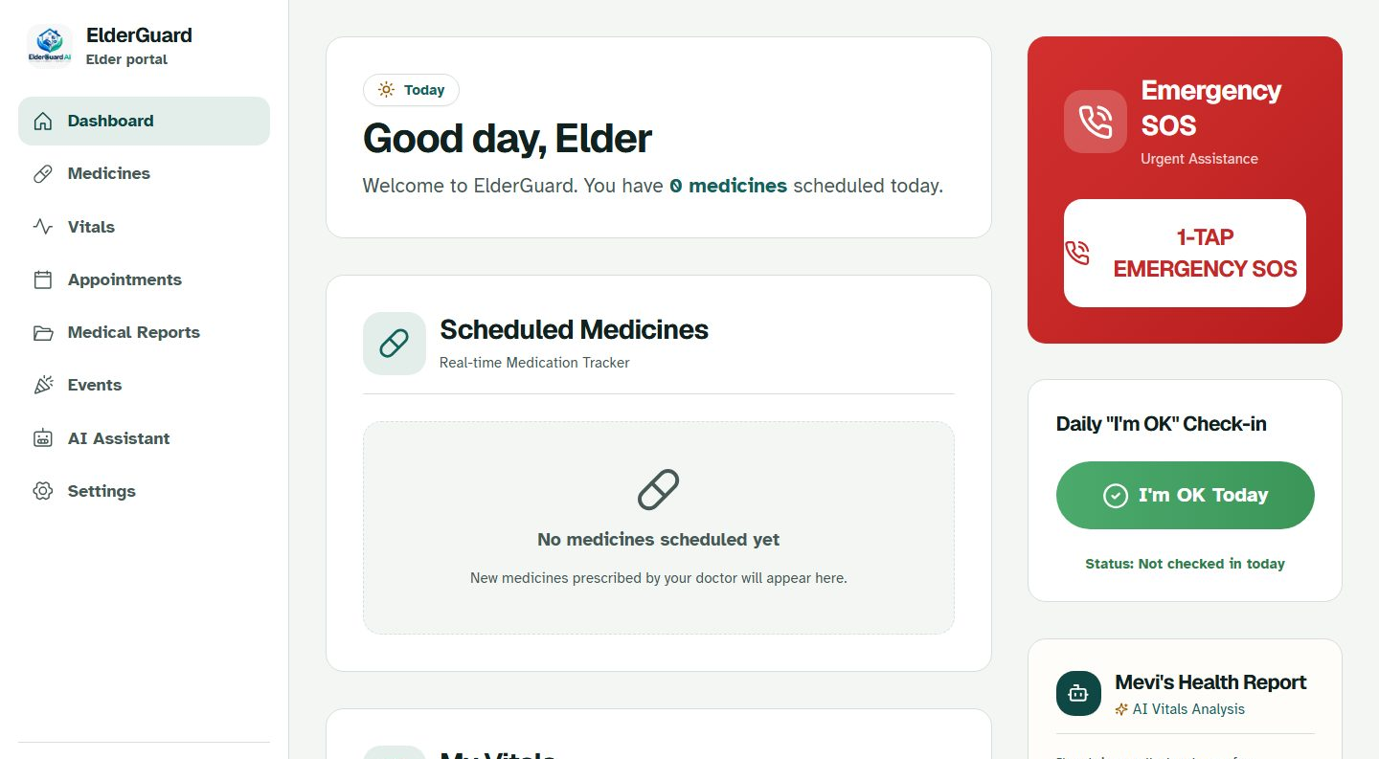


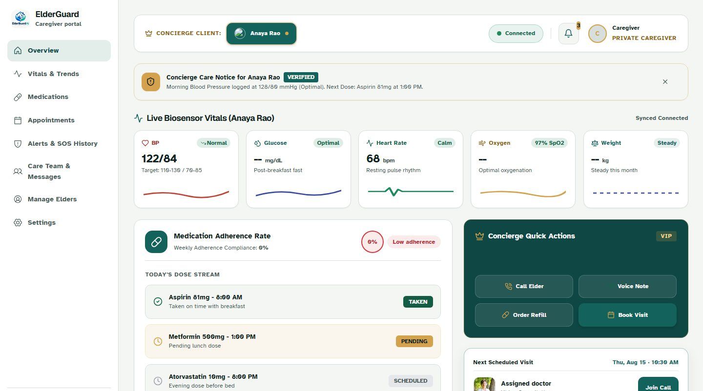
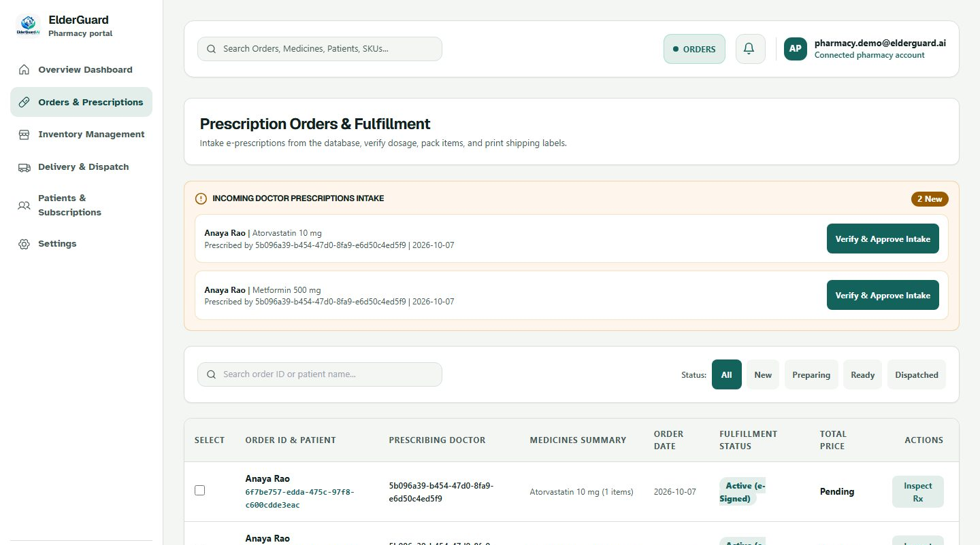
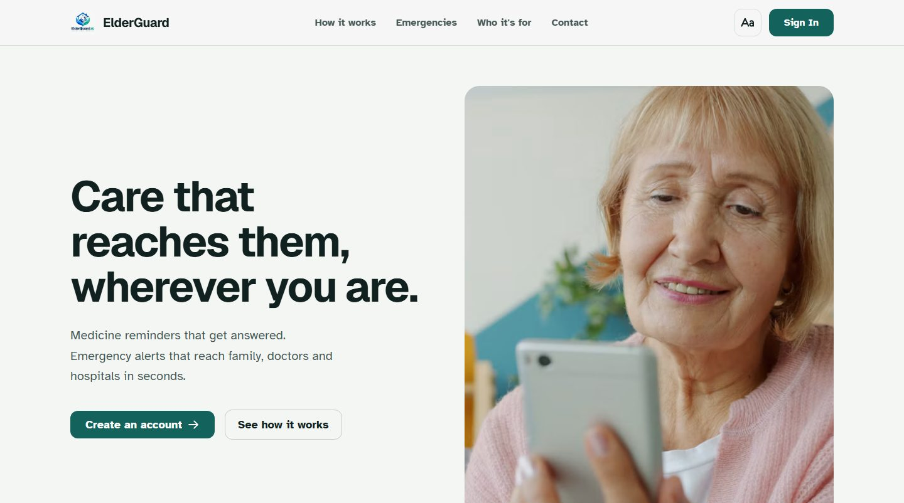
Prototype Development: Building Tangible Solutions for User Testing
Design System
ElderGuard AI · working prototype
Warm paper background, one teal accent, large readable type and a text-size control for low vision.
Interactive Portals
Five role-based portals (elder, caregiver, doctor, hospital, pharmacy) running on real data.
Minimum Viable Product
A working React and FastAPI app: reminders, SOS escalation, vitals, and prescriptions that reach the pharmacy.
Caregiver portal
Pharmacy queue
Landing page
Prototypes are learning tools. Build fast, fail fast and iterate based on what real users show you.

Slide 8
Testing Phase: Verifying the Prototype and Planning User Trials
Automated Testing
22/22
An automated browser opens every portal page, the demo story is checked end to end, and each screen is scanned against WCAG 2.1 accessibility rules.
Automated tests passing
Key Testing Methods
End-to-end tests (Playwright): 22 tests across all five portals and phone size
Accessibility audit (axe): 0 serious violations against WCAG 2.1 A/AA
SOS escalation drill: all 4 tiers fired in order in a timed run
Planned: teach-back and think-aloud sessions with real elders and caregivers
4/4
SOS tiers fired in the timed drill
Testing is discovery, not validation. Automated checks show that it works; sessions with real elders will show whether it helps.

Slide 9
Use Case: How Connected Care Protects an Elder at Home
Initial Challenge
1
Mrs. Anaya Rao, 77, lives alone and takes three medicines a day. Her daughter Maya lives in another city and worries about missed doses and emergencies.
2
Empathy Insights
Anaya does not want to be a burden and Maya cannot call every hour. They want reassurance that does not feel like surveillance.
Design Response
3
A reminder rings and Anaya taps Taken; Maya sees it live. Dr. Mehta prescribes in the app and the order reaches the pharmacy. One tap on SOS alerts Maya first, then the hospital.
4
Expected Impact
Fewer missed doses, faster response and less worry for the family. To be measured in a pilot.
Illustrative scenario based on this project's demo data; impact is a target to be validated.

Slide 10




Integration Challenges: Balancing Elder Needs with Technical and Clinical Constraints
Privacy & Compliance
Emergency Reliability
Health data is highly sensitive. It needs consent, encryption and access logs in line with India's DPDP Act. Role-based access is in place; consent and audit features come next.
SOS must never stall. Alerts are in-app and push today; SMS and voice-call providers and a durable job queue are needed for production.
Safety first
Data & Integration
Access & Performance
ElderGuard alerts and informs; it does not diagnose or replace a doctor or emergency services.
Records come from elders, doctors, pharmacies and hospitals. One shared data model and clean APIs keep them consistent.
Older users often have older phones and slow networks. Large text and simple screens are prioritised; an installable app is next.
Successful integration needs continuous dialogue between clinicians, designers and engineers. Constraints often spark creative solutions when teams collaborate early.

Slide 11
Success Metrics: Measuring the Impact of ElderGuard
22/22
0
4
90%+
Tests Passing
Accessibility Issues
Escalation Tiers
Doses On Time
Automated end-to-end checks across all five portals
Serious issues found by an axe audit (WCAG 2.1 A/AA) on every page
Caregiver, second contact, hospital, emergency services, verified in a timed drill
Pilot target for doses logged when due, to be validated
The first three are measured on the prototype; the last is a target for the pilot, to be validated with real users
Qualitative Indicators of Success
Caregivers report less worry and fewer check-in calls
Elders use the SOS button and large-text mode without help
Doctors and pharmacies adopt the shared prescription flow
Shorter time from SOS to first response

Slide 12




Future Enhancements: Expanding ElderGuard's Reach and Reliability
Phase 1
Phase 1
Phase 2
SMS & Voice-Call Alerts
Verified Doctors & Hospitals
Multilingual Voice Assistant
Reach caregivers and hospitals even without the app, with delivery receipts and retries.
Licence checks before a clinical account can issue prescriptions.
Speak and listen in Tamil, Hindi and other regional languages.
Phase 2
Phase 3
Phase 3
Installable Mobile App
Wearable Integration
EHR & ABDM Integration
Push notifications, offline mode and an always-ready SOS button.
Read heart rate and blood pressure, and detect falls, from smart watches.
Pull records securely from hospitals and ABHA health IDs, with consent.
Roadmap: Phase 1 reliable alerts and trusted accounts → Phase 2 voice and mobile → Phase 3 wearables and health-record integration.

Slide 13


Next Steps: Taking ElderGuard from Prototype to Pilot
Validate with Elders and Families
In Summary
Run usability sessions with older adults and caregivers, and refine the screens from what they struggle with.
Connected information
→ faster response
→ safer elders
→ peace of mind
Harden for Real Use
Add SMS and call alerts, secure secrets and logins, privacy consent and monitoring.
Pilot and Scale
Start small, measure impact, and scale what works.
Partner with a clinic or care home for a small pilot, measure results, then expand.
Elder care is an ongoing commitment to staying close to the people we serve and improving relentlessly.

Slide 14


Thank you!
ElderGuard AI: Care that reaches them, wherever you are

