Slide 1
Analysis and Visualization of E-Retailers Customers Retention and Purchase decision Affecting Factors.
By : - Dinesh Mutha

Slide 2
PROBLEM STATEMENT
Customer satisfaction has emerged as one of the most important factors that guarantee the success of online store; it is a key stimulant of purchase or repurchase intentions and customer loyalty.
Five major factors that contribute to the success of an e-commerce store have been identified as: service quality, system quality, information quality, trust and net benefit.
The research investigated the factors that influence the online customers repeat purchase intention.
The combination of both utilitarian value and hedonistic values are needed for repeat purchase intention (loyalty) positively.
The data is collected from the Indian online shoppers. Results indicate the e-retail success factors, which are very much critical for customer satisfaction.

Slide 3
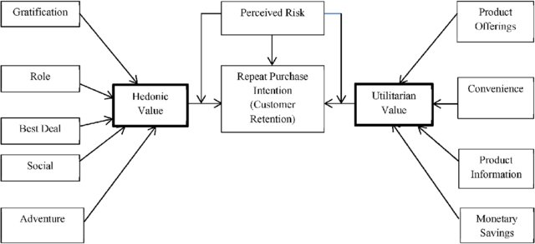
BLOCK DIAGRAM OF VALUES REQUIRED

Slide 4
OBJECTIVE
The objective is to apply our analytical skills to provide findings and conclusion that would help to predict customer retention for a E-Retail company using their data on users provided over period of time.
Using the model we had to determine which features were most influential in loss of valuable customer and then making a plan for how the company could use this information to increase customer retention.

Slide 5
ANALYSIS ON DATA PROVIDED
Data used from : datasheet.xlsx
Software : Anaconda, Python, Jupyter.
Libraries: Pandas, NumPy, matplotlib, seaborn, scikit-learn

Slide 6
STEPS FOLLOWED
First we have imported the necessary libraries and loaded the entire dataset in our Jupyter Notebook
Then checked the shape of our dataset and found that we have a total of 269 rows and 71 different columns.
We removed the integers from columns and made columns identicle throughout the dataset.
We checked for null values and couldn’t find any null values or missing values present in our dataset.
By checking the data types we came to know that all the columns have ‘object’ data type except the column representing the Pin Code which has ‘integer’ data type.

Slide 7
DESCRIPTION OF DATASET
The data is collected from the Indian online shoppers. Our Dataset consists of reviews and feedbacks of customers on top 5 Indian Online Retailers : Amazon, Flipkart, Snapdeal, Myntra and Paytm.
Questions are formed on the basis of brand strength, brand empathy, overall customer satisfaction and perceived value for money with intention to recommend.
Results indicate the e-retail success factors which are very much critical for customer satisfaction and retention.

Slide 8
DATA VISUALIZATION
What is Data Visualization?
It is defined as a graphical representation that contains the information and the data from the dataset.
Benefits of Good Data Visualization?
Data visualization is technique of visual art that grabs our interest and keeps our main focus on the message captured with the help of eyes.
Different Data Visualization Analysis are Univariate Analysis: In the univariate analysis, we will be using a single feature to analyze almost all of its properties. Bivariate Analysis: When we compare the data between exactly 2 features then it is known as bivariate analysis. Multivariate Analysis: In the multivariate analysis, we will be comparing more than 2 variables.

Slide 9
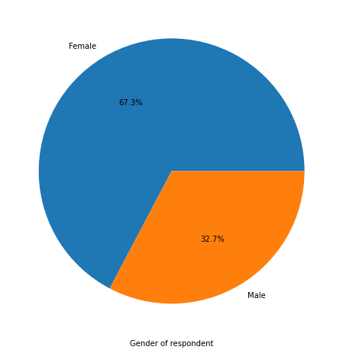
UNIVARIATE ANALYSIS

Slide 10
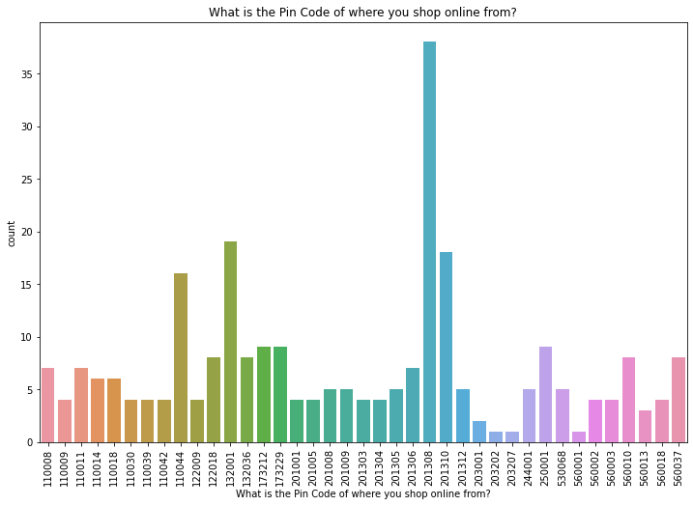
BIVARIATE ANALYSIS

Slide 11
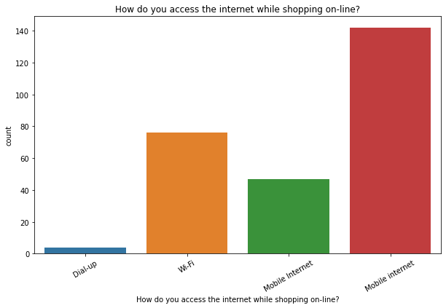
BIVARIATE ANALYSIS

Slide 12
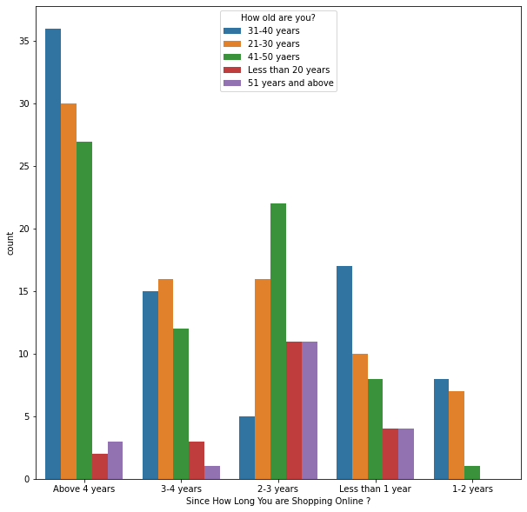
MULTI VARIATE ANALYSIS

Slide 13
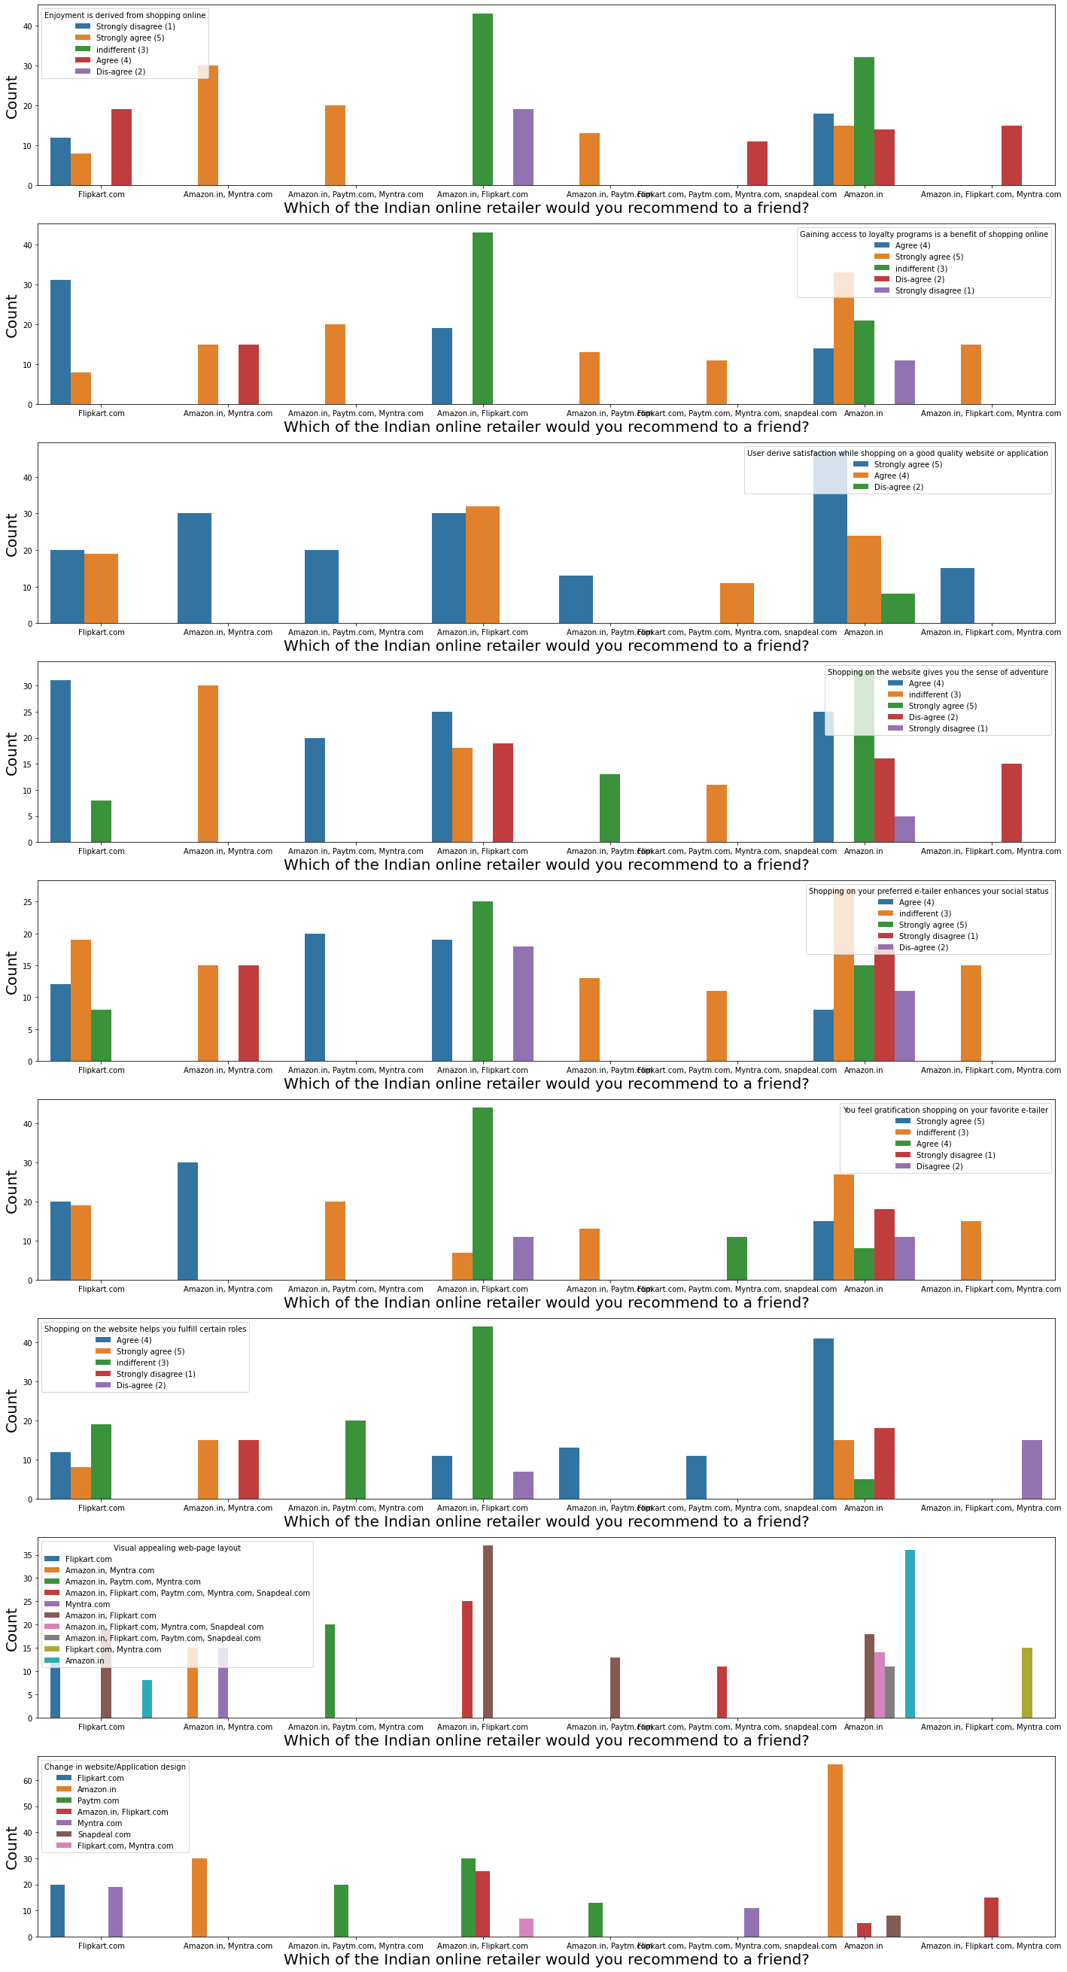
CORELATION BETWEEEN CUSTOMER RETENTION AND HEDONIC VALUES

Slide 14
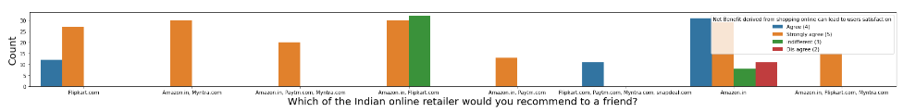
CO-relation between customer retention and Utilitarian values.

Slide 15
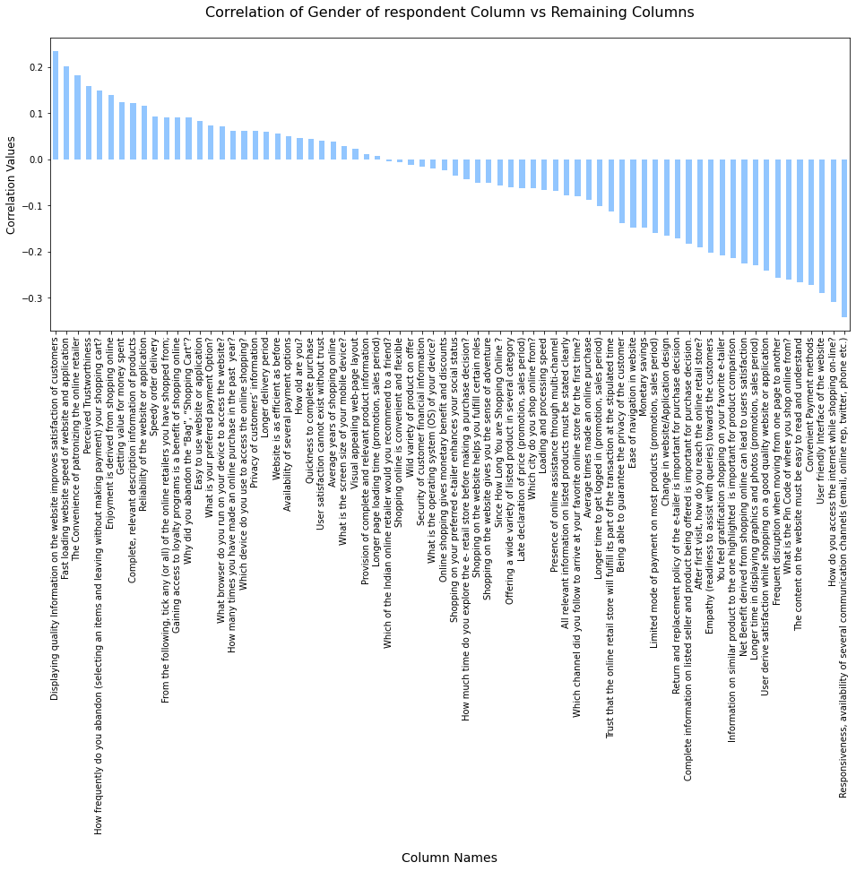
CORELATION OF INDEPENDENT COLUMN AND REMAINING COLUMNS

Slide 16
OBSERVATIONS AND CONCLUSION
Based on observations the first 47 features tell us how e-retail is helpful and growing based on customer inputs. The data explained how the online platform has been used more often in which CITY, PIN CODE, AGE etc. It also showed us that in some factors there is less importance given to contribute to the success of an e-commerce store, so based on that we could remove those factors and keep all the important factors. Also we could improve on some factors that influence the online customers repeatitive purchase intention.
Apart from the first 47 features the rest of the features showed which online platform has been used more based on the success factors. Based on this case study, Amazon is the most reliable and has been fulfilled all the customer requirements. After Amazon the data showed Flipkart has been used more for online shopping.
The case study from Indian e-commerce customers showed Amazon and Flipkart has been used mostly for Online Shopping and most recommended by Friends. So based on the research factors Amazon and Flipkart are the e-commerce platform which are having the combination of both utilitarian and hedonistic values to keep the repeat purchase intention (loyalty) positively.

Slide 17
# Suggested improvements and Remarks.
AMAZON
Improvements needed:
During promotions give disturbance free shopping experience to customers.
Improve payment options for customers.
Try to flash product price early during promotion.
Reduce the delivery time of the products.
Good Remarks:
Convenient to use and also a good website for shopping.
Availability of complete information of the products.
Presence of online assistance through multiple channels.
Reliable website and app, perceived trustworthiness.

Slide 18
FLIPKART
Improvements needed:
During promotions give disturbance free shopping experience to customers.
Improve payment options for customers.
Try to flash product price early during promotion.
Flipkart and Amazon almost share the same feedbacks with varying percentages difference.
Good Remarks:
Convenient to use and a good website for shopping.
Fast delivery of products.
Availability of complete information of the products.
Presence of online assistance through multiple channels.
Reliable website and app, perceived trustworthiness.
Wild variety of products to offer.

Slide 19
MYNTRA
Improvements needed:
During promotions give disturbance free shopping experience to customers.
Try to flash product price early during promotion.
Reduce the delivery time of the products during promotions.
Good Remarks:
Convenient to use and a good website.
Availability of several payment options.
Availability of complete information of the products.
Reliable website and app, perceived trustworthiness.
Wild variety of product to offer

Slide 20
PAYTM
Improvements needed:
Reduce the delivery time of the products during promotions.
Try to flash product price early during promotion.
During promotions give disturbance free shopping experience to customers.
Late declaration of price and discounts.
Frequent disturbance is occurring while moving from one page to another.
Good Remarks:
Convenient to use and a good website.
Quickness to complete a purchase.
About 60-65% of the customers feel that either web or app is reliable.
Around 20-25% of the customers believe that paytm has a wild variety of products on offer.

Slide 21
SNAPDEAL
Improvements needed:
Reduce the delivery time of the products during promotions.
Try to give the product price early during promotion.
During promotions, try to give a disturbance free shopping experience to customers.
Late declaration of price and discounts.
No one has expressed to recommend snapdeal to a contact as it has the most negative feedbacks among all other websites.
Good Remarks:
Convenient to use.
54% of the customers are happy about the availability of financial information security.

Slide 22
THANK YOU

