Slide 1
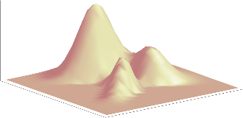
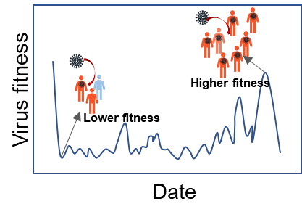


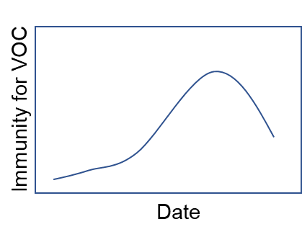



Fitness landscape
A
Virus fitness
Binding
Effective immunity
Mobility
Model output of reported
cases
Data
source
ACE2 Binding
Extended SEIR Model
Immune escape
fitting
Vaccination
coverage
Reported cases data
B

