Slide 1
ATmega32 EEPROM-Based Data Logging
and Configuration Storage System
Internal EEPROM Read/Write Operation on the ATmega32 Microcontroller
Group Project Presentation
Course : CT 321

Slide 2
Group Members
Students Name | Registration Numbers
SALIMA ABDI MFAUME | T23-03-09616
EDNA SAMWEL DIDAS | T23-03-09544
DENIS RICHARD SOWANI | T23-03-12706
KARIMU JOSEPH MKIYA | T23-03-15224

Slide 3
Problem Statement
● Embedded systems often need to remember information even after power is switched OFF
● Examples: saved threshold values, calibration settings, user preferences, event counts, alarm limits, configuration data
● Ordinary RAM loses its contents when power is removed
● The ATmega32's internal EEPROM can retain stored data without external power
● This project demonstrates EEPROM read/write operation through a practical data logging and configuration storage system

Slide 4
Project Objective
● Design and implement an EEPROM-based data logging and configuration storage system
● Use the ATmega32 internal EEPROM, push buttons, LEDs, buzzer, and an LCD display
● Allow the user to increase, decrease, save, read, and clear a stored value
● Ensure the stored value remains available after reset or power cycling
User Value -> EEPROM Write -> Power-Off Retention -> EEPROM Read

Slide 5
Expected System Operation
Input / User Action | Expected Output
System powered ON | Last saved value is loaded from EEPROM
Increment button pressed | Current value increases
Decrement button pressed | Current value decreases
Save button pressed | Current value is written to EEPROM
Read button pressed | Stored value is displayed
Clear button pressed | EEPROM value is reset to default
Reset button pressed | System restarts and reloads stored value
Power switched OFF then ON | Last saved value is recovered

Slide 6
Main Hardware Components
Component | Qty | Purpose
ATmega32 microcontroller | 1 | Main controller and internal EEPROM device
LCD module (16x2 HD44780) | 1 | Displays current and stored values
Push buttons | 6 | Increment, decrement, save, read, clear + reset
LEDs | 2 | Save and error/status indication
Current-limiting resistors | 2 | LED protection
Buzzer + NPN driver transistor | 1 | Save confirmation / error alert
Reset push button + pull-up resistor | 1 | Manual microcontroller reset
Crystal oscillator + capacitors | 1 | 8 MHz clock source
Power supply | 1 | 5 V regulated supply

Slide 7
ATmega32 Pin Mapping
Pin / Resource | Function | Connected Device
Internal EEPROM | Non-volatile storage | Stores saved value
PA0 - PA4 | Digital input | INC / DEC / SAVE / READ / CLEAR buttons
PB0 | Digital output | SAVE / status LED
PB1 | Digital output | ERROR LED
PB2 | Digital output | Buzzer (via NPN driver transistor)
PD4 / PD5 / PD6 | Digital output | LCD RS / RW / EN
PC4 - PC7 | Digital output | LCD D4 - D7 (4-bit mode)
RESET pin | Reset input | Reset push button + 10 kΩ pull-up

Slide 8
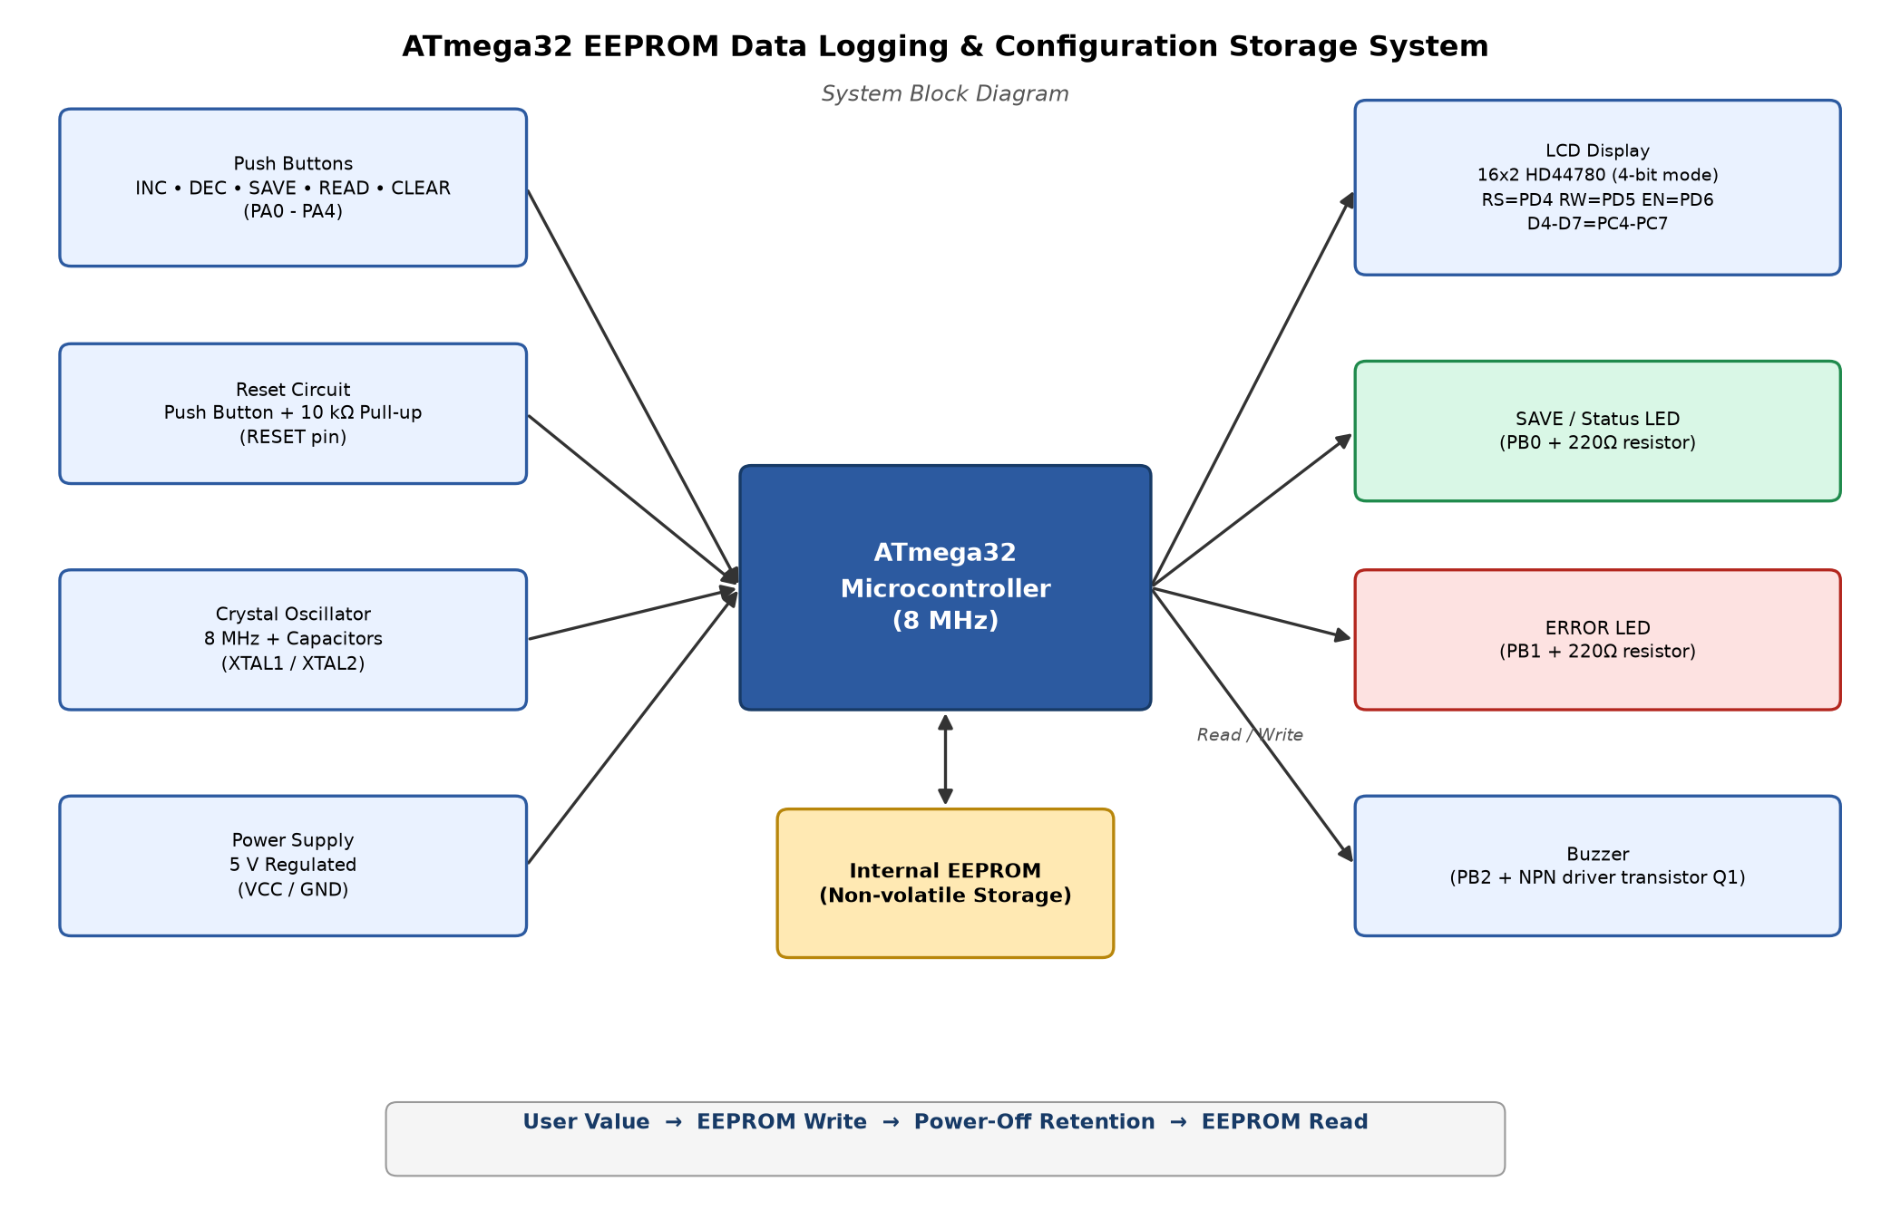
System Block Diagram

Slide 9
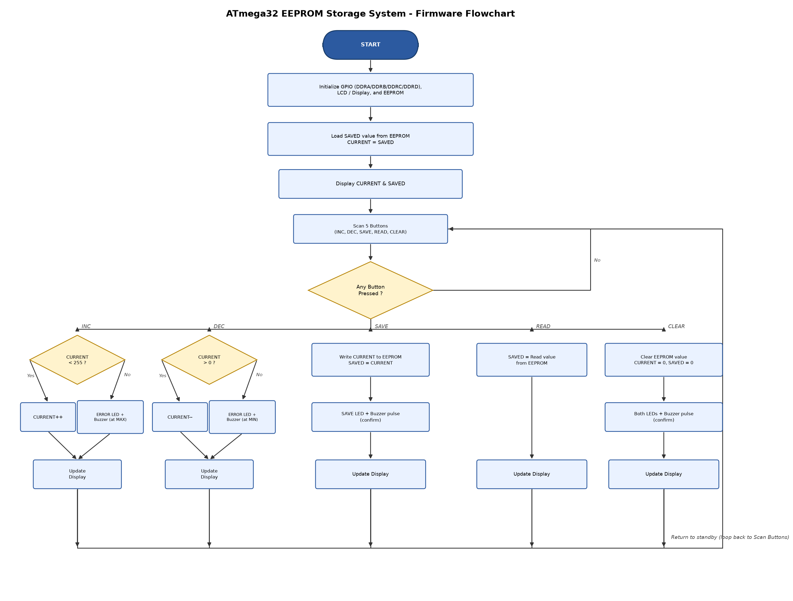
Firmware Flowchart

Slide 10
EEPROM Address Map
A magic byte distinguishes a blank (erased) EEPROM, which reads as 0xFF, from a genuinely saved value
Address | Size | Content
0x00 | 1 byte | Magic / init byte (0xAA once initialized)
0x01 | 1 byte | Saved configuration value (0 - 255)

Slide 11
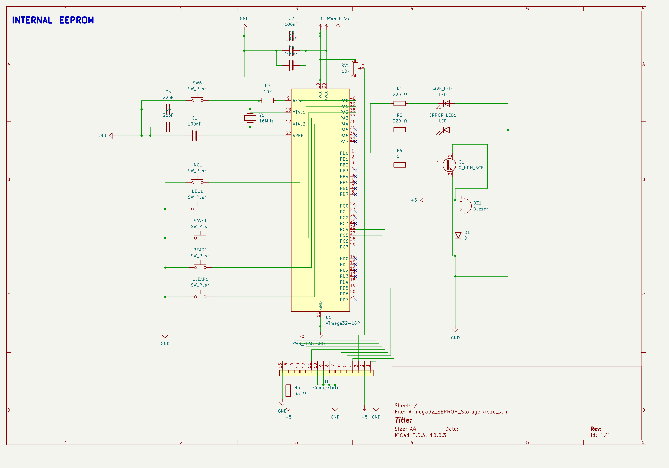
KiCad Schematic Design
0 ERC violations

Slide 12
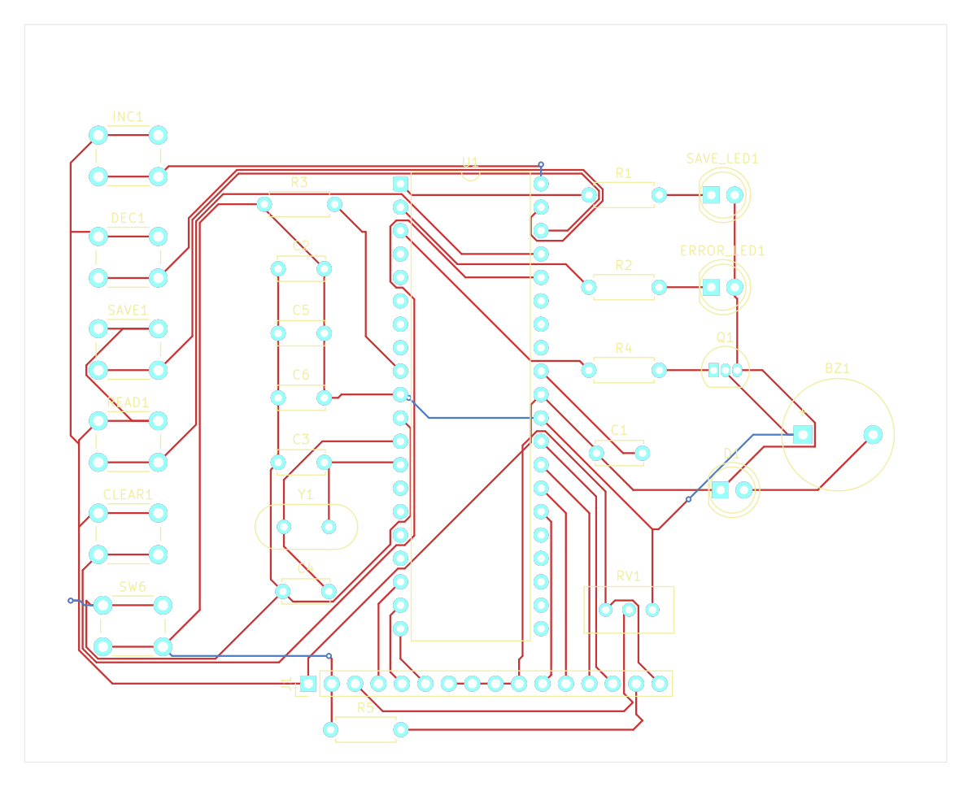
KiCad PCB Layout
0 DRC violations, 0 unconnected nets

Slide 13
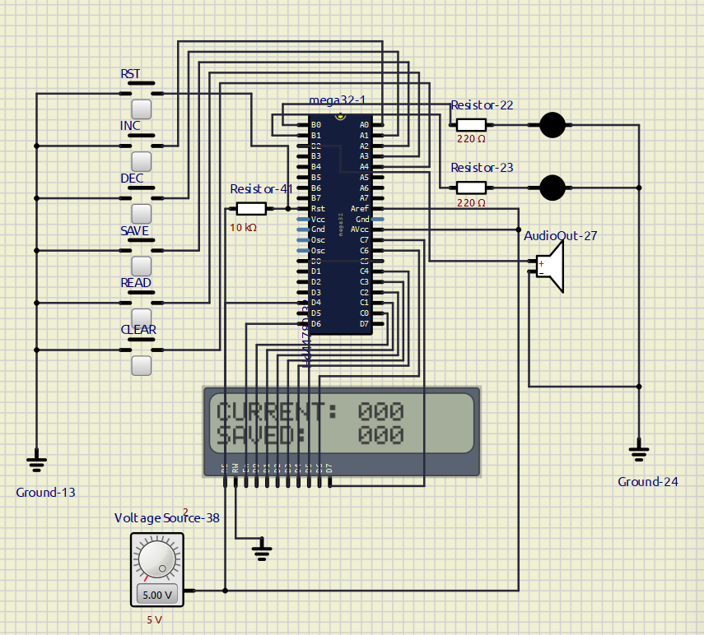
SimulIDE Simulation - Startup
System loads the last saved value from EEPROM on power-up

Slide 14
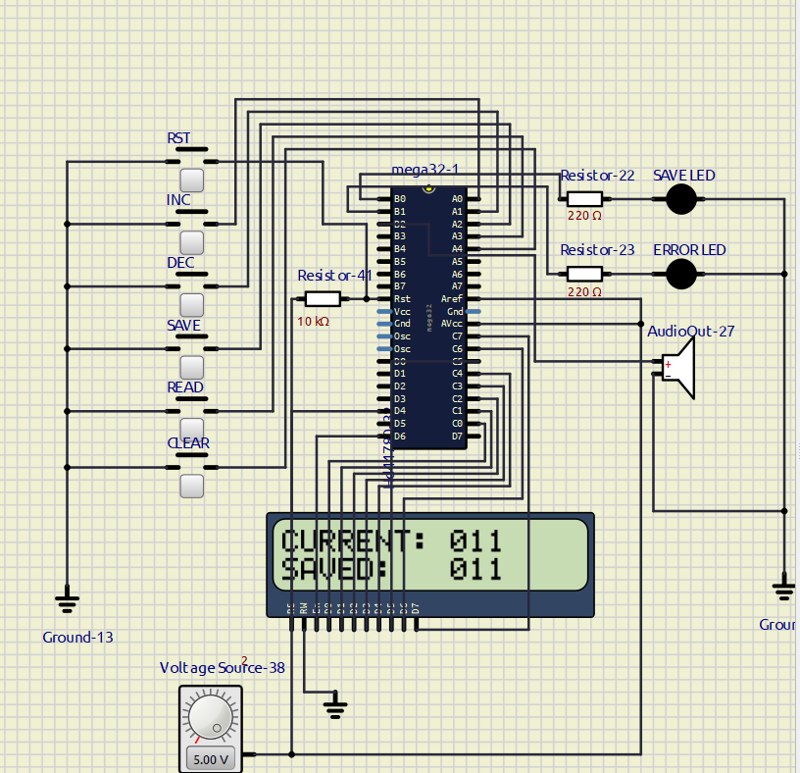
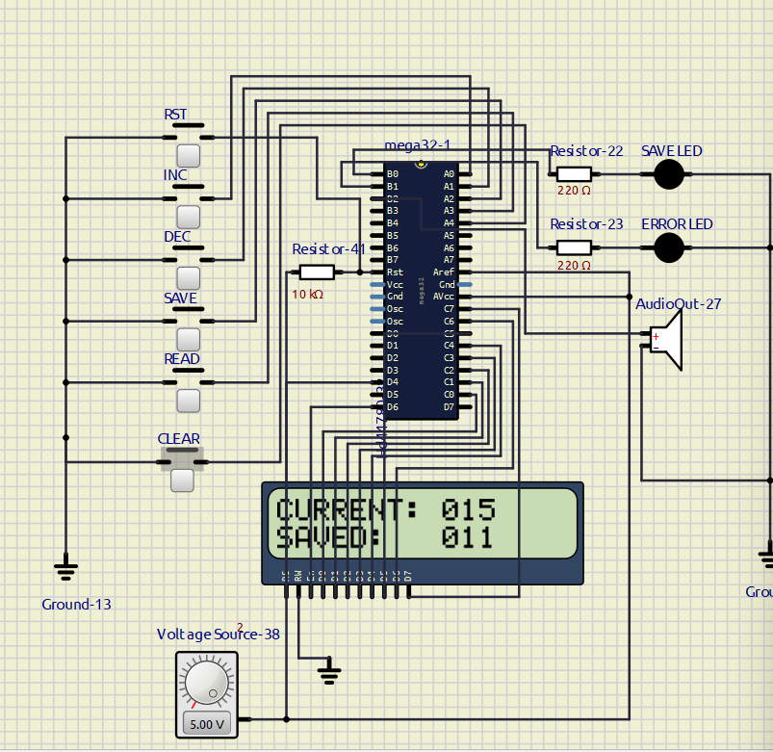
SimulIDE Simulation - Save & Read
SAVE: current value written to EEPROM
READ: stored value re-read from EEPROM

Slide 15
Test Results Summary
All 8 functional test cases passed in SimulIDE
Test Case | Result
Startup (first power-up) | PASS - CURRENT: 000, SAVED: 000
Increment | PASS - clamps correctly at 255
Decrement | PASS - clamps correctly at 0
Save | PASS - SAVED updates to match CURRENT
Read | PASS - SAVED re-read independently from EEPROM
Clear | PASS - both values reset to 000
Reset recovery | PASS - last saved value reloaded
Power-cycle recovery | PASS - last saved value recovered

Slide 16
Extension Task (Optional)
● Store multiple records instead of a single value
● Example: last five event-count values or threshold settings
● User scrolls through stored records using buttons or serial commands
● Requires careful EEPROM address management and simple record indexing in software

Slide 17
Conclusion
● Successfully implemented EEPROM read/write operations on the ATmega32
● Designed and verified a complete schematic and PCB in KiCad (0 ERC/DRC violations)
● Built and tested firmware controlling buttons, LCD, LEDs, and buzzer
● Validated complete system behavior in SimulIDE - all test cases passed
● Demonstrated reliable data retention across reset and power cycling

Slide 18
Thank You

