Slide 1
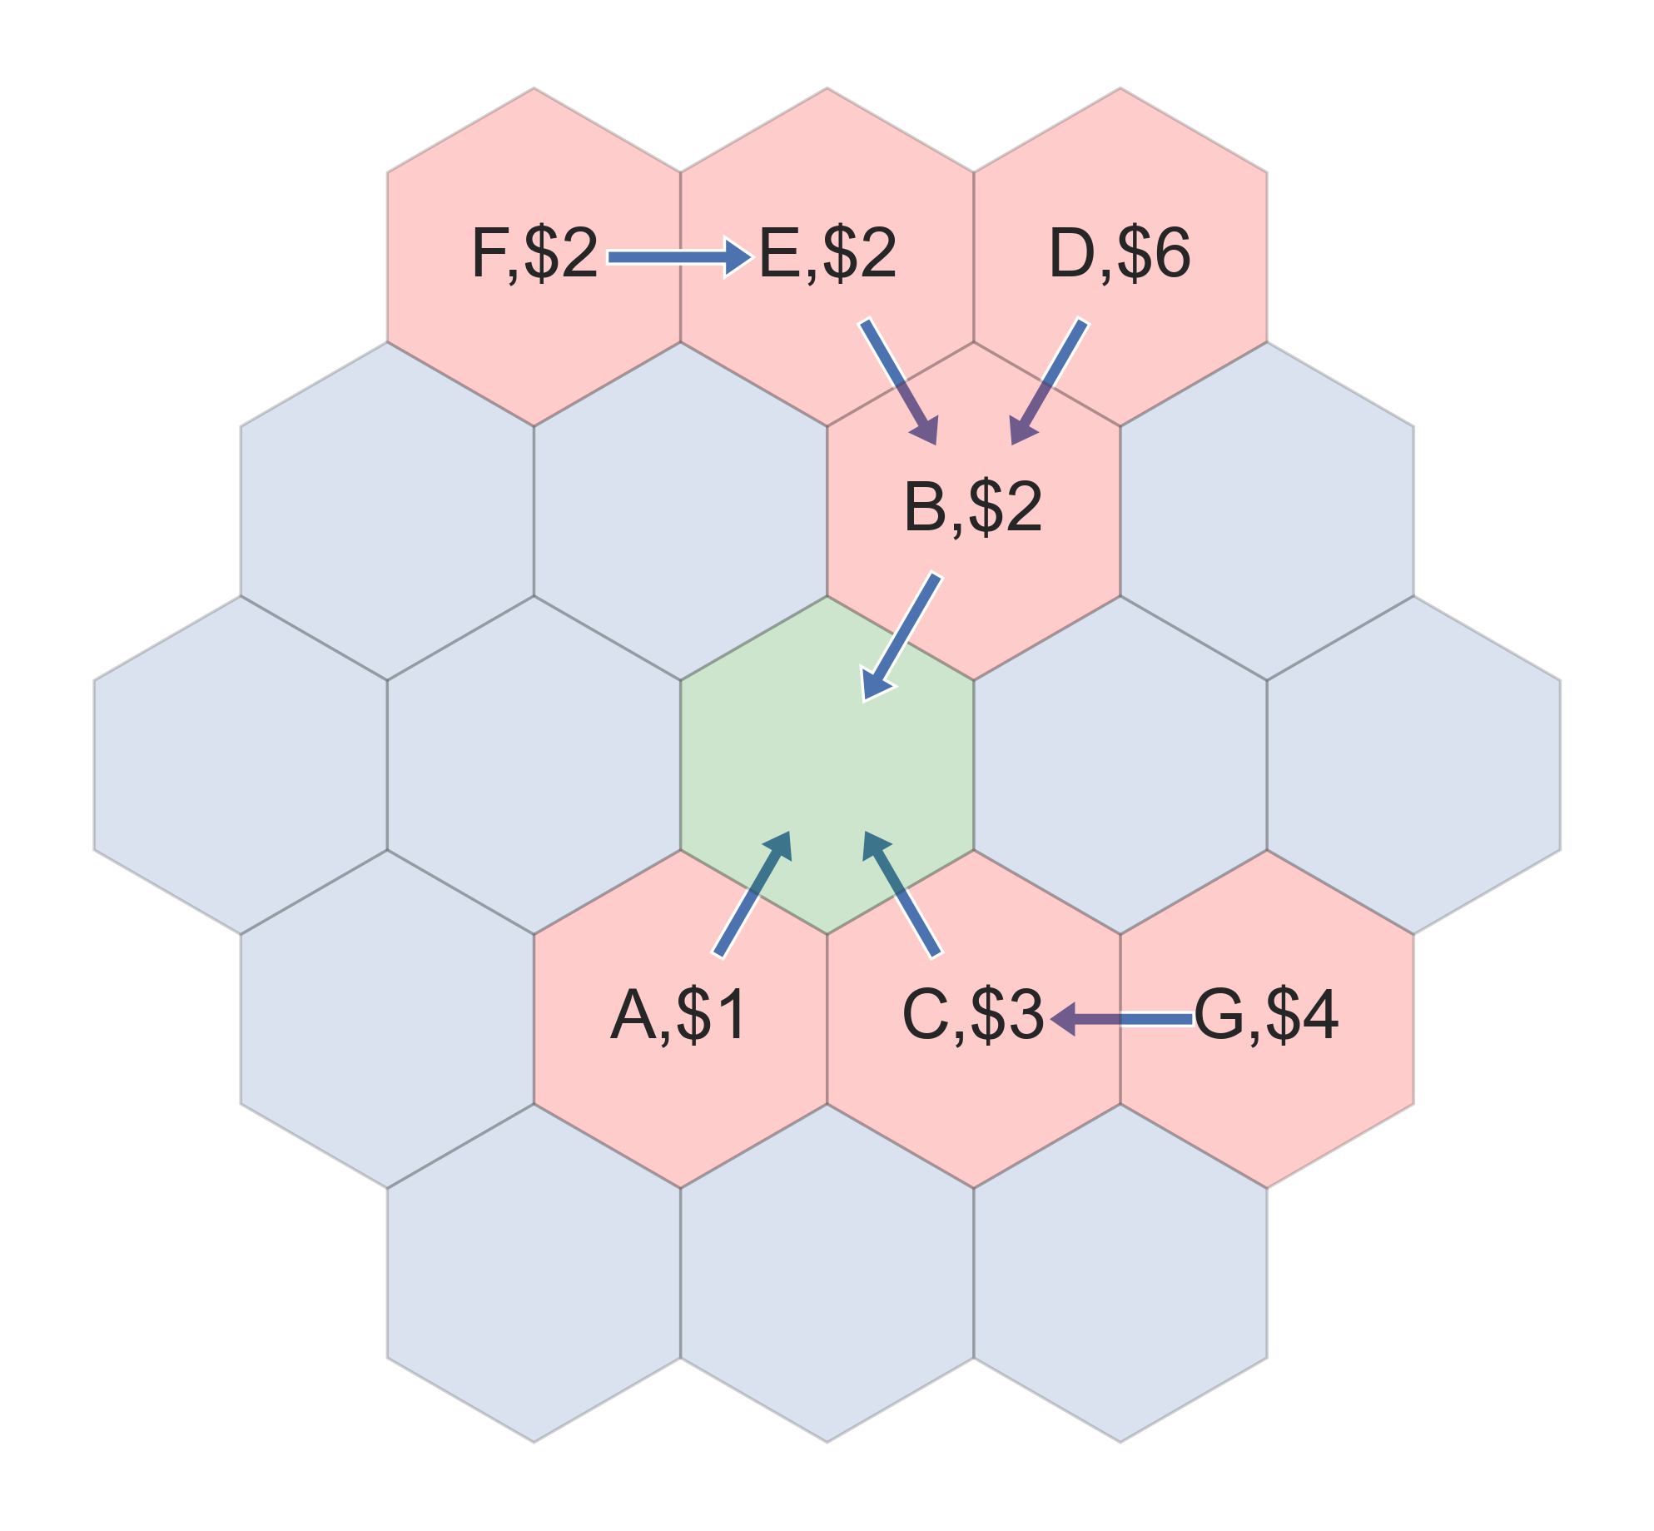



Consider this scenario
Multiple flights vying for center hex
We present 2 more methods of prioritization
Weighted methods based on second-price auctions [cite VCG here]
Second Price
Second Backpressure
Notes:
Consider the following scenario
11:30

