Slide 1

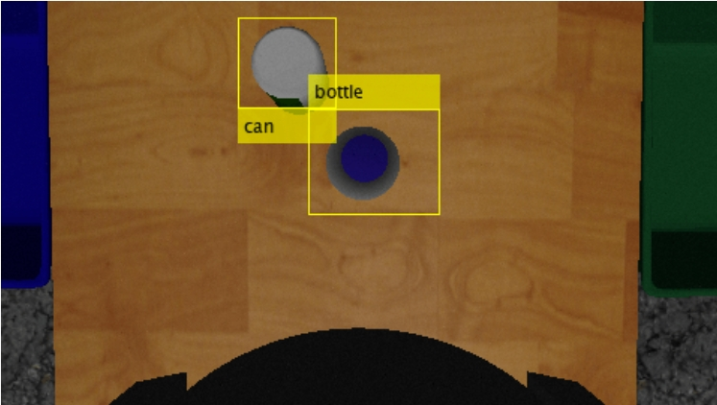
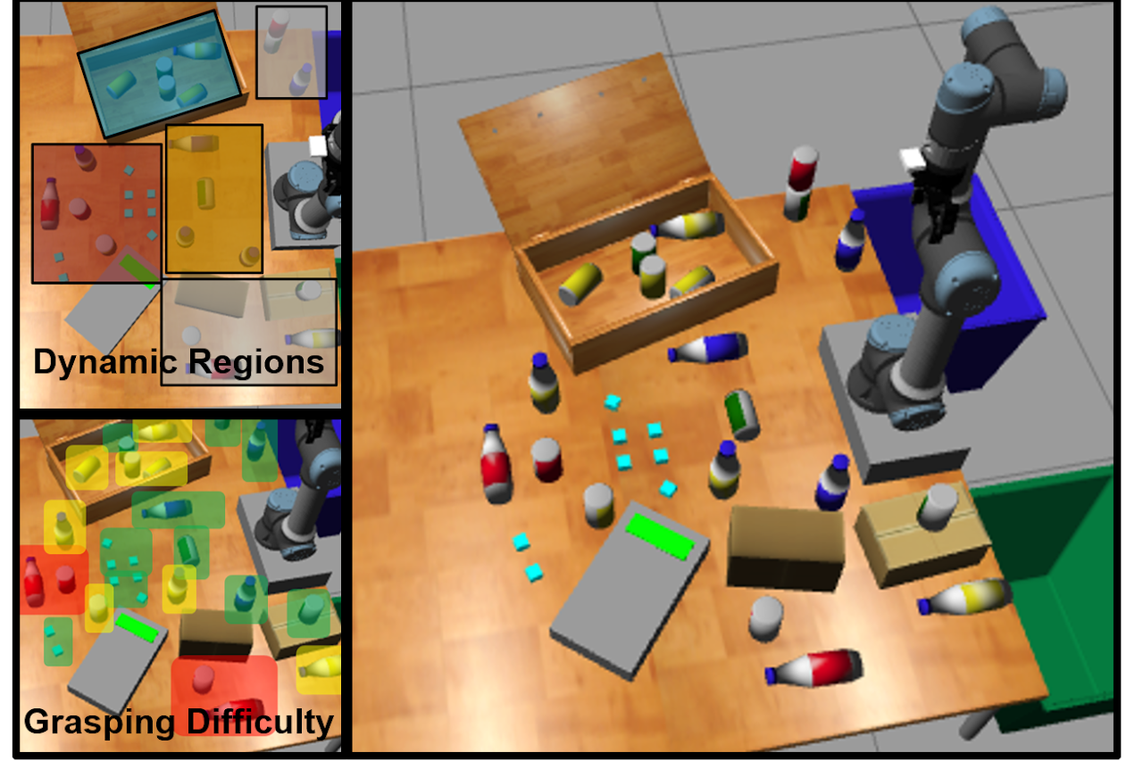
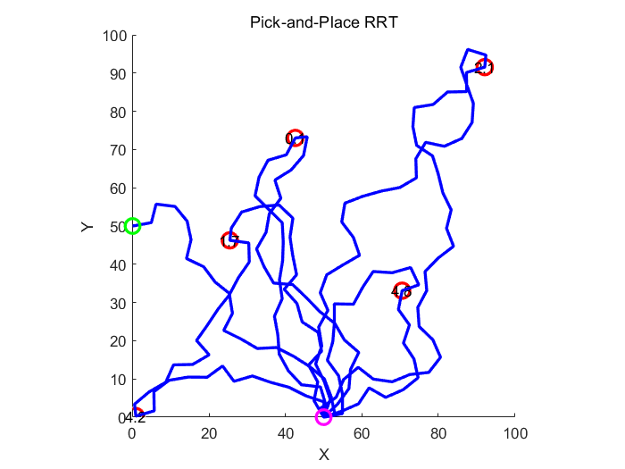
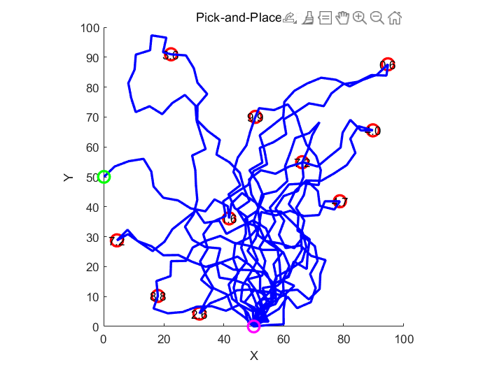
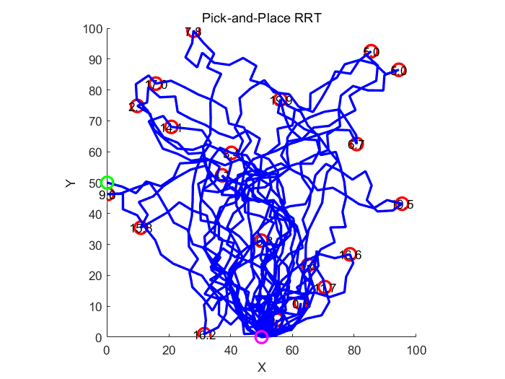
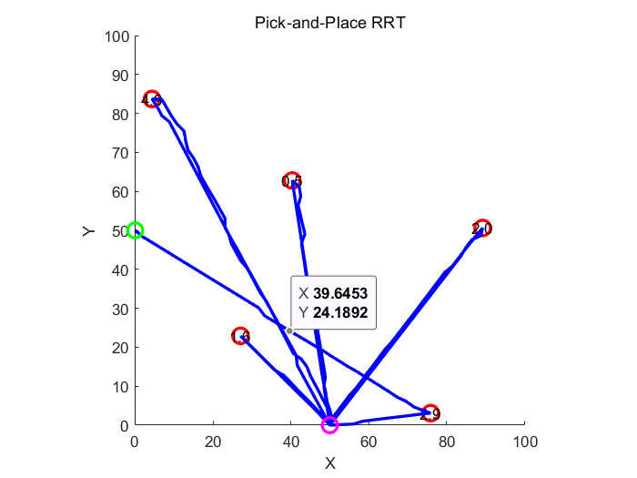
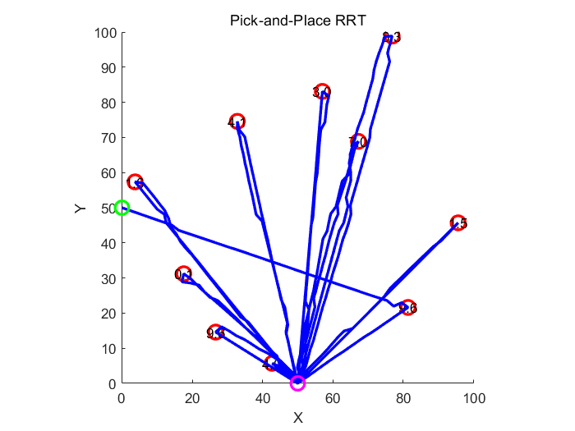
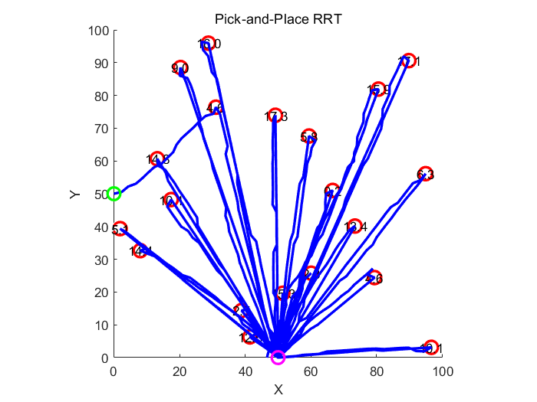
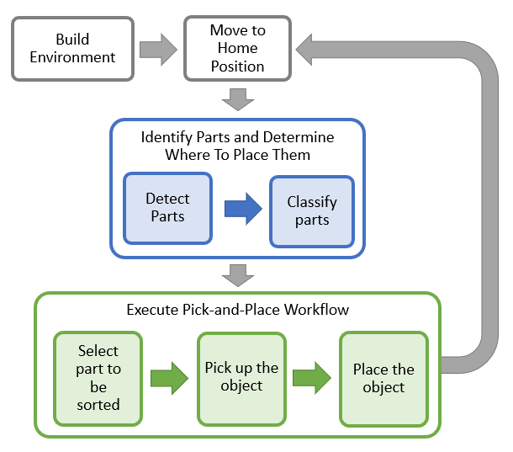
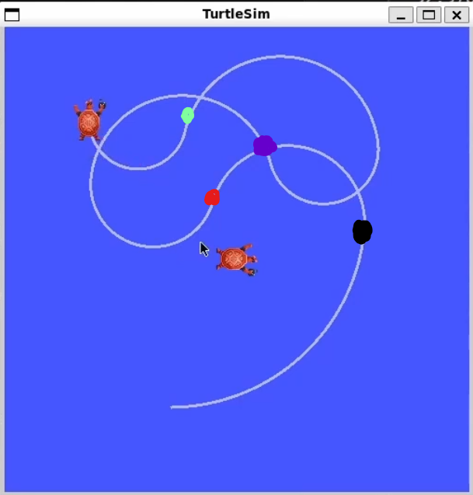
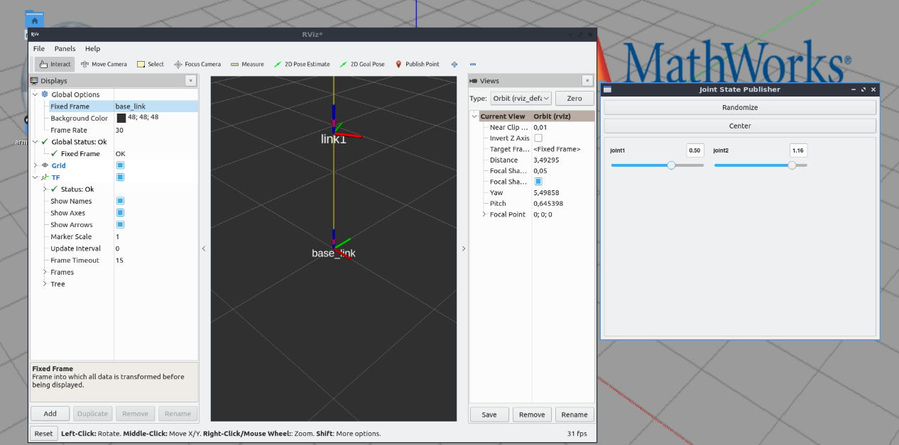
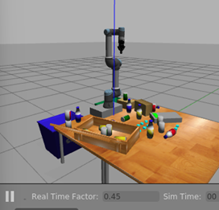
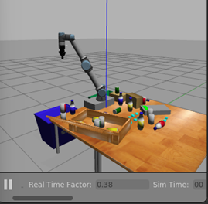





RoboCup: Autonomous Robot Manipulation (ARM) Challenge
Member: Botong Wen (botong.wen@kcl.ac.uk), Qianyu Hu (qianyu.hu@kcl.ac.uk), Yutong Cui (yutong.cui@kcl.ac.uk), Mengting Wang (mengting.wang@kcl.ac.uk), Dongjian Ma (dongjian.ma@kcl.ac.uk), Kexin Zhang, Oluwatimilehin Tijani (oluwatimilehin.tijani@kcl.ac.uk), Weitao Deng (weitao.deng@kcl.ac.uk)
ROBOCUP 2
Introduction & Summary
Preliminary Results
The focus of this project is implementing the logic to complete a recycling task with a robot manipulator in a dynamic environment. This involves implementing perception and control algorithms in MATLAB and Simulink to grasp and manipulate specific objects present in the table scene. These objects include bottles, cans, and detergent pouches that will be sorted into two bins. The logic should be robust and able to adapt to new environments effectively. The table is split into five sections and each section dictates the possible positions and poses for the items within. This means some sections have a higher difficulty than others.
Scene from a simulation environment showing the different sections and their difficulties [1].
The success of this project is measured by the system's ability to accurately detect bottles, cans, and pouches, calculate object and end-effector positions relative to key frames, plan efficient grasping and sorting paths, and control the arm for smooth, precise movements, all in near real-time.
Detection:
The object is detected and a bounding box with class is generated by the model.
Motion Planning:
Position based RRT algorithm are designed and tested, which could avoid collision.
Transformation:
Transforms for static and moving frames were done using ROS and TF2 [3]
Successfully published and listened to transformations for static and moving frames
Investigated heuristics to identify the frames for each of the five table sections dynamically
Control:
Currently, after completing all the environment configurations, MATLAB has been able to successfully communicate with VirtualBox and manipulate the robotic arm and gripper for movement.
Methodology
Each coloured dot shows a frame position that was broadcast during simulations for a moving frame
Methodology for pick and place action logic [2].
Environment Setup:
Setup Virtual Machine to run Gazebo, ROS, and RViz; connect virtual machine to MATLAB and Simulink.
Detection:
Data Acquisition: RGB images is captured using the simulated camera.
Model Training: The YoloV4 model is trained on a GPU-enabled system with Matlab.
Image processing: Publish the item information for downstream processes.
Motion Planning:
Data pretreatment: Discretize objects model into coordinates.
Workspace conversion: Convert workspace into C-space using inverse kinematics analysis tools such as MoveIt!
RRT Algorithm Design: Design C-spaced RRT algorithm and use genetic optimization algorithm to improve it.
Transformation:
Identity static frames for the table, each section on the table, the sorting bins, the robot manipulator base and end-effector, and the scale on the table.
Publish transformations for table items relative to their corresponding table sections' frame.
Publish transformations for the table items relative to the end-effector's frame.
Verify the transformations using RViz.
Control:
Inverse kinematics: it will be used to calculate the pose of each joint.
Gripper: To ensure stable grasping and placement of objects, it is necessary to test several times and adjust the gripper's clamping force.
PID controller: the accuracy of the robotic arm can be ensured in the simulated environment or even in the real scene.
Summary
We’ve made strong progress on four key tasks, setting the stage for an efficient pick-and-place algorithm. The detection model has been preliminarily trained to identify items in different colors, poses, and orientations, with room for improvement. We’ve defined a message structure for broadcasting item identification to other components.
For transformations, we’ve explored defining frames and publishing transformations, which will guide the RRT model in generating optimal manipulator paths. Control tests using inverse kinematics successfully generate joint variables for arm movement along waypoints. The integration of these tasks will lead to an optimal algorithm.
For our stretch goal, we plan to implement dynamic path planning to recover from deviations and improve item placement and retrieval.
References ​
[1] RoboCup, "ARM - RoboCup," RoboCup, [Online]. Available: https://arm.robocup.org. [Accessed: 26-Nov-2024].
[2] MathWorks, "Pick and Place Workflow Using Stateflow," MathWorks, [Online]. Available: https://uk.mathworks.com/help/robotics/ug/pick-and-place-workflow-using-stateflow.html. [Accessed: 26-Nov-2024].
[3] Open Source Robotics Foundation, "tf2 Tutorials," ROS Wiki, [Online]. Available: http://wiki.ros.org/tf2/Tutorials. [Accessed: 26-Nov-2024].

