Slide 1

Digital Image Processing
(UE24EC342AC1)
Retinal Blood Vessel Extraction from Eye Images using Classical DIP
Team Number :
Shriya Arunkumar SRN: PES1UG24EC206
Samarth Sheshadri SRN: PES1UG24EC180
Sahil Nair SRN: PES1UG24EC174

Slide 2
CONTENTS
  Introduction
  Algorithm/DIP Concepts Applied (All 4 units coverage)
  System workflow/Flowchart
  Novelty(If any) and Individual Contribution
  Demonstration
  Results
  Conclusion & Real life Applications
  Q & A

Slide 3
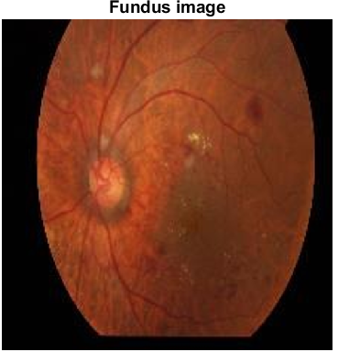
INTRODUCTION
Input: A colour photo of the back of the eye (a fundus image). The blood vessels appear as thin, dark, curved lines.
Processing: Extract a clean black-and-white vessel map and colour vessels by thickness using Unit 1 basics, Unit 2 transforms, Unit 3 enhancement and restoration, and Unit 4 morphology, without machine learning.
Output:
For every image: a figure for each unit, the final coloured vessel map, an overlay on the photo, and a table of numbers (vessel area, length, branch points).
Input: one fundus image (testimage1)

Slide 4
  ALGORITHM & CONCEPTS APPLIED
prepare the image → compress it → enhance it → extract the vessel lines → measure and colour them
UNIT 1
UNIT 2
UNIT 3
UNIT 4
Image basics
Image transforms
Enhancement and restoration
Morphology and output
Colour channel split (R, G, B)
Masking by thresholding
Interpolation (resizing)
Sampling and quantisation
DFT (Fourier) spectrum
DCT compression
DCT noise removal
SVD compression
DCT vs SVD comparison
Histogram equalisation, CLAHE
Background (lighting) correction
Spatial filters: smooth, sharpen
Frequency filters: low, high, notch
Noise removal: mean, median, Wiener
Black top-hat transform
Opening with line shapes
Thresholding and cleanup
Skeleton (thinning)
Distance transform, pseudocolour

Slide 5
  SYSTEM WORKFLOW / FLOWCHART
Input
Unit 1: Prepare
Unit 2: Compress
Unit 3: Enhance
Colour eye photo
(JPEG, any size)
Eye-area mask, Green
channel, enlarge (bicubic)
DCT, keep 10%
(PSNR at least 35 dB)
Lighting correction,
CLAHE, median filter
Outputs
Measure and colour
Unit 4: Extract
Vessel map, overlay,
CSV of numbers
Skeleton, width,
pseudocolour
Top-hat, line opening,
threshold, cleanup

Slide 6
  NOVELTY & INDIVIDUAL CONTRIBUTION
What is new in our project
Shriya
Choices are made by numbers, not by eye: PSNR, MSE and contrast (CNR) pick the best method
Top-hat combined with line-shaped openings at 12 angles: keeps thin lines, removes round spots.
Works for any image size
No machine learning: every step is a course concept
Unit 1 image basics, project foundation and integration, Unit 3 enhancement
Samarth
Unit 2 DFT and DCT, Unit 3 restoration (noise removal and notch filter)
Sahil
Unit 2 SVD, Unit 4 morphology and pseudocolour output, evaluation

Slide 7
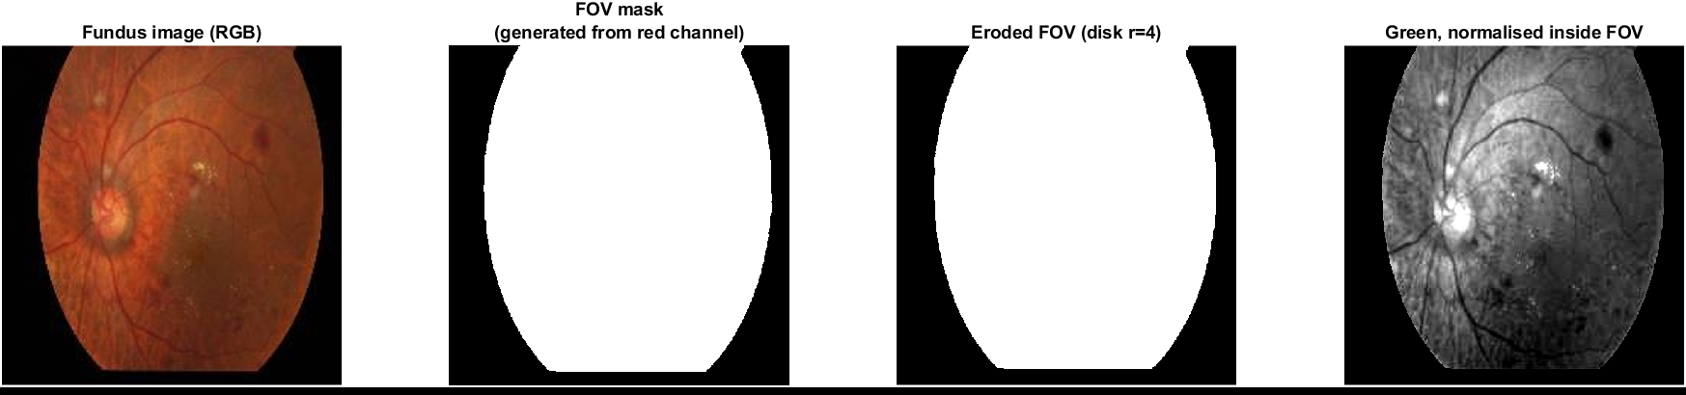
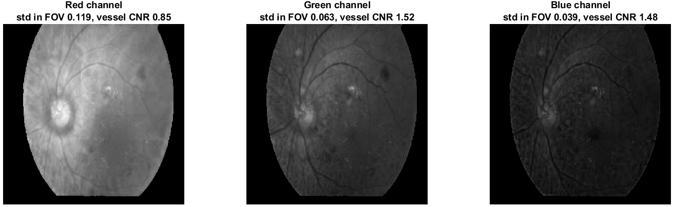
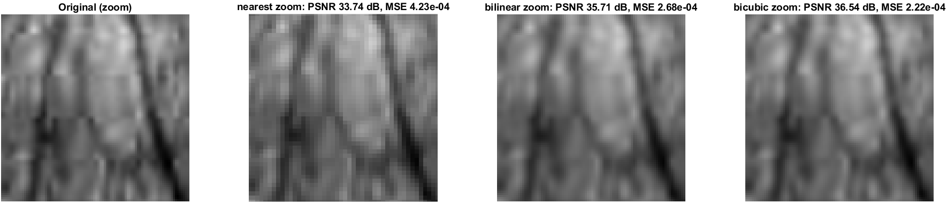
  UNIT 1: IMAGE BASICS
Photo, mask, shrunk mask, Green layer. White = the eye area we measure; black is ignored.
Colour channel split (RGB: Red, Green, Blue)
Masking by thresholding (FOV: Field of View)
Interpolation
Sampling and quantisation
Red, Green, Blue layers of the same photo. Vessels are darkest and clearest in Green.
Zoomed: original, nearest, bilinear, bicubic. Nearest looks blocky; bicubic is closest to the original.

Slide 8
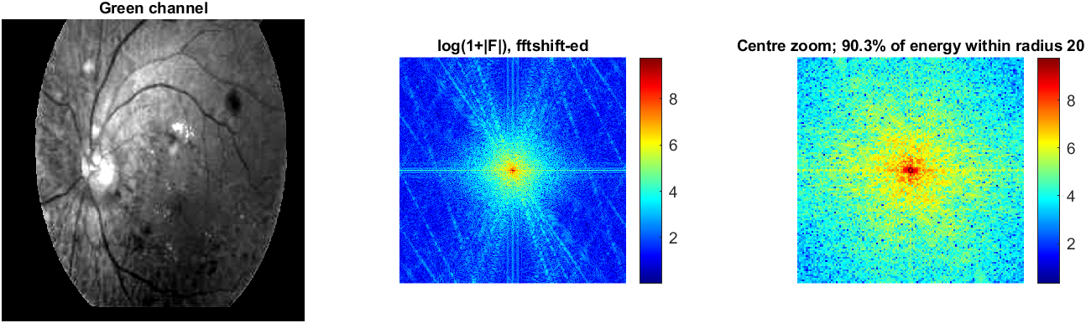
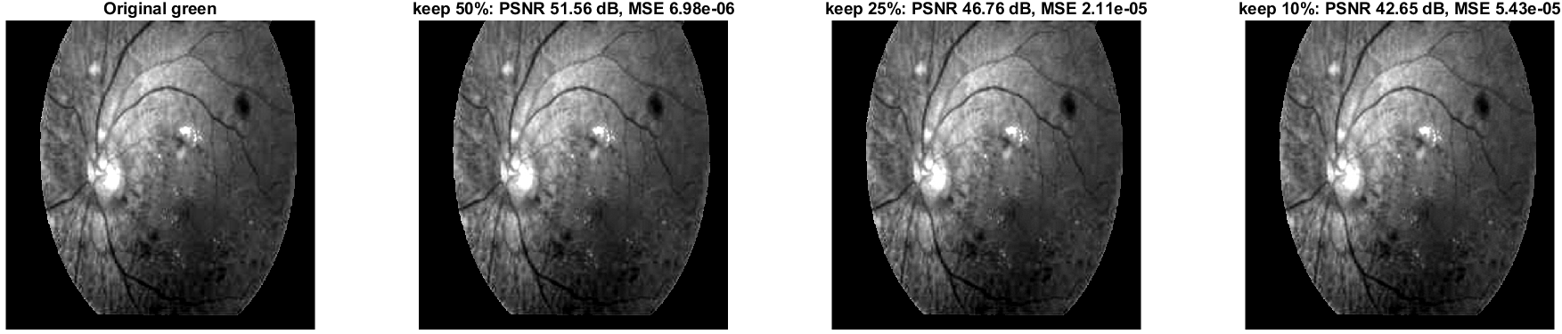
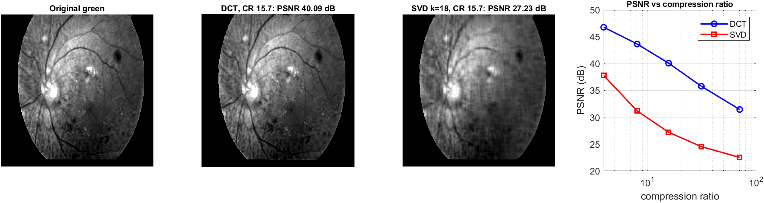
  UNIT 2: IMAGE TRANSFORMS
Green image, its frequencies (centre = smooth parts, edges = fine lines), and a zoom: 90% of the energy is in the centre.
DFT (Discrete Fourier Transform)
DCT (Discrete Cosine Transform) compression
DCT noise removal
(SVD (Singular Value Decomposition)
DCT vs SVD
Original, then rebuilt from 50%, 25% and 10% of DCT values. Even 10% looks the same, so the image can be stored much smaller.
Original, DCT, SVD at the same size: DCT stays sharp, SVD is blurry. Graph: blue DCT line is always above red SVD.

Slide 9
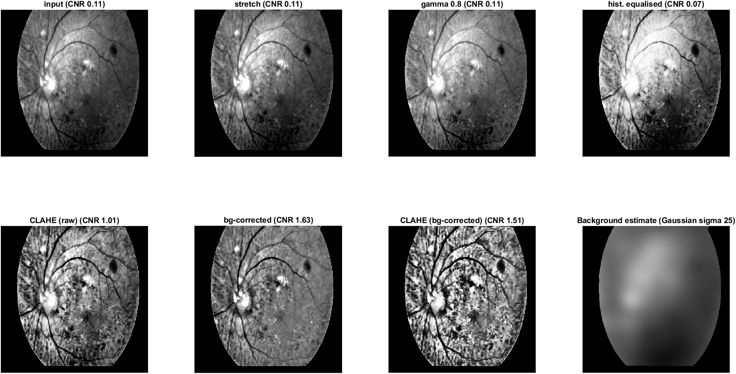
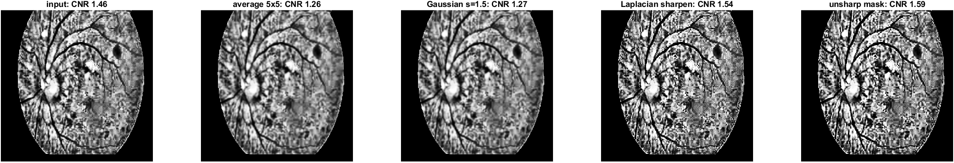
  UNIT 3: IMAGE ENHANCEMENT
Top: input, stretch, gamma, histogram equalisation (uneven light stays). Bottom: CLAHE, light removed, both, and the light estimate we subtract.
Histogram equalisation
Background (lighting) correction
CLAHE (Contrast Limited Adaptive Histogram Equalisation)
Spatial filters
Input, average, Gaussian (blurrier), Laplacian, unsharp (sharper). Sharpening makes thin lines stand out.

Slide 10
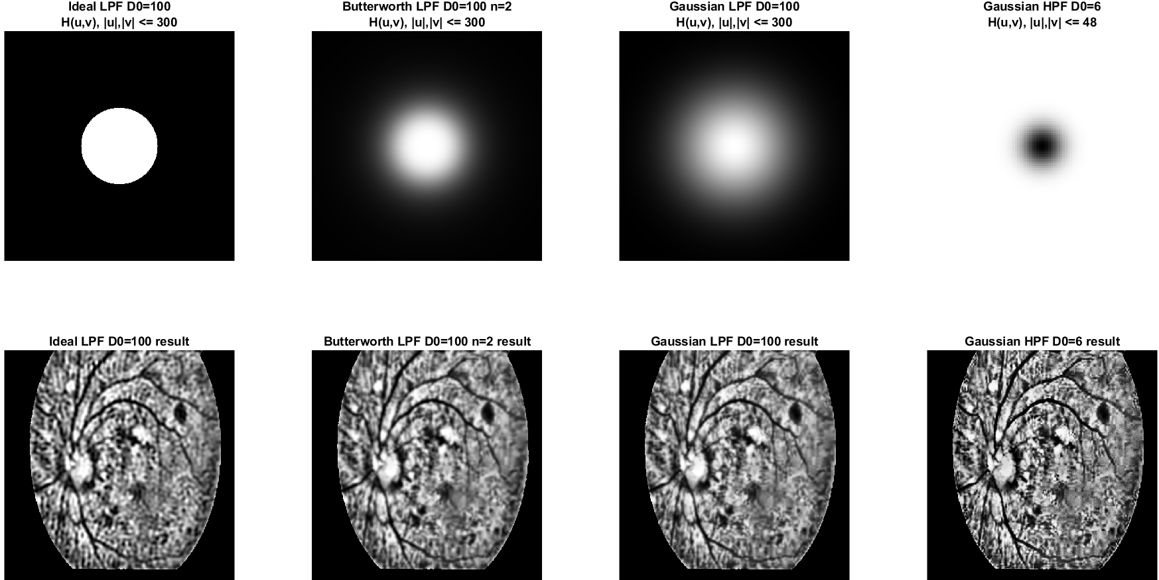
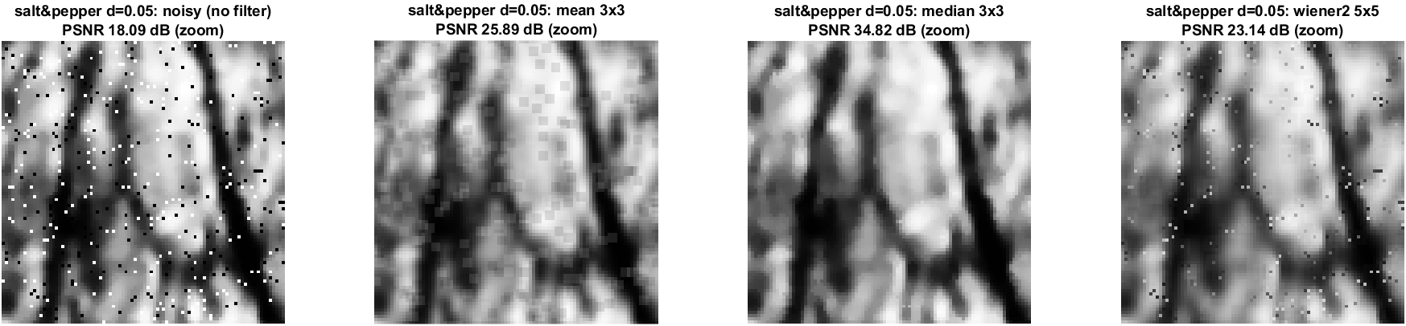
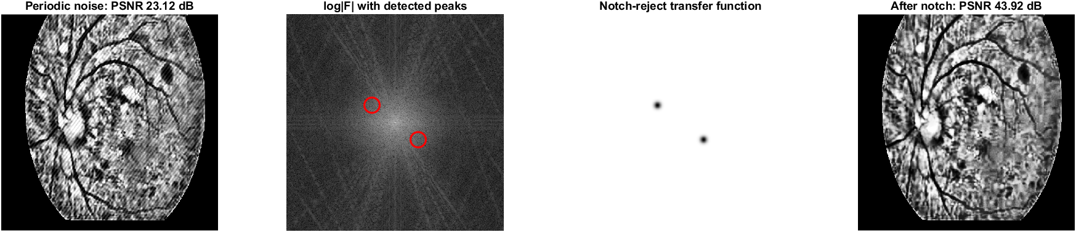
  UNIT 3: FREQUENCY FILTERING AND RESTORATION
Top: filter shapes (white = frequencies kept). Bottom: results. The sharp ideal filter makes ripples; the soft Gaussian does not.
Low-pass filters (LPF)
High-pass filter (HPF)
Noise removal
Notch filter
Salt-and-pepper noise (black and white dots), then mean, median, Wiener. Median removes the dots best.
Stripe noise, its spectrum (red circles = stripe dots), the notch mask that blocks them, and the clean result.

Slide 11
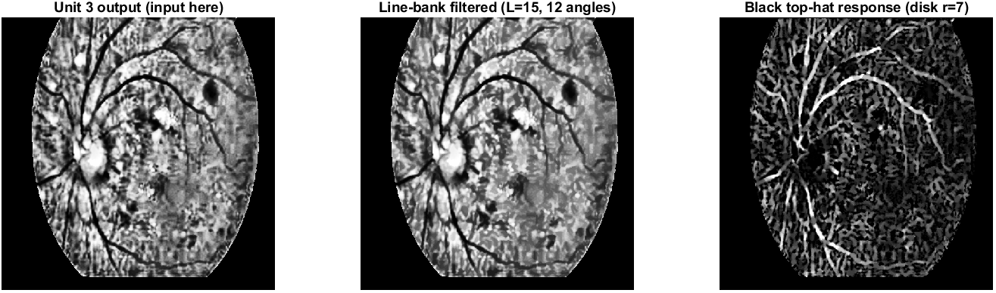
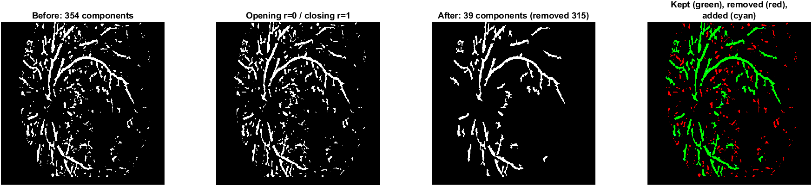
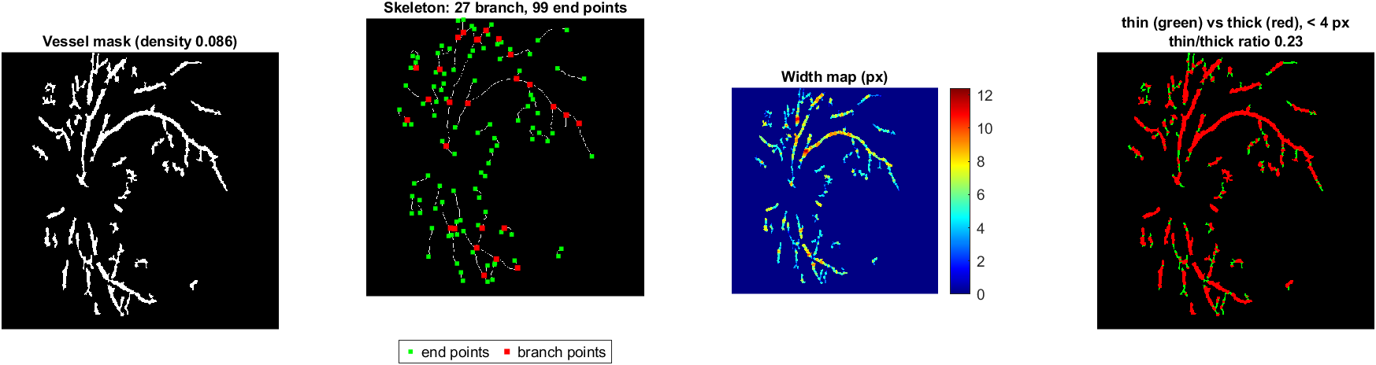
  UNIT 4: MORPHOLOGICAL PROCESSING
Input from Unit 3, after the line filter, after the black top-hat. Top-hat leaves only thin dark lines, shown bright.
Black top-hat
Opening with line shapes
Thresholding
Cleanup
Skeleton (thinning)
Distance transform and pseudocolour
Mask before and after cleanup. Green = vessel pieces kept, red = tiny noise pieces removed.
Mask, skeleton (1-pixel lines with branch and end points), width map, and thin (green) vs thick (red).

Slide 12
DEMONSTRATION
1
Open MATLAB in the project folder.
2
Put the eye images in the data folder.
3
Type run_all_images (or main_pipeline for one image).
4
Open outputs / image name to see every unit's figures, the vessel map, the overlay and the numbers.

Slide 13
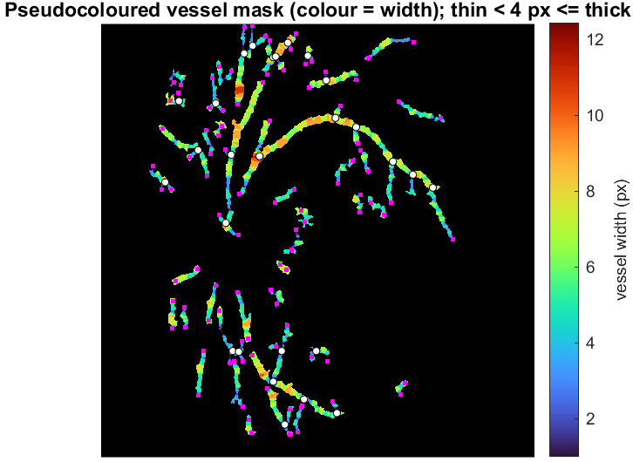
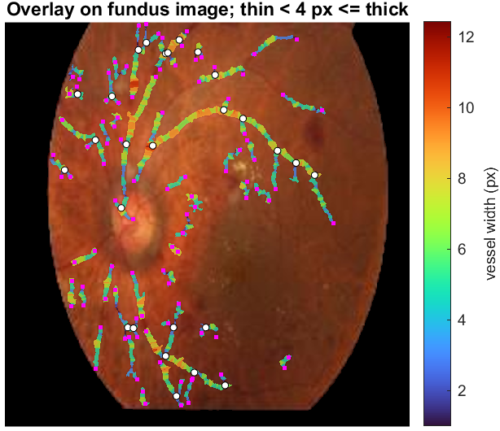
RESULTS: testimage1 (DISEASED), FULL PIPELINE
0.086
Vessel area: 8.6% of the eye
27
Branch points
3062 px
Total vessel length
0.23
Thin to thick ratio
Vessel map: only the vessels, coloured by width
Overlay: the map on the photo, to check it
The main vessel lines are found and sit exactly on the vessels in the photo (overlay check).
Cleanup removed 315 small noise pieces; 39 connected vessel pieces remain.
Colour shows width: thick lines near the bright disc, thin lines further out.

Slide 14
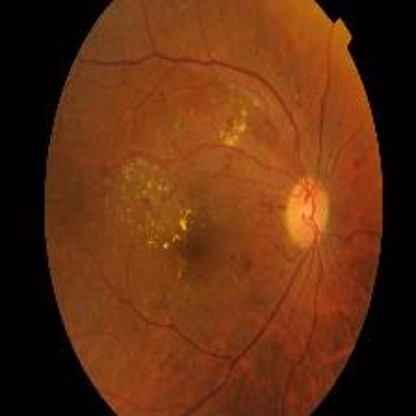
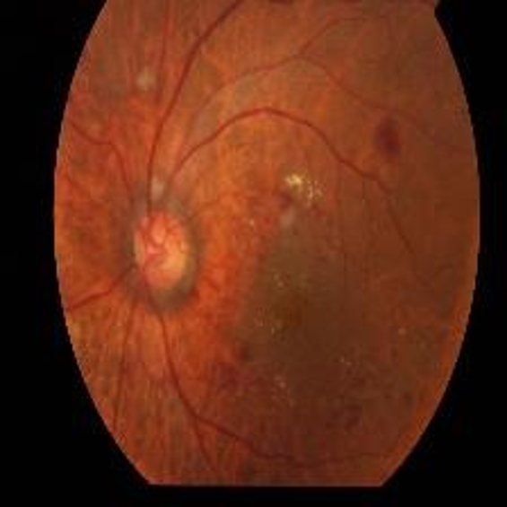
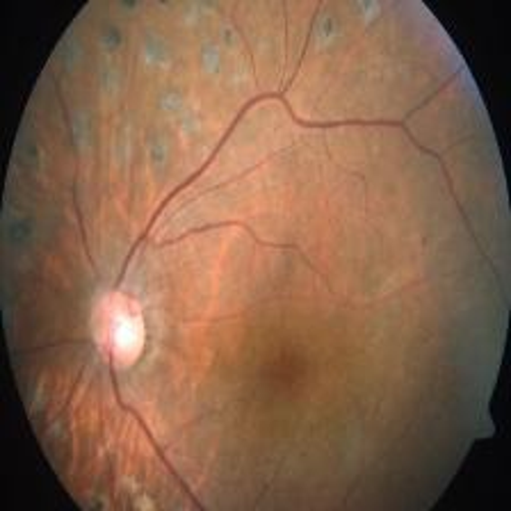
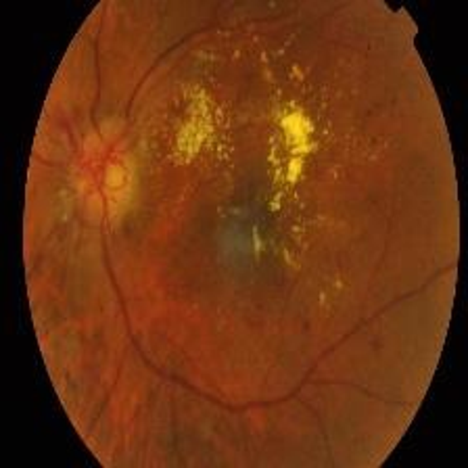
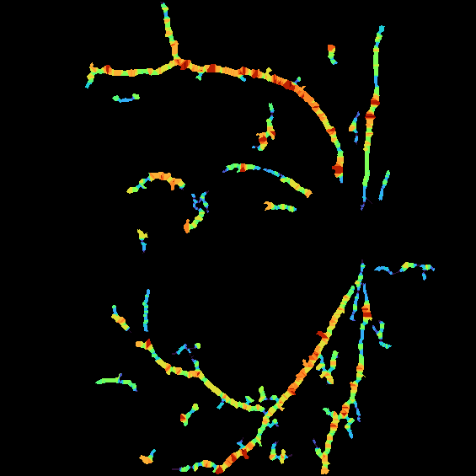
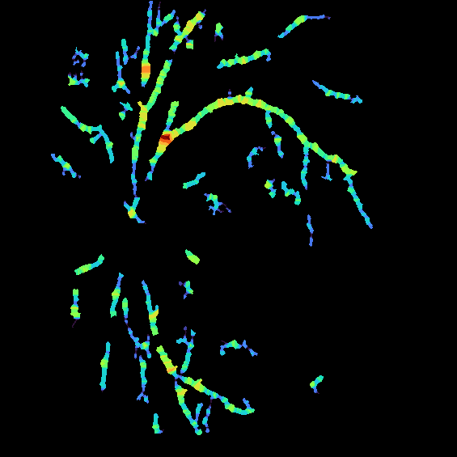
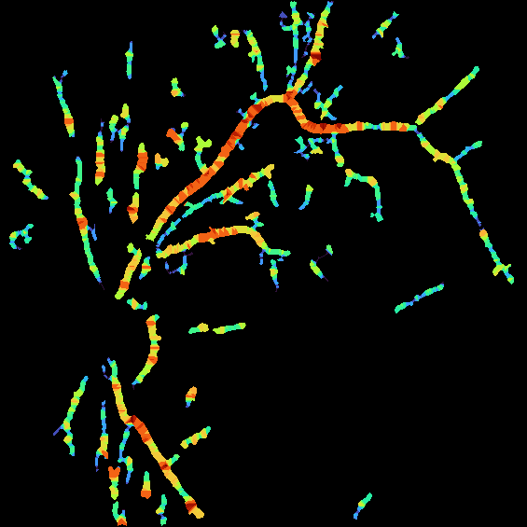
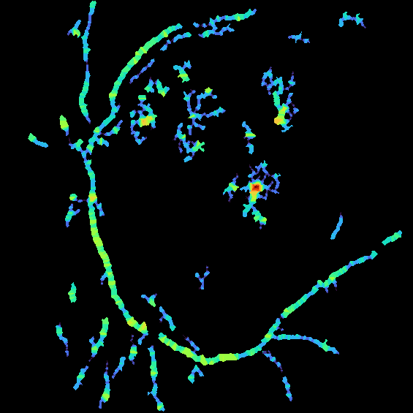
RESULTS: DISEASED EYES (TESTIMAGES 2 TO 5)
testimage2
testimage3
testimage4
testimage5
Input photo
the eye image we start with
Vessel map
our final output: only the vessels, colour = width
Vessel area and call
0.079
DISEASED
0.084
DISEASED
0.092
DISEASED
0.091
DISEASED

Slide 15
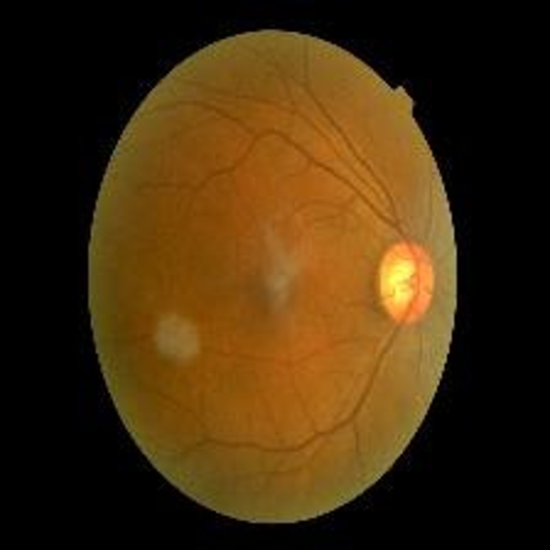
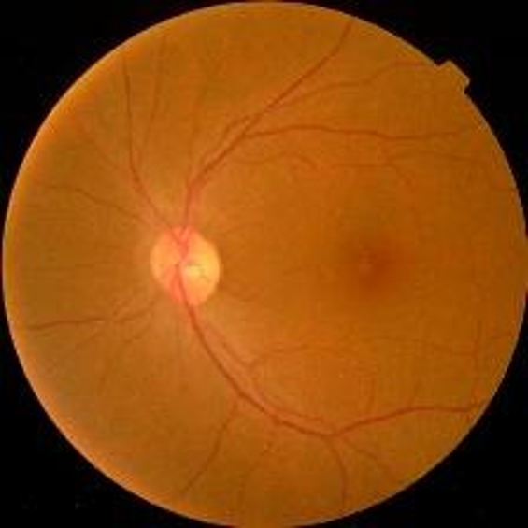
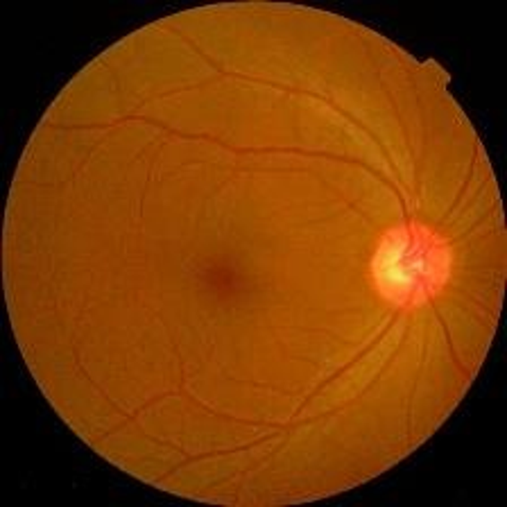
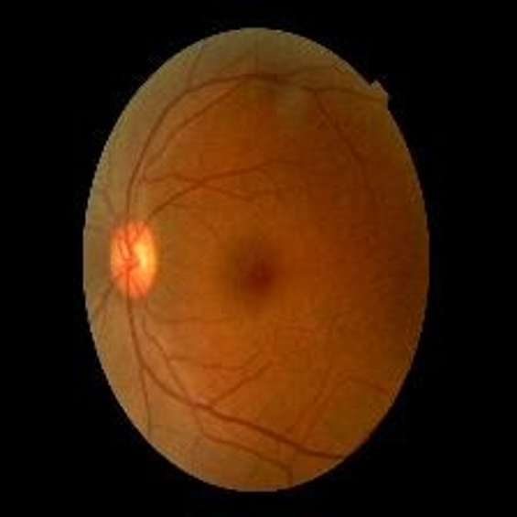
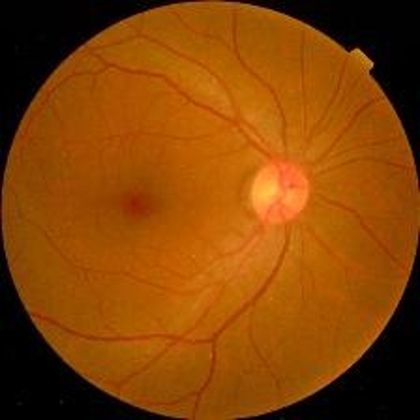
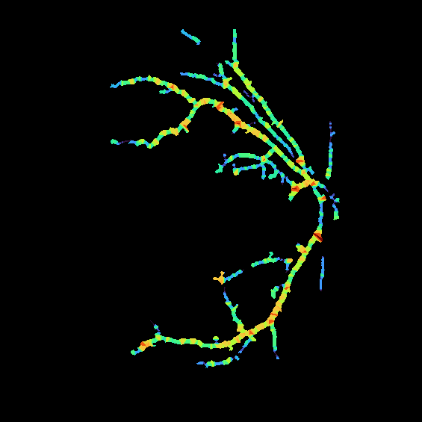
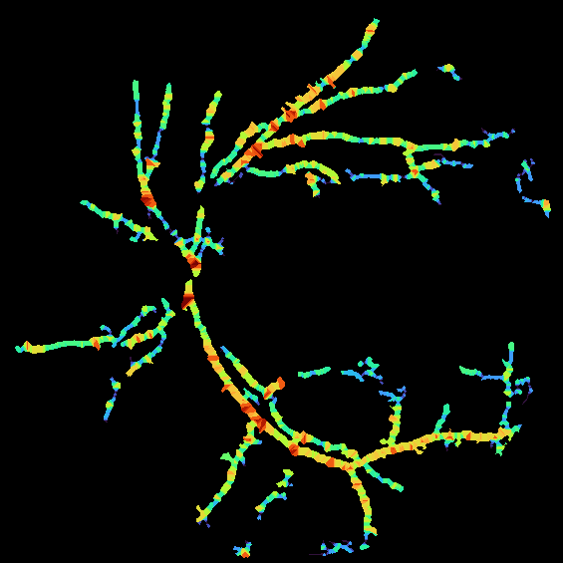
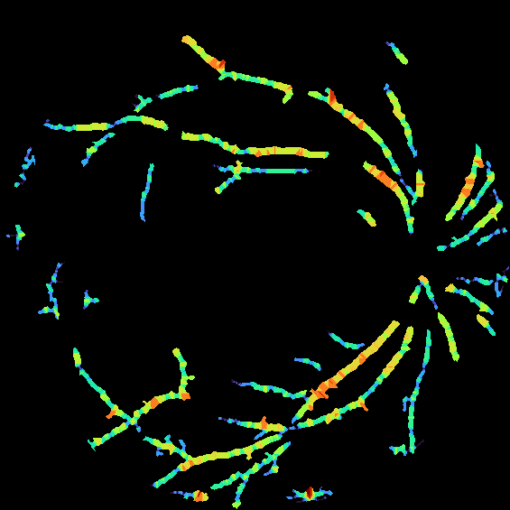
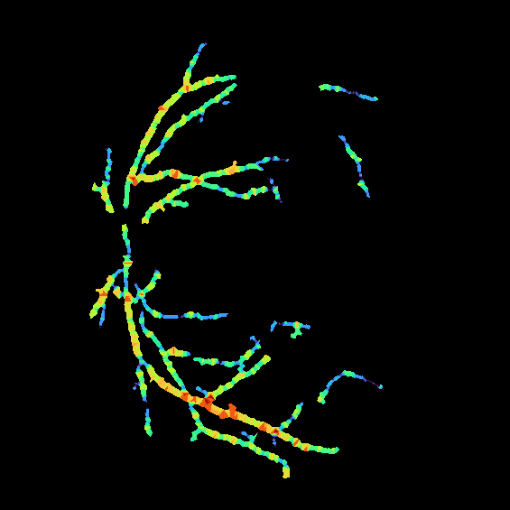
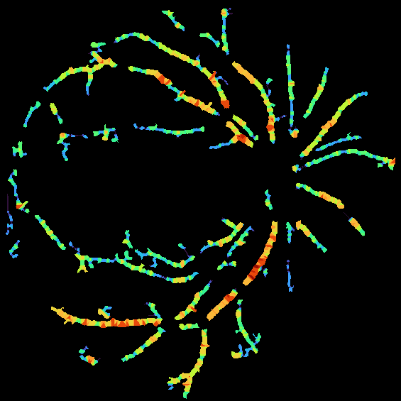
RESULTS: HEALTHY EYES (TESTIMAGES 6 TO 10)
testimage6
testimage7
testimage8
testimage9
testimage10
Input photo
the eye image we start with
Vessel map
our final output: only the vessels, colour = width
Vessel area and call
0.094
HEALTHY
0.099
HEALTHY
0.095
HEALTHY
0.105
HEALTHY
0.102
HEALTHY

Slide 16
CONCLUSION & REAL LIFE APPLICATIONS
Conclusion
Real life applications
Extracted vessel lines using only classical DIP from Units 1 to 4, with no machine learning.
Numbers guided every choice: Green channel, bicubic, DCT 10%, lighting correction plus CLAHE.
Morphology (top-hat with line shapes) is the key step that separates thin lines from the background.
The final output is a coloured vessel map plus simple numbers for every image.
Eye screening support: a quick vessel map a doctor can look at.
Medical image storage: DCT compression saves space and keeps quality.
Other thin-line images: roads in satellite photos, cracks in walls and roads, fingerprints, leaf veins.
Cleaning noisy or striped images with median and notch filters.
Teaching: shows each DIP concept working on a real image.

Slide 17
Q & A

Slide 18
Thank You

