Slide 1
FOCUS
A One-Stage Time Management App
IEM DIP GROUP 1
18/04/2022

Slide 2
TABLE OF CONTENTS
Project Introduction
Version 2 Design
1
4
Demo Showcase
Methodologies
2
5
Version 1 Design
Conclusion
3
6
Background & Motivations
Game Component
Our live demo & Use cases
Frontend & Backend
Our UI design considerations
Overall Project Journey

Slide 3
1
Introduction
Presenter: Goh Jessie

Slide 4
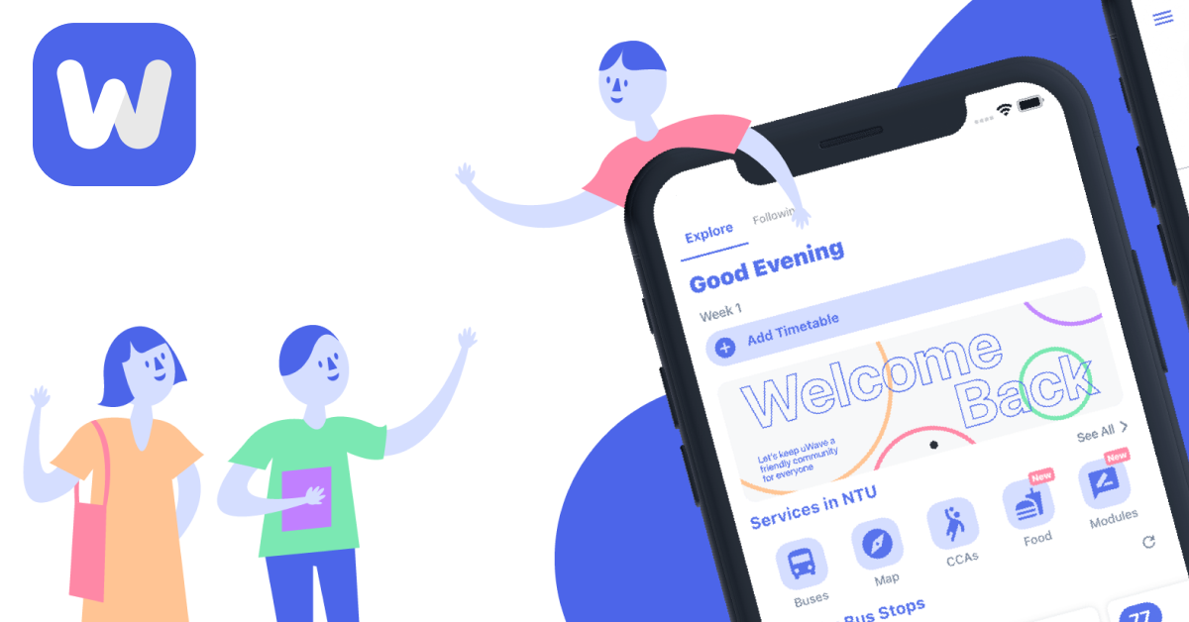
uWave
Targets university students with timetable, bus locations and social functions.
1. Absence of important functions
2. Diminished user experience

Slide 5
Social functions can enhance productivity.

Slide 6
AIM
OBJECTIVES
To build a productivity mobile application targeted at tertiary students and young working adults, with improved productivity features and a smaller social aspect.
Improve the UI/UX
Incorporate multiplayer interaction;
Incorporate progress rankings;
Incorporate a motivational section within the app.

Slide 7

SNEAK PEEK

Slide 8
2
Use Cases & Demo
Presenter: Gwenn Tan Yiru
Notes:
Thankyou Jessie, now i will go through the Use case and Demo of focus(click)

Slide 9

Use Case
View Profile
Display total weekly tasks
View weekly Calendar
Search all events
Login
Verify password
Signup
Update account database
User
View Game
Display all users’ position
Update Position
Firebase Database
Add Category
Update Category database
Friends
Add Event
Add Task
Set date and time
Search Categories
<<include>>
Add Deadline
<<extends>>
Notes:
Sign up page → edit profile page → add category → add event(with that new cat) → show event in calendar→ show click complete task → hardcode show chart in profile page increase by 1
Thankyou, jessie, now i will go through the use case.
This is Jane, she and her friends have been very busy with submission from university the week. They are looking to better organsise their time and improve their productivity. Thus they decided to download Focus. (sign up screen)
After signing up they are able to edit and customise their profile.
To start planning her week, jane first adds the category in which the event would be under. Then she is able to add the event and link it to the category. Now, she is able to view the event in the weekly calendar and not miss it.
Jane is also able to add tasks the same way she adds her events, and upon completion she can check it off and see her progress on the profile screen. Going to the game tab, jane would also be able to see her avatar move and step and view the fireworks animation as a reward for completing the task. Not only that, she can also view her friends progress. This way, they can encourage each other and perhaps engage in a friendly competition to see who is able to move further.
When ever Jane feels stressed or is in need for some motivation between tasks, she can go to the motivation tab to receive some encouragement.
Now

Slide 10
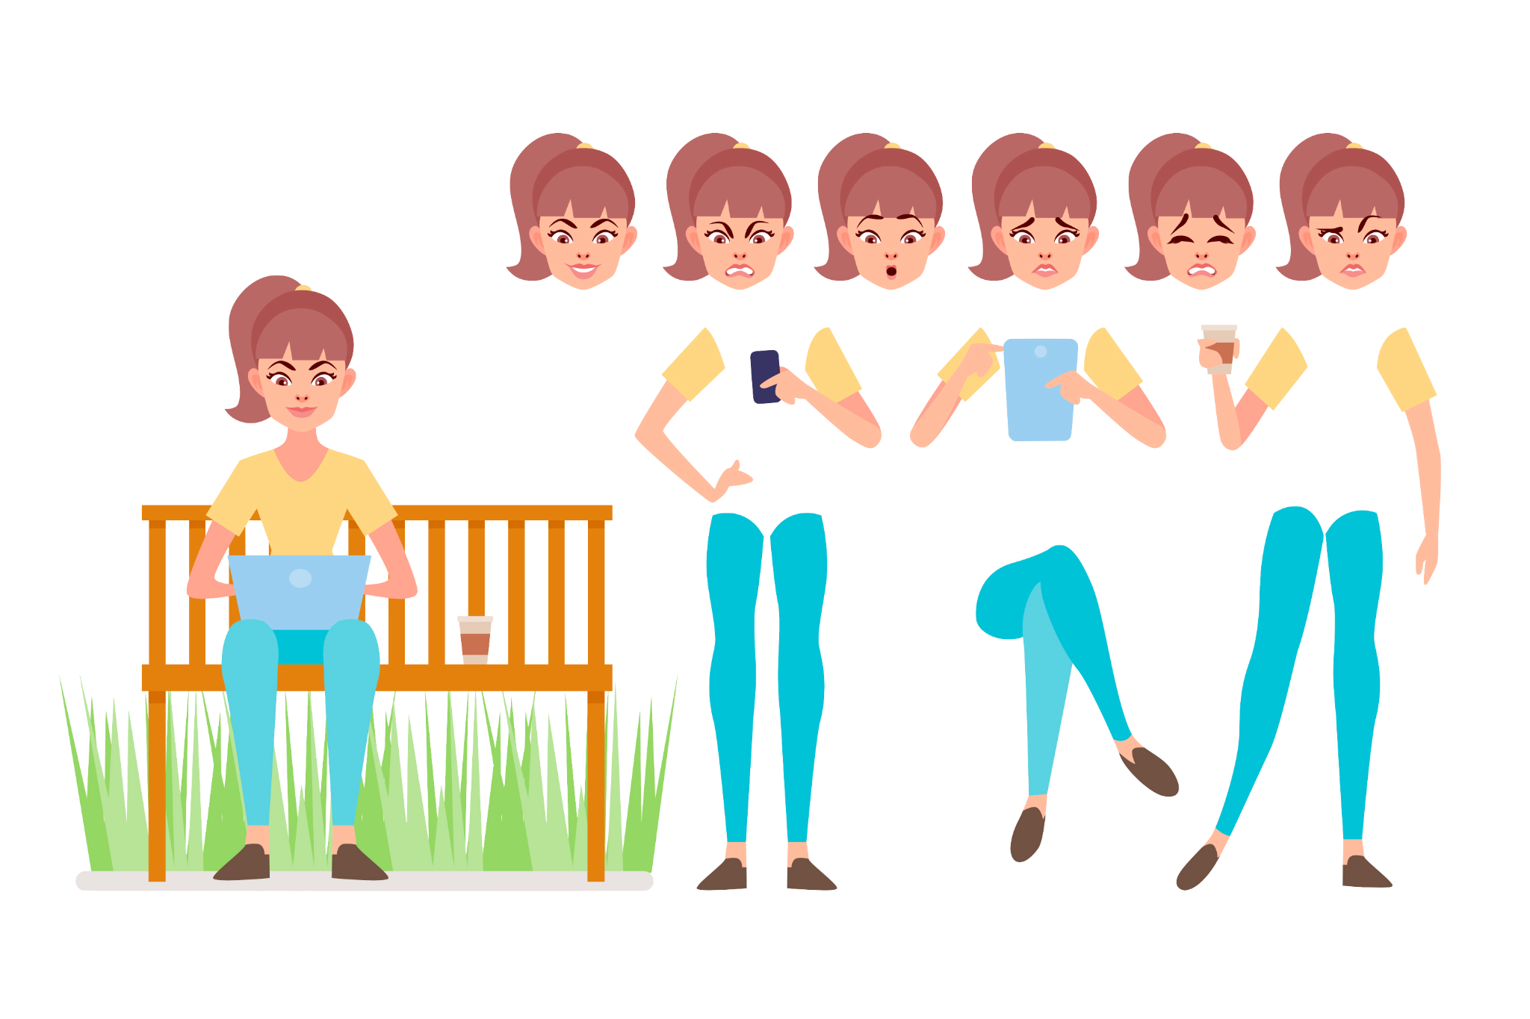
Use Case
Meet Jane, a university student
Notes:
This is Jane, and like all of us she is a busy university stude nt.(click)

Slide 11

Use Case
work
Like many of us Jane struggles between multiple commitments
school
CCA
And this stresses her out
Notes:
She struggles between multiple commitments between school and CCA, (click) and this stresses her out greatly. Thus she is looking to better organsise their time and improve their productivity. (click)

Slide 12
Notes:
And thus, introducing focus (click)
In focus, jane is able to signup using her email and password. Thereafter, she is able to customise her profile information and add her desired profile picture.
To start planning her week, jane first adds the category in which the event would be under. Then she is able to add the event and link it to the category.
Now, she is able to view the event in the weekly calendar and not miss it.
She is also able to view her friend’s progress tracker in the game page,
Jane is also able to add tasks the same way she adds her events, and upon completion she can check it off and see her progress on the profile screen. Going to the game tab, jane would also be able to see her avatar move and step and view the fireworks animation as a reward for completing the task.
When ever Jane feels stressed or is in need for some motivation between tasks, she can go to the motivation tab to receive some encouragement.
Now

Slide 13
3
Version 1 Design
Presenter: Tan Jichen
Notes:
Thank you Gwenn, After seeing the user demo, I will share our design specifications, dive deep into how we came up with the interface design for our focus app.

Slide 14
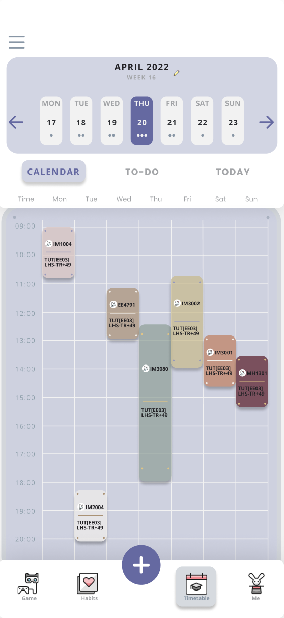
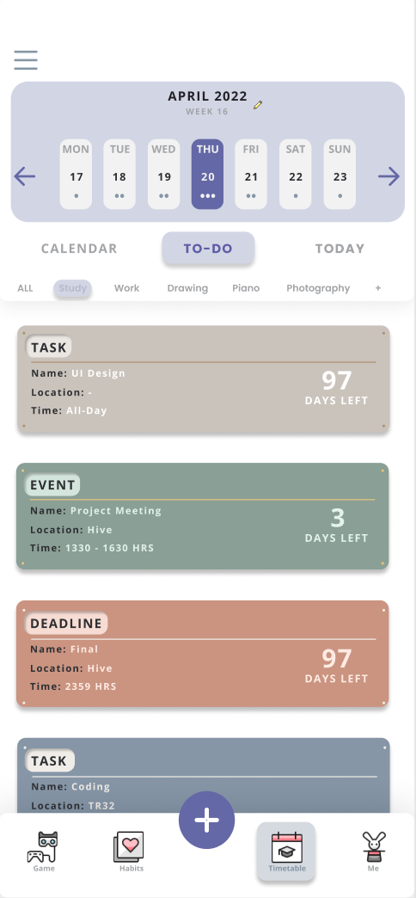
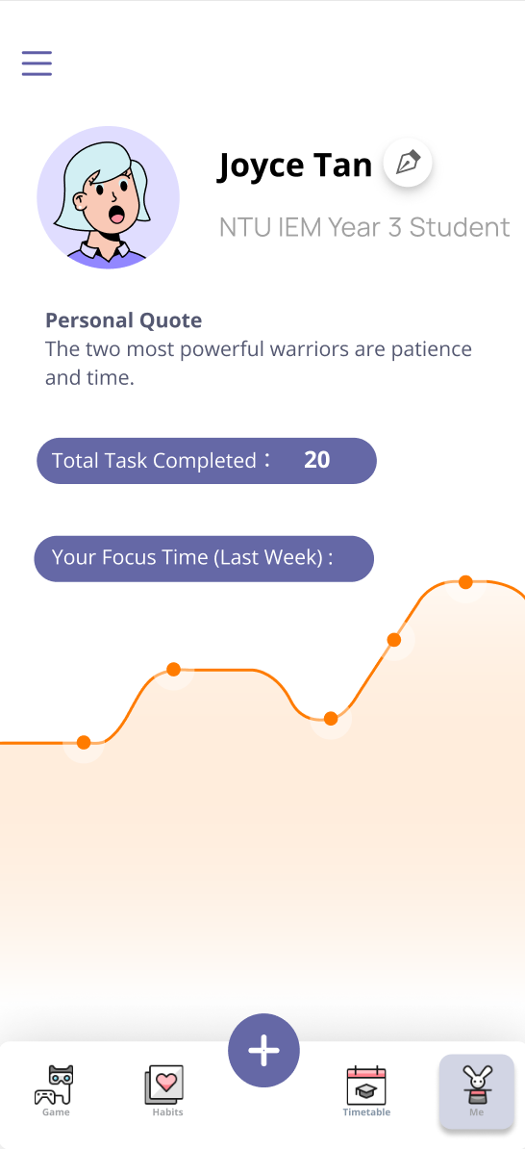
Interface Design
Design Consideration
Part 1: Overall layout and style
User-centric
Efficiency - focused
Simple and intuitive navigation
Minimalistic look
Highlight main functions
Notes:
In order to create a better user experience, we design by thinking from their point of view. Our app is supposed to be efficient to use, help with their productivity.
Therefore, our app is designed in a clean and minimalistic look, it also allows easy navigation. As shown in the demo just now, on the first screen here, we have top bar as time indication and bottom bar as function indication, users will be able to swipe the screen to switch pages and locate a time in the week. On the second screen, Users will also be able to scroll down to see their full TO-DO list.
On the third screen, We give enough highlight to the main functions, for example we also use contrast here, to draw people’s attention to their performance dashboard.

Slide 15
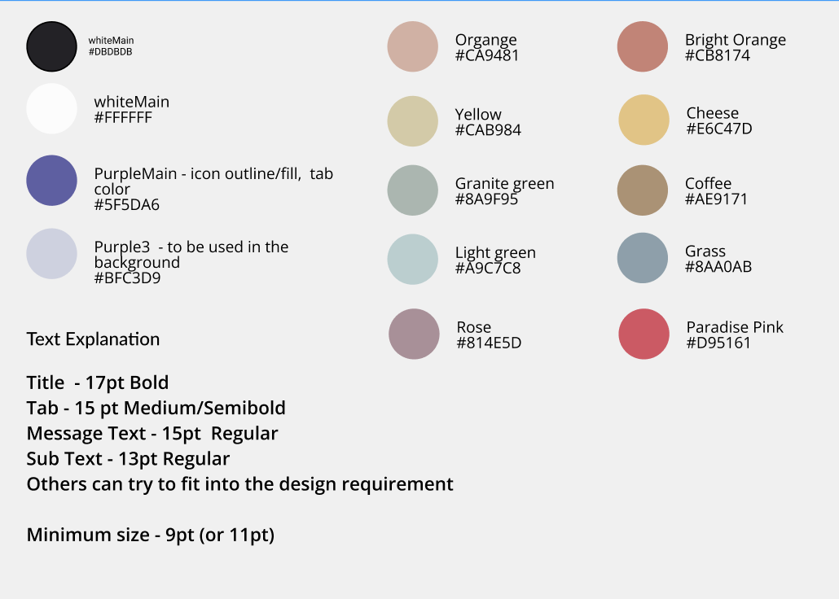
Interface Design
Design Consideration
Part 2: Selection of color & font
Muted color palette
Sans-serif font
Calm, soothing & encouraging feeling
Contrast and highlight
Customizable
Notes:
Next, regarding the choice of color and font. We implement a muted color palette, because it gives out a calm and soothing feeling. The purple color on the left is the main color, it has been widely used in button, container, highlight and background color in our app with varying shades. On the right-side, they are the color for each individual calendar activities, they help user to distinguish different categories, the colorful combination also give users an encouraging feeling to complete their goals.
Moving on wards, we will share about our game design

Slide 16
4
Version 2 Design
Presenter: Wang Xinyu

Slide 17

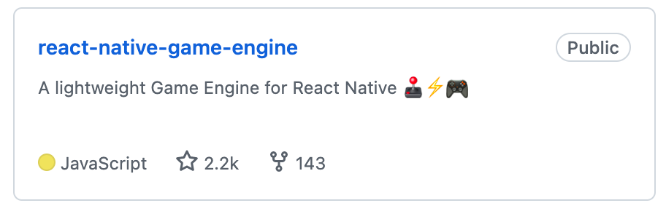

How we did this
Main Package Used:
Current stages for existing tasks
→ Calculation of Progress
→ Real-Time render of avatar movements

Slide 18
5
Methodologies
Presenter: Marcus Leong Yu Zhen

Slide 19


Technological Tools
React Native
Firebase
Building visually attractive native apps
Use only JavaScript for both Android and iOS
Observe changes to codebase instantly
Utilise Google’s cloud infrastructure
Real Time Non-SQL Database
Updates app display with zero latency
Notes:
The first technological took we used was react native to help build the front end of the app. React Native is a framework created by facebook in 2015 for developing native apps that are highly visual in nature. Being native means that they are not webapps that look like a mobile app, they are a true mobile app. Apps built using react native works on both android and iOS using only javascript. This means that we do not need 2 different groups of people maintaining 2 code bases for andrioid and iOS following the philosophy of learn once, write anywhere. In development, it supports fast refresh meaning that we can instantly observe any changes made to the codebase on any platform
The second technological tool we are making use of is firebase. Firebase is a suite of tools that makes use of Google’s cloud platform to manage infrastructure. This means that we can create a real time non-SQL database that automatically stays in sync with the front end on our app with zero latency when any changes to the data is made in the database which is a feature that is extremely important for our timetable app.

Slide 20
6
Conclusion
Presenter: Guo Xinying

Slide 21
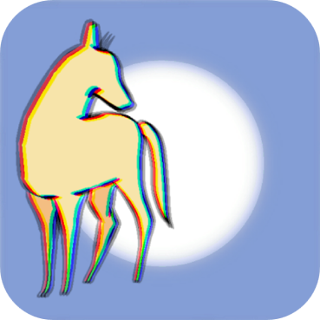
PROJECT STAGES
STAGES | OBJECTIVE 1 | OBJECTIVE 2
Brainstorming | Market research | Analyze limitations Propose improvements
UI Design | Colour theme/Fonts/Layout | Game components/Avatar
Frontend & Backend DevOps | Navigation/Mechanics design | Data schema design/DevOps
Documentation & Publicity | User/Maintenance guide | Publicity video/poster design
Notes:
Thank you, Marcus. We've covered the background, motivations, UI design, use cases, and implementation of our app. So now, let me make a conclusion. As our logo indicates, time flies, and a semester is fleeting. Through brainstorming, market research, UI design, frontend and backend development, we realized our ideas at the beginning of the semester. Based on uWave, we successfully produced a one-stop, highly customized, multi-user interactive time management app.

Slide 22

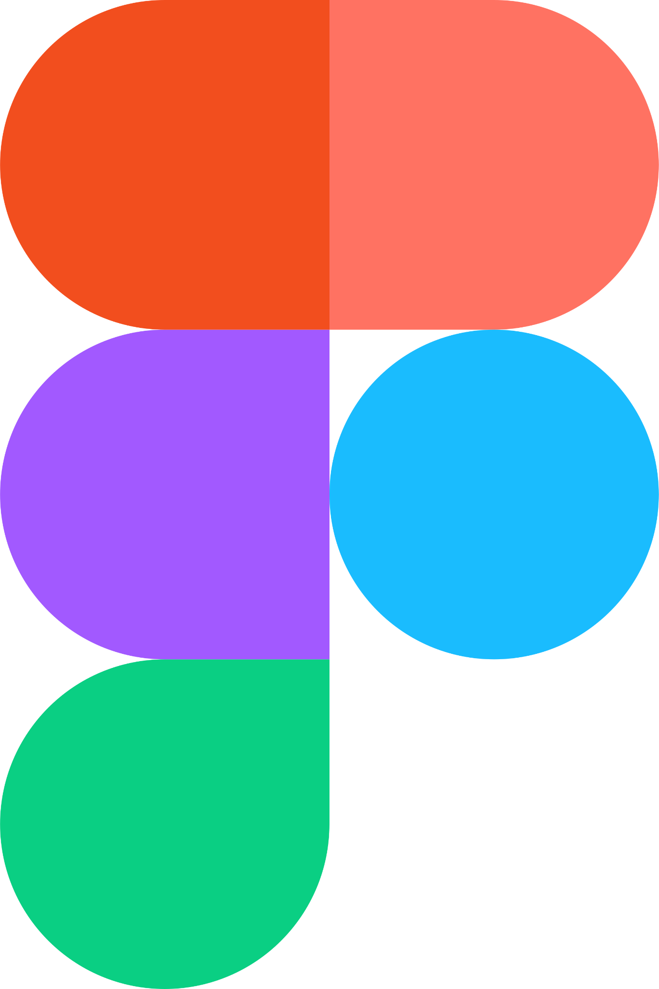


PROPOSAL EVOLUTION
1st UI Demo !
Finish Our App !
1st Prototype !
1st Live Demo !
End of UI Design
End of Version 2 Development
WEEK 4
WEEK 13
WEEK 2
WEEK 8
End of Brainstorming
End of Version 1 Development
Notes:
We experienced the complete project development process. We designed and implemented our app from scratch with the help of UI design tools such as PhotoShop and Figma, front-end development languages and frameworks such as React Native and Javascript, back-end database such as Firebase, and project management software such as Notion. We learned plenty of new engineering knowledges and gained a lot of modern tool use skills. The cooperation within our group was very efficient and enjoyable, and everyone made great contributions to the project. Hopefully, we can apply the experience accumulated this time to actual application development process in the future.
Thank you for listening! We really hope you enjoyed our presentation. Thank you.

Slide 23

THANKS!
DO YOU HAVE ANY QUESTIONS?
IEM DIP GROUP 1

