Slide 1
Hadoop Security
Architecture

Slide 2
Outline
Problem Statement
Security Threats
Solutions to Threats
HDFS
MapReduce
Oozie
Interfaces
Performance
Reliability and Availability
Operations and Monitoring

Slide 3
Problem Statement
The fundamental goal of adding Hadoop security is that Yahoo's data stored in HDFS must be secure from unauthorized access. Furthermore, it must do so without adding significant effort to operating or using the Grid. Based on that goal, there are a few implications.
  All HDFS clients must be authenticated to ensure that the user is who they claim to be. That implies that all map/reduce users, including services such as Oozie, must be also authenticated and that tasks must run with the privileges and identity of the submitting user.
  Since Data Nodes and TaskTrackers are entrusted with user data and credentials, they must authenticate themselves to ensure they are running as part of the Grid and are not trojan horses.
  Kerberos will be the underlying authentication service so that users can be authenticated using their system credentials.

Slide 4
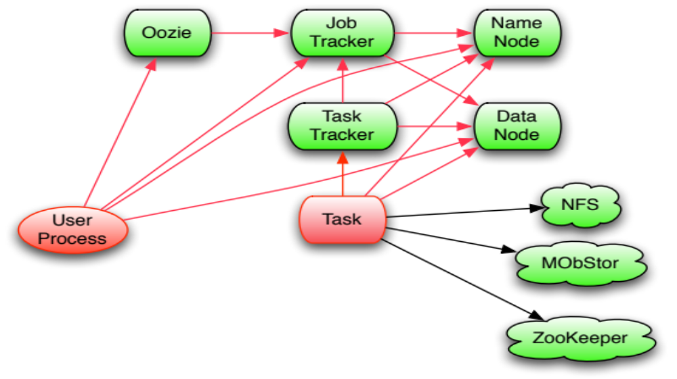
Communication and Threats

Slide 5
Security Threats in Hadoop
User to Service Authentication
  No User Authentication on NameNode or JobTracker
    Client code supplies user and group names
  No User Authorization on DataNode – Fixed in 0.21
    Users can read/write any block
  No User Authorization on JobTracker
    Users can modify or kill other user’s jobs
    Users can modify the persistent state of JobTracker
Service to Service Authentication
  No Authentication of DataNodes and TaskTrackers
    Users can start fake DataNodes and TaskTrackers
No Encryption on Wire or Disk

Slide 6
Solutions to Threats
Add Kerberos-based authentication to NameNode and JobTracker.
Add delegation tokens to HDFS and support for them in MapReduce.
Determine user’s group membership on the NameNode and JobTracker.
Protect MapReduce system directory from users.
Add authorization model to MapReduce so that only submitting user can modify or kill job.
Add Backyard authentication to Web UI’s.

Slide 7
Out of Scope for 0.20.100
Protecting against root on slave nodes:
  Encryption of RPC messages
  Encryption of block transfer protocol
  Encryption of MapReduce transient files
  Encryption of HDFS block files
Passing Kerberos tickets to MapReduce tasks for third party Kerborized services.

Slide 8
HDFS Security
Users authenticate via Kerberos
MapReduce jobs can obtain delegation tokens for later use.
When clients are reading or writing an HDFS file, the NameNode generates a block access token that will be verified by the DataNode.

Slide 9
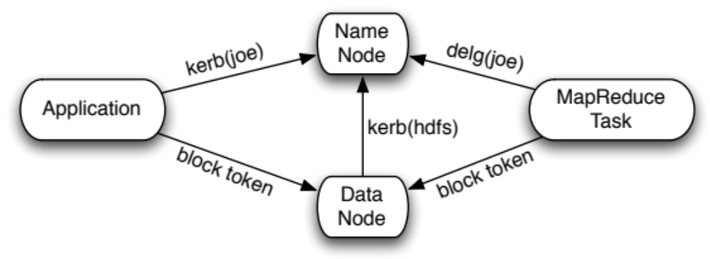
HDFS Authentication
Clients authenticate to NameNode via:
  Kerberos
  Delegation tokens
Client demonstrates authorization to DataNode via block access token
DataNode authenticates to NameNode via Kerberos

Slide 10
What does this *really* look like?
Need a Kerberos ticket to work
  kinit –l 7d oom@DS.CORP.YAHOO.COM
  hadoop fs –ls
  hadoop jar my.jar in-dir out-dir
    Works using ticket cache!
  Can display ticket cache with klist.

Slide 11
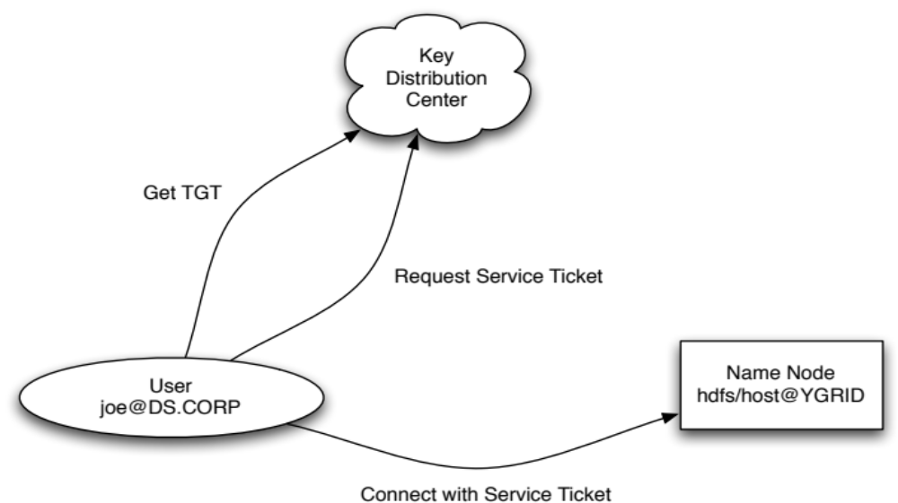
Kerberos Dataflows

Slide 12
Delegation Token
Advantages over using Kerberos directly:
  Don’t trust JobTracker with credentials
  Avoid MapReduce task authorization flood
  Renewable by third party (ie. JobTracker)
  Revocable when job finishes
tokenId = {owner pin, renewer pin, issueDate, maxDate}
tokenAuthenticator = HMAC(masterKey, tokenId)
Token = {tokenId, tokenAuthenticator}

Slide 13
Block Access Token
Only NameNode knows the set of users allowed to access a specific block, so the NameNodes gives an authorized clients a block access token.
Capabilities include read, write, copy, or replace.
The NameNode and DataNodes share a dynamically rolled secret key to secure the tokens.
tokenId={expiration, keygen, owner, block, access}
tokenAuthenticator = HMAC(blockKey, tokenId)
token = {tokenId, tokenAuthenticator}

Slide 14
MapReduce Security
Require Kerberos authentication from client.
Secure the information about pending and running jobs
  Store the job configuration and input splits in HDFS under ~user/.staging/$jobid
  Store the job’s location and secrets in private directory
JobTracker creates a random job token. It it used for:
  Connecting to TaskTracker’s RPC
  Authorizing http get for shuffle
    HMAC(job token, URL) sent from reduce tasks to TaskTracker

Slide 15
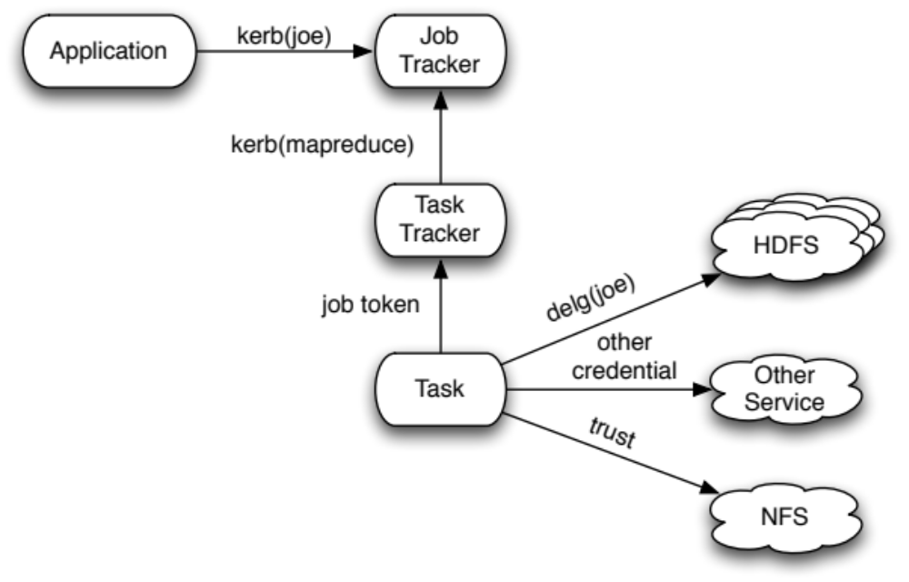
MapReduce Authentication
Client authenticates to JobTracker via Kerberos
TaskTracker authenticates to JobTracker via Kerberos
Task authenticates to the TaskTrackers using the job token
Task authenticates to HDFS using a delegation token
NFS is not Kerberized.

Slide 16
MapReduce Task Security
Users have separate task directories with permissions set to 700.
Distributed cache is now divided based on the source’s visibility
  Global – shared with other users
  Private - protected from other users

Slide 17
Web UI
MapReduce makes heavy use of Web UI for displaying state of cluster and running jobs.
HDFS also has a web browsing interface.
Use Backyard to authenticate Web UI users
Only allow submitting user of job to view job’s tasks.
HDFS web browser checks user’s authorization.

Slide 18
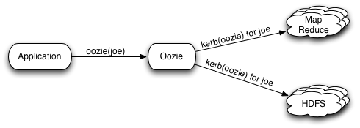
Oozie
Client authenticates to Oozie
  Custom auth for Yahoo!
Oozie authenticates to HDFS and MapReduce as “oozie” principal
“oozie” is configured as a super-user for HDFS and MapReduce and may act as other users.

Slide 19
Proxy Services Trust Model
Requires trust that service (eg. Oozie) principal is secure.
Explored and rejected
  Having user headless principals stored on Oozie machine “x/oozie” for user “x”
  Passing user headless principal keytab to Oozie
  Generalizing delegation token to have token granting tokens.

Slide 20
Summary
RPC
  Kerberos
    Application to NameNode, JobTracker
    DataNode to NameNode
    TaskTracker to JobTracker
Block Access Token
Backyard
  User to Web UI

Slide 21
Kerberos
Backyard
User (initial access),
2ndNN, Balancer
NN
Browser, 2ndNN, fsck
RPC
HTTP
HFTP
HTTP-DIGEST w/ delegation token
Task
DIGEST-MD5
Task
Accessing as user
distcp accessing as user
Kerberos
Backyard
DN
Browser
Task
access token
Socket
HTTP
HFTP
Forward delegation token
User, DN, Balancer, Task
Task
distcp accessing as user

Slide 22
JT
TT
RPC
HTTP
Backyard
Kerberos
User
Browser
Kerberos
Backyard
TT
Browser
Task
DIGEST-MD5
RPC
HTTP
Local Task
-HMAC
Task
Reduce Task getting
Map output

Slide 23
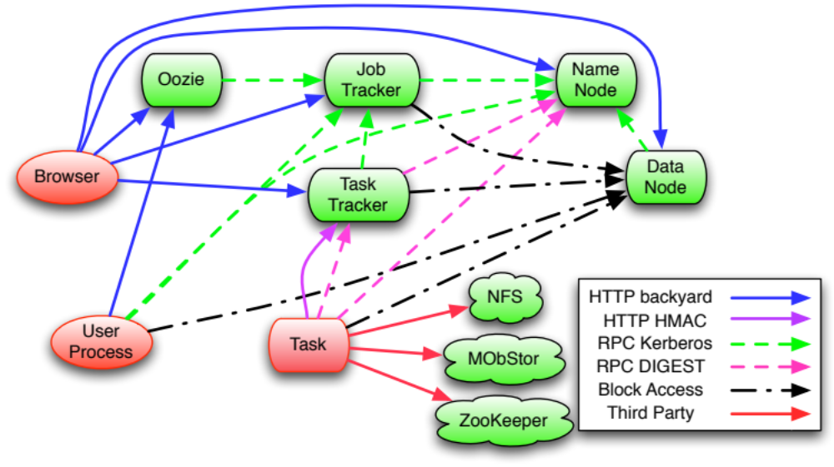
Authentication Paths

Slide 24
Pluggability
Pluggability in Hadoop supports different environments
HTTP browser user authentication
  Yahoo – Backyard
  External – SPNEGO or Kerberos login module
RPC transport
  SASL supports DIGEST-MD5, Kerberos, and others
Acquiring credentials
  JAAS supports Kerberos, and others

Slide 25
Performance
The authentication should not introduce substantial performance penalties.
Delegation token design to avoid authentication flood by MapReduce tasks
Required to be less than 3% on GridMix.

Slide 26
Reliability and Availability
The Kerberos KDC can not be a single point of failure.
  Kerberos clients automatically fail over to secondary KDC’s
  Secondary KDC’s can be sync’ed automatically from the primary since the data rarely changes.
The cluster must remain stable when Kerberos fails.
  The slaves (TaskTrackers and DataNodes) will lose their ability to reconnect to the master, when their RPC socket closes, their service ticket has expired, and both the primary and secondary KDC’s have failed.
  Decided not to use special tokens to handle this case.
Once the MapReduce job is submitted, the KDC is not required for the job to continue running.

Slide 27
Operations and Monitoring
The number of Kerberos authorizations will be logged on the NameNode and JobTracker.
Authorization failures will be logged.
Authentication failures will be logged.
The authorization logs will be a separate log4j logger, so they can be directed to a separate file.

