Slide 1
NEGOTIATION
Dr. Syed Ghufran Hashmi
Assistant Professor
IIIT Sonepat

Slide 2
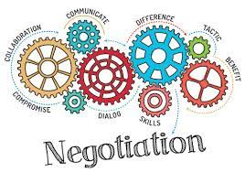
DEFINITION

Slide 3
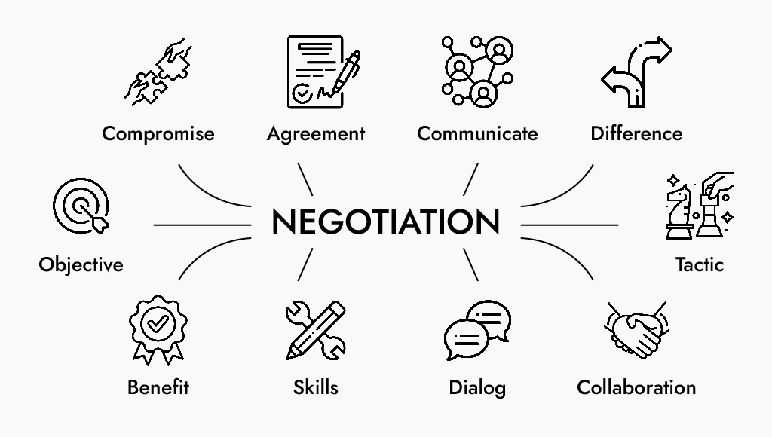

Slide 4
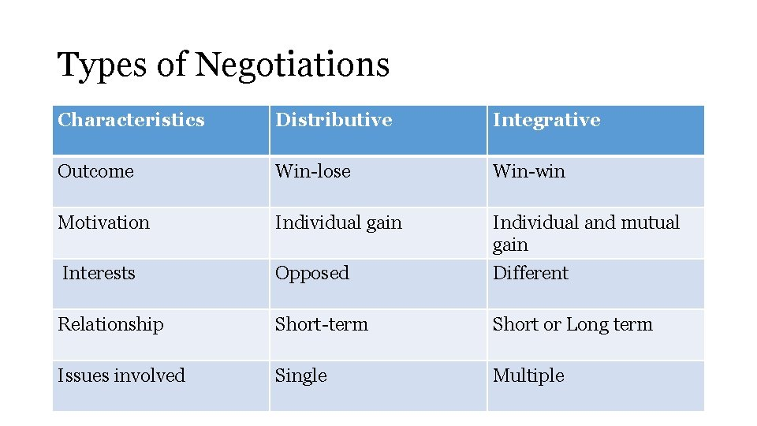

Slide 5
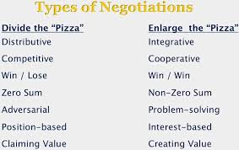

Slide 6
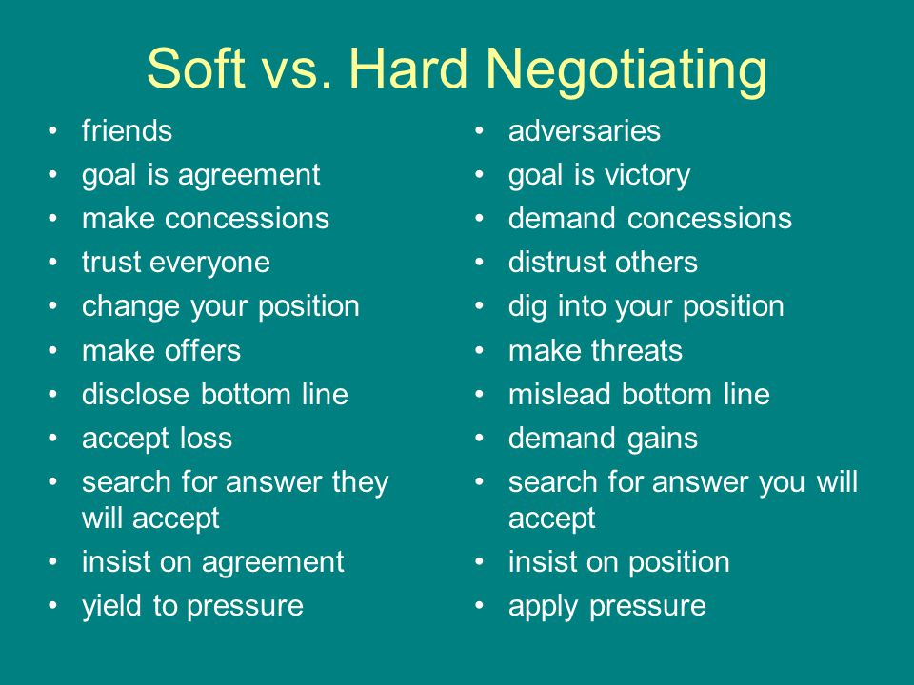

Slide 7
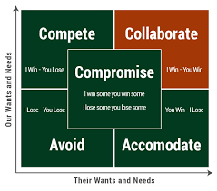

Slide 8
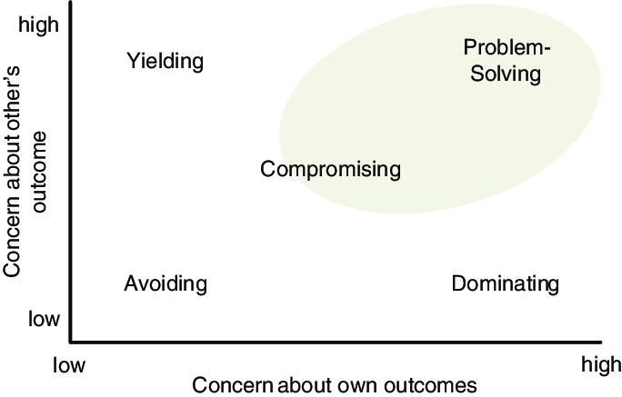
DUAL CONCERN MODEL

Slide 9
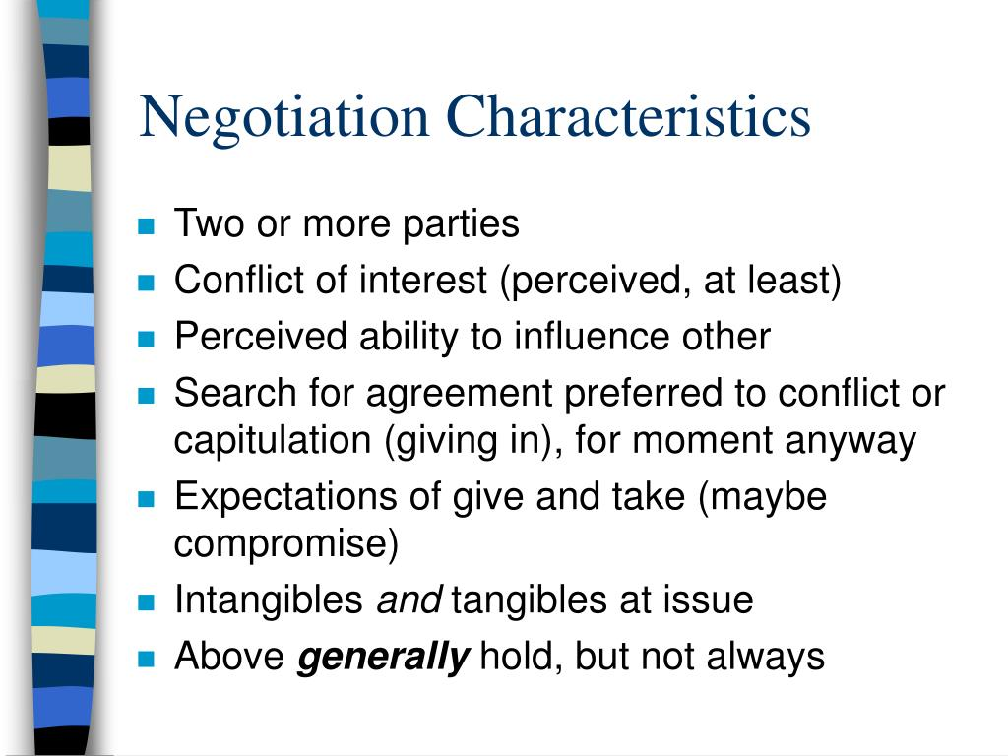

Slide 10
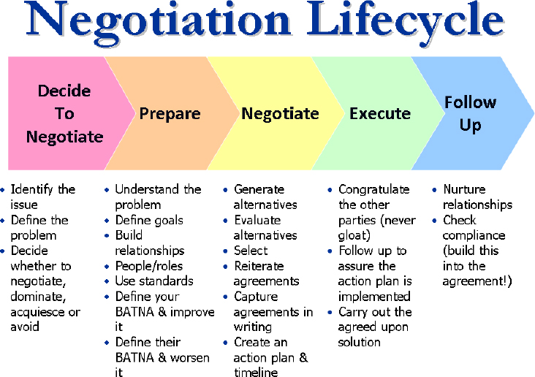

Slide 11
THANK YOU

