Slide 1
PRESENTATION
Dr. Syed Ghufran Hashmi
Assistant Professor
IIIT Sonepat

Slide 2
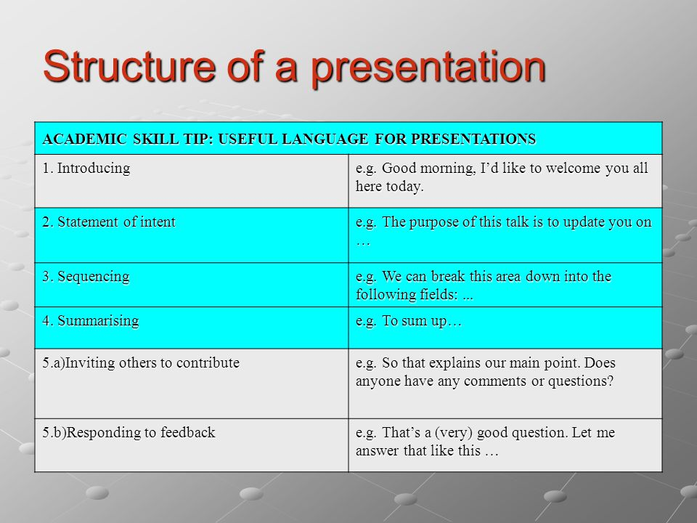
PRESENTATION: STRUCTURE & LANGUAGE

Slide 3
INTRODUCTION
Greeting the audience
Good morning/afternoon, ladies and gentlemen.
Good morning/afternoon, everyone.
Expressing the purpose
My purpose/objective/aim today is...
What I want to do this morning/afternoon/today is...
I'm here today to...

Slide 4
Giving the structure
This talk is divided into four main parts.
To start with/Firstly, I'd like to look at...
Then/Secondly, I'll be talking about...
Thirdly...
My fourth point will be about...
Finally, I'll be looking at...
Giving the timing
My presentation/talk/lecture will take/last about 20 minutes.
Handling questions
At the end of my talk, there will be a chance to ask questions.
I'll be happy to answer any questions you have at the end of my presentation.

Slide 5
Language used to refer to Visual aids
As you can see here...
Here we can see...
If we look at this slide...
This slide shows...
If you look at the screen, you'll see...
This table/diagram/chart/slide shows...
I'd like you to look at this...
Let me show you...
Let's (have a) look at...
On the right/left you can see...

Slide 6
Language used to refer Transitions
Let's now move on to/turn to...
I now want to go on to...
This leads/brings me to my next point, which is...
I'd now like to move on to/turn to...
So far we have looked at... Now I'd like to...

Slide 7
Giving examples
Let me give you an example...
such as...
for instance...
A good example of this is...
Summarising
What I'm trying to say is...
Let me just try and sum that up before we move on to...
So far, I've presented...
Digressing
I might just mention...
Incidentally...

Slide 8
CONCLUDING
Summing up
Summing up...
To summarise...
So, to sum up...
To recap...
Let me now sum up.
Concluding
Let me end by saying...
I'd like to finish by emphasising...
In conclusion I'd like to say...
Finally, may I say...
Closing
Thank you for your attention/time.
Thank you (for listening/very much).
Questions
If you have any questions or comments, I'll be happy to answer them now.
If there are any questions, I'll do my best to answer them.
Are there any more questions?

Slide 9
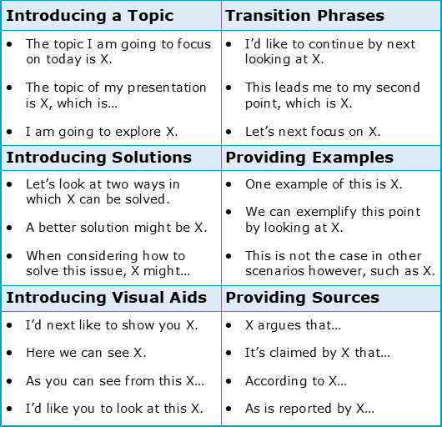

Slide 10
Posture is confident (standing up straight)
Hands are held in a comfortable position
Position is good (facing the audience, not talking to the screen or notes)
Movement is natural (not too much or too little)
Hands are used well (to emphasise points, to count, to demonstrate)
Nervous gestures (touching hair/glasses) are avoided
Eye contact is maintained throughout the presentation
The speaker looks at the whole audience (not just one or two people)
The speaker avoids talking to the screen/notes

Slide 11
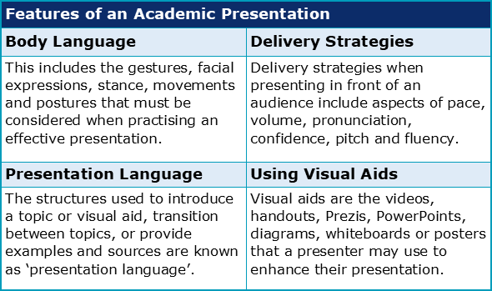

Slide 12
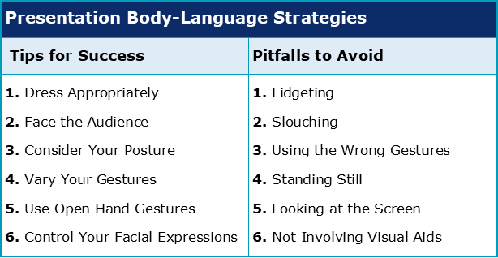

Slide 13
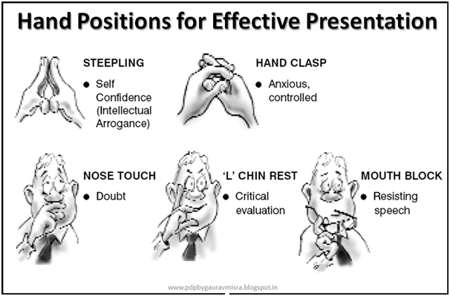

Slide 14
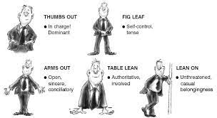

Slide 15
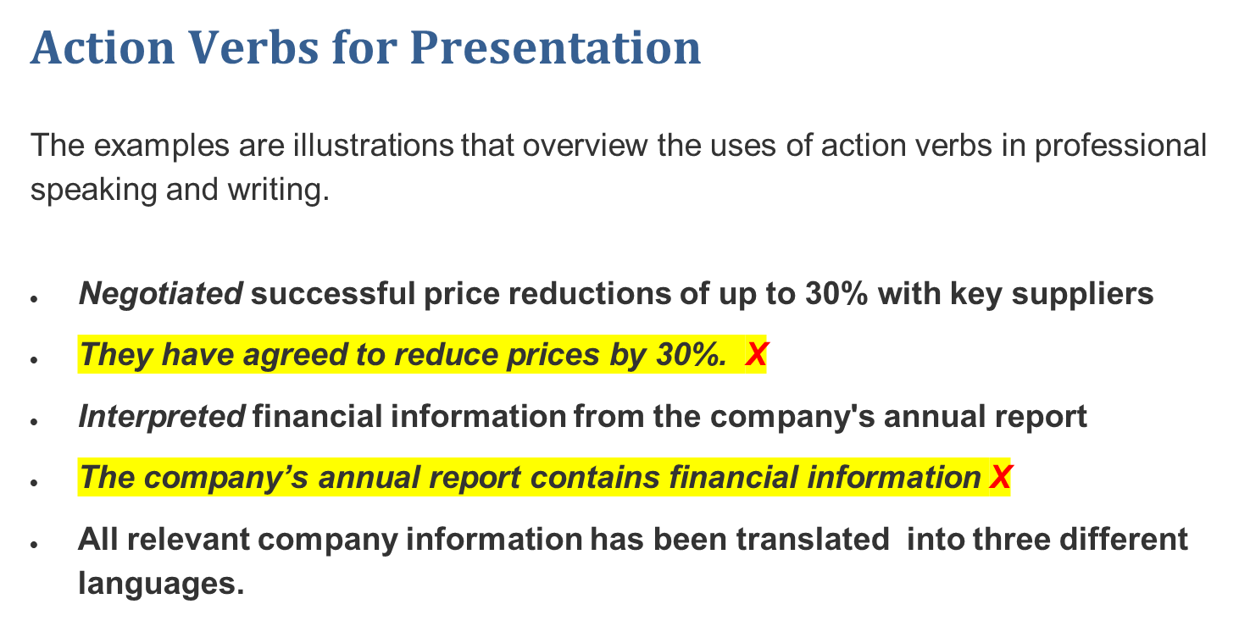

Slide 16
Created an interior design layout for a 500 square foot retail venue
Introduced a new method of navigating through the A Software Program
Presented a new research project to the managers at the location
Computed and recorded inventory valuation on a monthly basis
Documented inventory counts at the end of each working day
Verified the amount owed to the creditor in the Accounts Payable account
Assisted customers with choosing appropriate products
Trained new employees in the plant through demonstration techniques
Volunteered in the nursing home every weekend to serve the community

Slide 17
Defined a new product strategy and discussed how it would be implemented
Instructed Department B on how to reduce inventory and raise net sales
Prepared a tutorial manual for an English class last semester
Assembled an entire computer programming simulation for my CPT course
Designed a new form of Widget C for a manufacturing facility
Programmed three new computer programs tailored for a network system

Slide 18
Administered a variety of surveys to collect data about the employees
Implemented a safety communication program to promote safety awareness
Recommended an alternative solution to one of the company's problems
Eliminated unnecessary cost of each unit of production
Maximized profits by 15% during the month of July
Heightened the level of employee moral through program incentives
Examined a new mechanism that may reduce sickness on the campus
Identified a major defect in a microscopic organism last month
Surveyed a group of students with regard to Product A

Slide 19
THANK YOU

