Slide 1
Installation and
database upgrade technologies
workshop
Team Optimus ved Eirik Rasmussen og Tord Heimdal

Slide 2
Learning outcome
The installation technologies used for installing DIPS
How DIPS uses these technologies
How to investigate installation errors

Slide 3
Agenda
Chocolatey
Windows Powershell
DIPS Chocolatey packages
DIPS Delivery packages
DIPS Database Upgrade

Slide 4
Why this course?
We allready know how to install DIPS using chocolatey.
The installation artifacts (delivery packages) that DIPS sends to customers hides most of the details behind powershell scripts to simplify the installation.
When something fails it can be difficult to understand where the error comes from without knowlegde of the underlying technology.

Slide 5
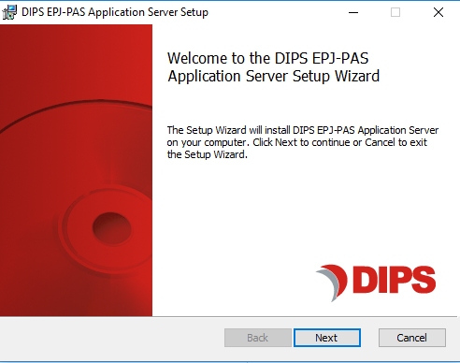
Why chocolatey?

Slide 6
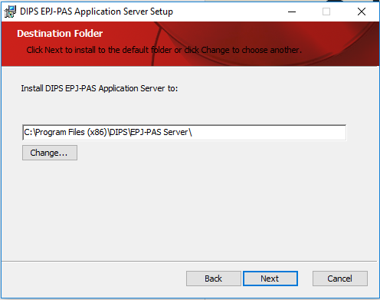
MSI: click next…

Slide 7
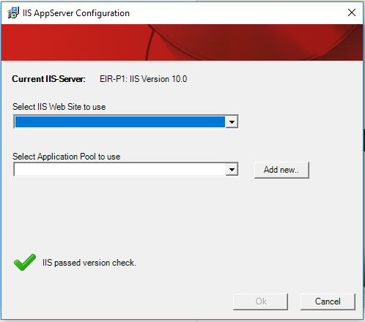
Manual IIS configuration

Slide 8
MSI
Made for manual installation
No artifact repository
No dependency management. You would have to invoke tenfolds of packages in the correct order to install Arena => time consuming
Manual handling of versions and upgrades
Difficult to automate
Does not scale up!

Slide 9
Chocolatey
Chocolatey is a commandline tool to install software on Windows
Chocolatey is a package manager, and is the windows equivalent to package managers on Linux, like apt-get or yum
Chocolatey enables us to automate the installation process
Chocolatey gives us dependency controll
https://chocolatey.org/

Slide 10
Chocolatey
Developed by Rob Reynolds in 2011 when working for RealDimensions Software, LLC.
In 2017 Rob started Chocolatey Software, Inc.

Slide 11
Why did DIPS choose chocolatey
Scriptable installation, enables us to automate the installation process
Dependency management
Package repository, f.ex http://dips-nuget
«The sane way to manage software on Windows»
DIPS uses the free, open source version of chocolatey.

Slide 12
What is a chocolatey package?
A chocolatey package is a zip archive
The archive may contain binaries, scripts, installers, :
Binaries + Executables
Installer package + installationscript
Installationscript that will download and execute an MSI (or exe)
*.nupkg extension but can be extracted using zip
Based on Nuget, which is the standard package manager for development dependencies
Packages stored in a package repository (http://dips-nuget)

Slide 13
How are chocolatey packages structured
\tools\
\tools\chocolateyInstall.ps1
\bin\
\_rels\.rels
package.nuspec

Slide 14
How to install chocolatey
https://chocolatey.org/docs/installation
Chocolatey can be used to upgrade itself
PS> choco upgrade chocolatey
PS> cup chocolatey
Check version:
PS> choco

Slide 15
Exercise 01
Install chocolatey

Slide 16
How to find and install chocolatey packages
https://chocolatey.org/packages
http://dips-nuget

Slide 17
How to install packages
PS>choco install $packageid –source $source –version 1.0.0
-source: can be either a local directory or a url. Can be ommited if package is available on the default source (chocolatey.org)
-version: only required if you want a specific version
Ex: choco install dips-dbupgrade –source http://dips-nuget/nuget/dips-rc

Slide 18
Exercise 2: Install a package

Slide 19
Other commonly used command
choco uninstall packageid
choco upgrade packageid
choco list –lo : lists installed packages
Complete list: https://chocolatey.org/docs/commands-reference

Slide 20
Nuget package explorer
A handy tool to view package contents
PS>choco install nugetpackageexplorer -skippowershell

Slide 21
What happens when a package is installed
PS> choco install notepadplusplus
Chocolatey checks if the package is allready installed
If not installed, Chocolatey downloads the package from the source and unzips it into c:\Programdata\chocolatey\lib\notepadplusplus
Executes the installscript embedded in the package if present: c:\Programdata\chocolatey\lib\notepadplusplus\tools\chocolateyInstall.ps1

Slide 22
chocolateyInstall.ps1
chocolateyInstall.ps1 is the powershellscript that chocolatey will execute after the package has been installed to c:\Programdata\chocolatey\lib\packageid
Is included in the package
Is not required (some packages installs executables that are available on the path)
If it is included and not executed the software is usually not completely installed or configured (-skippowershell)

Slide 23
All scripts
chocolateyInstall.ps1: Executed at package install
chocolateyUninstall.ps1: Executed when package is uninstalled
beforeModify.ps1: script in the installed package that is executed when running PS>choco upgrade

Slide 24
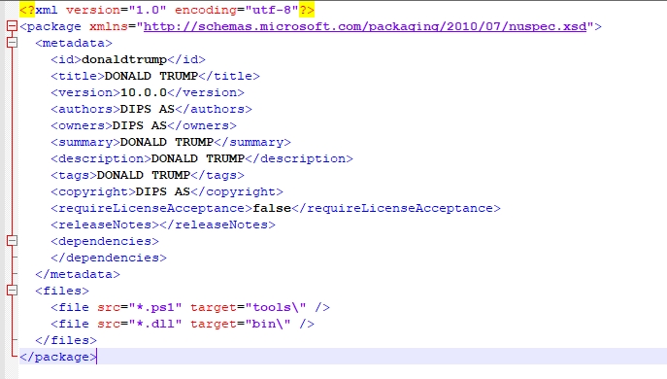
The nuspec file
XML describing metadata and content in package
https://docs.microsoft.com/nb-no/nuget/reference/nuspec

Slide 25
Package dependencies
A chocolatey package can have dependencies to other chocolatey packages.
Dependencies are automaticly installed before the specified package

Slide 26
Package dependencies
How to see which dependencies a package have:
Dips-nuget
Nuget Package Explorer
Unzip and check nuspec

Slide 27
Specifying dependencies
Dependencies are specified in the nuspecfile prior to creating the package using the choco pack command
<dependencies>
<dependency id="dips-choco-utility" version=«1.0.0" />
</dependencies>
Dependencies may be restricted to specific versions, minimum version, maximum versions, or version ranges.
Minimum version is the most common

Slide 28
Specifying versions on dependencies
Versions are specifed in the dependency tag in the nuspec
Version=«1.0.0» : minimum version 1.0.0
Version = «[1.0.0]» : Only version 1.0.0
Version = «[1.0.0,): minimum version 1.0.0
Version = «[1.0.0,2.0.0]» : Version from 1.0.0 to 2.0.0
Version = «[1.0.0,2.0.0)»: Versions from 1.0.0 and lower than 2.0.0
Version = «[,2.0.0)» All versions lower than 2.0.0
Version = «[,2.0.0]» Version 2.0.0 and lower

Slide 29
Creating packages
Creating packages is easy
PS> choco pack c:\temp\mypackage\mypackage.nuspec
https://chocolatey.org/docs/create-packages

Slide 30
Exercise 03: create a package

Slide 31
Chocolatey Logfiles
C:\ProgramData\chocolatey\logs

Slide 32
Versioning of packages
Release: n.n.n.n
Prelease: n.n.n.n-buildNNN
If the version ends with «-SometextNNN» nuget threats the package as prerelease.
Chocolatey does not automatically accept prerelease packages.
To install a pre-release package use the argument «-pre»
PS> choco install packageid -pre

Slide 33
Package parameters
A package can have parameters
PS> choco install packageid –s c:\temp –params «/key:value /key:value»
Parameters are only valid if the package has a chocolateyInstall.ps1 script.
Parameters are accessible for the script from the environment variable $Env:ChocolateyPackageParameters
Must be parsed.

Slide 34
Troubleshooting install errors
Package installation can be divided into two categories:
Package installation errors
Installscript (chocolateyInstall.ps1) errors

Slide 35
Getting additional console output
Verbose : choco install packageid –source c:\temp –v
Debug: choco install packageid –source c:\temp -d

Slide 36
The packages.config file
The packages.config file is an alternative to specifying multiple packages on the commandline, and enables setting of properties for each package individually.
<packages>
<package Id=«dips-arena-framework-client» version=«19.1.0» source=«http://dips-nuget/nuget/dips-dev» params=«/InstallLocation=C:DIPS»>
<package Id=«dips-arena-desktop-client» version=«19.1.0» source=«http://dips-nuget/nuget/dips-rc» params=«/InstallLocation=C:DIPS»>
</packages>

Slide 37
DIPS chocolatey packages
Different flawors on the server side
Most common: installscript that copies files from the package library folder to «InstallLocation», before IIS setup is created.
Java applications: Choco-package containing «msi» that is executed silently
Many packages may copy files to the same «InstallLocation» in order to get a working software. Ex: DIPS Arena Client
«InstallLocation» is a package parameter: PS>choco install dips-arena-desktop-client –params «/InstallLocation:C:\DIPS»
DIPS Choco-packages make extensive use of dependencies

Slide 38
dips-choco-utility
A chocolatey package that contains install-time functionality
Developed by Team Snøhetta and Team Optimus
Install three separate Powershell modules:
DIPSChoco
DIPS.IIS
DIPS.Config

Slide 39
dips-choco-utility: DIPSChoco
Simplifies the installscripts in DIPS chocolateypackages
Functions
Install-DIPSPackage
Uninstall-DIPSPackage
Get-InstallParameters
Git repository: Choco-Utility

Slide 40
dips-choco-utility: DIPS.IIS
Functions to setup IIS and registers all actions so that the IIS setup will be removed when the package is uninstalled.

Slide 41
dips-choco-utility: DIPS.Config
Functions to upload configuration values to configserver during package installation

Slide 42
A look at a DIPS Arena package chocolateyInstall.ps1
Examples from client and server, how they work with parameters, config, IIS, and filecopy

Slide 43
Windows Powershell
https://docs.microsoft.com/en-us/powershell/scripting/getting-started/getting-started-with-windows-powershell?view=powershell-6

Slide 44
Powershell scripts
Contained in files named *.ps1
Can take parameters
Executed from powershell: PS> .MyScript.ps1
With parameters: PS> .MyScript.ps1 –Hostname vt-arenaserver

Slide 45
Powershell Modules
Powershell modules are installed on the machine at C:\Program Files\WindowsPowerShell\Modules
A module contain a collection of functions that are globally available on the machine
Ex: the module DIPSChoco contains functions for copying files from a Chocolatey package to a specified destination.
Module functions can be defined in dll’s or in powershell scripts (*.psm1)
To get a list of all installed modules and their functions:
Get-Module -Listavailable

Slide 46
DIPS Powershell modules
DIPSChoco
DIPS.IIS
DIPS.Config
DIPSDatabaseReset
DIPSDBUpgrade
DIPSMartUpgrade

Slide 47
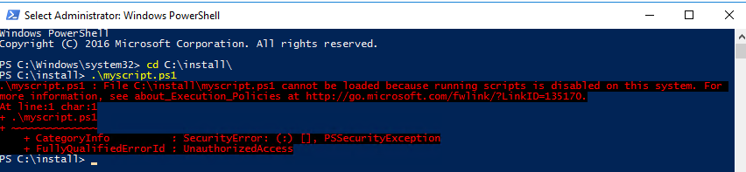
Script execution permissions

Slide 48
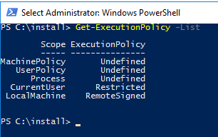
Script execution permissions

Slide 49
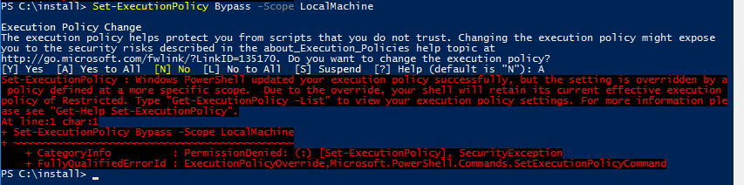
Script execution permissions

Slide 50
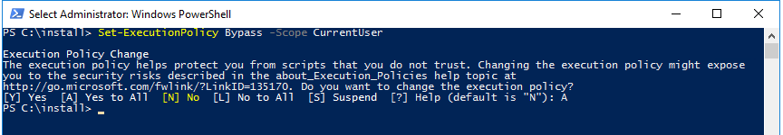
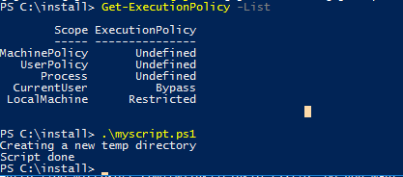
Script execution permissions

Slide 51
Exercise 4: Setting script permissions

Slide 52
Exercise 05: Create package with installscript

Slide 53
Exercise 06: Create installscript

Slide 54
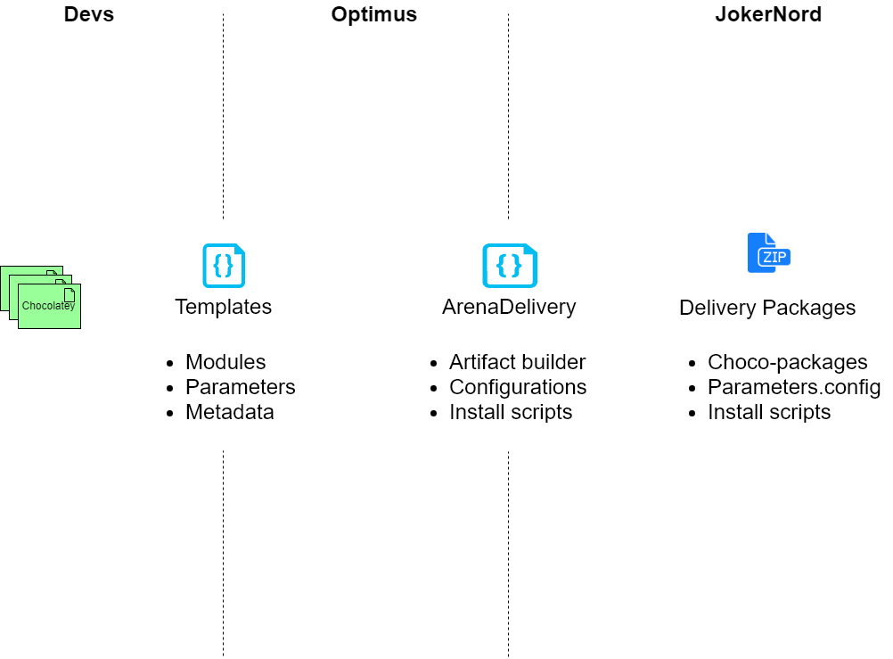
DIPS Delivery Process

Slide 55
DIPS Delivery Packages
A collection of Chocolatey packages for an Arena Client, Server, etc. installation
Zip archive containing Chocolatey packages (offline source), parameter files, and setup scripts to ease the installation

Slide 56
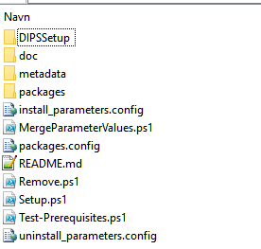
Arena Delivery Artifact content
Chocolatey packages
Metadata
Actual packages
Parameters
Parameter values
Parameter mapping
Install scripts
Setup
Remove
Test-Prerequisites

Slide 57
Setup.ps1
Reads install_parameters.config and parameterMappings.config
Writes final-packages.config, which will set parameters for each individual package
Executes: choco install final-packages.config

Slide 58
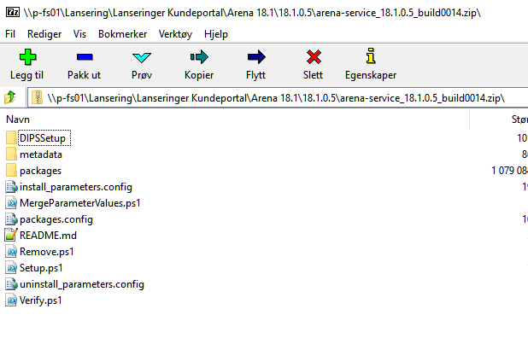
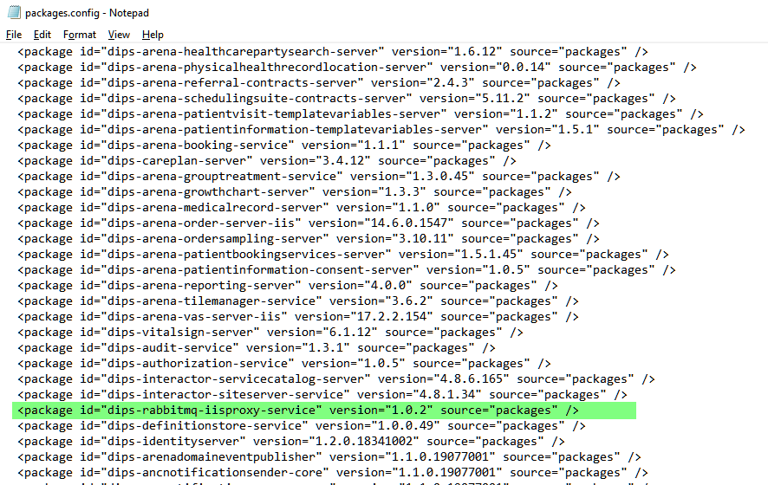
Let us track a package

Slide 59
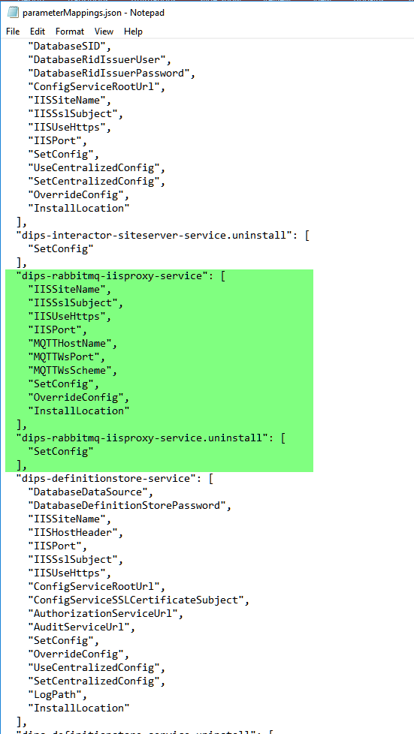
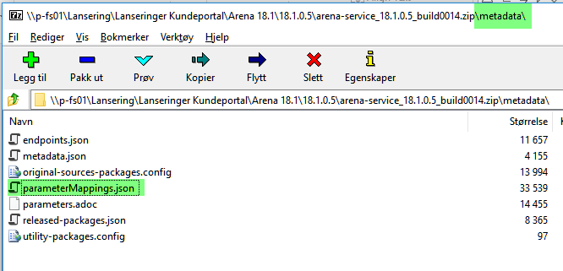
Parameter mapping

Slide 60
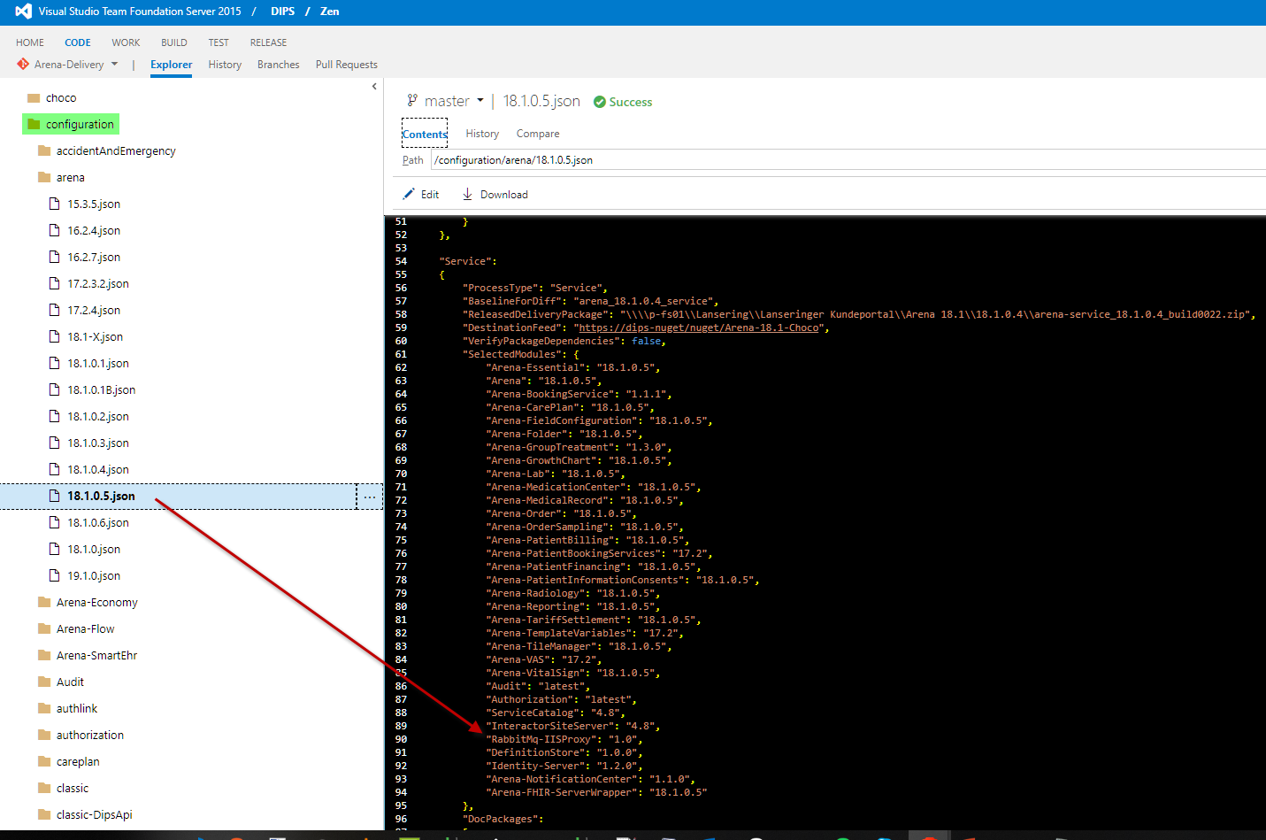
ArenaDelivery Configuration

Slide 61
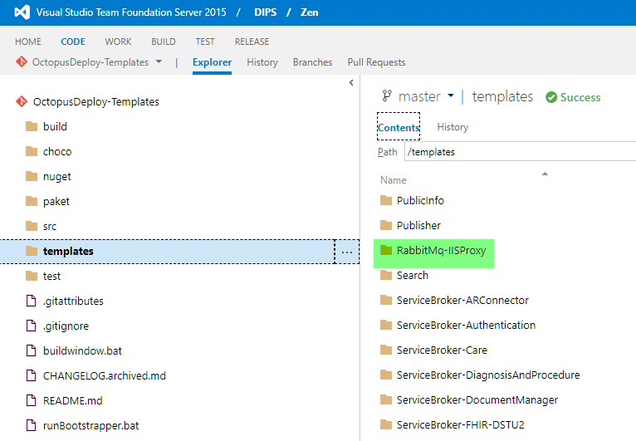
Octopus Deploy Templates

Slide 62
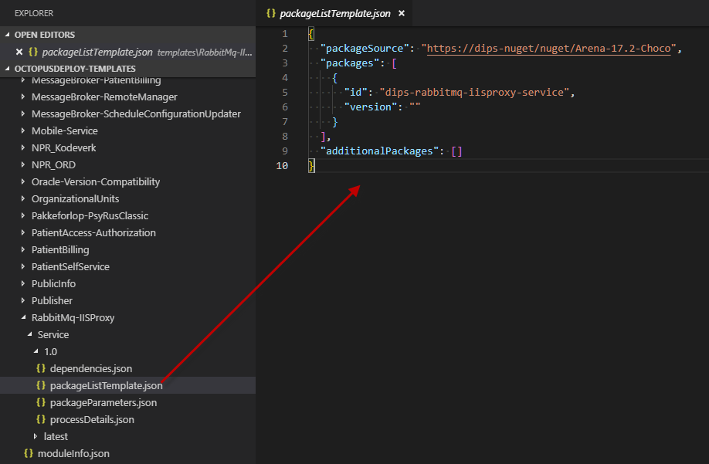
Templates – Package List

Slide 63
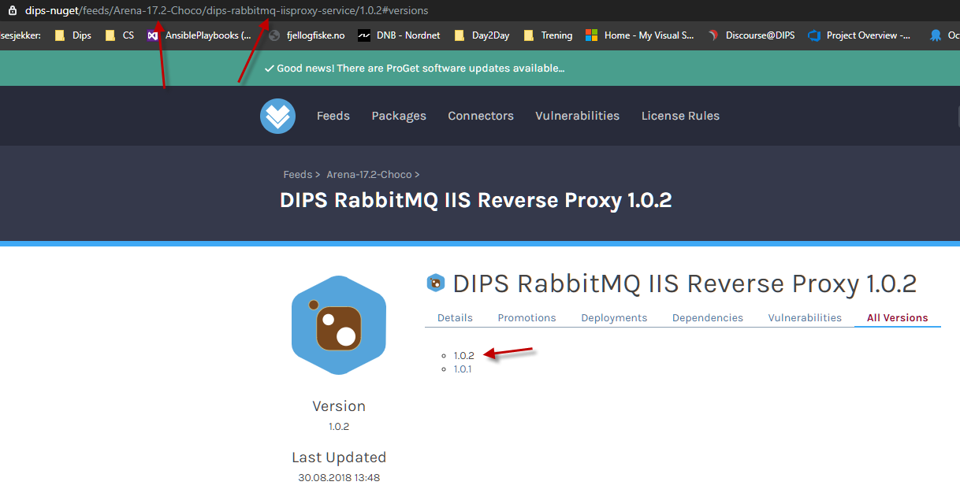
DIPS-Nuget

Slide 64
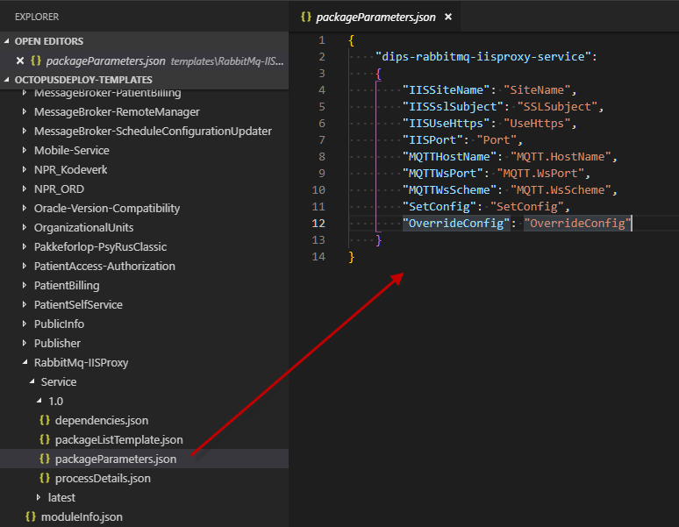
Templates – Package Parameters

Slide 65
Database
Chocolatey is not a tool that is designed to be used for database migrations
DIPS proprietary usage
Choosed because we needed something that:
Packages upgrade (dupfiles) for each program package (artifacts)
Handles dependencies

Slide 66
Database
DIPS Chocolatey packages for database is a highly proprietary and customized solution
No one else as far as we know uses Chocolatey for database
Chocolatey is intended for software that is installed to disk, not database
https://wiki/Database-Chocolateypackages
Databases cannot be upgraded by installing chocolatey packages to disk. A custom tool is required to mirror the packages in the database to disk so that Chocolatey can work with it.
Std chocolatey package: dips-dbupgrade

Slide 67
A look at a database Chocolatey package
Dupfiles
Json-file
chocolateyInstall.ps1

Slide 68
dips-dbupgrade
dips-dbupgrade is a Chocolatey package that installs a powershell module named DIPSDBupgrade.
The module contains the function: Install-Databasepackages
Install-DatabasePackages –Packages packageId –Source c:\temp –Database vd-dbbuild10/dips –InstallDir c:\temp –Password oracle

Slide 69
Install-DatabasePackages
Tests that the specified database can be connected to and that it is a DIPS database (i.e not a datamart)
Executes prerequsites tests (dupconsole, path)
Creates a new folder inside installDir: vd-dbbuild10-dips-20190610-101010
Sets Chocolatey to work with this directory as its working directory (i.e. like a clean machine)
Queries the database for all installed packages
Creates a representation of all the packages in the database in :$InstallDir\database-date-time\choco\chocolatey\lib

Slide 70
Install-DatabasePackages cont.
Installs packages into :$InstallDir\database-date-time\choco\lib
Each package has now:
installed its dups to $InstallDir\$database\dup
written a line in $InstallDir\$database\json\moduleOrder.txt
copied its json order file to $InstallDir\$database\json\
Creates an ordered list of dupfiles based on all dup-order.json files
Queries the database to find if all these dupfiles must be executed
Executes dup-files using dupconsole and runs dwdba after each dup to generate triggers and views

Slide 71
Database package versioning
DIPS Arena framework for DIPS Arena 19.1.0
A package has an id and a version
id: dips-arena-framework-server version 19.1.0
id: dips-arena-framework-client version 19.1.0
id: dips-arena-framework-database-19.1.0 version 1.0.0

Slide 72
Database package versioning
Unlike server and client, which are replaced when a new version is installed, database is upgraded by running sqls on the database.
Each database package contains only the sql (dupfiles) to upgrade from one version to the next. Not sqls to upgrade from an empty database.
The package has a dependency to the package for the previous version.

Slide 73
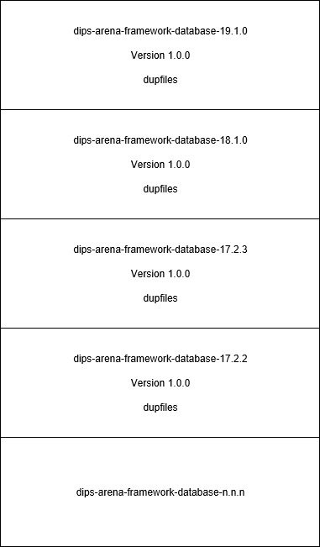
Database package versioning

Slide 74
Database package versioning
To separate we can use «program version» and «nuget version»
Id: dips-arena-programpackage-database-$programversion
Version: $nugetversion
The «nuget version» has less importance for database packages.

Slide 75
Database package normal installation
A database Chocolatey package will register itself into the table dwdbversjonlogg in the database
A database Chocolatey package can only be installed into the database one time.
Therefore, when a specific database package id has been released its content cannot be changed in a way that upgrades the database differently (alters state).
Changes that makes the package (dupfiles) more robust to execution errors are allowed because they do not cause any different content in the database.

Slide 76
Database package versioning
Development The package content is changed frequently
Release
No more database changes. The package represents a version with a fixed content
dips-arena-framework-database-19.1.0
1.0.0
Database changes
dips-arena-framework-database-19.1.0
1.0.1
Package changed to make it more robust to execution errors
dips-arena-framework-database-19.1.0
1.0.2
dips-arena-framework-database-19.1.0
1.0.3

Slide 77
Database Delivery Packages
Delivery packages for the database will grow in size for each Arena version, because of dependencies to previous packages
A delivery package for 19.1.0 will normally contain all packages from 18.1 and the new packages for 19.1

Slide 78
Database delivery diff-released.txt
Shows diff vs the released package specified in the delivery configuration
Upgraded packages: packages from 18.1 with upgraded «nuget version»
Added packages: dips-arena-framework-database-19.1.0
Removed packages:

