Slide 1
ThreeMisses
A C++ hash table built for persistent memory

Slide 2
App type
ThreeMisses is an AppDirect application optimized for low-latency storage such as the Optane DC PM device
Why is it called ThreeMisses?
Currently implemented on Windows 10 and Ubuntu 19.10

Slide 3
Basic functionality
ThreeMisses is a file-format (natively serialized) persistent hash table that provides an interface similar to the C++ unordered_map<string,string> data type, as well as a more advanced interface for higher performance.

Slide 4
How to use
Instantiate a ThreeMisses variable to represent the data, providing paths for the index and data files.
Then you can use the ThreeMisses variable as though it were a memory-resident hash table like "unordered_map<string, string>".

Slide 5
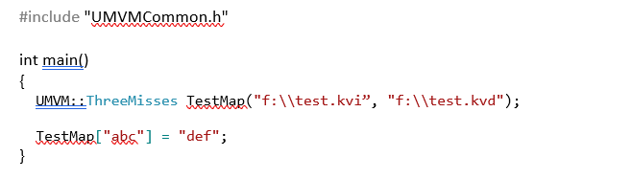
Sample code

Slide 6
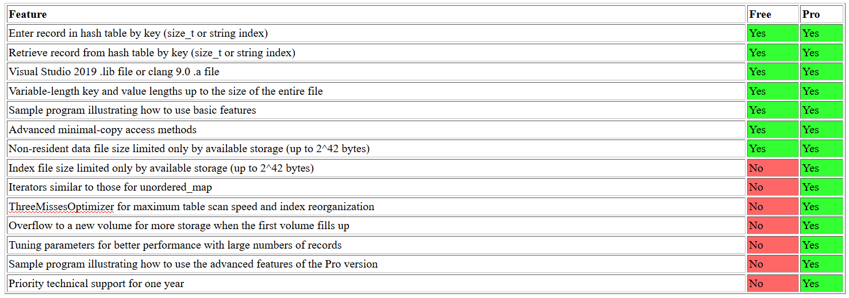
Features by edition

Slide 7
Testing environment
PMEM Server hardware configuration: 4215 CPU, 128 GB DRAM, 4x128 Optane DIMMs
NVDIMM Server hardware configuration: 96 GB NVDIMMs
Half read, half read-and-update in place
All data stored on PMEM or NVDIMM

Slide 8
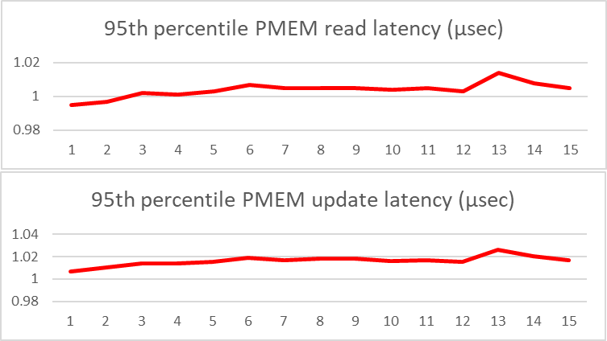
PMEM test results
Fixed-length records with 8-byte keys, 8-byte values
Linux OS, Storage allocation = 30 x record count, Horizontal axis: Record count in billions

Slide 9
NVDIMM test results
Variable-length records averaging 6-byte keys and 3-byte values
Linux OS, Storage allocation = 17 x record count Horizontal axis: Record count in billions

Slide 10
Third party test results
Tested by a research group at UNC-Charlotte
Results available at GitHub repo (pmemids_bench)
https://github.com/DIR-LAB/ycsb-storedsbench/blob/threemiss/UNCTesting/results/threemisses.csv
They also have a paper titled “A Performance Study of Optane Persistent Memory: From Indexing Data Structures’ Perspective”, accepted in MSST 2020 (https://www.storageconference.us)

Slide 11
The future?
ThreeMisses is a "killer app" for persistent memory and I'm actively pursuing relationships with companies that will help get it into the hands of all PM developers.
Depending on the terms of those agreements, I may also be selling it on the threemisses.com web site

