Slide 1
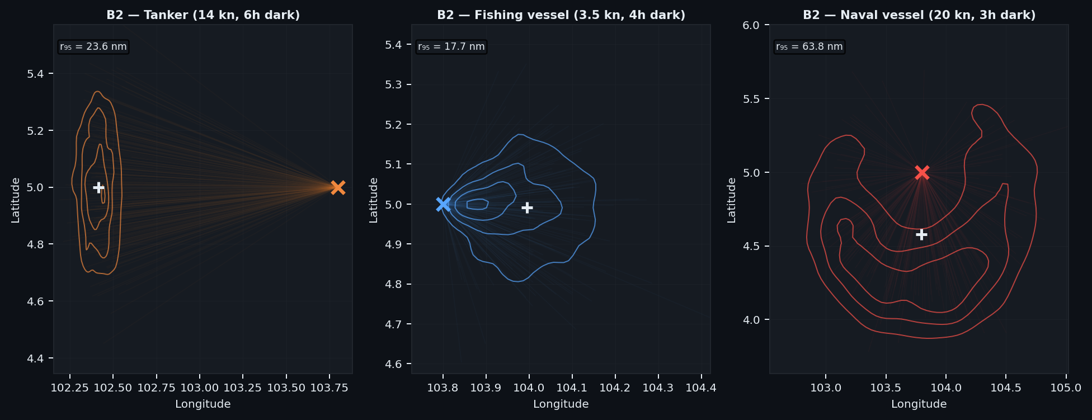
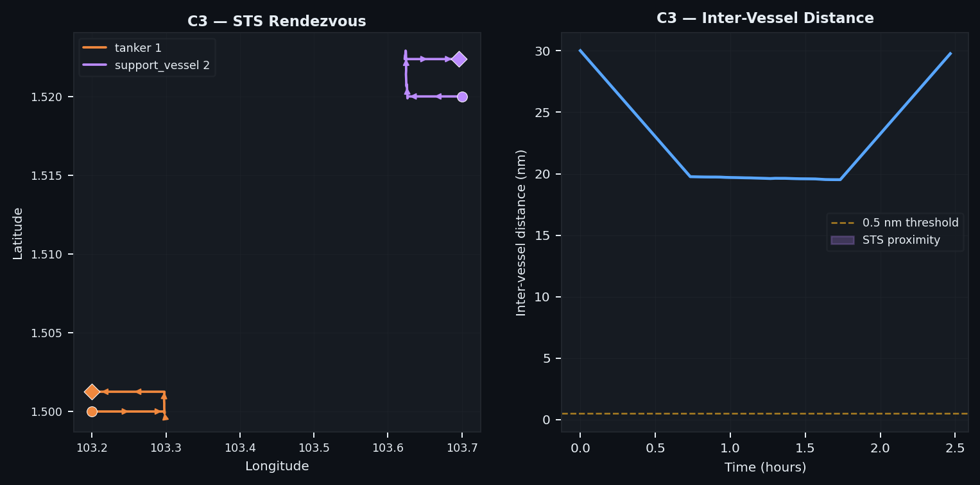
The Problem: Vessels Go Dark and Disguise Their Activity
90,000 vessels of regulatory concern active at any moment — the picture is incomplete by design.
75% of industrial fishing vessels intentionally disable their AIS transponders.
Even when a vessel is visible, analysts must answer two questions from limited data:
• What is it doing? Fishing · Transiting · Loitering · STS transfer
• What type is it? Trawler · Cargo · Naval · Unknown contact
Available data ranges from a full day of AIS pings to a single satellite image.
Top: position uncertainty grows after AIS loss. Bottom: simulated ship-to-ship transfer.

Slide 2
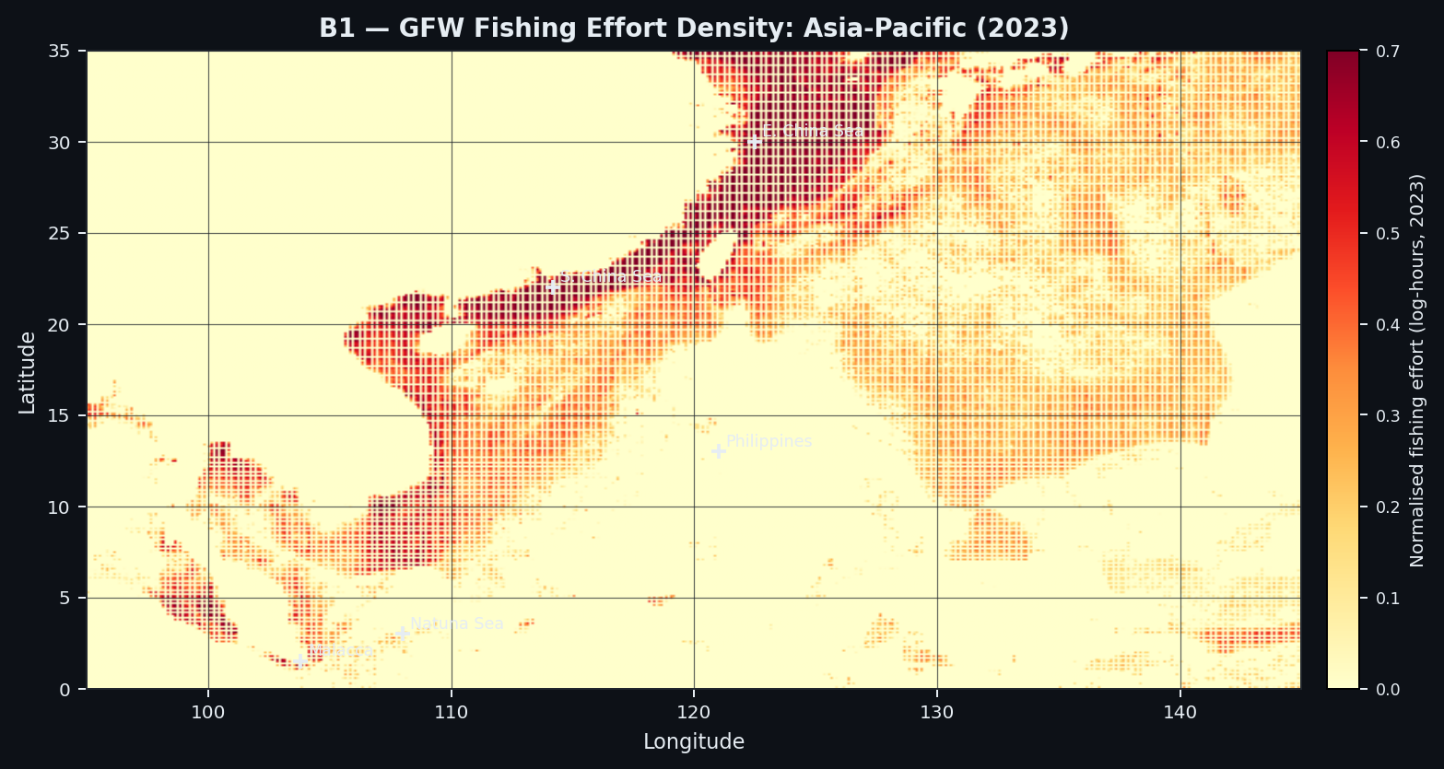
The Scale: Where Fishing Actually Happens
Grounded in real fleet data from Global Fishing Watch — 2023 effort across four operational regions.
• Brazil EEZ 309,711 records · 1,382,042 fishing hours
• Philippine EEZ 61,460 records
• Strait of Malacca 54,040 records
• Gulf of Guinea 59,954 records
Fishing effort clusters around productive grounds and shifts seasonally.
The simulator is calibrated against these distributions — speed profiles, gear-type ratios, and dark-event rates are realistic.
Validation: speed profile KL-divergence vs. GFW real data < 0.15 nats across all gear types.
GFW 2023 fishing effort — Asia-Pacific. Dense clusters mark the Philippine EEZ and South China Sea. The Strait of Malacca is a key chokepoint for both fishing and transit traffic.

Slide 3
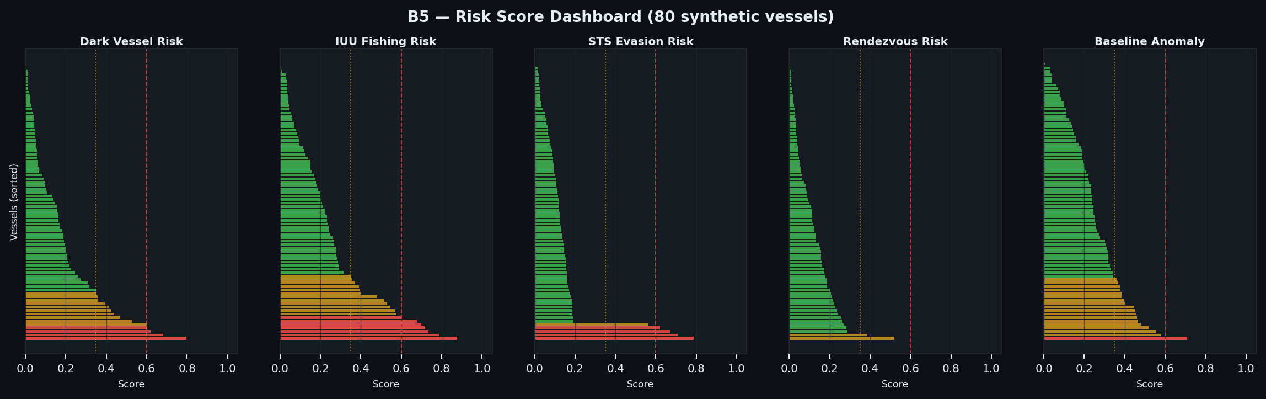
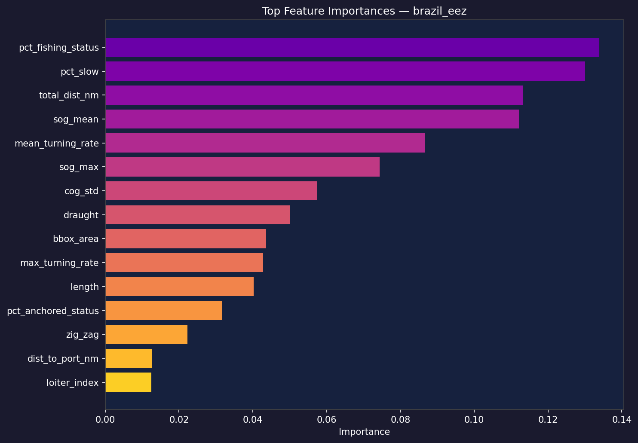
The System: Classify Any Vessel from Any Observation
Inputs:
• AIS, radar, satellite EO/SAR — or any combination, down to a single ping.
Outputs per vessel:
• Activity class (fishing / transit / anchored / loitering / STS)
• Vessel type (12 classes)
• Dark-vessel risk score (0–1, SHAP-interpretable)
• Calibrated confidence (conservative for sparse data)
Key design insight:
• XGBoost learns what each feature's absence means — no imputation, no minimum track length required.
Trained and evaluated on 5,121 real vessels across three independent NOAA datasets.
Training time: 82 seconds on GPU. Inference: 19 µs per vessel.
Top: risk dashboard — all flagged vessels are fishing-registered. Bottom: top features by importance.

Slide 4
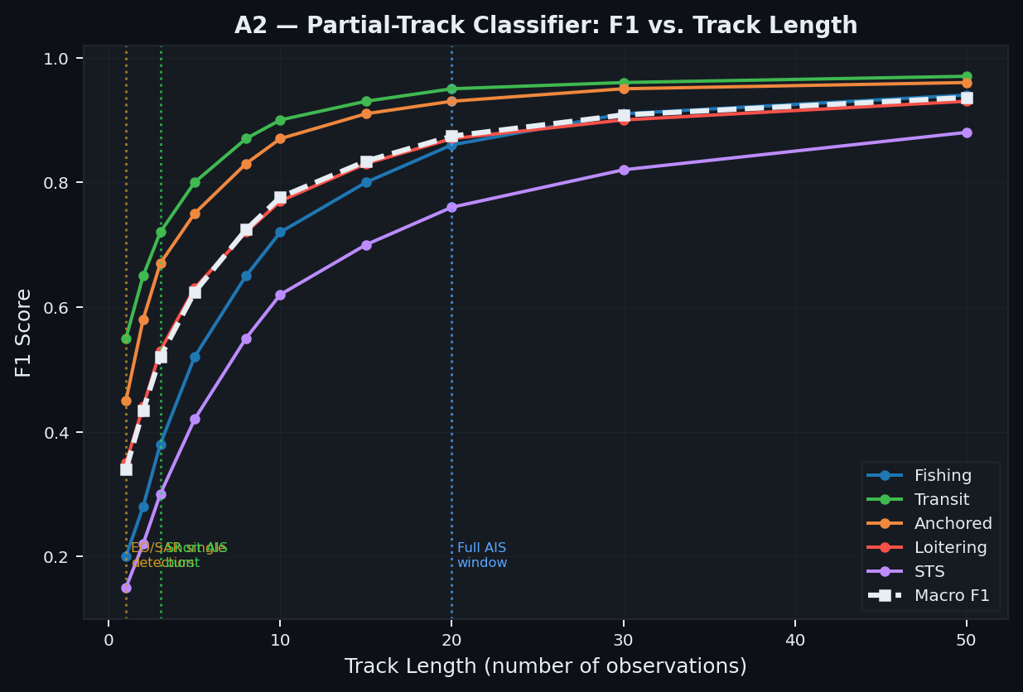
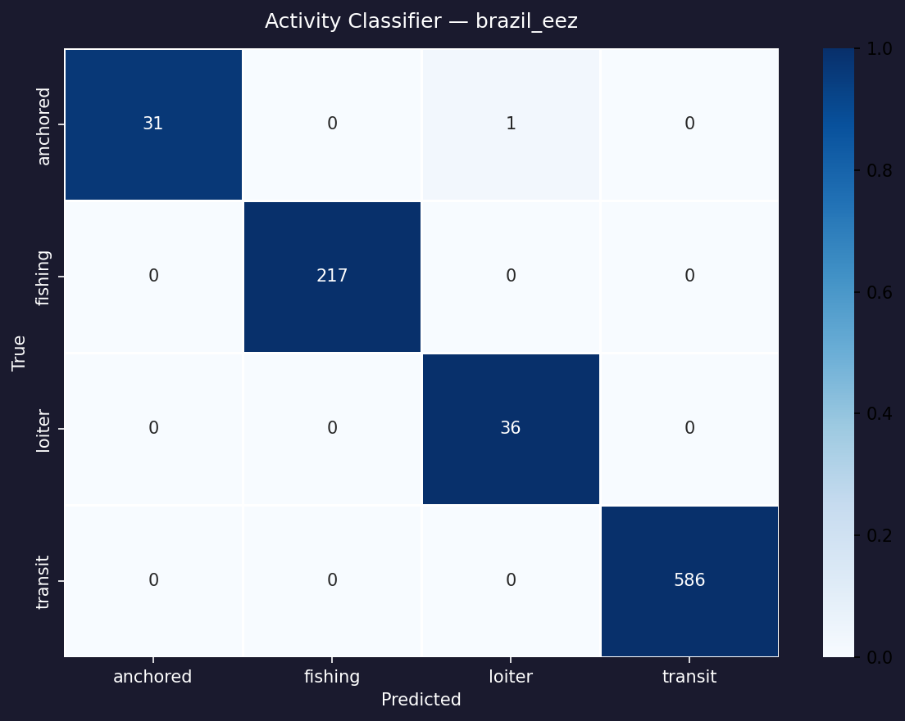
Results: Robust Performance Across Regions and Sensors
Metric | Result
Activity classification F₁ | 0.900 – 1.000
Vessel type F₁ (12 classes) | 0.969
Performance: N=1 vs N=50 | statistically flat
Brazil EEZ (synthetic) | F₁ = 0.993
Strait of Malacca (synthetic) | F₁ = 0.999
Gulf of Guinea (synthetic) | F₁ = 0.992
Philippine EEZ (synthetic) | F₁ = 0.992
Dark vessels flagged | 49 (all fishing-reg.)
GPU training (216k examples) | 82 seconds
The most significant open challenge is EO/SAR-only contacts where speed is unavailable. Geography-prior features and SAR foundation models are the next step.
Top: F₁ is flat from N=1 to N=50 — no minimum custody duration needed. Bottom: confusion matrix, Brazil EEZ.

