Slide 1
Analysis of Twitter
Sentiments Using Spark
Streaming
Dishant Fapot
Vittal Miskin
Manisha Tirunahari

Slide 2

Aim
The goal is to connect to Twitter data, look for tweets containing a specific term, and assess whether those tweets are positive, negative, or neutral in tone.³

Slide 3
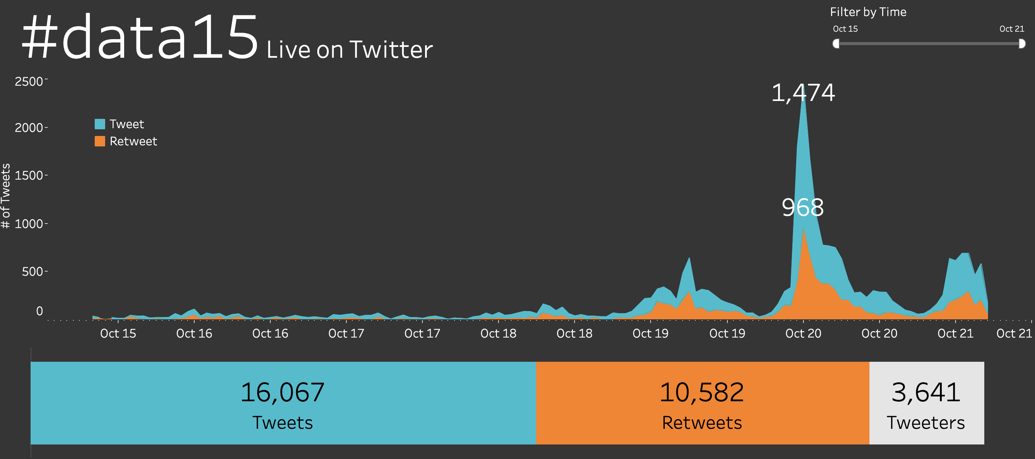
Just take a look of number of tweets in Twitter these days:

Slide 4
AGENDA
Data Collection
Data Organization
Data Analyzation
Data Visualization

Slide 5
Data Collection:
Tweepy is our primary data source; this is a library in python which allows users to use Twitter API. The following are the steps that are followed to access Twitter API:¹
Initially, we created a developer account on Twitter
Created a project “SentaAMulti”
This project was updated to elevated access as our code was unsatisfied with the requirements. Earlier, we had essential access, which only accepts 500k tweets per month, and this elevated access allows up to 2M tweets per month
Now, the final step is to collect the required keys.

Slide 6
Data organization:
In organizing data, we focus on cleaning and preprocessing data and using it for required purposes.² The following are the points that involving in organizing data:
Planning
Architecture
Implementation

Slide 7




Plan of streaming
Collect twitter data
platform
Data streaming
Preprocessing
Classification of tweets
Using tweepy( posting a tweet, finding tweets)
Platform for streaming data, chosen: Kafka
Twitter uses two kinds of API: search API, streaming API
Filtering
Tokenization
Removal of stop words
Categorizing tweets as positive, negative or neutral

Slide 8
architecture
Twitter data
kafka
bucket
MONGODB
Tableau/ power BI
Using tweepy
handling real-time data
Using spark streaming for scoring and in turn gets updates of infrequent model
Store the data got after analysis
Platform that has interactive dashboards and visuals that present real-time data

Slide 9
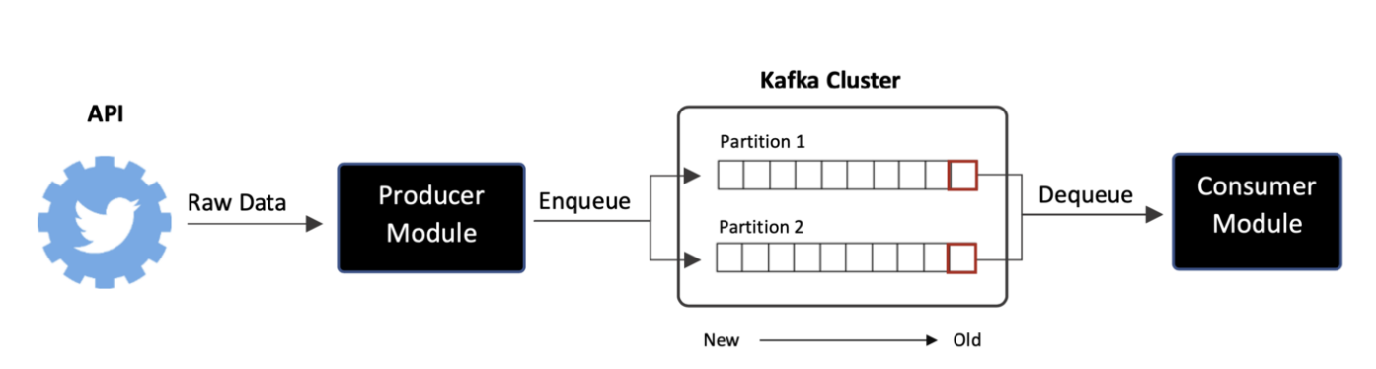
Using Kafka streaming
This is how the cluster is created to listen data from producer.⁵

Slide 10
Analyzing data
We have TextBlob to classify our data. TextBlob is a lexical-based sentimental analysis algorithm for calculating polarity based on its weight dictionary. Textblob is a natural language toolkit-based Python NLP package (NLTK). It uses NLTK because it is easy to use, and deploy, consumes fewer resources, provides dependency parsing, and can be applied to even small applications. Working with text data and performing complicated analyses are both possible with Textblob. Textblob produces polarity and subjectivity as its two outputs after receiving a sentence.⁶
Polarity output lies between [-1,1]
-1 refers to negative sentiment
0 refers to neutral sentiment.
+1 refers to positive sentiment.
Subjectivity output lies within [0,1], which refers to personal judgments and opinions.

Slide 11
implementation
Choosing of data:
req_fields = "tweet.fields=text"
We require only text of the tweets.
Preprocessing of data:
# Removing links
tweet = re.sub(r'http\S+', '', str(tweet))
tweet = re.sub(r'bit.ly/\S+', '', str(tweet)
tweet = tweet.strip('[link]')
# Removing puntuations
my_punctuation = '!"$%&\'()*+,-./:;<=>?[\\]^_`{|}~•@â'
tweet = re.sub('[' + my_punctuation + ']+', ' ', str(tweet))
Classification of tweets:
from textblob import TextBlob
TextBlob is a lexical-based sentimental analysis algorithm that uses NLTK for calculating polarity. (I.e.based on its weight dictionary.)

Slide 12
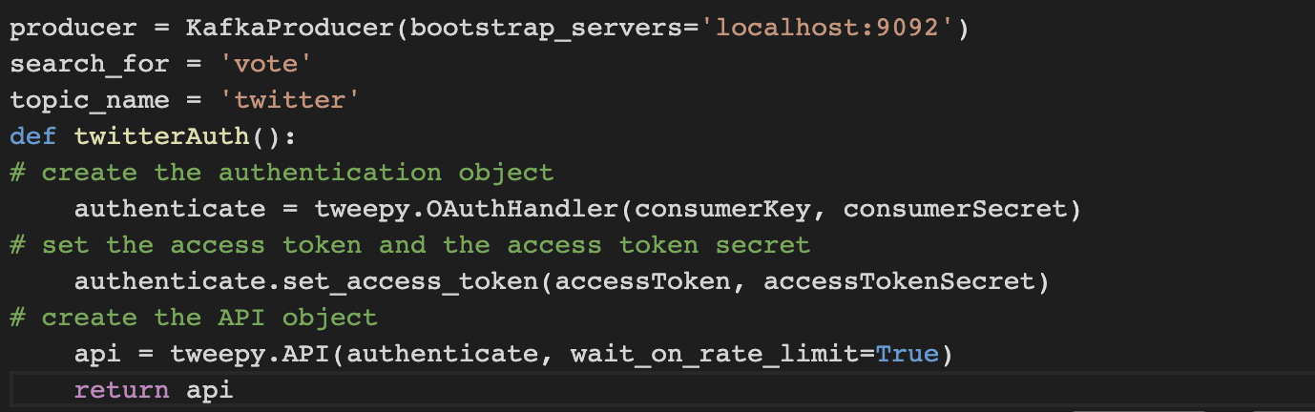
Now, creating a Kafka producer. The main goal is to connect to Twitter API and get tweets about a particular topic. Here, I am selecting particular word as "vote"

Slide 13
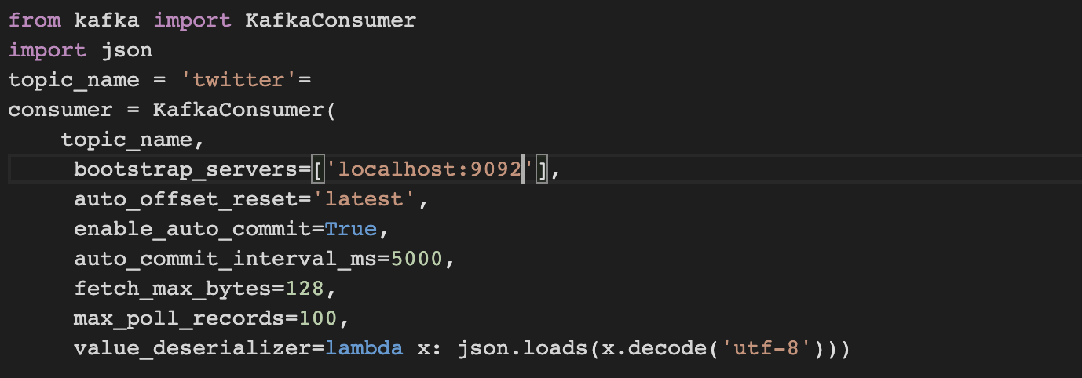
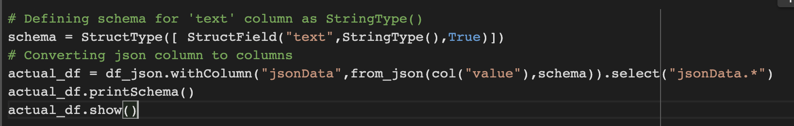
The second part is creating a Kafka consumer:
Streaming:
Schema:

Slide 14
The second part is creating a Kafka consumer:
Streaming:
Schema:

Slide 15
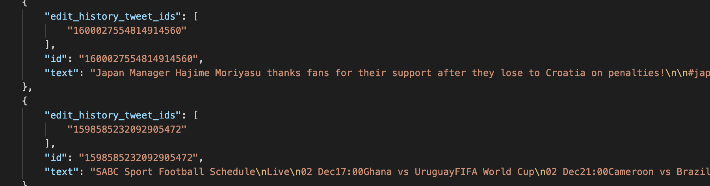
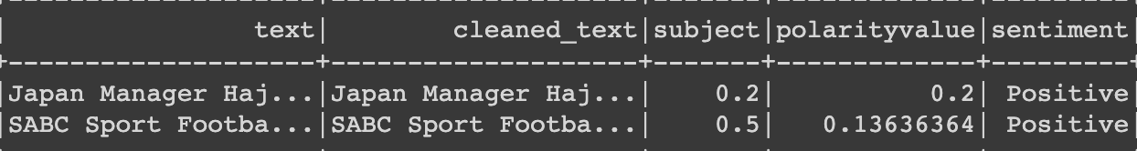
Glimpse of streamed data in JSON files:
After preprocessing the text column:

Slide 16
Visualization of data

Slide 17
Conclusion
We proposed an efficient sentimental analysis technique using pyspark machine learning library to execute different algorithms.
Lastly, during the implementation, we gained in-depth knowledge in field of big data analytics. We got to explore tools like Power BI and Tableau which are used wide across the technological companies.

Slide 18
Future scope:
Explore a new approach to sentiment classification based on integrating Deep Learning Libraries with the Apache Spark platform.⁷
With help of this real time data, use different features to enhance the accuracy of data.

Slide 19
Reference:
https://www.hindawi.com/journals/wcmc/2021/3920325/
https://medium.com/@lorenagongang/sentiment-analysis-on-streaming-twitter-data-using-kafka-spark-structured-streaming-python-part-b27aecca697a
https://www.bmc.com/blogs/working-streaming-twitter-data-using-kafka/
https://scholarworks.calstate.edu/downloads/db78tc01m
https://www.linkedin.com/pulse/real-time-twitter-sentiment-analysis-via-kafka-spark-streaming-fang
https://traintestsplit.com/twitter-sentiment-analysis-in-python-with-code/
https://ceur-ws.org/Vol-1558/paper41.pdf

Slide 20
THANK YOU

