Slide 1
Distributed Systems in LinkedIn - the World's Largest Professional Network
SANJAY R
2021115091

Slide 2
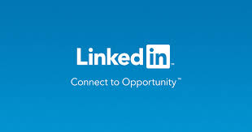
INTRODUCTION
LinkedIn, the world's largest professional network, relies on distributed systems to support its vast user base and complex operations. Distributed systems in LinkedIn refer to the network of servers and services that work together to provide a seamless experience for its users.

Slide 3
NEED FOR DISTRIBUTED SYSTEM IN LINKEDIN
Distributed systems essential for LinkedIn's large scale and complexity.
Enable efficient processing, storage, and retrieval of data across multiple servers.
Ensure high availability and scalability.
Facilitate real-time data processing, reducing response time.
Support seamless access from different regions with varying network conditions.
Managing advertisements, utilizing algorithms for personalized ads.

Slide 4
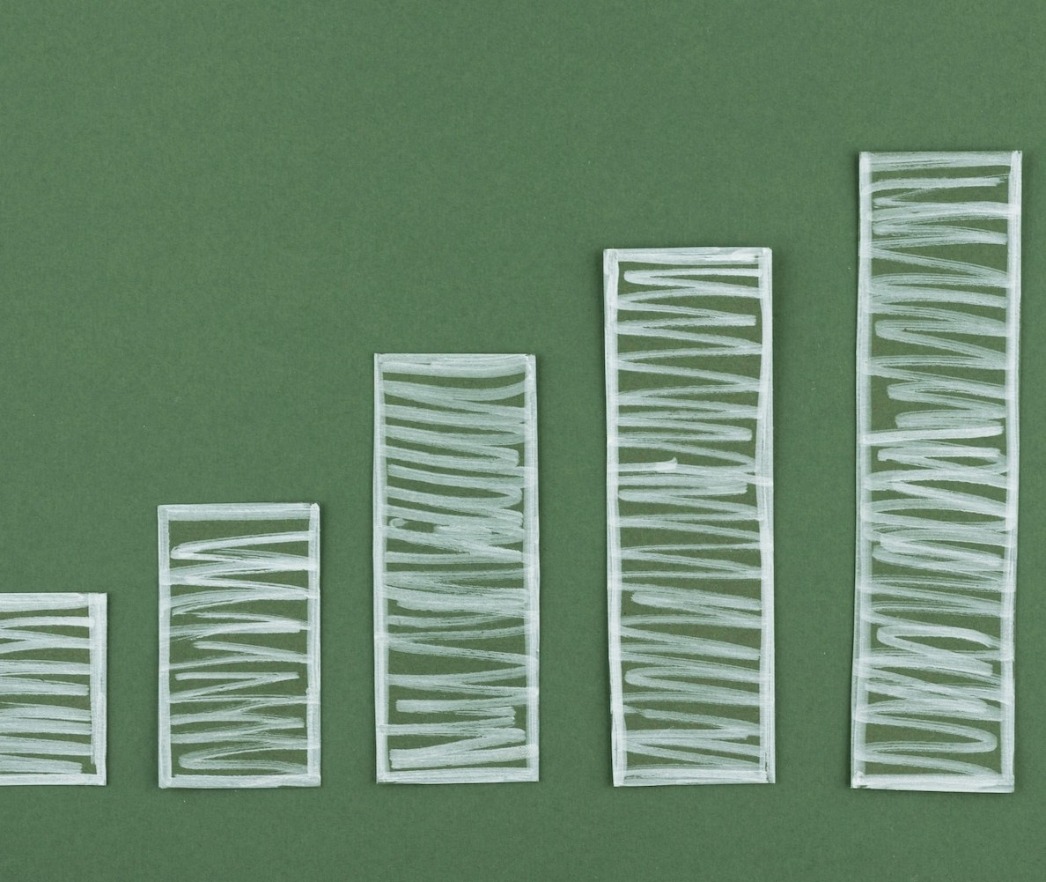
SCALABILITY
LinkedIn’s distributed systems allow horizontal scaling by adding more servers or nodes as the user base grows.
Features like sharding databases enable LinkedIn to distribute data across multiple servers, preventing bottlenecks and ensuring smooth operations even during peak loads.

Slide 5

MICROSERVICES ARCHITECTURE
LinkedIn uses microservices architecture where the application is broken down into smaller, loosely coupled services.
Easier development, deployment, and scaling of individual components.

Slide 6

DISTRIBUTED DATA STORAGE AND AVAILABILITY
Distributed data storage systems like NoSQL databases (e.g., Cassandra, MongoDB) are used to store and manage user profiles, connections, posts, and other data.
Replication of data across multiple geographically distributed data centers ensures availability.

Slide 7
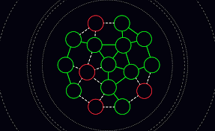
FAULT TOLERANCE
Resilience through replication, fault detection and self-healing mechanisms.
Redundancy, graceful degradation and failover are used for system failure mitigation.

Slide 8
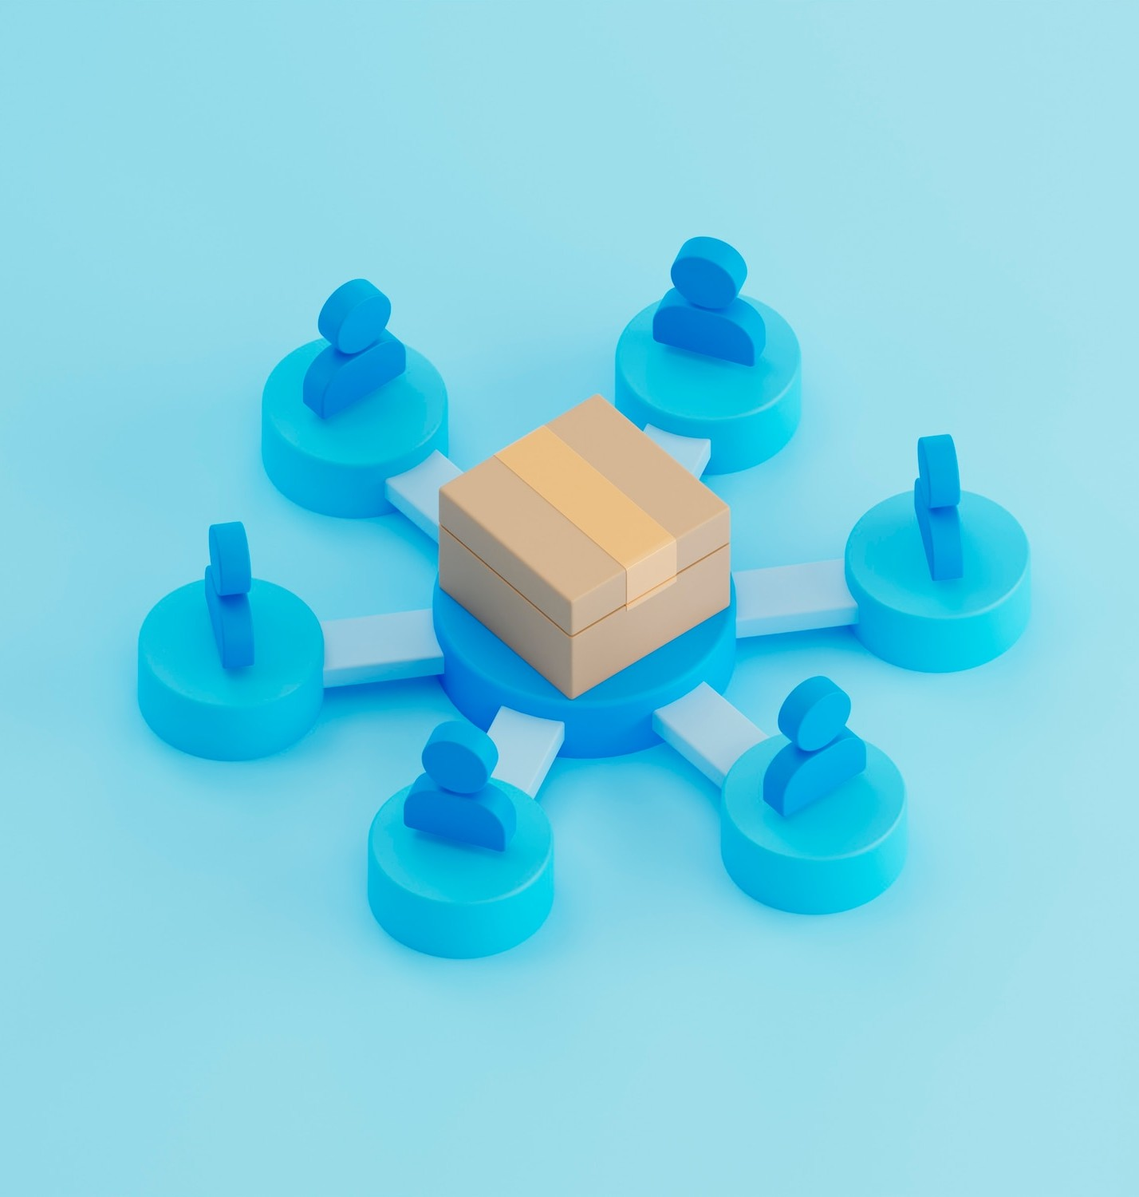
LOAD BALANCING
Essential for distributing incoming traffic across multiple servers to ensure optimal performance and reliability.
LinkedIn employs load balancers to evenly distribute requests among its servers and prevent any single point of failure.

Slide 9
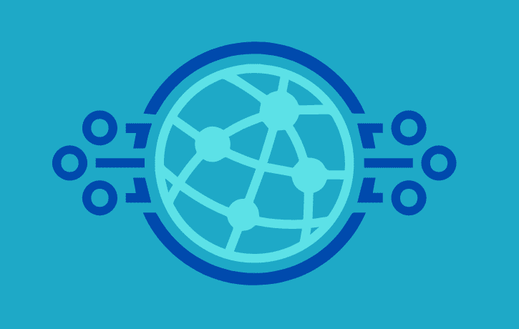
CACHING
Distributed content delivery networks (CDNs) are employed to cache static content closer to users, reducing latency and enhancing performance.
Edge computing is also utilized to execute certain computations closer to the user, further reducing response times.

Slide 10

SECURITY
Data encryption
Access controls
Authentication mechanisms
Regular security audits.
Intrusion Detection and Prevention Systems (IDPS)

Slide 11
ADVANTAGES
Scalability: Distributed systems allow LinkedIn to scale seamlessly to accommodate growing user demands.
High Availability: By distributing services across multiple nodes and data centers, LinkedIn ensures continuous availability.
Fault Tolerance: Redundancy and fault-tolerant mechanisms mitigate the impact of hardware failures or network issues.
Performance: Distributed systems enable LinkedIn to deliver fast response times and handle heavy workloads efficiently.
Global Reach: With distributed architectures, LinkedIn can serve users worldwide with minimal latency.

Slide 12
DISADVANTAGES
Complexity: Designing, deploying, and maintaining distributed systems is inherently complex and requires expertise.
Consistency Challenges: Achieving strong consistency in a distributed environment without sacrificing performance can be challenging.
Synchronization Overhead: Data synchronization and coordination between distributed components can introduce overhead and latency.
Network Dependency: Distributed systems are heavily reliant on network connectivity, making them vulnerable to network failures or latency issues.
Security Concerns: Securing data and communications in distributed systems requires robust security measures to prevent breaches or data leaks.

Slide 13
CONCLUSION
In conclusion, LinkedIn's distributed system architecture stands as a testament to the successful integration of several critical components, including scalability, availability, security, fault tolerance, load balancing, caching, and performance optimization. Each of these elements plays a pivotal role in ensuring that LinkedIn's platform operates smoothly, efficiently, and securely to meet the demands of its extensive user base and complex functionalities.

Slide 14
THANK YOU

